Slide 1
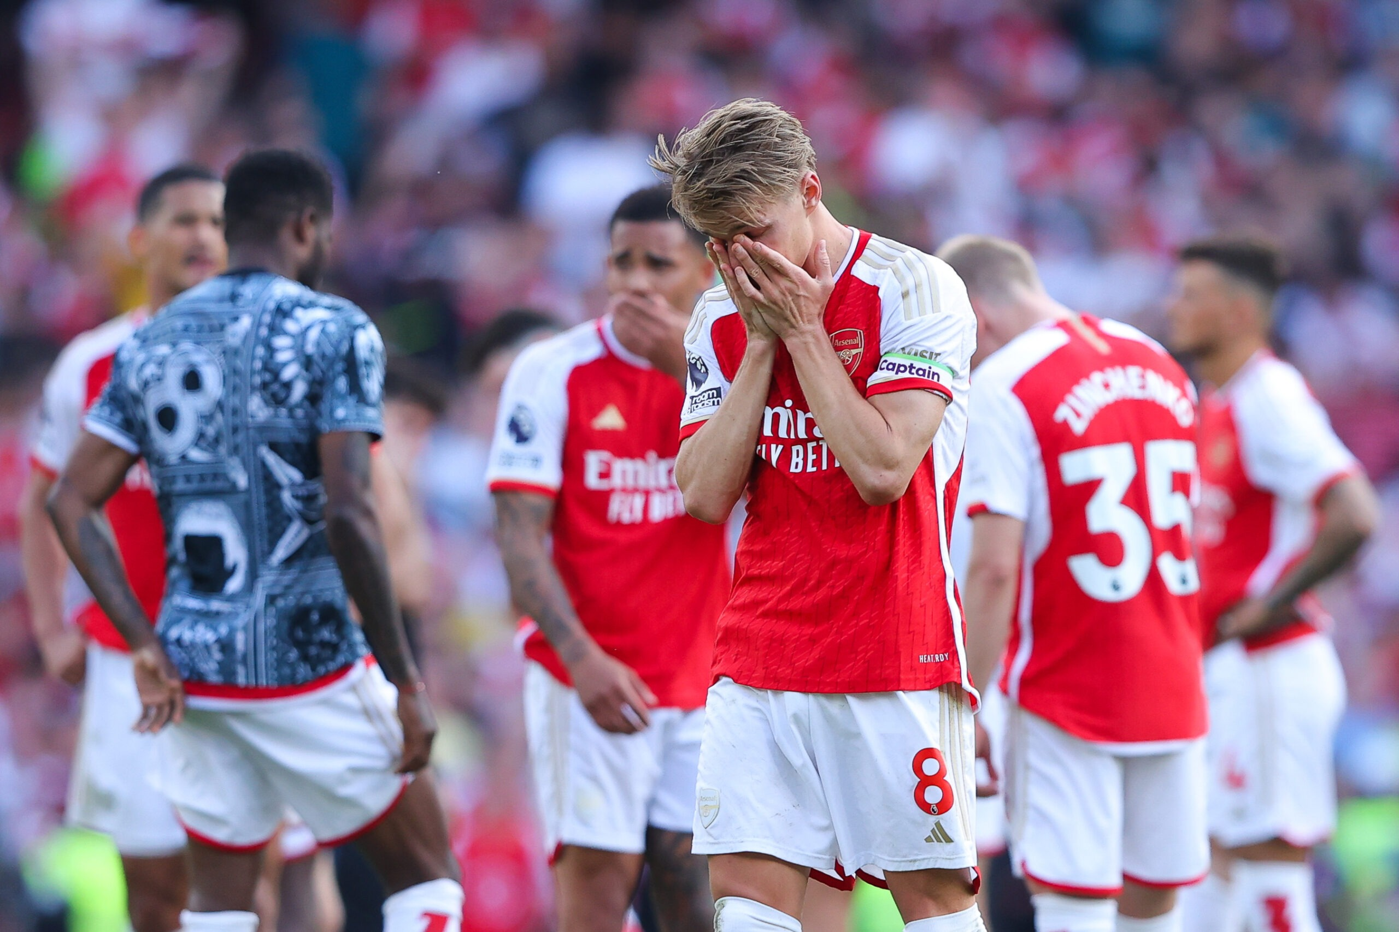
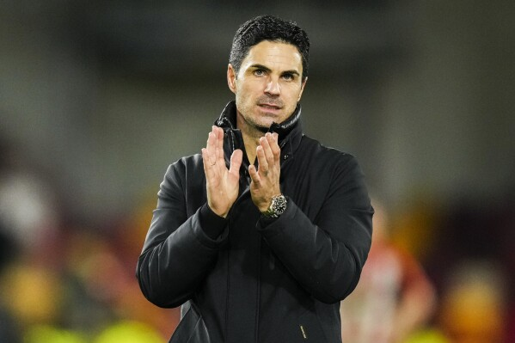
Why Arsenal is Always 2nd Place
By Matheus Grover

Slide 2
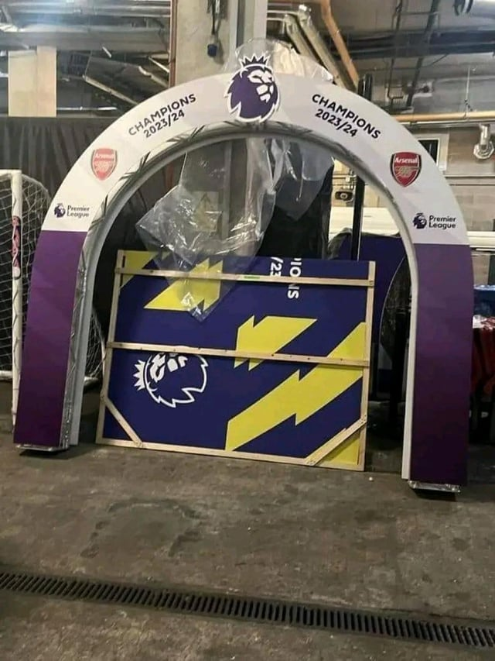
Problem and Motivation
Five seasons under Coach Mikel Arteta = 1 Trophy 3 consecutive 2nd place finishes
2022-23 collapse: 248 / 296 days in 1st, finished 2nd
8th -> 8th -> 5th -> 2nd -> 2nd -> 2nd
No CL -> No CL -> No CL -> No CL -> Quarter Finals -> Semi Finals
Every Arsenal fan knows our problem; we’re consistently getting better but still haven’t pushed over the line yet.

Slide 3
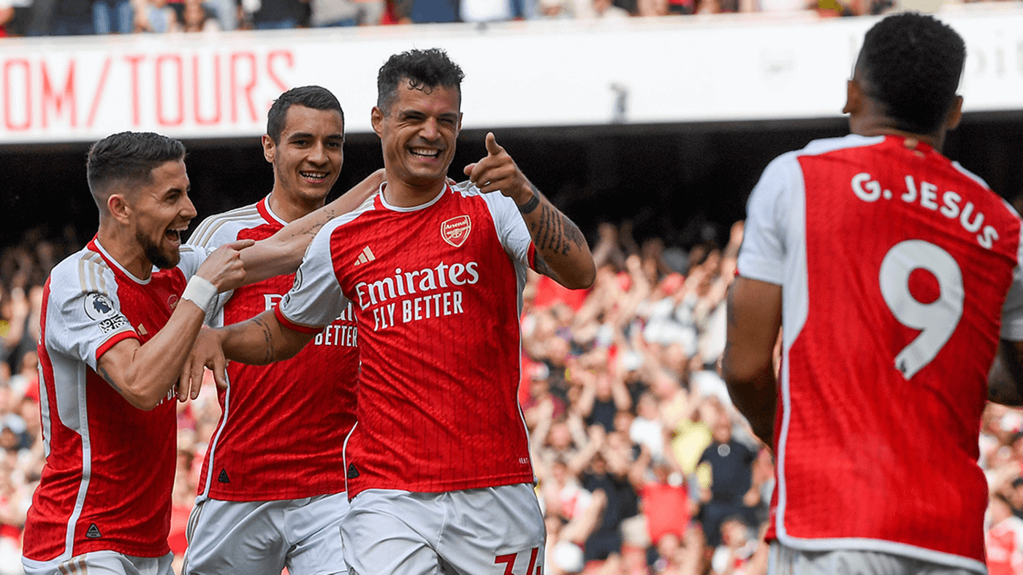
Hypothesis
After discussing with my Applied Consultant, he theorized that a tactical shift after spring 2023 changed how we play.
The Pre-shift Arsenal has:
Lower possession
Higher xG
Less cards
Conceded and scored more goals
In 2022-23 teams played more attacking against us

Slide 4
DATA
Fbref match logs: Arsenal, Man City, Liverpool (2022-2025)
Added discipline cards through a left join of a different google sheet
Created Variables:
Season, Era (Pre = 2022/23, Post = 2023/24, 2024/25)
Opponent Difficulty(Top -> Non-League)
Formation Style: (Defensive/Balanced/Attacking)
Points, Levels for Formation and Difficulty

Slide 5
EDA
Two forms of EDA, before I opened the data, I wrote down 9 predictions about what it would look like. Then created 15+ tableau figures answering these questions.
This helped me get a sense of what I was working with, what I was missing, what I was right and wrong about.
After I created all the earlier variables, I still wasn’t ready for analysis, my consultant and I drafted up the Hypothesis questions and I created another round of figures answering them.

Slide 6
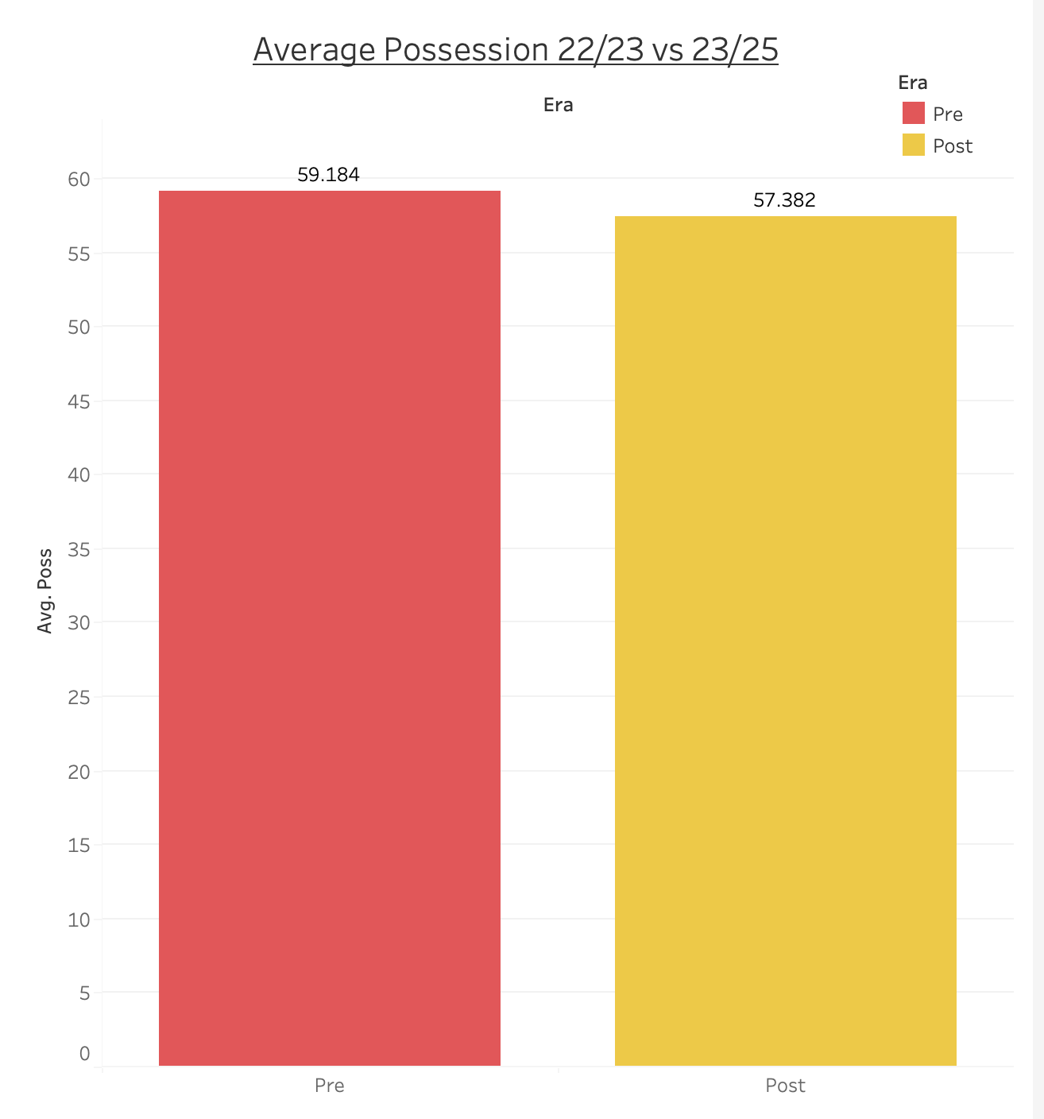
Arsenal 2022-23 has lower possession than 2023-2025

Slide 7
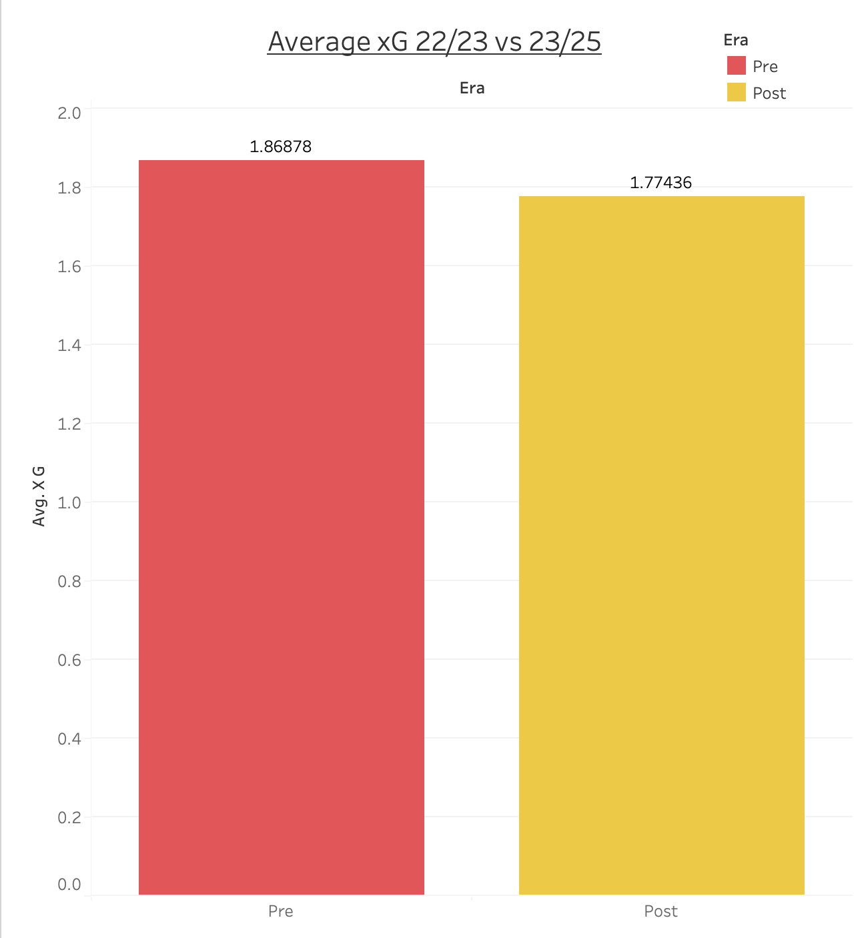
Arsenal 2022-23 has higher xG than 2023-2025

Slide 8
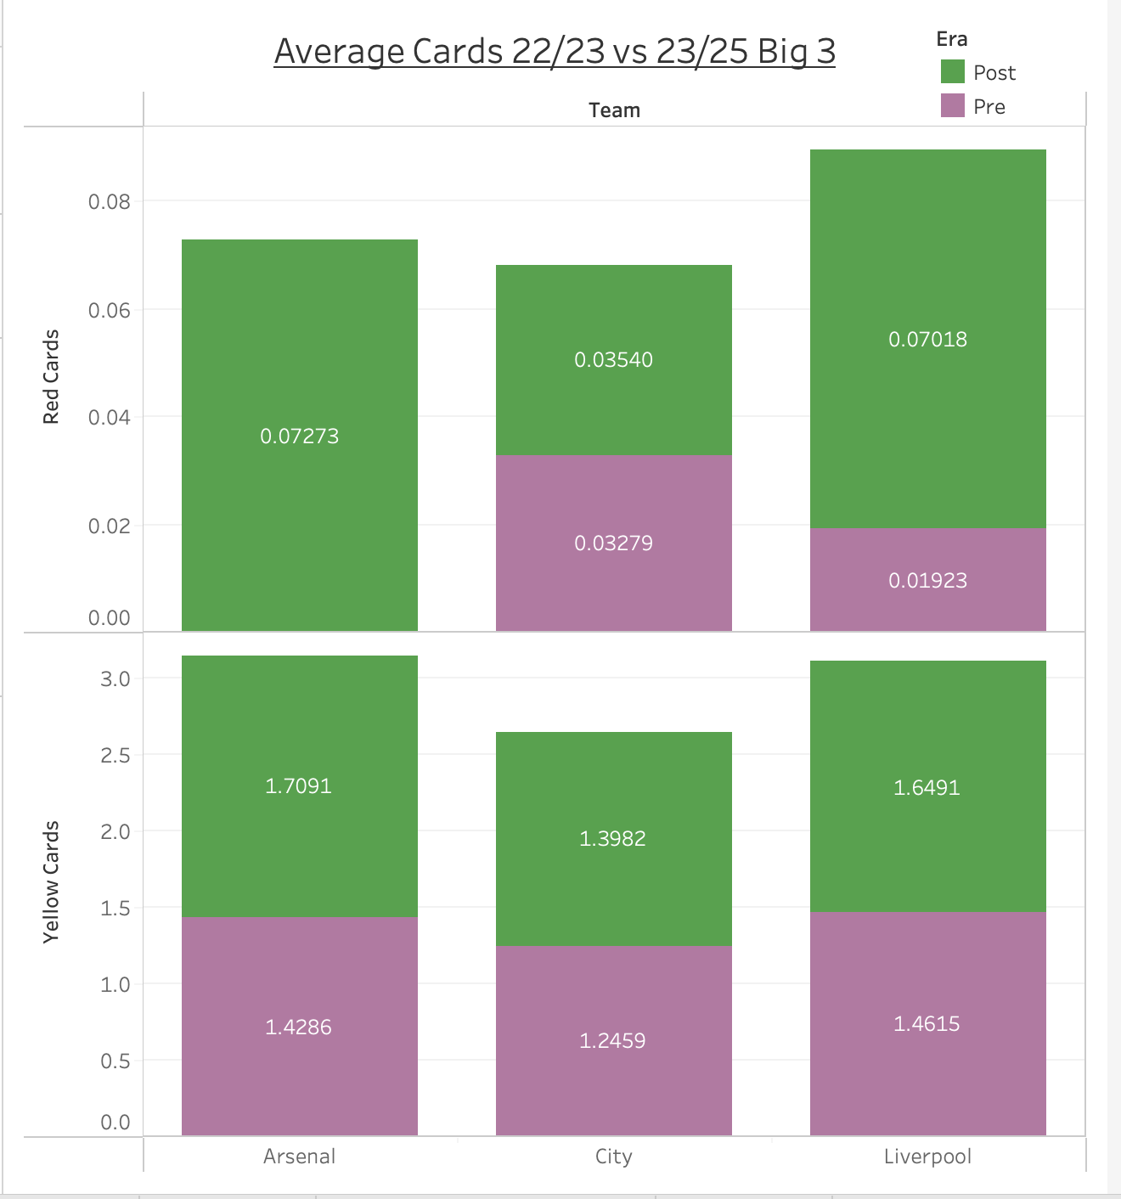
Arsenal 2022-23 has less cards than 2023-2025

Slide 9
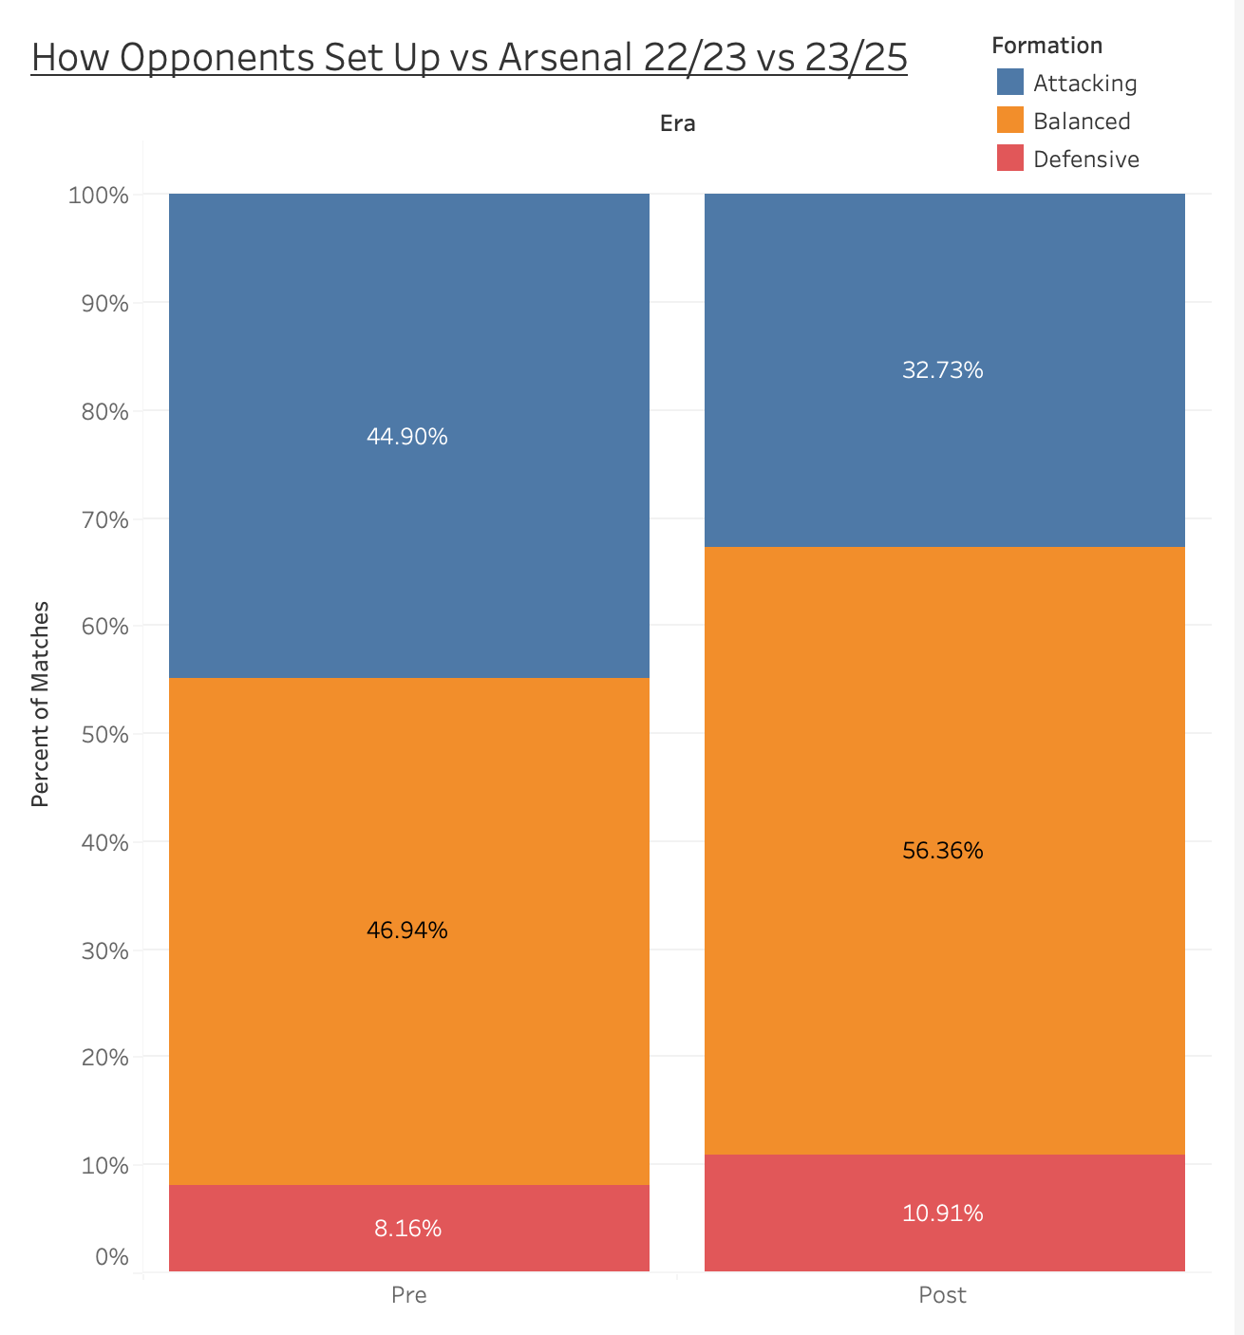
Arsenal 2022-23 teams played more attacking against us

Slide 10
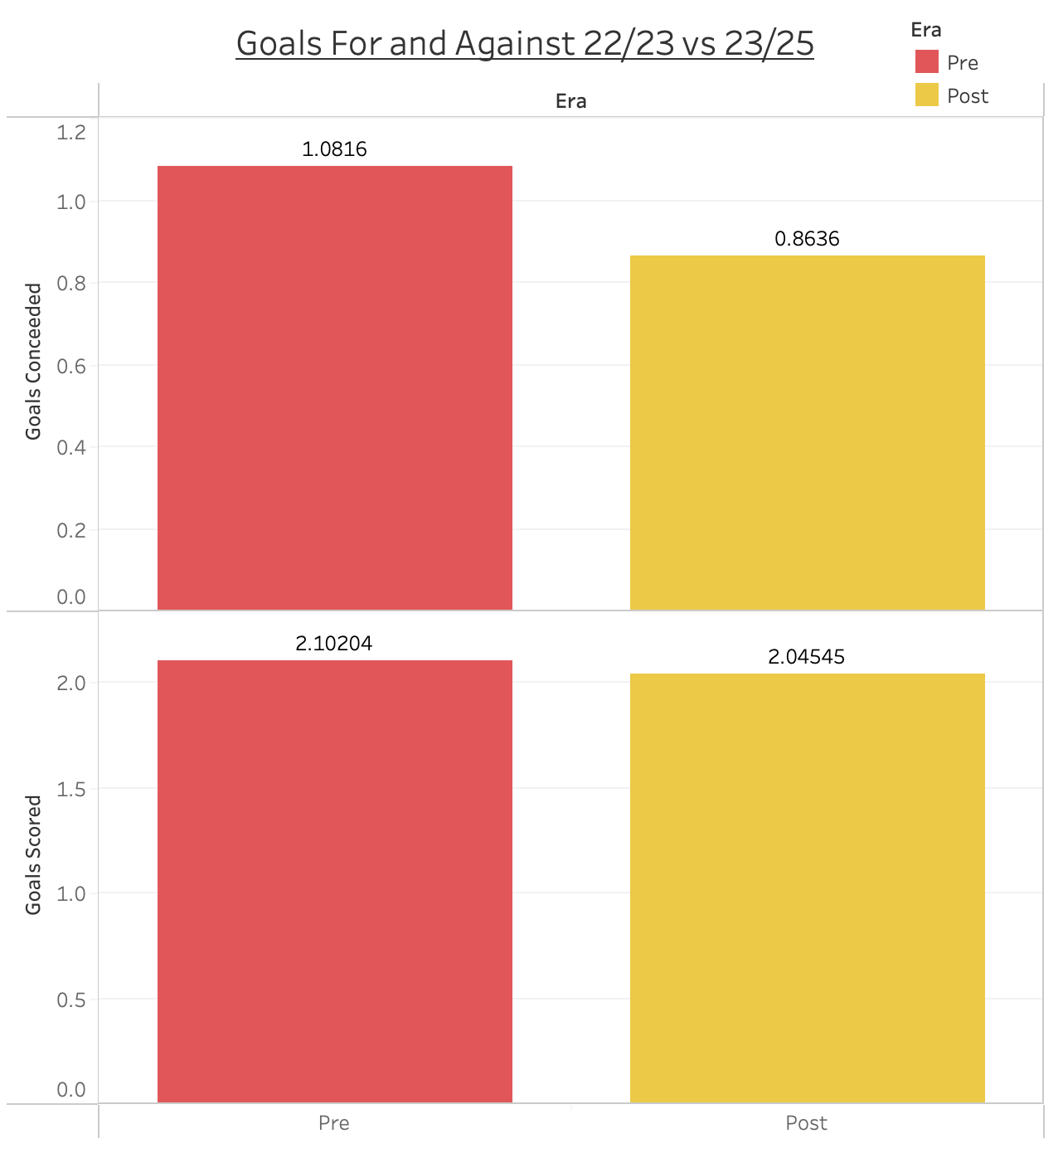
Arsenal 2022-23 conceded and scored more goals

Slide 11
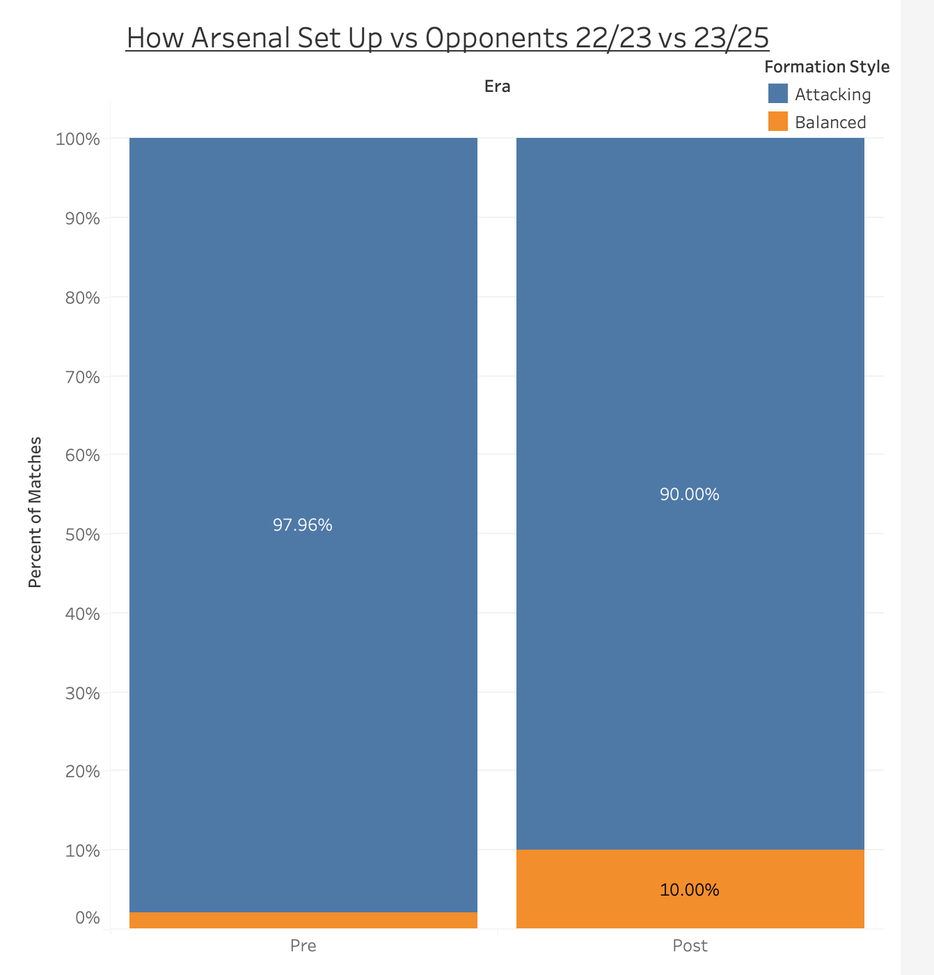
Finally, Arsenal switch their playstyle after 2022-23

Slide 12
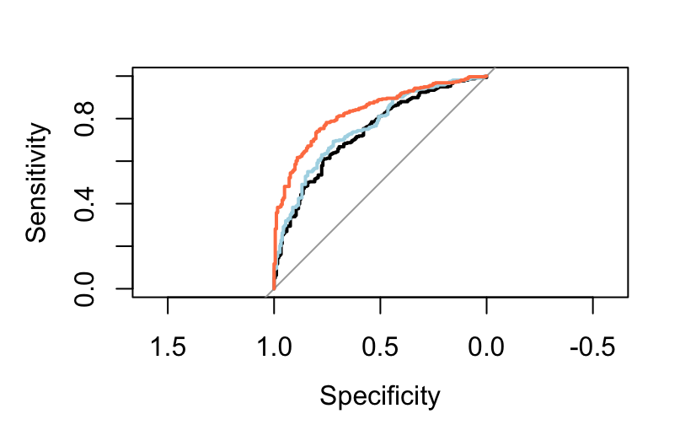
Logisitic Regression
Model 1(Baseline): glm(Win ~ Team + era + xG + Poss)
Model 2 (Interaction) glm(Win ~ Team + era * (xG + Poss + CrdY + CrdR + Two_CrdY)
Model 3(Full Tactical Model): glm(Win ~ Team + era * (xG + Poss + formation_style + Opponent_difficulty + opp_formation_style + CrdY + CrdR + Two_CrdY)
Model 1 AUC: 0.739 Model 2 AUC: 0.759 Model 3 AUC: 0.832

Slide 13
Model 3:
The most interesting coefficients were:
An extra expected goal raises win odds in the Post era, Beta = 0.958 and Odds Ratio = 2.6. However, the boost was larger in the Pre era with a Beta = 1.48 and OR = 4.4).
Possession no longer matters after 2023 the Beta is almost equal to 0, whereas it modestly lowered win odds in 2022-23.
Before 2023, each extra yellow made a win less likely. After 2023, each yellow made a win more likely.
In 2022–23 playing against a defensive‐minded team hurt Arsenal’s win odds. After 2023, it helped, a defensive opponent tripled their chances of winning.

Slide 14
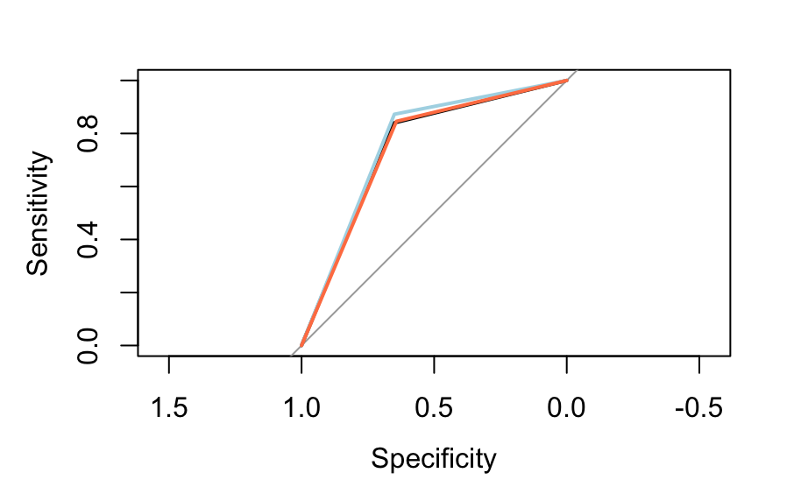
Regression Trees
ACL_Fit_Tree_1 <- rpart(Win ~ era + Team + xG + Poss + CrdY + CrdR + Two_CrdY + formation_style + Opponent_difficulty + opp_formation_style, data = Flag_df, method = "class")
Tree_Pre <- rpart(Win ~ xG + Poss + formation_style + Opponent_difficulty + CrdY, data = filter(Flag_df, era == "Pre"), method = "class")
Tree_Post <- rpart(Win ~ xG + Poss + formation_style + Opponent_difficulty + CrdY, data = filter(Flag_df, era == "Post"), method = "class")
All Seasons AOC: 0.7472, Pre 22/23 AOC: 0.7613, Post 22/23 AOC: 0.744

Slide 15
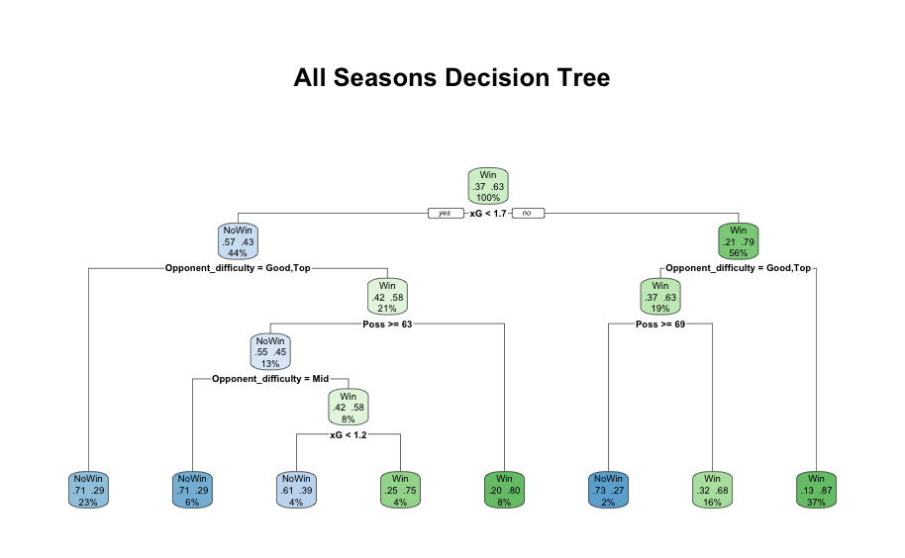
All Seasons Decision Tree

Slide 16
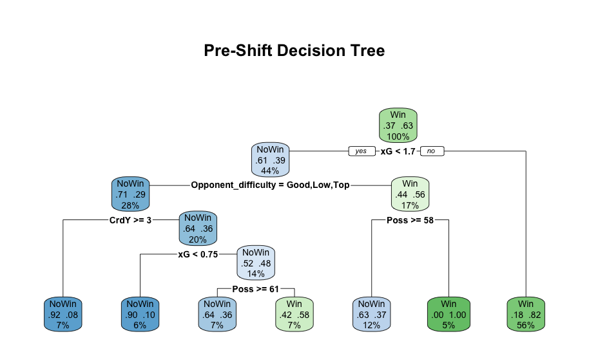
2022/23 Decision Tree

Slide 17
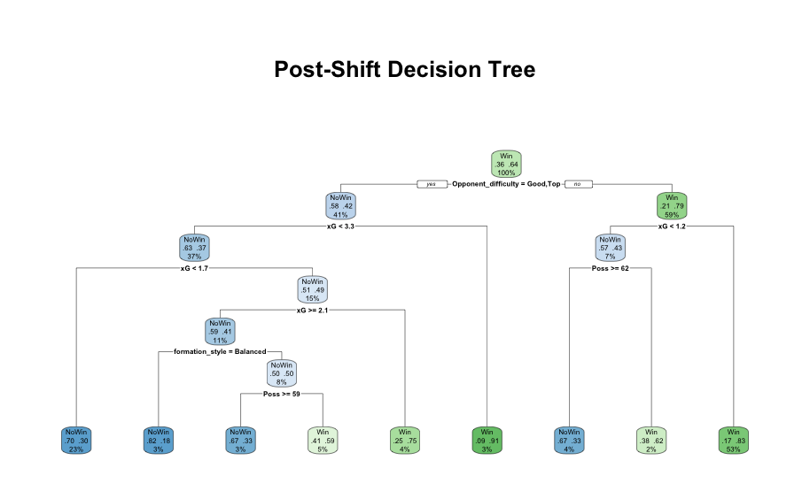
2023/24 & 2024/25 Decision Tree

Slide 18
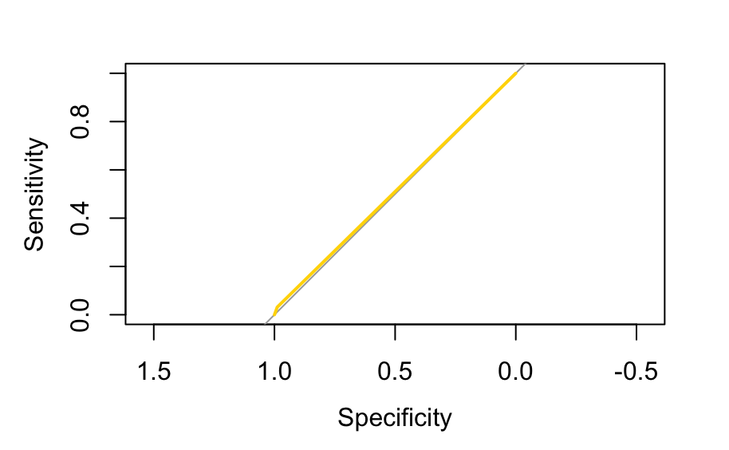
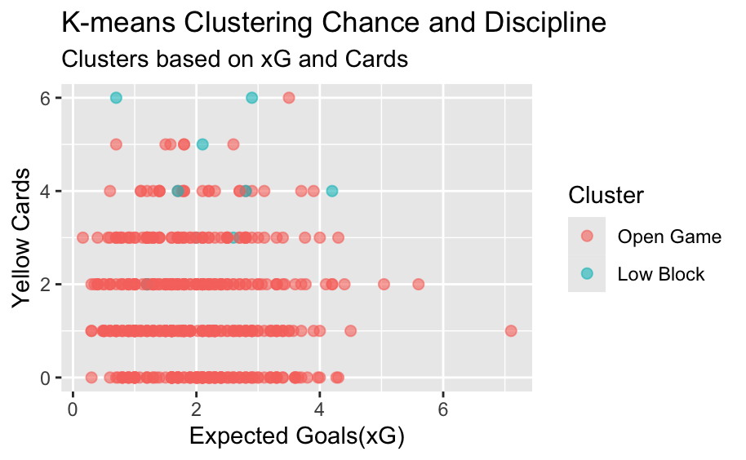
K-means
Two clear styles emerge
Open Game High xG, few yellows -> proactive, chance-heavy football
Low Block Low xG, many yellows -> tight, foul-heavy contests
Quick take-away
When Arsenal create chances and stay disciplined, their matches cluster in the Open Game group, signaling attacking control.
When chance creation stalls and fouls rise, matches shift to the Low Block group, showing a more defensive, stop-start pattern.

