Slide 1
POC - VSTS CUIT Walkthrough (Retirement Studio)
2013.10.12
Webber Ling, Shanghai

Slide 2
Topics
What is VSTS CUIT?
What so we have in QTP now?
QTP vs. CUIT
POC Screens Touched
CUIT Features (Compare against QTP)
Next step

Slide 3
What is CUIT
Microsoft Coded UI Testing (CUIT) is an integrated component of Visual Studio Premium and Ultimate, which provides user interface automated testing feature.
It shares the same features as that of mainstream automated testing tools:
Record & Playback
User defined functions
Object Repository

Slide 4
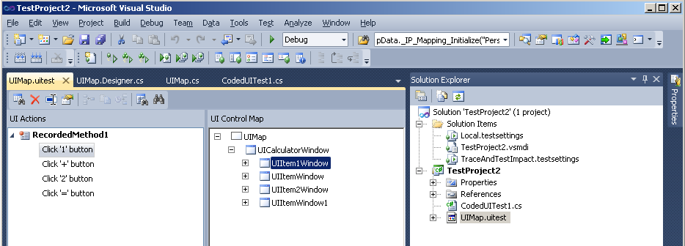
What is CUIT
Methods
Object Repository

Slide 5
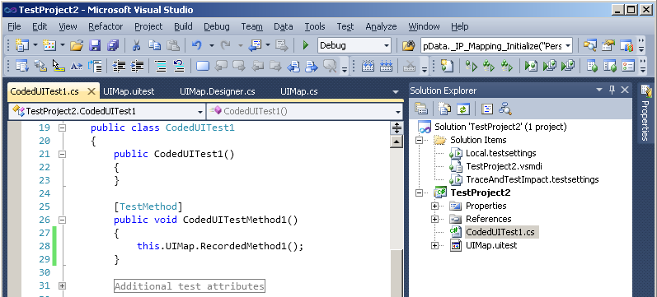
What is CUIT
Test Script
Method

Slide 6
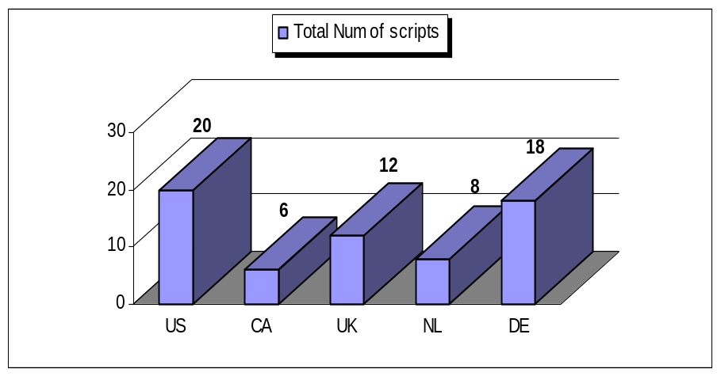
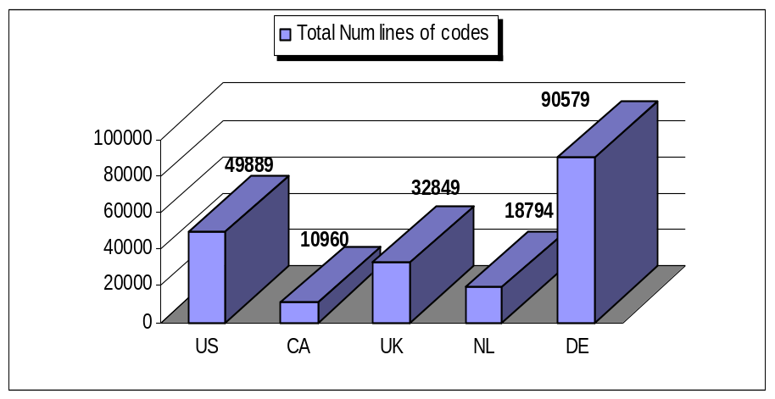
What we have in QTP
204,571 lines of codes in Test Scripts
111,158 lines of codes in Function Library
3,401 shared objects in Object Repository
95 hours to finish all scripts execution

Slide 7
What we have in QTP ➔ What we will have in CUIT
Generic Function Lib
Object Repository
Test script is a combination of function calls
One screen, one(or multiple) functions
.Net Function Lib
Object changes ➔ Update Object Repository
Studio Function Lib
Screen changes ➔ Update screen function
Test scripts remain untouched
Test Scripts

Slide 8
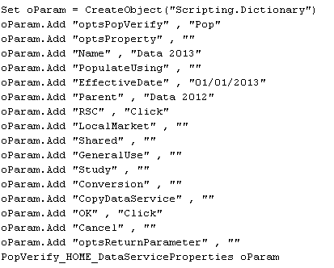
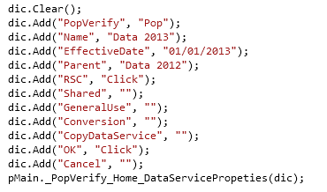
What we have in QTP ➔ What we will have in CUIT
In Studio Function Library:
QTP function call (vbs code)
CUIT function call (c# code)

Slide 9
QTP vs. CUIT
QTP CUIT
Recording & Playback 10 10
Object Identification 10 5
Function Library 10 10
Programming Language 10 (VBS) 20 (C#)
Runtime Error Handling 10 8
Data Driven 10 10
Maintenance 10 15
Training/Transfer 10 7
Performance 10 12
Optical Character Recognition 10 N/A

Slide 10
POC Screens Touched
US008 Create New (100%)
  Data
  Assets
  Val – Participant Dataset
  Val – Table Manager
  Val – Assumptions
  Val – Provisions
  Val – Methods
  Val – Funding Information
  Val – Output Manager
US018 Create New – Focus on Data service
  Current View
  Imports
  Filters
  Derivations (Custom, Service, Date, Age)
  Checks
  Batch Update
  Reports
  Snapshots
  Output Manager

Slide 11
CUIT Features (compare against QTP)
Modularized Objects & Functions
Maximum Objects & Code Re-use
FarPoint objects handling
Script performance

Slide 12
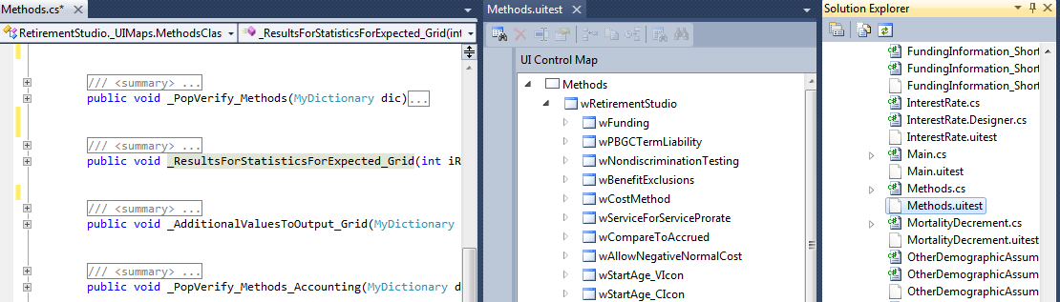
CUIT Features – 1
Modularized Objects & Functions

Slide 13
CUIT Features – 1
Modularized Objects & Functions
Objects & Functions are independent from screen to screen
In QTP, all objects are in one file, all functions are in one file
Number of QTP Objects
3401
Number of QTP Functions
1115
In CUIT, each screen has its own objects and functions, very easy to locate
Note, CUIT object identifier is very weak compare against QTP, which force us to split objects by screen

Slide 14
CUIT Features – 2
Maximum Objects & Code Re-use
Output Manager as example:
Objects in Output Manager
QTP | 183
CUIT | 38
Lines of Codes in Output Manager
QTP | > 22,000
CUIT | 1,360
CUIT: Data Service as example:
One to cover all dialogs
PMD | Derivation Definition
Check Definition | Filter Definition
One to cover all derivation types
Custom | Age
Service | Date
Size of Script:
Number of lines in US008 Create New
QTP | 15,615
CUIT | 12,298
Number of lines in US018 Data 2012
QTP | 6,330
CUIT | 4,688

Slide 15
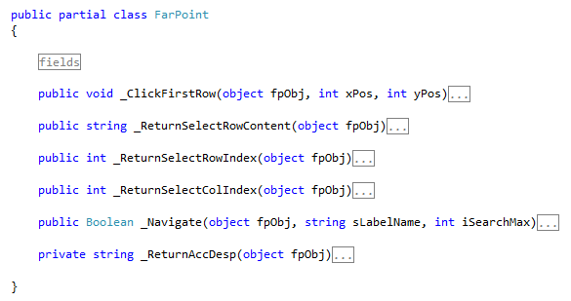
CUIT Features – 3
FarPoint objects handling
A generic FarPoint class is coded to provide common functions for all FarPoint objects

Slide 16
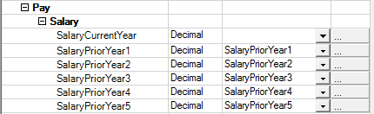
CUIT Features – 3
FarPoint objects handling
Human intelligence is added in coding FarPoint objects

Slide 17
CUIT Features – 4
Script performance enhancement
Count in minutes | Data2011 | Conversion2011
QTP | 30 | 90
CUIT | 24 | 75
Number of lines in US008 Create New
QTP | 15,615
CUIT | 12,298

Slide 18
References
http://msdn.microsoft.com/en-us/library/dd286726.aspx
http://en.wikipedia.org/wiki/Microsoft_UI_Automation

Slide 19

www.mercer.com.au

