Slide 1
01_CUIT_GettingStarted
Create your first CUIT project
2015.07.20
Webber Ling, Shanghai

Slide 2
Training Schedule
Getting Started (Frist CUIT Project, IDE walkthrough)
Medium Level (Down to detail, objects, methods, validations, data driven)
Framework (Framework walkthrough, setup project under framework)
Best Practice (PopVerify function, Naming conventions, etc)

Slide 3
Topics
Create your first CUIT project
Record/Reply
Project walkthrough
Objects
Methods
Test Script
Call system generated/user-defined method

Slide 4
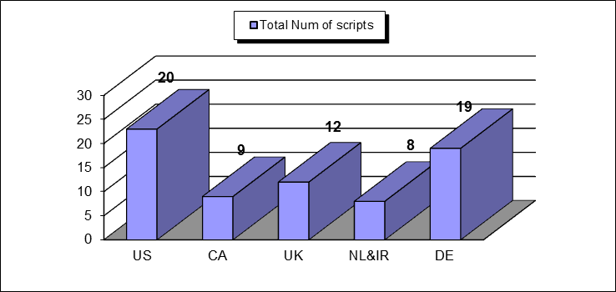
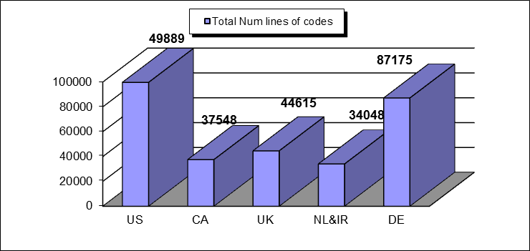
Capability of CUIT
60% have been done in CUIT
What we have in QTP
303,088 lines of codes in Test Scripts
129,158 lines of codes in Function Library
3,675 shared objects in Object Repository
150 hours to finish all scripts execution

Slide 5
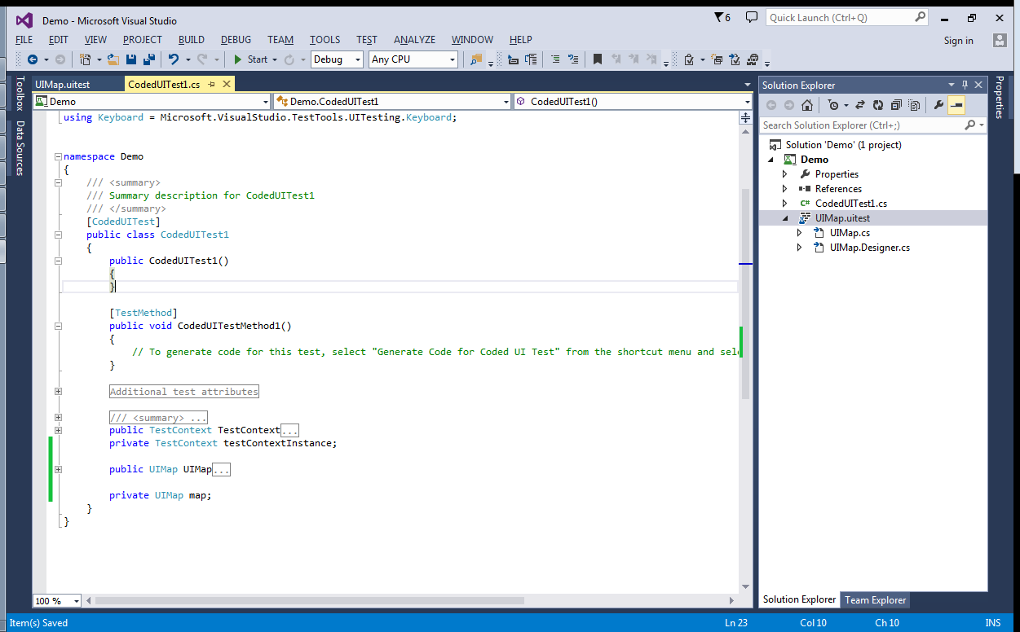
Create your first CUIT project
Start Visual Studio Premium 2013:
File -> New -> Project -> Coded UI Test Project

Slide 6
Record/Replay
Manual Steps
Type in “Coded UI” in google and click Search
Click the link of the first returned result
Page navigates to MSDN
CUIT Steps
Right click UIMap.uitest and select “Edit with Coded UI Test Builder”
Click the “Record” button (red)
Do the manual steps (Visual Studio is recording now)
Click the “Pause” button and click “Generate Code”
Give a meaningful name and click “Add and Generate”
Close the recording window

Slide 7
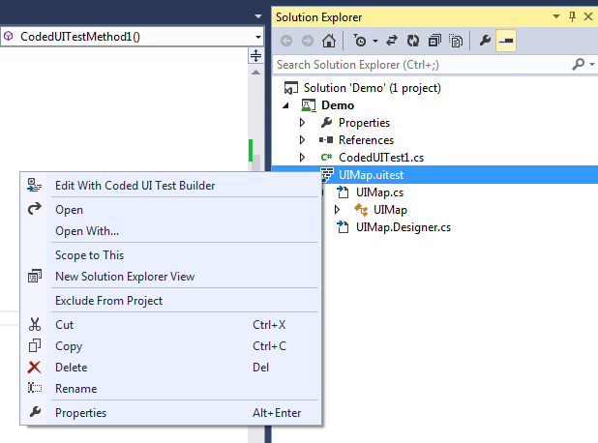
Record/Replay
Edit with Coded UI Test Builder

Slide 8


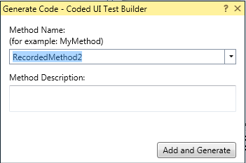
Record/Replay
Start Recording
Doing manual steps here…………
Stop Recording
Generate Code
Add and Generate

Slide 9
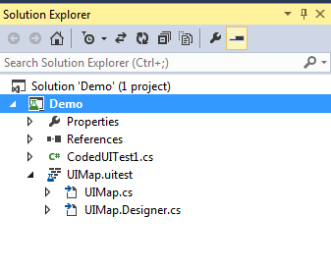
Project Walkthrough
Test Script
Visualized Objects & Methods
User defined methods
System generated objects & Methods
Note:
Be careful to Designer.cs, it is to be overwritten by system from time to time, never update this file manually

Slide 10
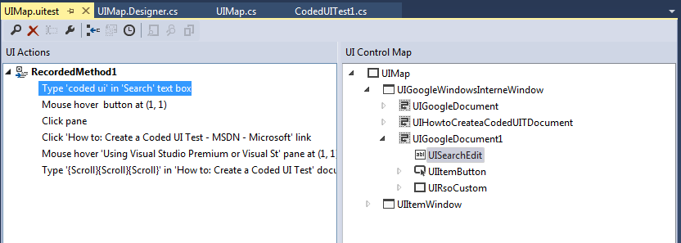
Objects & Methods
UIMap.uitest

Slide 11
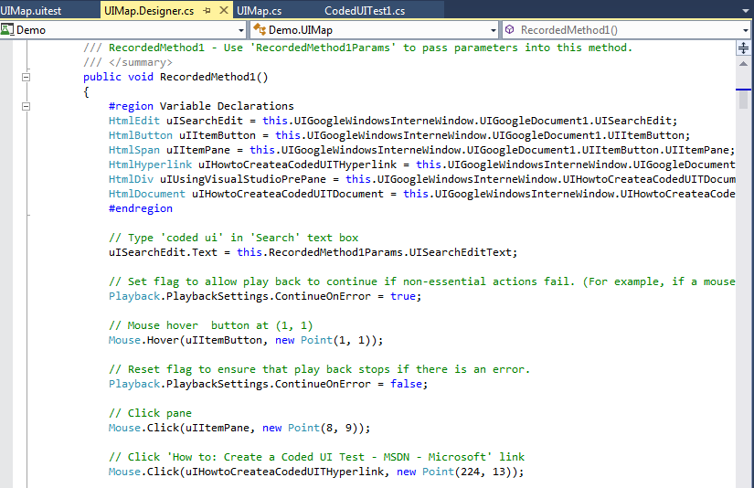
Object & Methods (system generated codes)
UIMap.Designer.cs

Slide 12
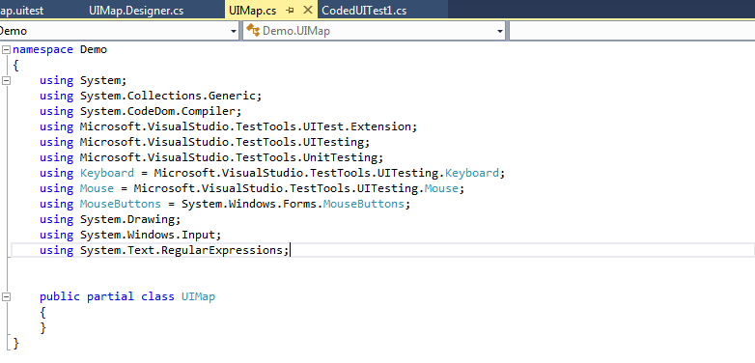
Methods (user defined)
UIMap.cs
Note:
Always define your own methods here to be called from test script.

Slide 13
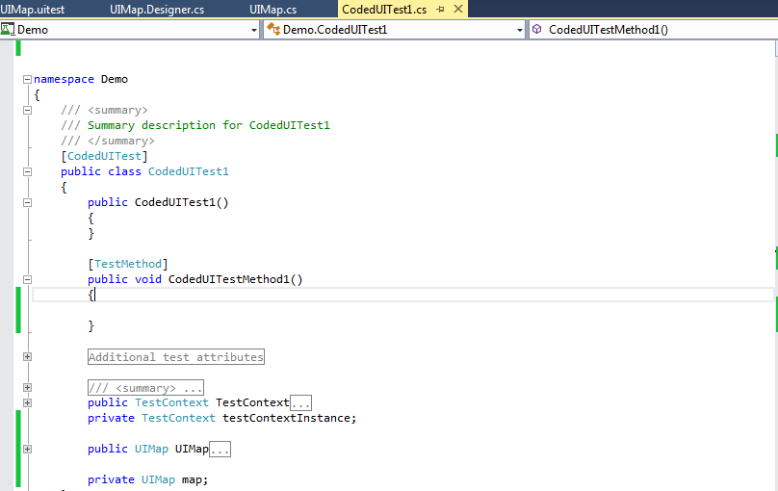
Test Script
CodedUITest1.cs

Slide 14
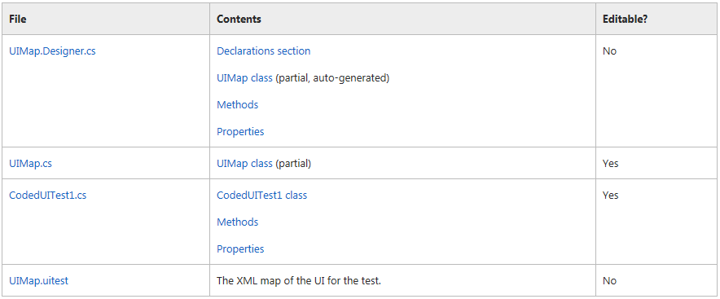
Overview
Yes

Slide 15
Demo – 1
Call system generated method

Slide 16
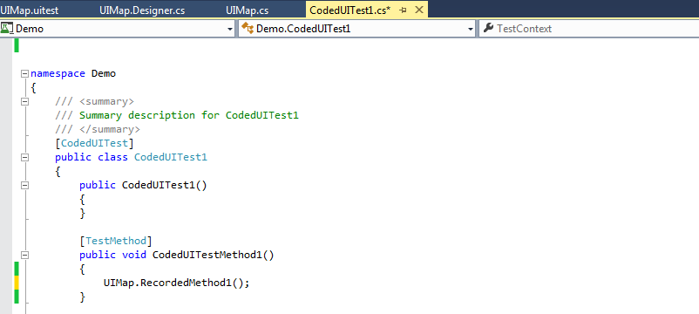
Call system generated method
Call RecordedMethod1() in CodedUITest1.cs (test script)

Slide 17
Demo – 2
Call user defined method

Slide 18
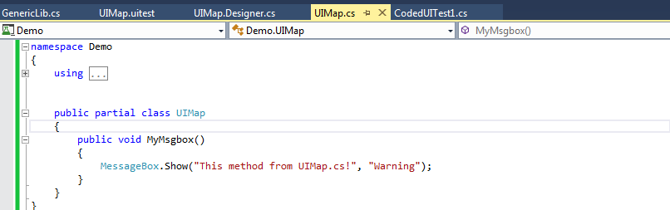
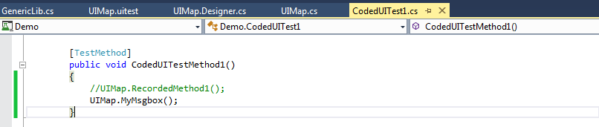
Call user defined method
Define a custom method (MyMsgBox) in UIMaps.cs
Call MyMsgBox in CodedUITest1.cs (test script)

Slide 19
References
http://en.wikipedia.org/wiki/Microsoft_UI_Automation
http://msdn.microsoft.com/en-us/library/dd286726.aspx
https://msdn.microsoft.com/en-AU/library/dd286681(v=vs.100).aspx

Slide 20
Q & A

Slide 21

www.mercer.com.au

