Slide 1
02_CUIT_MediumLevel
2015.07.21
Webber Ling, Shanghai

Slide 2

Training Schedule
Getting Started (Frist CUIT Project, IDE walkthrough)
Medium Level (Down to detail, objects, methods, validations, data driven)
Framework (Framework walkthrough, setup project under framework)
Best Practice (PopVerify function, Naming conventions, etc)

Slide 3
Topics
Add control
Add Validation
Interact with objects
Synchronization
Test Initialize() and Test Clean Up()
Data Driven

Slide 4

Add Control
Edit with Coded UI Test Builder
Add New Control
Record Action
Note:
For object (what is easy to loose focus, e.g. context menu), use short-cut key Ctrl+Shift+I

Slide 5
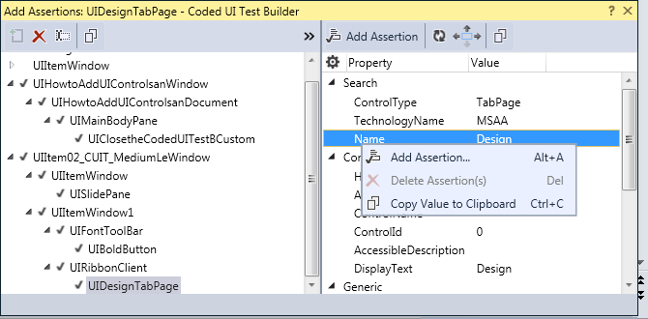
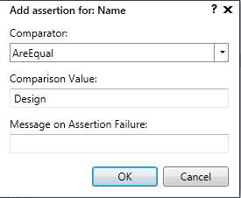
Add Validation
Right click on the property → Add Assertion

Slide 6
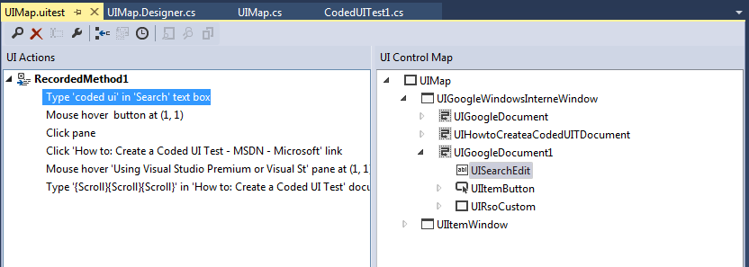
Interact with Objects
UIMap.uitest

Slide 7
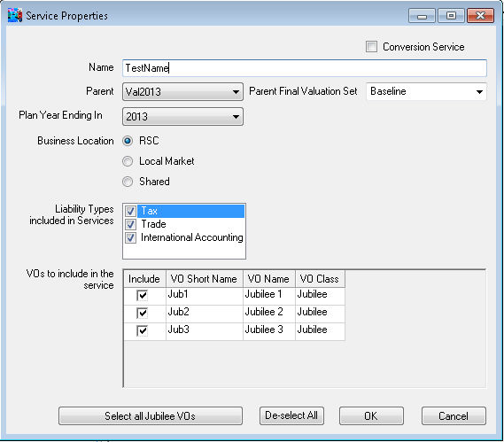
Interact with Objects
CheckBox
Edit
ComboBox
RadioButton
Button

Slide 8
Interact with Objects (QTP & Selenium)
QTP
CheckBox ➔ obj.set(“ON”), obj.set(“OFF”) property(“checked”)
Edit ➔ obj.set (sText) property(“text”)
ComboBox ➔ obj.select (sItem) property(“text”)
RadioButton ➔ obj.set property(“checked”)
Button ➔ obj.click
Selenium
CheckBox ➔ obj.click isSelected()
Edit ➔ obj.sendKeys(sText) getAttribute(“value”)
ComboBox ➔ select.selectByVisibleText(sItem) getFirstSelectedOption().getText()
RadioButton ➔ obj.click isSelected()
Button ➔ obj.click

Slide 9
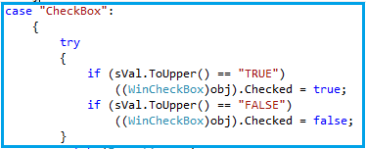
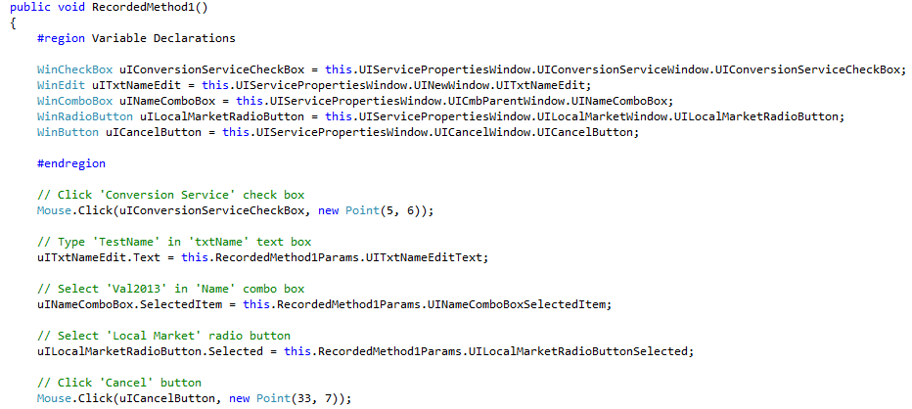
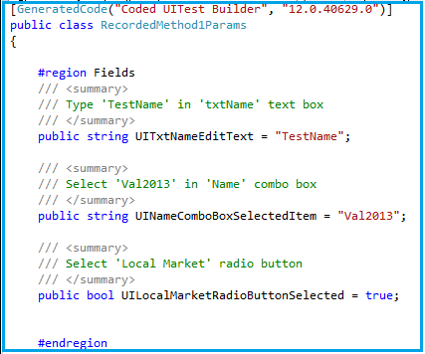
Interact with Objects (CUIT)

Slide 10
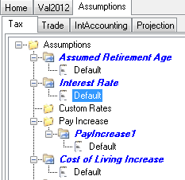
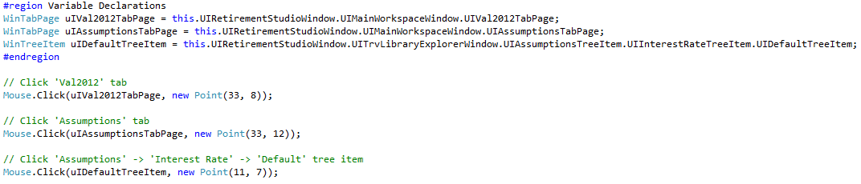
Interact with Objects
Question:
How to work with runtime tree view item whose name is NOT fixed?

Slide 11
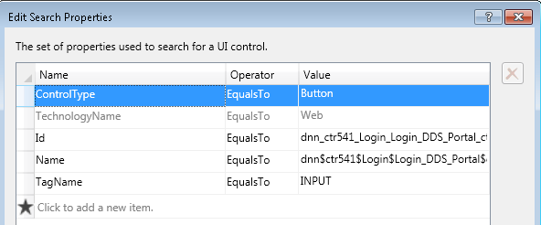
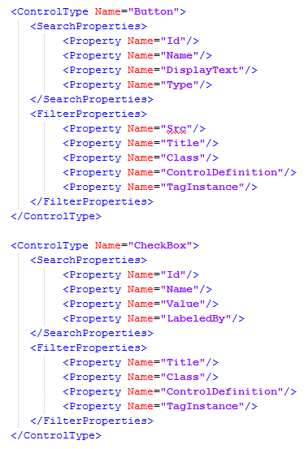
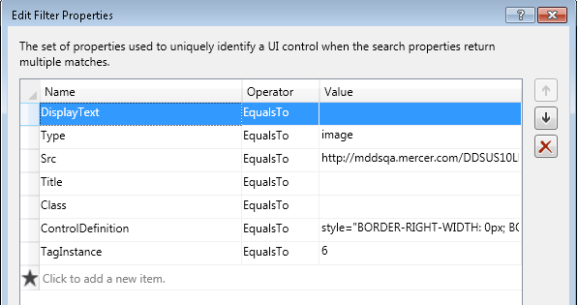
Interact with Objects
C:\Program Files (x86)\Common Files\Microsoft Shared\VSTT\12.0\

Slide 12
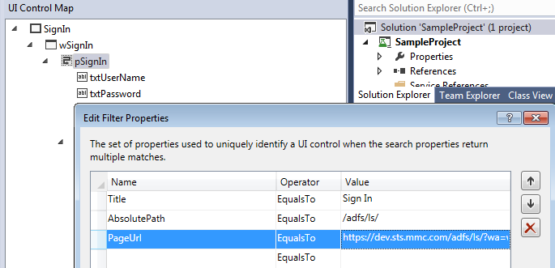
Interact with Objects
Why and When we need to modify PropertyConfiguration.xml?
https://dev.sts.mmc.com/adfs/ls/?wa=wsignin1.0&wtrealm=http%3a%2f%2fmsso1-qa.mercer.com%2fadfs%2fservices%2ftrust&wctx=a303a7d7-3063-4717-a477-fdd5a8dd9c07&wct=2015-09-01T03%3a09%3a32Z

Slide 13
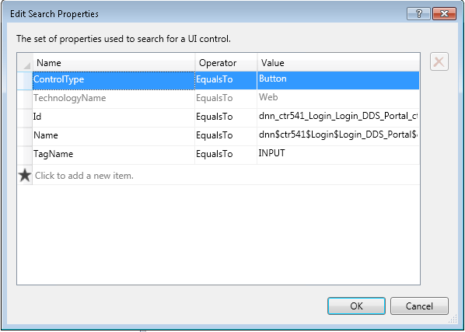
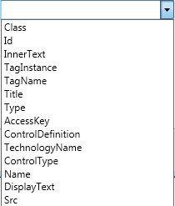

Interact with Objects

Slide 14
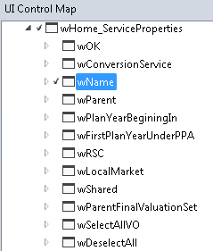
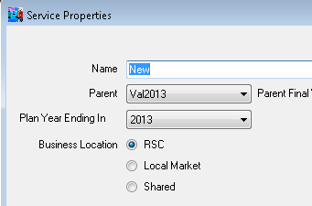
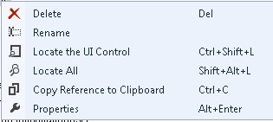
Interact with Objects

Slide 15
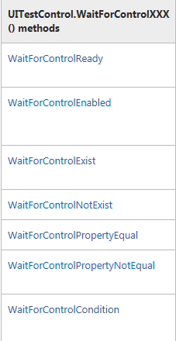
Synchronization
https://msdn.microsoft.com/en-us/library/gg131072(v=vs.120).aspx
Waits for the control to be ready to accept mouse and keyboard input. The engine implicitly calls this API for all actions to wait for the control to be ready before doing any operation.
Waits for the control to be enabled when the wizard is doing some asynchronous validation of the input by making calls to the server.
Waits for the control to appear on the UI. For example, you are expecting an error dialog after the application has done the validation of the parameters.
Waits for the control to disappear from the UI. For example, you can wait for the progress bar to disappear.

Slide 16
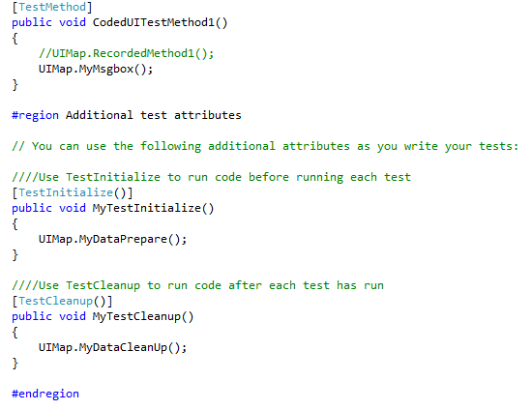
Test Initialize() and Test Clean Up()
In test script:
MyTestInitialize()
CodedUITestMethod1()
MyTestCleanUp()

Slide 17
Data Driven
https://msdn.microsoft.com/en-us/library/ee624082(v=vs.120).aspx
Setup your own Excel data file
Get data from excel file
Pass into test script/method
Use iteration to control the execution

Slide 18
References
http://en.wikipedia.org/wiki/Microsoft_UI_Automation
http://msdn.microsoft.com/en-us/library/dd286726.aspx
https://msdn.microsoft.com/en-AU/library/dd286681(v=vs.100).aspx

Slide 19

www.mercer.com.au

