Slide 1
_CUIT Framework Walkthrough
2015.07.28
Webber Ling, Shanghai

Slide 2

Training Schedule
Getting Started (Frist CUIT Project, IDE walkthrough)
Medium Level (Down to detail, objects, methods, validations, data driven)
Framework (Framework walkthrough, setup project under framework)
Best Practice (PopVerify function, Naming conventions, etc)

Slide 3
Topics
CUIT Framework Folder Structure
Multi Function Layer
CUIT Framework Work Flow
Generic Lib, Lib Web, Lib Win
Object Repository & Page Functions
Test Script
Setup Project under Framework

Slide 4
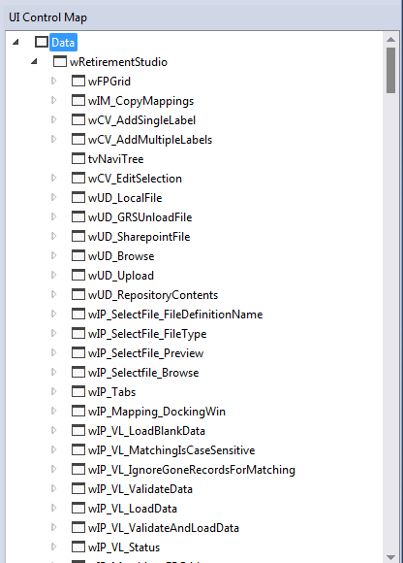
Why need to organize your project under Framework?
Well-organized objects
Well-organized methods
Easy to maintain
Easy to use
Easy to split tasks/roles

Slide 5
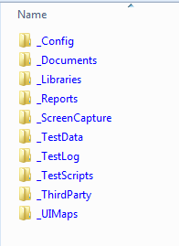
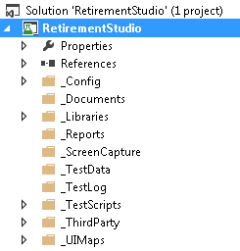
CUIT Framework Folder Structure
Physical Folder Structure
Visual Studio Project Structure
Note: Please refer to <RTG Visual Studio Automation Framework.doc> for detailed info.
It is under \SampleProject\SampleProject\_Documents

Slide 6
Multiple Function Layer
Generic Lib
.Net Function Lib
Web Function Lib
Reports Compare Lib
Others…..
UIMap Screen 1
Function Screen 1
UIMap Screen 2
Function Screen 2
UIMap Screen 3
Function Screen 3
…
Test Scripts
Note: Please refer to <RTG Visual Studio Automation Framework.doc> for detailed info.

Slide 7
Automation Work Flow
RTG Visual Studio Automation Framework - Work Flow
Documents
Config Files
Third Party
UIMap 1
Function 1
Reports
UIMap 2
Function 2
Web Lib
Test Script
UIMap 3
Function 3
Screenshots
Generic Lib
.NET Lib
.
.
.
Other Libs
Log
Test Data

Slide 8
Automation Work Flow (maintenance procedure)
UIMap 1
Function 1
Test script is a combination of function calls
UIMap 2
Function 2
Test Script
One screen, one/multiple functions
UIMap 3
Function 3
Object changes ➔ Update UI Map
.
.
.
Screen changes ➔ Update screen function
Test scripts remain untouched
Test Data

Slide 9
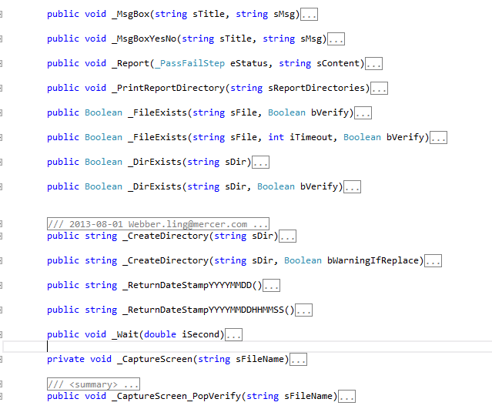
Generic Lib
General functions, e.g. IO, Directory, Excel, Screen Capture, Log, etc

Slide 10
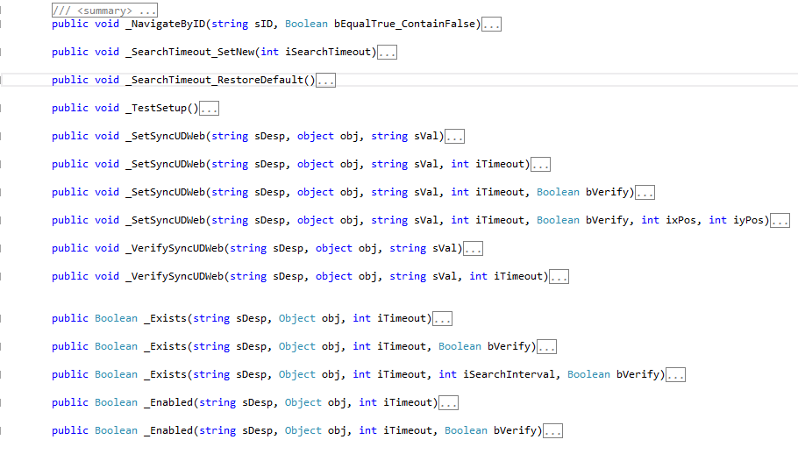
Generic Lib Web
Web Page functions

Slide 11
Generic Lib Web
Applies to any kind of page objects, e.g. Edit, Radio Button, Link, Check box, List, etc
sVal = “Click” (Link, Button)
sVal = “True”/”False” (Radio button, Check box)
sVal = “ItemToBeSelected” (List, Combo box)
Benefits:
One common function to cover all objects
Simplified coding, testers are not required to familiar with low level object interaction
Note: Notify webber.ling@mercer.com or shirley.miao@mercer.com to if needs update
\\cnshn13db04v\share_SDC\ESS_Automation_Framwork\CUIT\000_LibraryUpdate

Slide 12
Generic Lib Win
Applies to any kind of page objects, e.g. Button, Edit, Radio Button, Check box, List, etc
sVal = “Click” (Button)
sVal = “True”/”False” (Radio button, Check box)
sVal = “ItemToBeSelected” (List, Combo box)
Benefits:
One common function to cover all objects
Simplified coding, testers are not required to familiar with low level object interaction

Slide 13
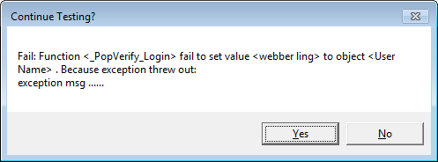
What SetSyncUD does?
Check Object Exists
Check Object Enabled
Set Value to Object based on Object Type
Verify expected value is set to object
Note:
Exception will be thrown out and be catched with meaningful message, user get the chance to keep testing or stop

Slide 14
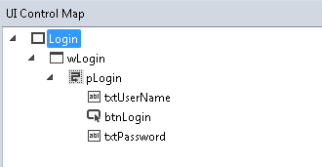
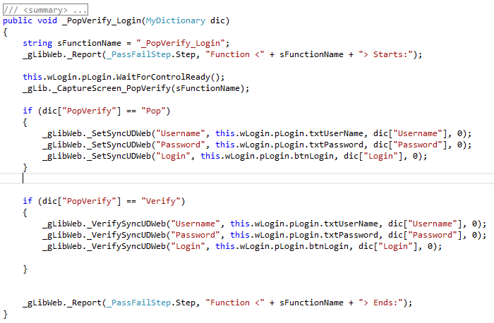
Object Repository & Page Functions
Basically, one page one UI map, e.g Login Page

Slide 15
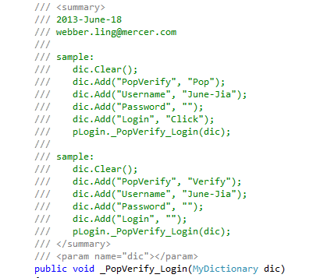
Object Repository & Page Functions
Call Page Functions, either with “Pop” or “Verify”
Note: Please refer to <RTG Visual Studio Automation Framework – PopVerifyFunction.doc> for detailed info.
It is under \SampleProject\SampleProject\_Documents

Slide 16
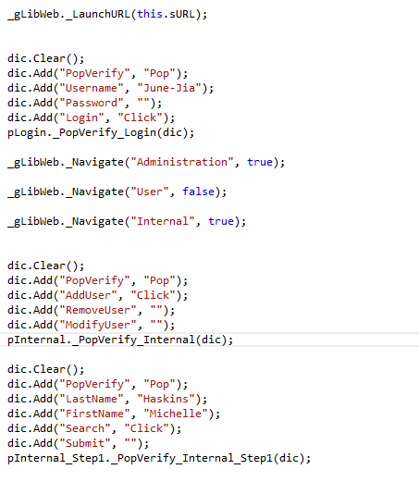
Test Script
Test script is a just a combination of Page function calls

Slide 17
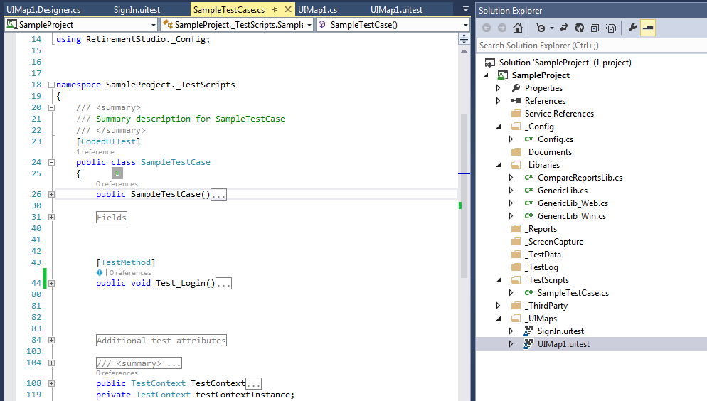
Sample Project
\\cnshn13db04v\share_SDC\ESS_Automation_Framwork\CUIT\SampleProject

Slide 18
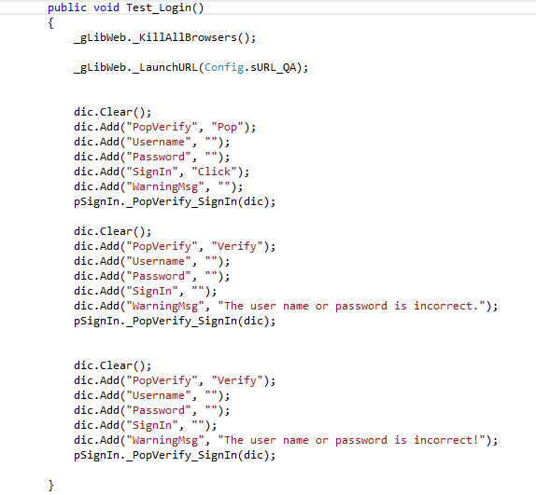
Sample Project

Slide 19
Sample Project
Create your own project based on Sample
Copy the whole Sample Project folder to local
Configure your project in Config.cs, e.g. URL, timeout, etc
Add your UI Maps under _UIMaps folder
Create your _PopVerify methods in uimap.cs file
Add your test script under _TestScripts folder
Create your test script in your test script file

Slide 20
Benefits
Common Library codes are modularized and under well-maintain
Pages are independent and page function coding is very easy and straightforward
Test script creation is just copy/paste/update parameters from sample
Test script is readable and easy to understand
Learning/Traning curve is very short, everyone can do automation
Multi tester can work on different page simultaneously
Each completed page (objects and functions) can be shared with others for scripting
Easy maintenance
  Object changes, update object repository
  Screen changes, update screen function
  Test script remains untouched
Transfer cost is minimized since everyone work on the same framework

Slide 21

www.mercer.com.au

