Slide 1
_CUIT Best Practice
2015.07.28
Webber Ling, Shanghai

Slide 2
Topics
Setup your first project under RTG VS Automation Framework
Multiple UIMaps and Naming Convention
Object Naming Conventions
Work with Properties (define runtime object)

Slide 3
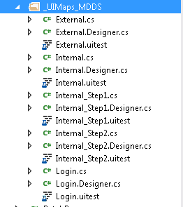

Slide 4
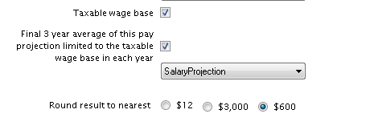
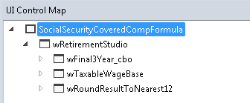

Slide 5
http://blogs.msdn.com/b/visualstudioalm/archive/2012/12/10/coded-ui-test-configuring-search-properties-while-recording-on-internet-explorer.aspx

Slide 7

www.mercer.com.au

