Slide 1
QTP Training
2013.07.03
Webber Ling, Shanghai

Slide 2
Topics
Our Targets
Topics will be covered in the coming trainings
Your Interests/Weak Points
QTP Framework walkthrough
Homework

Slide 3

Targets
Know basic QTP, VBS coding, debugging
Understand QTP Object Identification
Understand Object Repository and Regular Expression
Understand ESS QTP Automation Framework
Able to script under ESS QTP Automation Framework
  Call Existing PopVerify functions to create test script
  Create new PopVerify functions
  Maintain function libraries

Slide 4
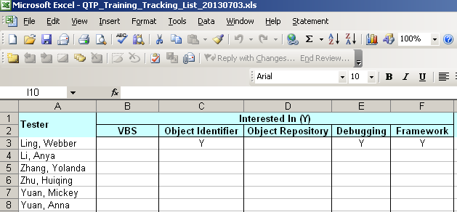
Your Interests
\\cnshn13db04v\Share_SDC\ESS_Automation_Framwork\Training\Documents\QTP\QTP_Training_Tracking_List_20130703.xls

Slide 5
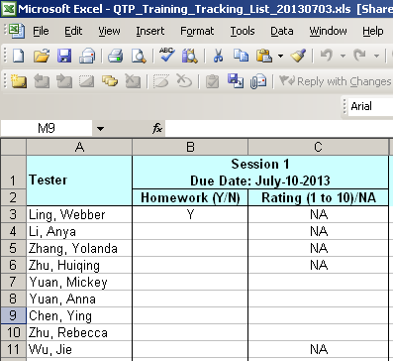
Homework & Rating
\\cnshn13db04v\Share_SDC\ESS_Automation_Framwork\Training\Documents\QTP\QTP_Training_Tracking_List_20130703.xls

Slide 6
Basic QTP, VBS coding, debugging
QTP Installation:
\\cnshn13db04v\Share_SDC\ESS_Automation_Framwork\InstallationFiles\QTP
Training Slides:
\\cnshn13db04v\Share_SDC\ESS_Automation_Framwork\Training\Documents\QTP\ESS Auto Framework Training - GettingStarted.ppt
Training Videos:
\\cnshn13db04v\Share_SDC\ESS_Automation_Framwork\Training\Videos
About QTP License
Use Trial version when you first time install QTP, which should have 15 days license free
6 ESS QTP license, have to enter license server after trial version expires
ESS QTP license server: 10.197.49.154

Slide 7
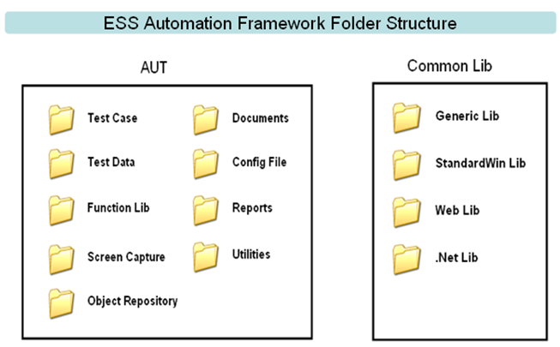
ESS Automation Framework Overview – Folder Structure

Slide 8
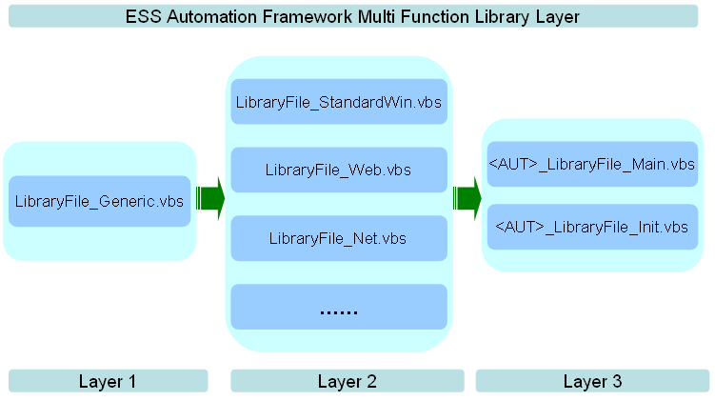
ESS Automation Framework Overview – Function Library

Slide 9
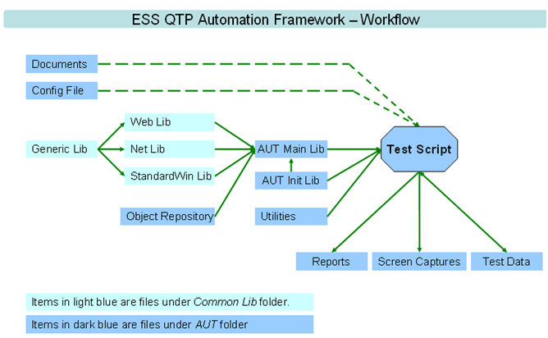
ESS Automation Framework Overview – Work flow

Slide 10
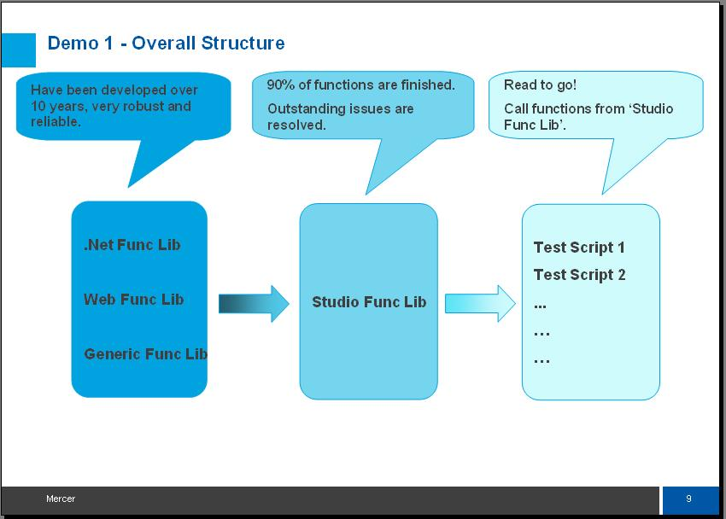
ESS Automation Framework Overview – Work flow

Slide 11
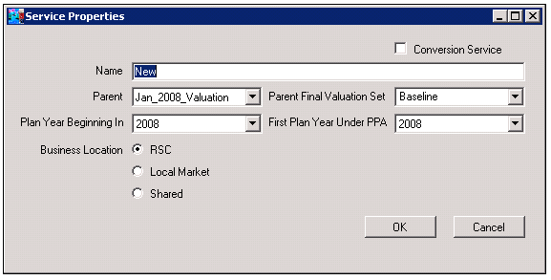
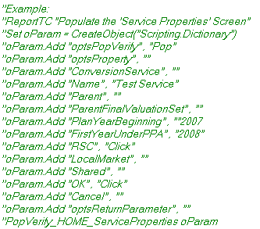
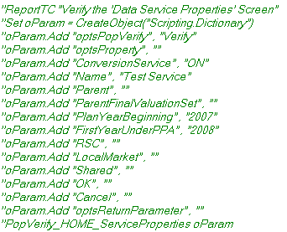
ESS Automation Framework Overview – PopVerify Function

Slide 12
ESS Automation Framework Overview
Framework Introduction Doc:
\\cnshn13db04v\Share_SDC\ESS_Automation_Framwork\Training\Documents\QTP\ESS QTP Automation Framework.doc
PopVerify Function Doc:
\\cnshn13db04v\Share_SDC\ESS_Automation_Framwork\Training\Documents\QTP\ESS QTP Coding Standard - PopVerifyFunction.doc

Slide 13
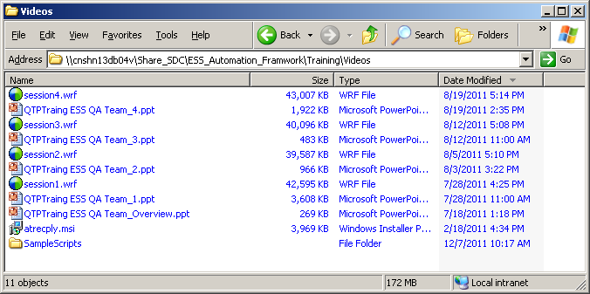
Homework
Training Videos:
\\cnshn13db04v\Share_SDC\ESS_Automation_Framwork\Training\Videos
Training videos are around 6 hours in total

Slide 14

www.mercer.com.au

