Slide 1
QTP Training
2013.07.05
Webber Ling, Shanghai

Slide 2
Topics
Build up Your “First” Framework
Generate the Folder Structure
Rename Existing Files (libraries, configID, network mapping file, shared OR)
Configure QTP (working dir, resource, object repository dir, configID)
Create Your “First” Test Script
Update AUTName_FunctionLibrary_Init.txt
Add objects into Shared Object Repository
Create PopVerify Function
Run Test

Slide 3
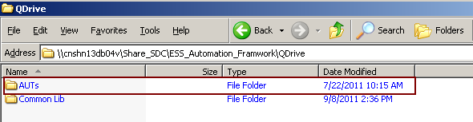
Build up Your “First” Framework
Generate the Folder Structure
Copy from:
\\cnshn13db04v\Share_SDC\ESS_Automation_Framwork\QDrive

Slide 4
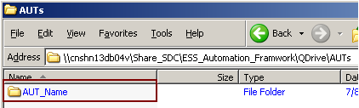
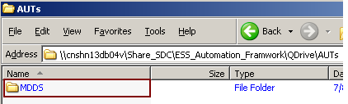
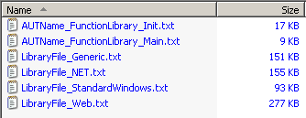
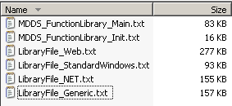



Build up Your “First” Framework
Rename Existing Folders/Files (libraries, network mapping file, shared OR)

Slide 5

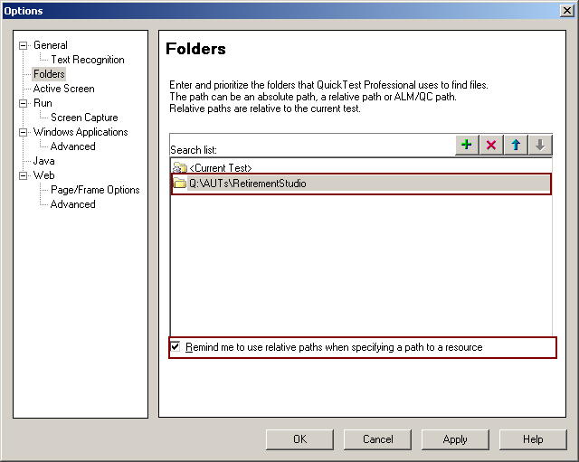
Build up Your “First” Framework
Configure QTP
Run configID script in QTP (save, close and re-open QTP)
Add Search List (Tools -> Options -> Folders)

Slide 6
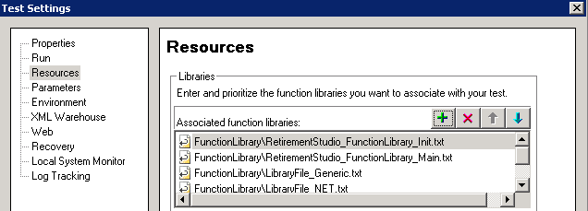
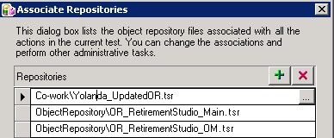
Build up Your “First” Framework
Configure QTP
Add resources (File -> Settings -> Resources)
Associate Object Repository (Resources -> Associate Repositories)

Slide 7

Create Your “First” Test Script
Update AUTName_FunctionLibrary_Init.txt
Add objects to your Shared Object Repository
Create PopVerify_<ScreenName> function
Run Test

Slide 8
Homework

Slide 9

www.mercer.com.au

