Slide 1
QTP Training
2013.07.15
Webber Ling, Shanghai

Slide 2
Topics
PopVerify Function Detail
\\cnshn13db04v\share_SDC\ESS_Automation_Framwork\Training\Documents\QTP\ESS QTP Coding Standard - PopVerifyFunction.doc
Scripting.Dictionary
Run mode
Populate
Verify
Working with Objects

Slide 3
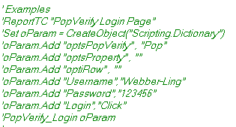

PopVerify Function Detail – “Scripting.Dictionary”
Value
Key
Key
Value
Go to Demo 1
Assign Key “Username” with Value “Webber-Ling”

Slide 4
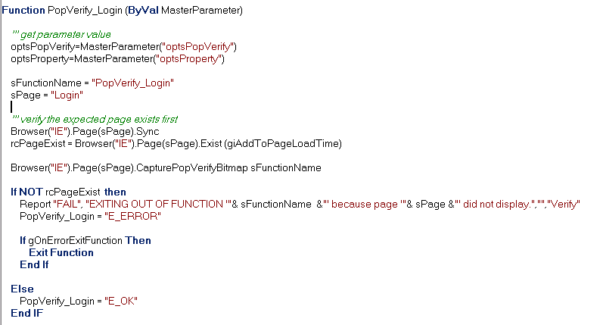
PopVerify Function Detail – Sync and Page Existing Checking
Sync page and wait for page display
Capture screen for further reference
Give user option to keep testing or quit
Exit Function if Page NOT exist

Slide 5
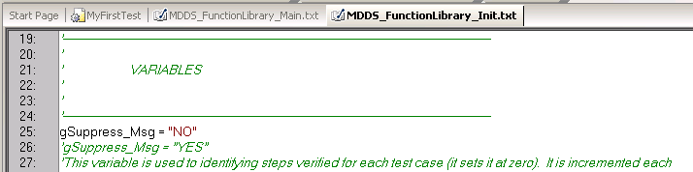

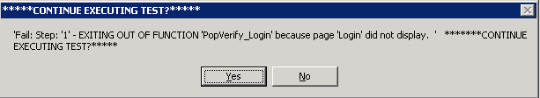
PopVerify Function Detail – Run Mode
“NO” to popup message box with error info and waiting for user inputs (user-interaction mode)
“YES” to continue testing without message popup (silence mode)
Go to Demo 2

Slide 6
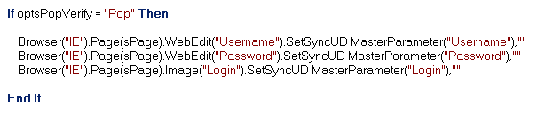
PopVerify Function Detail – Pop
Method: SetSyncUD (sValue, iTimeout)
sValue – “Click”, Value to be set/select, also takes index with format “#6” for List, ComboBox
iTimeout – sync time, default is 50

Slide 7
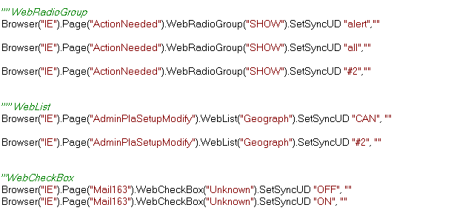
PopVerify Function Detail – Pop
WebRaidoGroup, WebList, WebComboBox take both Text and Index as input
WebCheckBox only taks ON/OFF as input
Go to Demo 3

Slide 8
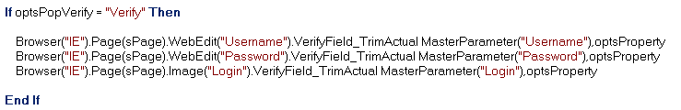
PopVerify Function Detail – Verify
Method: VerifyField_TrimActual (sValue, optsProperty)
sValue – Actual value of specified optsProeprty which displays on the screen, e.g. “Webber” is the value of property “Text” of WebEdit(“Username”)
optsProperty – The property name used to check, e.g. “Text”, “Visible”, “Exist”, etc
Each object has its Default Property which meets most of our testing requirements, so we can leave “optsProperty” blank
Go to Demo 4

Slide 9
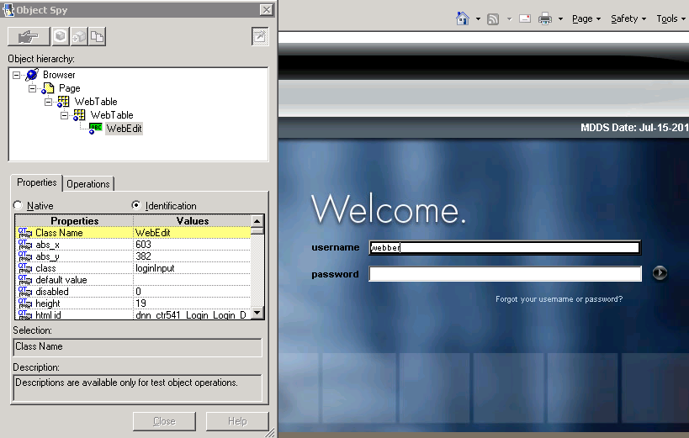
Working with Objects - Identifier
Object Identifier

Slide 10
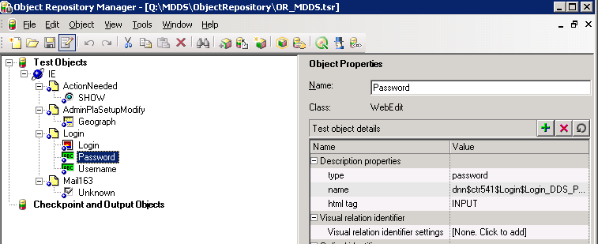
Working with Objects – Shared Object Repository
Test Property - Runtime Property
Regular Expression: .* matches everything
Go to Demo 5

Slide 11
Homework & Rating
Build your Framework using your own project
Create PopVerify functions
Create TestScript call PopVerify functions (both Pop and Verify should be used)

Slide 12

www.mercer.com.au

