Slide 1
QTP Training
2013.07.29
Webber Ling, Shanghai

Slide 2
Topics
Table Methods in Web library
TBL_GetCellData
TBL_ClickLink
TBL_VerifyCellData
TBL_VerifyDataExistsInTable
TBL_VerifyDataDoesNotExistsInTable
……
……
Code Your TBL Function

Slide 3
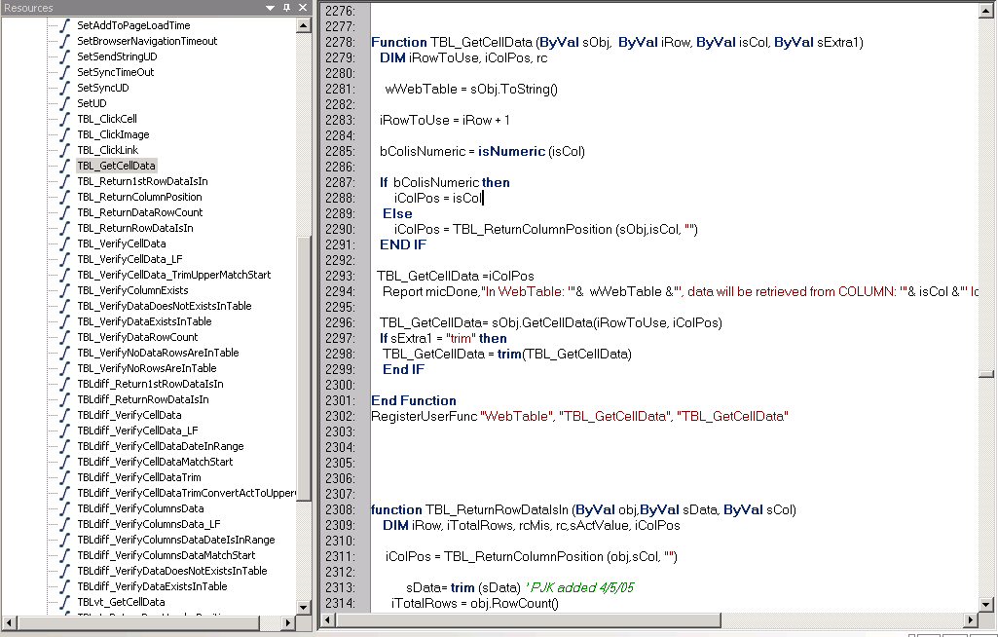
Table Methods in Web library

Slide 4
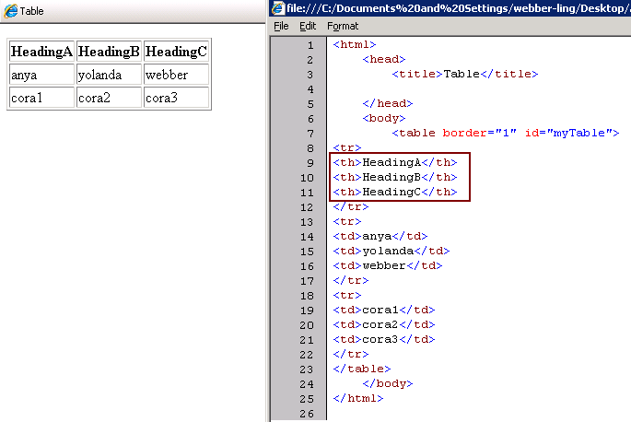
Standard Table

Slide 5
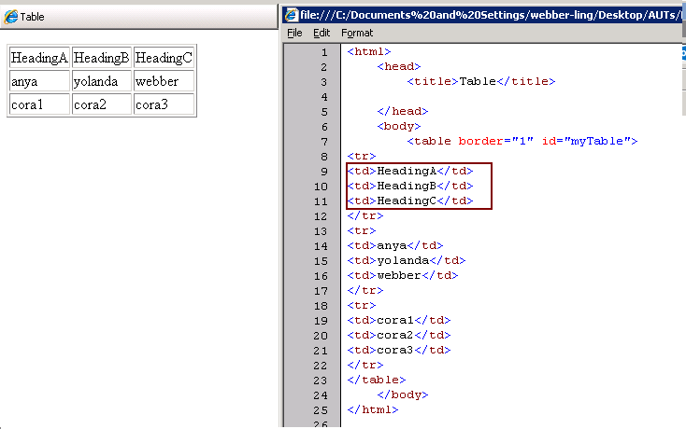
Non-Standard Table

Slide 6
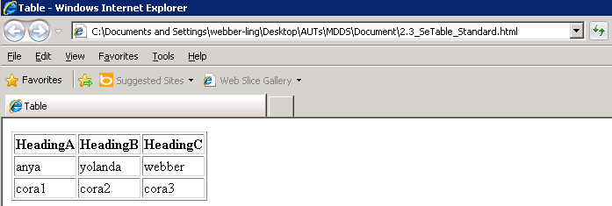
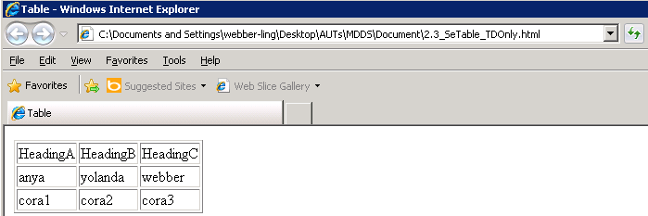
TBL Method – TBL_GetCellData (iRow, isCol, sExtra)
Go to Demo 1

Slide 7
TBL Method – TBL_VerifyCellData (sValue, iRow, isCol)
Go to Demo 2

Slide 8


TBL Method – TBL_VerifyDataExistsInTable (sCol, iOptRow, sData)
Method: TBL_VerifyDataExistsInTable (sCol, iOptRow, sData)
Go to Demo 3

Slide 9
TBL Method – TBL_VerifyDataDoesNOTExistsInTable
Method: TBL_VerifyDataDoesNOTExistsInTable (sCol, iOptRow, sData)
Go to Demo 4

Slide 10
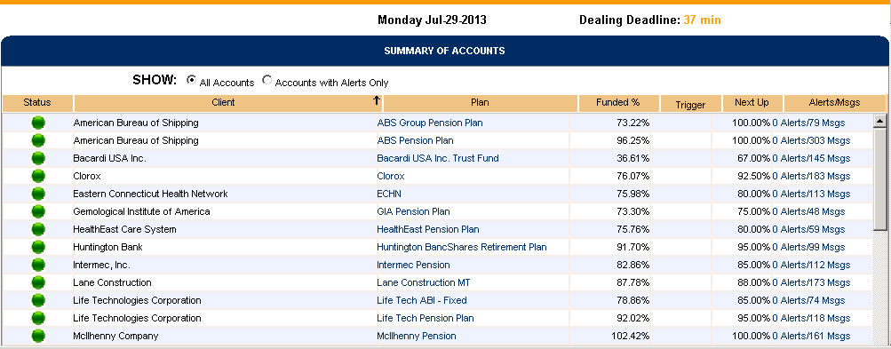
Table without Column Header

Slide 11
TBL Method – TBL_GetCellData
Method: TBL_GetCellData (iRow, isCol, sExtra1)
Go to Demo 5

Slide 12

TBL Method – TBL_ClickLink
Method: TBL_ClickLink (iRow, iCol, iOptRow)
Go to Demo 6

Slide 13
TBL Method – TBL_VerifyCellData
Method: TBL_VerifyCellData (sValue, iRow, isCol)
Go to Demo 7

Slide 14
Code your TBL Function
Go to Demo 8

Slide 15
Homework & Rating
Build your Framework using your own project
Create PopVerify functions
Create TestScript call PopVerify functions (both Pop and Verify should be used)
Code your PopVerify_TBL function and call it in your test script

Slide 16

www.mercer.com.au

