Slide 1
Selenium Introduction
2012.03.28
Webber Ling, Shanghai

Slide 2
Topics
What is Selenium?
Supported OS, Browser
Programming Language/Testing Framework
Selenium Components
How Selenium works?
Selenium Documents

Slide 3
What is Selenium?
Selenium automates browsers.
Start at 2004 at ThoughtWorks in Chicago with Jason Huggins ➔ initial
2006: Shinya, Mike, Wang Peng Chao, Huang Liang, Xiong Jie ➔ close to 1.0

Slide 4
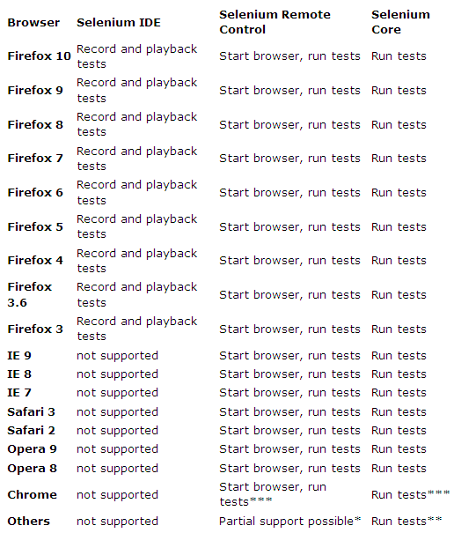
Supported OS, Browser
Supported OS:
Windows
Linux
Solaris
Others…..

Slide 5
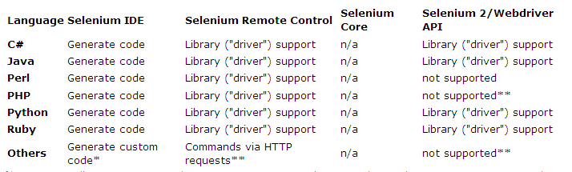
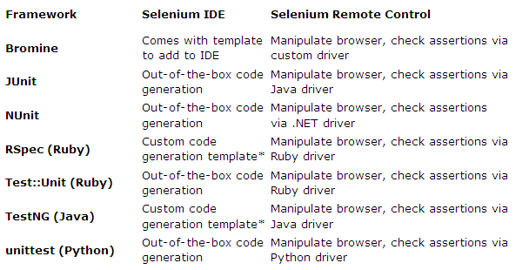
Programming Language/Testing Framework

Slide 6
Selenium Components
Selenium IDE
Selenium RC
Selenium User Extensions
Selenium 2.0 and WebDriver

Slide 7
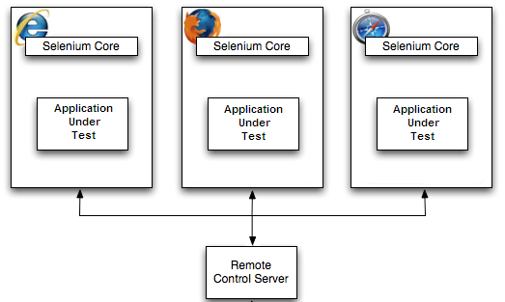
How Selenium works?
Selenium IDE ➔ Record/Enhance test script
Selenium RC ➔
Build testing framework, control testing execution, results reporting, etc
Third-Party Testing Framework ➔

Slide 8
Selenium Documents
Selenium Home:
http://seleniumhq.org/
Selenium IDE:
http://seleniumhq.org/docs/02_selenium_ide.html
Selenium RC:
http://seleniumhq.org/docs/05_selenium_rc.html
Selenium 2.0 and WebDriver:
http://seleniumhq.org/docs/03_webdriver.html
Official Selenium Blog:
http://seleniumhq.wordpress.com/

Slide 9

www.mercer.com.au

