Slide 1
Selenium IDE
2012.04.11
Webber Ling, Shanghai

Slide 2
Topics
What is Selenium IDE?
Supported OS, Browser
Selenium IDE Walkthrough
GUI
Recording
Synchronization
Verifications and Asserts
Locating Elements
Matching Text Patterns
Flow Control
Store Commands and Variables
JavaScript and Selenese Parameters
Selenese Print Command
Debugging

Slide 3
What is Selenium IDE?
IDE (Integrated Development Environment)
Firefox add-in
Develop Selenium test cases
➔ Recording
➔ Playback
➔ Debugging
➔ Enhancement
➔ Export Test Case using preferred programming language

Slide 4
Supported OS, Browser
Supported OS: Windows, Linux, Solaris, Others…..
Supported Browser: Firefox 3 and after
You can only use IDE on Firefox, IE and other browsers are NOT supported.
However, test cases can be run on all supported browsers

Slide 5
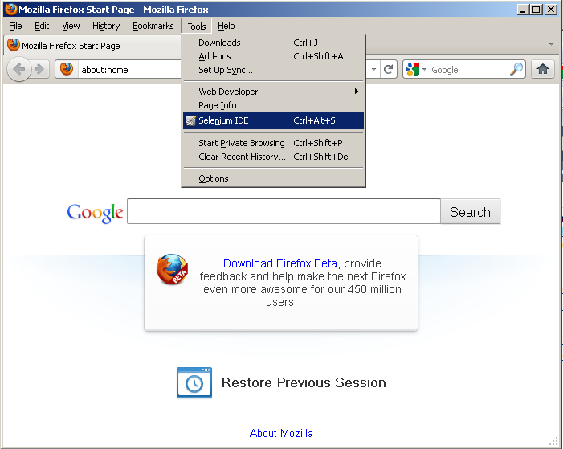
Selenium IDE Walkthrough - GUI

Slide 6
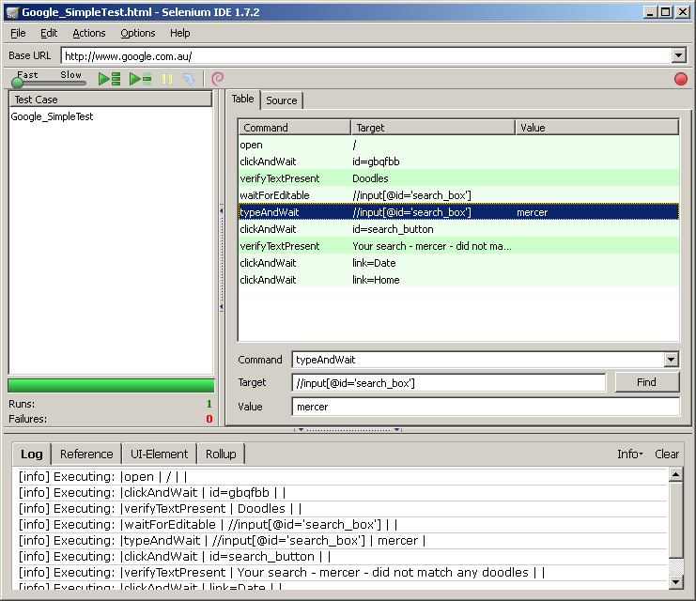
Selenium IDE Walkthrough - GUI
AUT URL
Test Suite
Test Case
Codes
Selenese
Support Information

Slide 7
Selenium IDE Walkthrough - Recording
Recording is ON by default when IDE is opened
Options->Options: Start recording immediately on open ➔ control recording status
Frequently used commands
click or clickAndWait: clicking a link
type: entering values
select: selecting options from a drop-down list box
click: clicking checkboxes or radio buttons

Slide 8
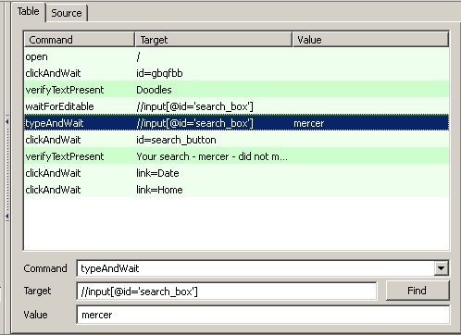
Selenium IDE Walkthrough - Synchronization
clickAndWait
waitForEditable
typeAndWait
waitForPageToLoad
waitForElementPresent
Selenium provides integrated Selenese for various sync purpose !

Slide 9
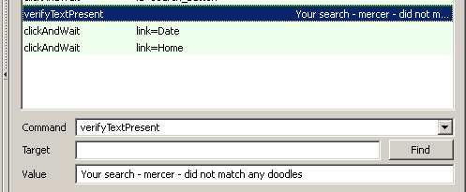
Selenium IDE Walkthrough – Verifications and Asserts
“assert”, “verify”, “waitFor”
Assert fails ➔ test is aborted
Verify fails ➔ test continue execution and log failure
waitFor fails ➔ test stop if condition does not become true within timeout setting
Example:

Slide 10
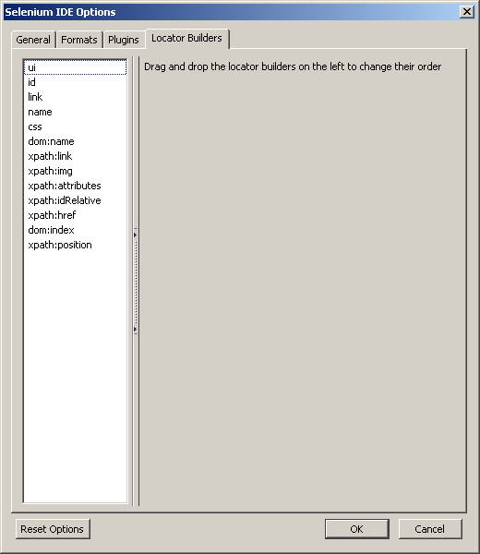
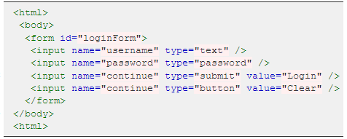
Selenium IDE Walkthrough – Locating Elements
How Selenium identify web objects?
By Id
By Name
By XPath
By Link Text
By DOM
By CSS
Refer to IDE online document chapter: Locating Elements

Slide 11
Selenium IDE Walkthrough – Matching Text Patterns
Selenese: verifyTextPresent, verifyTitle, verifyText, assertConfirmation……
Three Types of Patterns:
Exact Patterns: exact: mercerabc
Globbing Patterns (default): glob: mercer*
➔ * matches anything
➔ [aeiou] matches any lowercase
➔ [0-9] matches any digit
➔ [a-z A-Z 0-9] matches any alphanumeric character
Regular Expression Patterns: regexp: mercer *
Sample:
➔ [0-9] {1,2} ?
➔ [ap]m ?

Slide 12

Selenium IDE Walkthrough – Flow Control
IDE supports Flow Control ???
Support condition statements? (if-else…)
Support iteration? (for, while…)
Options:
Run script using Selenium RC using programming language’s flow control
Run a small JavaScript snippet within script using StoreEval command
Install the goto-sel-ide.js extension

Slide 13



Selenium IDE Walkthrough – Store Commands and Variables
Selenese: store
Commonly used commands:
storeElementPresent (true or false)
storeText
storeEval (result of running the script)

Slide 14
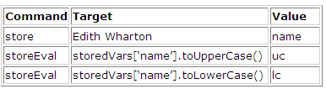
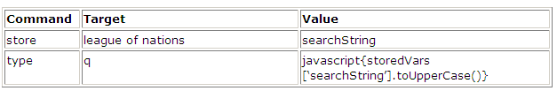
Selenium IDE Walkthrough – JavaScript and Selenese Parameters
All variables created in IDE are stored in JavaScript associated array: storedVars[‘VariableName’]
uc=“EDITH WHARTON”
lc=“edith wharton”
Syntax: javascript{storedVars[‘VariableName’].toUpperCase()}

Slide 15

Selenium IDE Walkthrough – Selenese Print Command

Slide 16
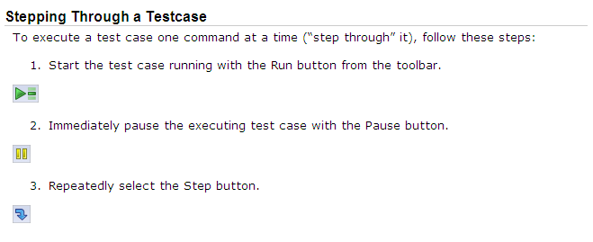
Selenium IDE Walkthrough – Debugging

Slide 17
Selenium Documents
Selenium Home:
http://seleniumhq.org/
Selenium IDE:
http://seleniumhq.org/docs/02_selenium_ide.html
Selenium RC:
http://seleniumhq.org/docs/05_selenium_rc.html
Selenium 2.0 and WebDriver:
http://seleniumhq.org/docs/03_webdriver.html
Official Selenium Blog:
http://seleniumhq.wordpress.com/

Slide 18

www.mercer.com.au

