Slide 1
Selenium RC
2012.04.26
Webber Ling, Shanghai

Slide 2
Topics
What is Selenium RC?
Supported OS, Browser
Selenium RC Walkthrough
Installation
Workflow
General Configuration with Client Driver
Sample codes

Slide 3
What is Selenium RC?
JavaScript program
A set of JavaScript functions
Selenium RC (Remote Control server)
➔ Selenium Server (Selenium-Core)
➔ Receive Selenium commands (Server: HTTP request GET/POST)
➔ Interpret Selenium commands (Selenium-Core)
➔ Execute Selenium commands (Selenium-Core)
➔ Reports back to the program
➔ Client Libraries
➔ Each supported language with its own client library
➔ Client library takes Selenium comments and pass to Selenium Server for execution
➔ Client library receives the result from Selenium Server

Slide 4
Supported OS, Browser
Supported OS: Windows, Linux, Mac, Others…..
Supported Browser: Firefox, IE, Safari, Opera, Chrome, etc…
Almost every browser is supported!

Slide 5
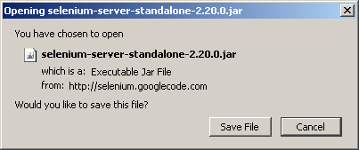
Selenium RC Walkthrough - Installation
Download Page: http://seleniumhq.org/download/
Installing/Running
➔ Installation: NOT required
➔ Running: java – jar selenium-server-standalone-<version-number>.jar
➔ Verification: java –version (shows 1.5 or later means it is fine)

Slide 6
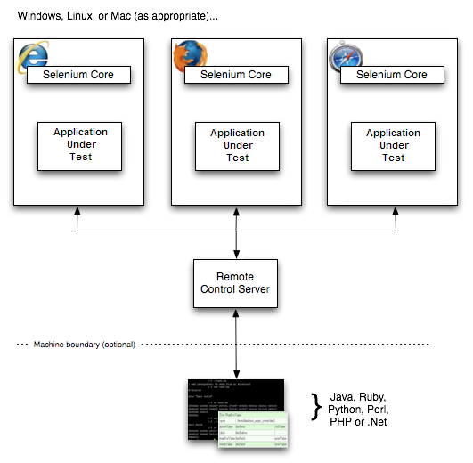
Selenium RC Walkthrough - Workflow
interpret commands
execute commands
Using browser’s built-in JavaScript interpreter
Selenium commands
Results of commands

Slide 7
Selenium RC Walkthrough – General Configuration with Client Driver
Java Client Driver
➔ Download Selenium-RC
➔ Start any java IDE (e.g. Eclipse)
➔ Create new project
➔ Add “selenium-java-<version-number>.jar” to project classpath
➔ Record test from Selenium IDE and export to java code
➔ Start Selenium Server
➔ Run test in the java IDE
Step by Step instructions:
http://seleniumhq.org/docs/appendix_installing_java_driver_client.html

Slide 8
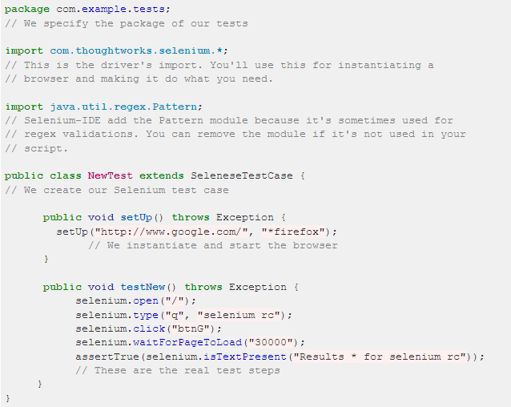
Selenium RC Walkthrough – Sample Codes

Slide 9
Selenium Documents
Selenium Home:
http://seleniumhq.org/
Selenium IDE:
http://seleniumhq.org/docs/02_selenium_ide.html
Selenium RC:
http://seleniumhq.org/docs/05_selenium_rc.html
Selenium 2.0 and WebDriver:
http://seleniumhq.org/docs/03_webdriver.html
Official Selenium Blog:
http://seleniumhq.wordpress.com/

Slide 10

www.mercer.com.au

