Slide 1
Hello World - IDE
2012.05.05
Webber Ling, ESS Shanghai

Slide 2
Topics
Record Your first Selenium IDE script
Replay
Verify & Assert
Enhance Selenium IDE script
Parameterization
Text Matching
Synchronization
Debugging
Export IDE script to other programming language

Slide 3
Record Your first Selenium IDE script
Step 1: Launch browser and go to http://www.google.com.au
Step 2: Type in “HelloWorld” in search field
Step 3: Click “Search” button
Step 4: Verify search result
Step 5: Type in “HelloWorld1” in search field
Step 6: Click “Search” button
Step 7: Assert search result
Step 8: Click “Search” button

Slide 4
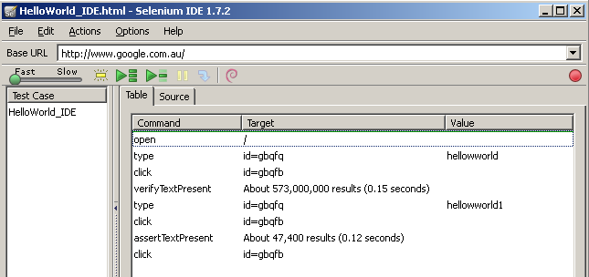
Record Your first Selenium IDE script - Replay
Question 1: Replay Pass or Fail?

Slide 5
Record Your first Selenium IDE script – Verify & Assert
Question 2: Which line of code it will stop at?

Slide 6
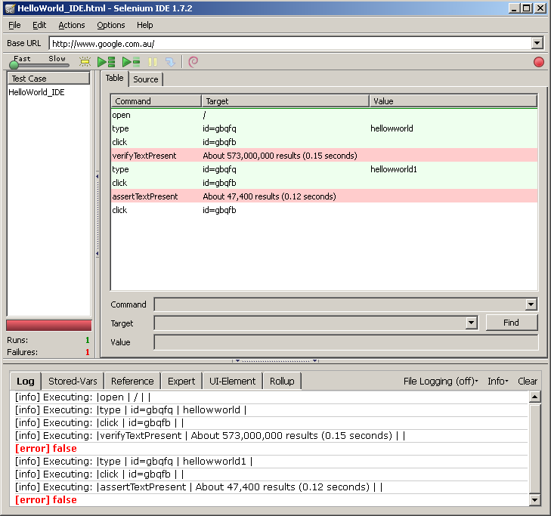
Record Your first Selenium IDE script – Verify & Assert

Slide 7


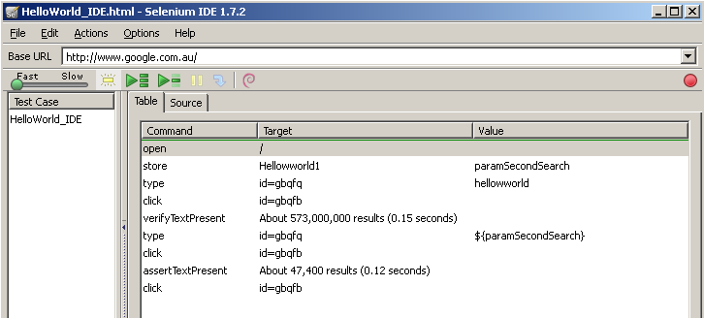
Enhance Selenium IDE script – Parameterization
General Selenium Parameterization

Slide 8
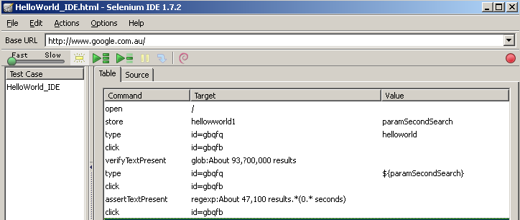
Enhance Selenium IDE script – Text Matching
Matching Text Patterns:
exact:
regexp:
glob:

Slide 9
Enhance Selenium IDE script – Synchronization
Question: Replay Pass or Fail?

Slide 10
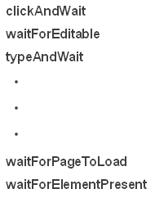
Enhance Selenium IDE script - Synchronization
General Selenium Synchronization
typeAndWait
clickAndWait

Slide 11
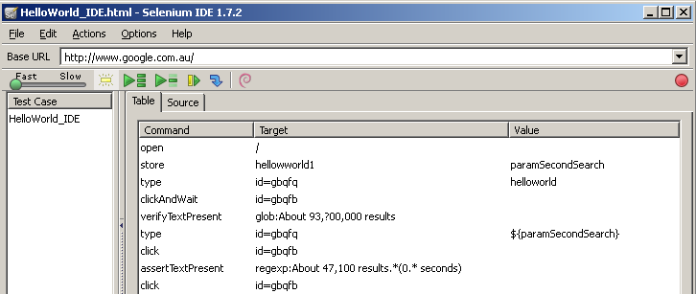
Enhance Selenium IDE script - Synchronization
Question 1: Replay Pass or Fail?
Answer 1: Fail
Question 2: How to deal with it?

Slide 12
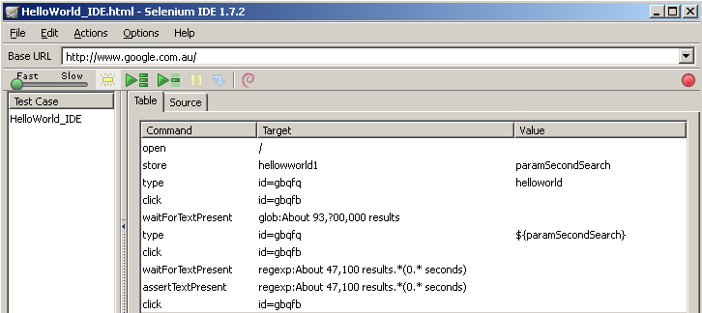
Enhance Selenium IDE script - Synchronization
waitForTextPresent acts as same as verifyTextPresent, but with sync
Keep assert functionality ➔ add waitFor in front of assert

Slide 13
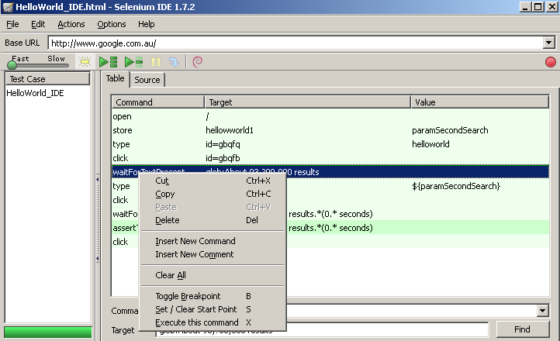
Enhance Selenium IDE script - Debugging
Toggle Breakpoint: set breakpoint and execution stop at the line
Set / Clear Start Point: set start point where the execution start from the line
Execute this command: execute single line of command

Slide 14
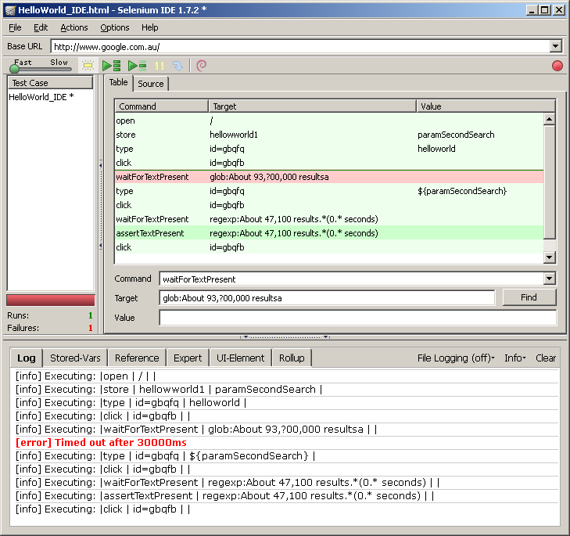
Enhance Selenium IDE script - Debugging

Slide 15
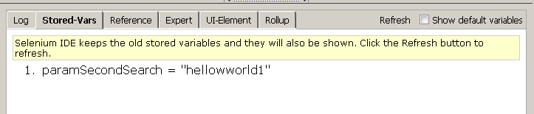
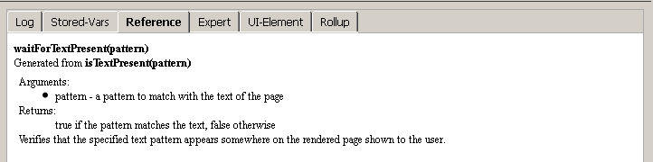
Enhance Selenium IDE script - Debugging
Parameter checking:
Function reference:

Slide 16
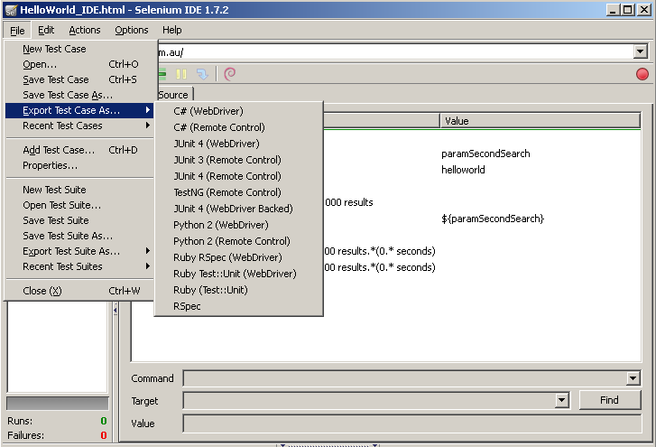
Export Selenium IDE script to other programming language
Exported as plain txt file which can be copied and pasted to your development IDE

Slide 17

www.mercer.com.au

