Slide 1
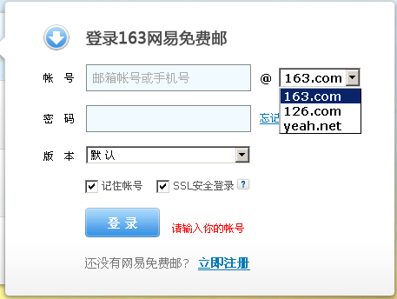

Slide 2
Steps
Step 1: Launch browser and go to http://email.163.com/
Step 2: Type in user name (valid or invalid)
Step 3: Get the user name just typed in and print it out
Step 4: Select mailbox “126.com”
Step 5: Get the selected mailbox and print it out
Step 6: Check off “记住帐号” checkbox
Step 7: Get the checkbox status (check on or off) and print it out
Step 8: Click “登陆” button

