Slide 1
Selenium ESS Framework
2012.09.05
Webber Ling, Shanghai

Slide 2
Topics
Framework Overview
Generic Function Lib
Selenium Generic Function Lib
WebElementCustom Lib
WebEditCustom Lib
WebCheckBox Lib
WebListCustom Lib
WebTableCustom Lib
WebPageCustom Lib

Slide 3
Framework Overview
Edit
List
CheckBox
RadioButton
Table
WebElementCustom
Selenium Generic Function
Page
Generic Function

Slide 4
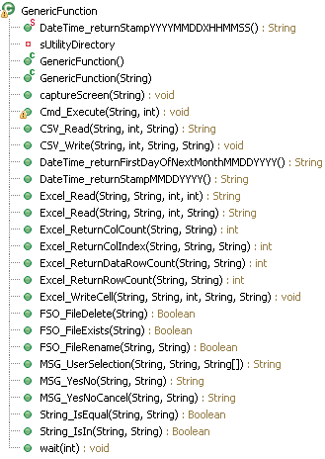
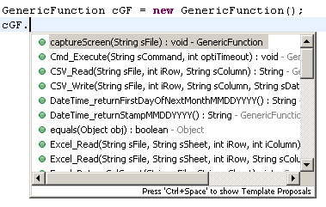
Generic Function
Class Definition:
How to call it:

Slide 5
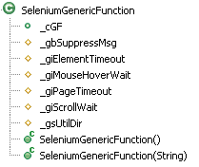
Selenium Generic Function
Class Definition:
Question 1 ???
Include Generic Function
Define global variables
Question 2 ???
Not used independently, Only for inherit !

Slide 6
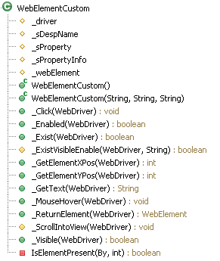
WebElementCustom
Class Definition:
Green members ➔ Welcome to Call !
Yellow members ➔ Be Careful !
Red members ➔ Do NOT Touch !

Slide 7
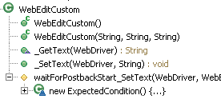

WebEditCustom
Class Definition:
Call it

Slide 8
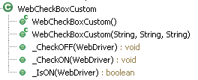
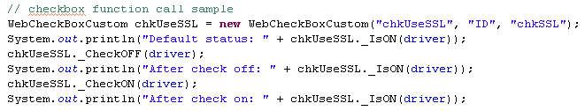
WebCheckBoxCustom
Class Definition:
Call it

Slide 9
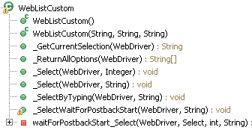
WebListCustom
Class Definition:

Slide 10
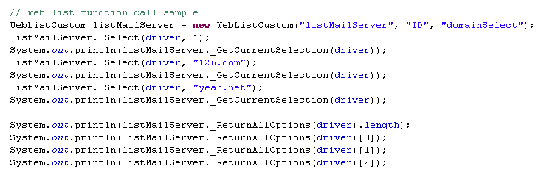
WebListCustom
Call it:

Slide 11
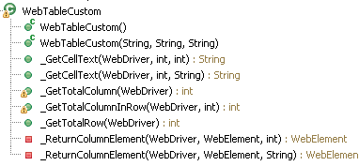
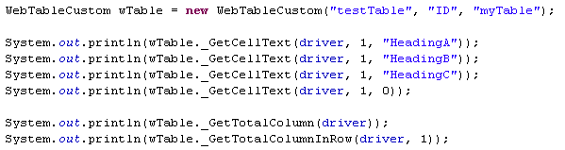
WebTableCustom
Class Definition:
Call it

Slide 12
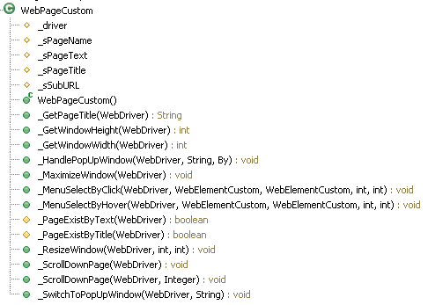
WebPageCustom
Class Definition:
Not used independently, Only for inherit !

Slide 13
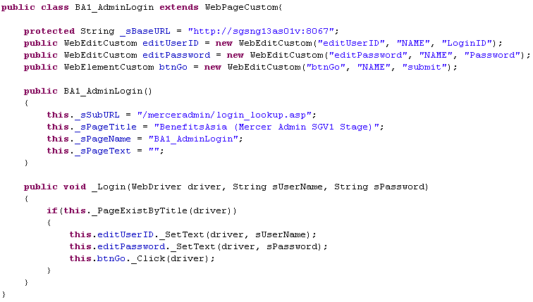
WebPageCustom
Call it:

Slide 14

www.mercer.com.au

