Slide 1
From Object to Page
2012.11.01
Webber Ling, Shanghai

Slide 2
Topics
Objects Overview
From object to page

Slide 3
Framework Overview
Edit
List
CheckBox
RadioButton
Table
WebElementCustom
Selenium Generic Function
Page
Generic Function

Slide 4
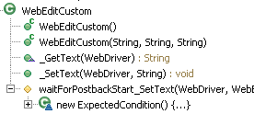

Object - WebEditCustom
Class Definition:
Call it

Slide 5
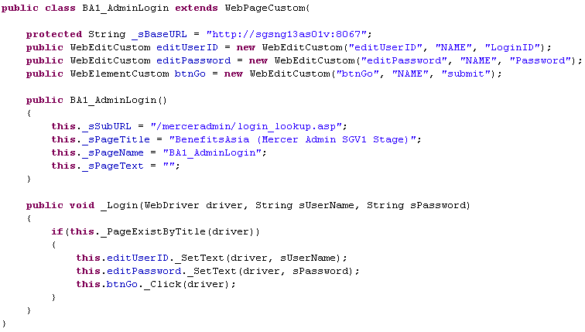
Web Page
How Page is defined:

Slide 6
Web Page
Create Pages:
Page 1
Page 2
Page 3
Page N
Object 1
Object 2
….
Object N
Function 1
Function 2
…
Function N
Object 1
Object 2
….
Object N
Function 1
Function 2
…
Function N
Object 1
Object 2
….
Object N
Function 1
Function 2
…
Function N
Object 1
Object 2
….
Object N
Function 1
Function 2
…
Function N

Slide 7
Web Page
Call Pages to create test script:
Page1 instancePage1 = new Page1()
instancePage1.object1.Action()
instancePage1.object3.Action()
instancePage1.function1.Call()
Page2 instancePage2 = new Page2()
instancePage2.function2.Call()
……….

Slide 8
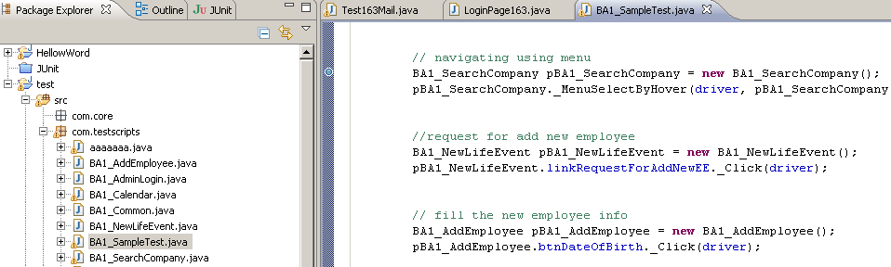
Web Page
Call Pages to create test script:

Slide 9
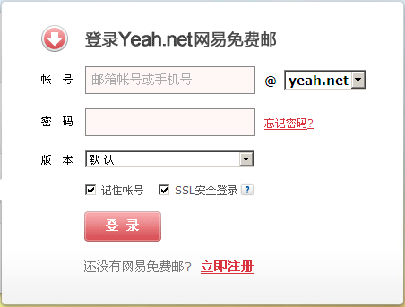
Web Page
Example: 163 Mail

Slide 10
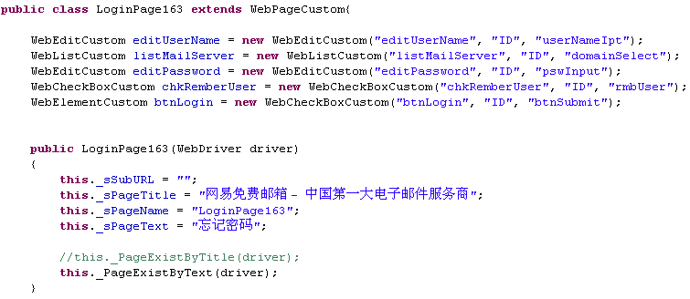
Web Page
How Page is defined:
Objects
Constructor

Slide 11
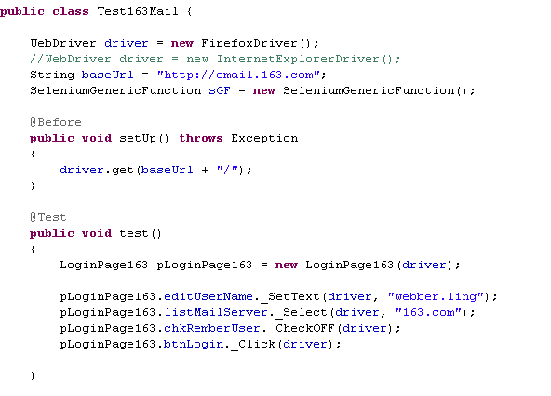
Web Page
Call Pages to create test script:

Slide 12
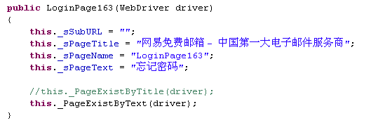
Web Page
Implicit Checking:

Slide 13
Web Page
DEMO

Slide 14

www.mercer.com.au

