Slide 1
Web Table
2012.11.13
Webber Ling, Shanghai

Slide 2
Topics
Different Types of Web table
How Selenium deal with Web table
WebTableCustom walk through
Demo

Slide 3


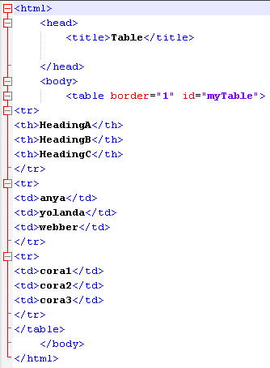
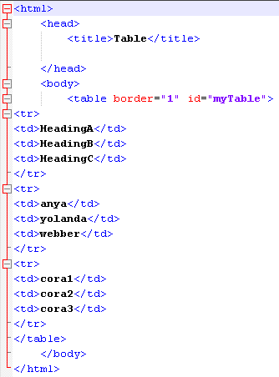
Types of Web table
A
B

Slide 4

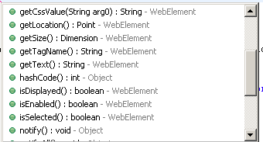
How Selenium deal with Web table
1. Web driver search Row first
2. Web driver search corresponding Column based on specified Row
3. Web driver return Cell element
Step 1
Step 2
Step 3

Slide 5
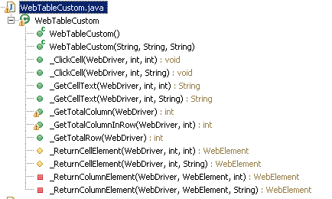
WebTableCustom walk through

Slide 6
WebTableCustom walk through
_GetCellText
_ReturnCellElement
_ReturnColumnElement

Slide 7
WebTableCustom walk through
_GetCellText supports Two types of function call:
Question: Which one is preferred? Why?
Note: sCol only applies to Standard Web table with “th”

Slide 8
Web Page

Slide 9

www.mercer.com.au

