Slide 1
Selenium Framework Improvement
2013.04.18
Webber Ling, Shanghai

Slide 2
Topics
Try – Catch implementation
Table function improvements
Find Element improvements
Runtime sync/timeout calculation improvements
Incorporated Portal Reporting/Non-reporting version
Added _Enable, _Visible sync time
Added print log to report actual time costs in sync
Updated Maximize to make browser fit into screen instead of full screen
Updated _MenuSelectByClick function to improve performance
Added object Highlight functionality and option to enable/disable this feature
Updated WebTableCustom to make Cell element scroll into view automatically
Example: How to deal with object without easy-identification info?

Slide 3
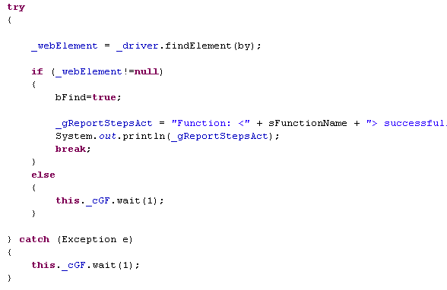
Try - Catch
Possible Throw-Exception codes
Where to get the exception message?
Use our own log/reporting mechanism with “meaningful” msg

Slide 4
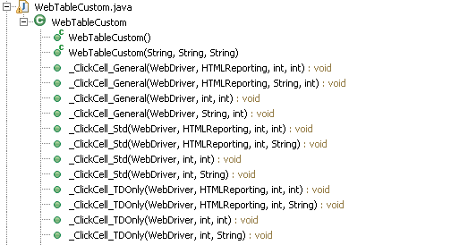
Table Functions
Standard/Non-Standard table support to improve execution performance
General table support by incorporating both Std/TDOnly tables
Row string name input supports common testing scenario

Slide 5
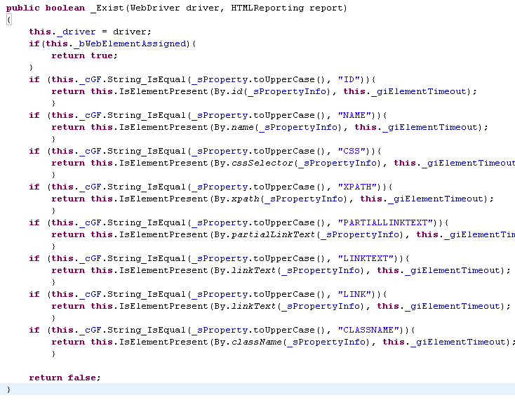
Find Element

Slide 6
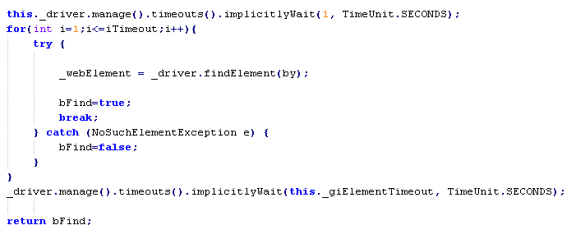
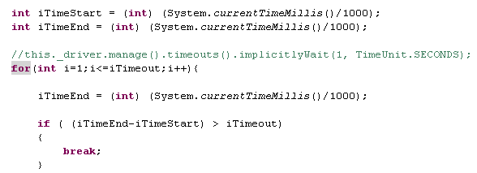
Runtime sync/timeout accuracy
Using system time to decide if actually time spent exceeds the predefined timeout
What’s our previous mechanism?
Why it is NOT accurate?

Slide 7
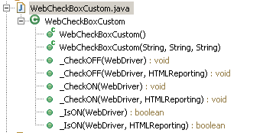

Two versions of Function are available: Reporting / Non-reporting

Slide 8
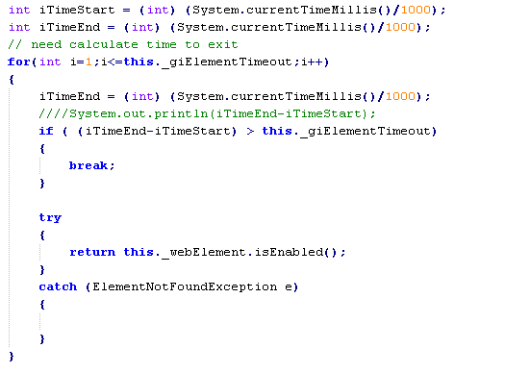
_Visible, _Enable sync time
Will this For loop wait _giElementTimeout for object Enable?

Slide 9
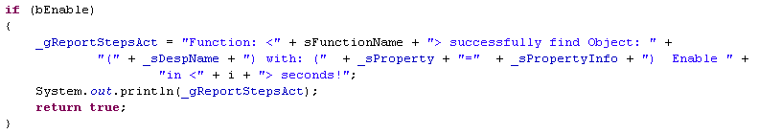
Print log for actual time spent on sync
With this log, user can find the actual time in Eclipse print log

Slide 10
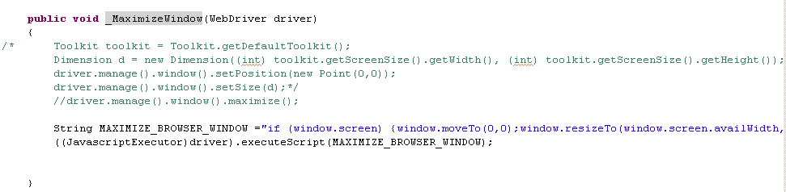
Browser window maximize

Slide 11
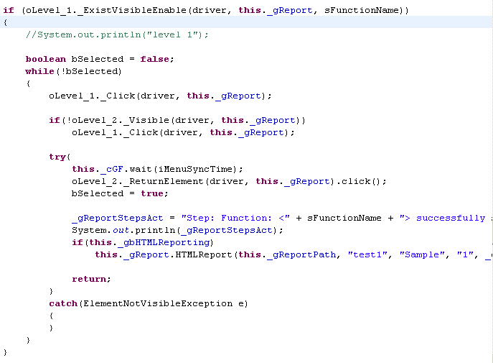
MenuSelectByClick

Slide 12
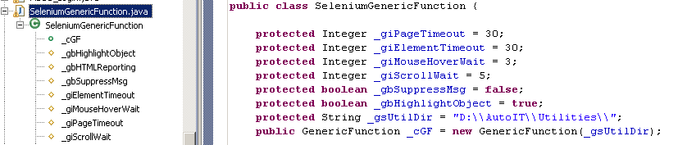
Object Highlight Feature

Slide 13
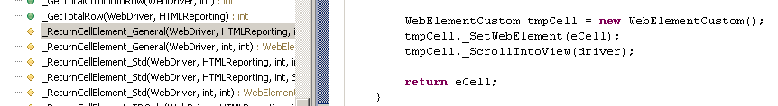
Web Table Cell auto scroll into view
Define a temp WebElementCustom element
Assign the selenium webelement to WebElementCustom
Call WebElementCustom function: _ScrollIntoView

Slide 14
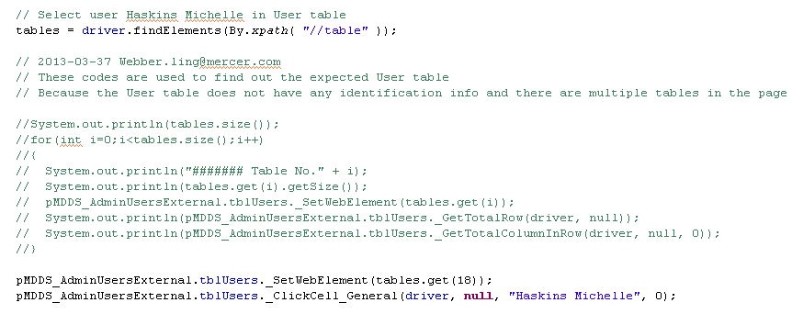
Example: Get object without easy-identified property

Slide 15
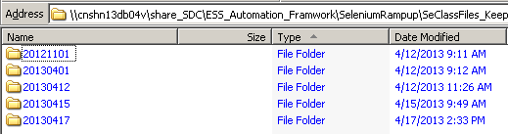
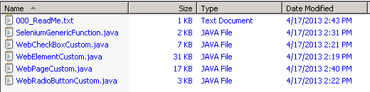
Where to get the latest function libraries?
\\cnshn13db04v\share_SDC\ESS_Automation_Framwork\SeleniumRampup\SeClassFiles_KeepUpdating

Slide 16

www.mercer.com.au

