Slide 1
Selenium: Find object using XPath and CSS
2013.05.09
Shelly Huang, Shanghai

Slide 2
Topics
Environment (Firefox)
How to get XPath and CSS by tool
How to Verify the Xpath and CSS
How to use in the Selenium
How to create XPath and CSS

Slide 3
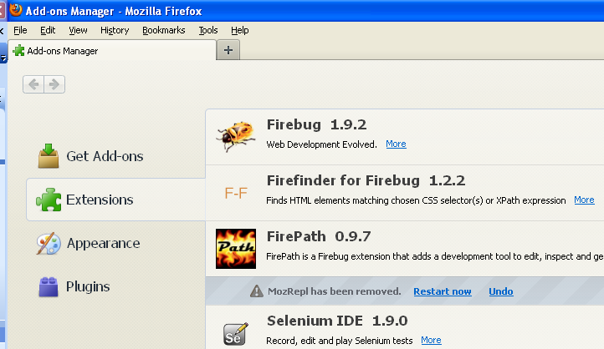

Environment (Firefox)
Tools -> Add-ons
Selenium IDE
Firebug
FirePath
Firefinder
XPath Checker

Slide 4
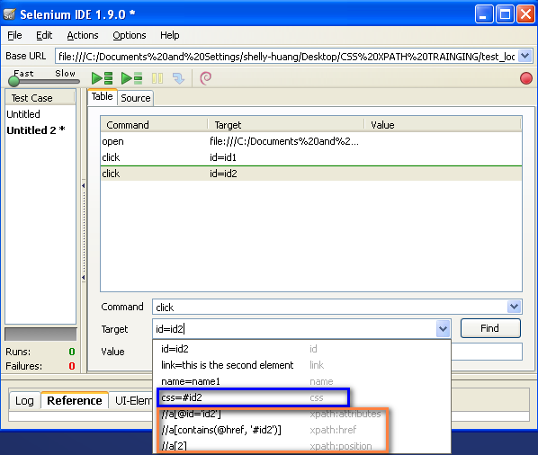
How to get XPath and CSS by tool
Selenium IDE - Recording

Slide 5
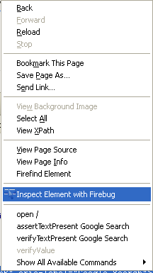
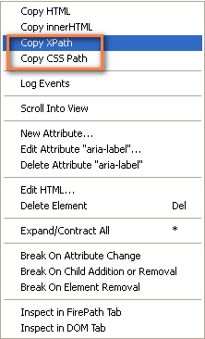
How to get XPath and CSS by tool
Firebug
- > Inspect Element with firebug
- > Button
- > Copy XPath / Copy CSS
- > Xpath Example (Table)

Slide 6
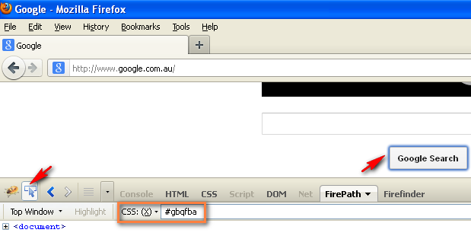
How to get XPath and CSS by tool
FirePath
- > Button
- > Select CSS(X), Click on the object, than the CSS displays

Slide 7
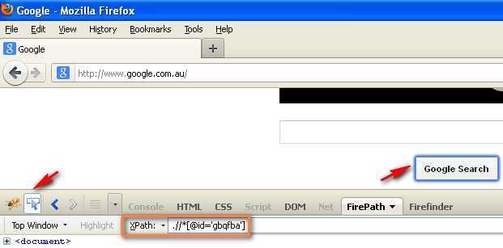
How to get XPath and CSS by tool
FirePath
- > Button
- > Select XPath, Click on the object, than the XPath displays

Slide 8
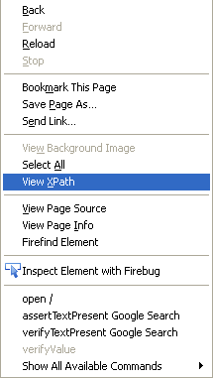
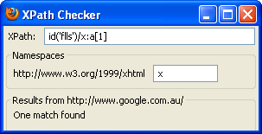
How to get XPath and CSS by tool
XPath Checker
- > Select the object then select View XPath

Slide 9
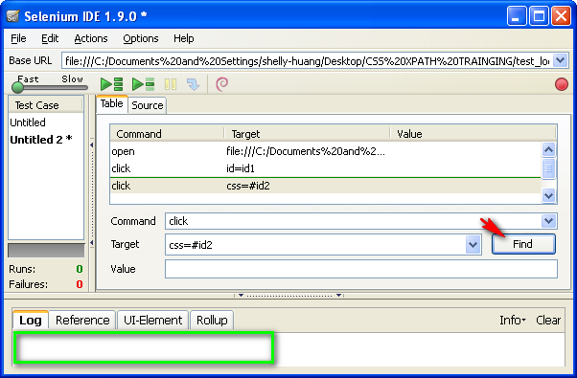
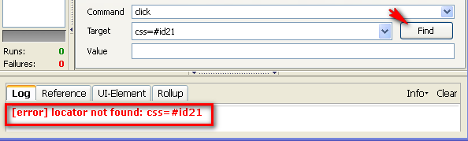
How to Verify the XPath and CSS
Selenium IDE – Find
- > Found
- > Not Found

Slide 10
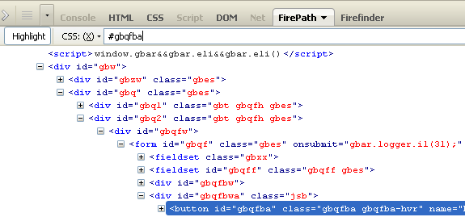

How to Verify the XPath and CSS
FirePath
- > Input the XPath or CSS then Enter
- > Found
- > Not Found

Slide 11
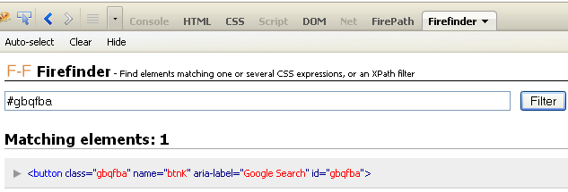
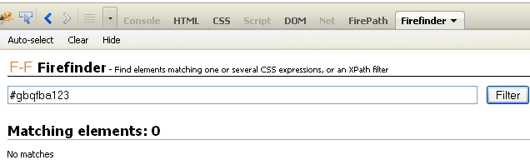
How to Verify the XPath and CSS
Firefinder
- > Input the XPath or CSS then Enter
- > Found
- > Not Found

Slide 12
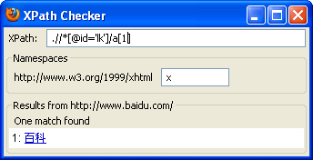
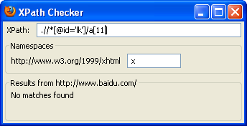
How to Verify the XPath and CSS
XPath Checker
- > Input XPath then Enter
- > Found
- > Not Found

Slide 13
How to use in the Selenium
Tips
- > IDE Find
- > Converted to script
- > Copy from script

Slide 14
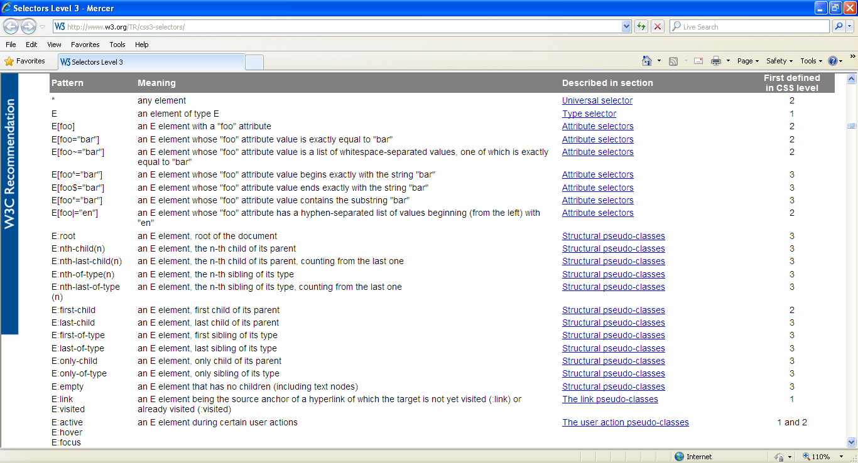
How to create XPath and CSS
XPath syntax
CSS selector syntax
- > How to use it
http://www.w3.org/TR/css3-selectors/

Slide 15

www.mercer.com.au

