Slide 1
Project 2 Web Testing Framework
By Thomas Sturgeon

Slide 2
Tool that I used
Cucumber
Maven
GitHub/Actions
Selenium
Junit
Hamcrest

Slide 3
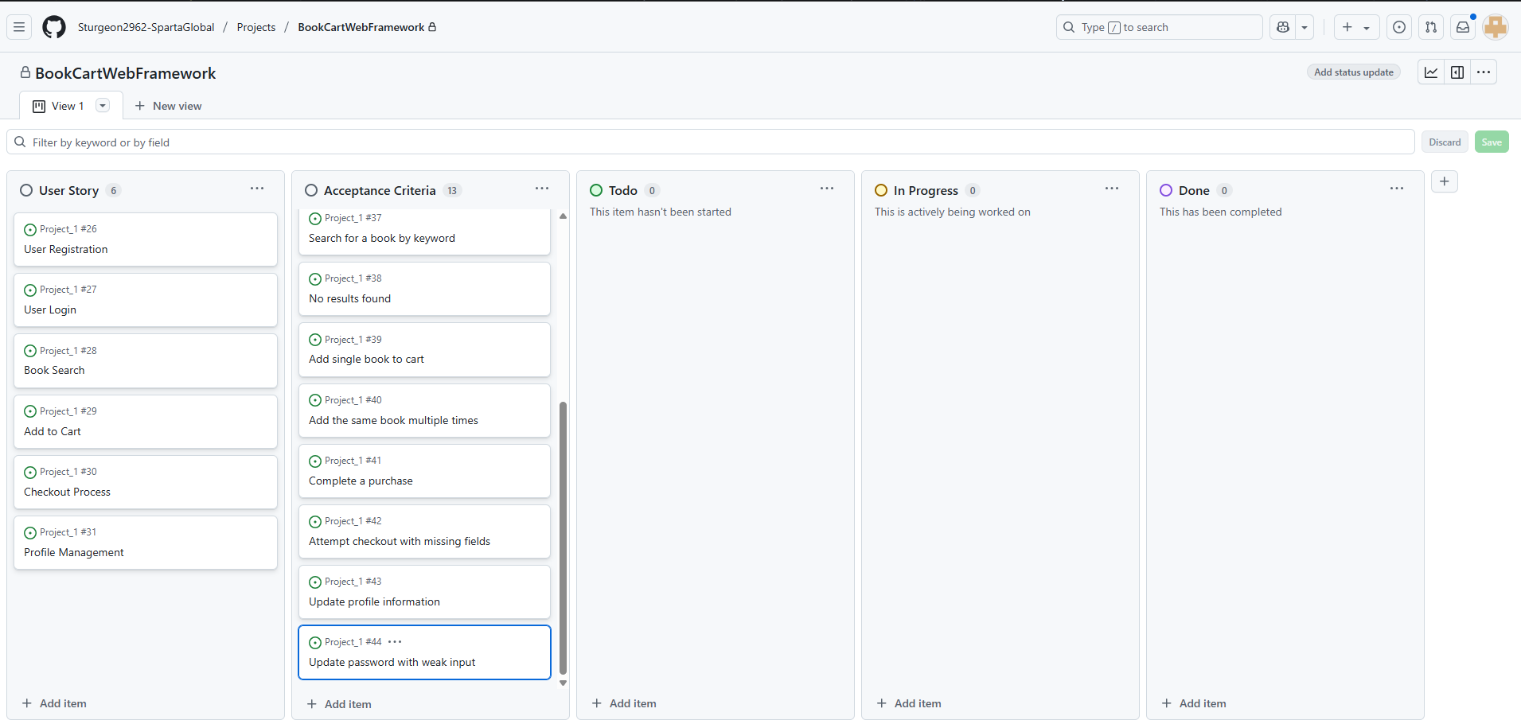
Project Board Setup

Slide 4
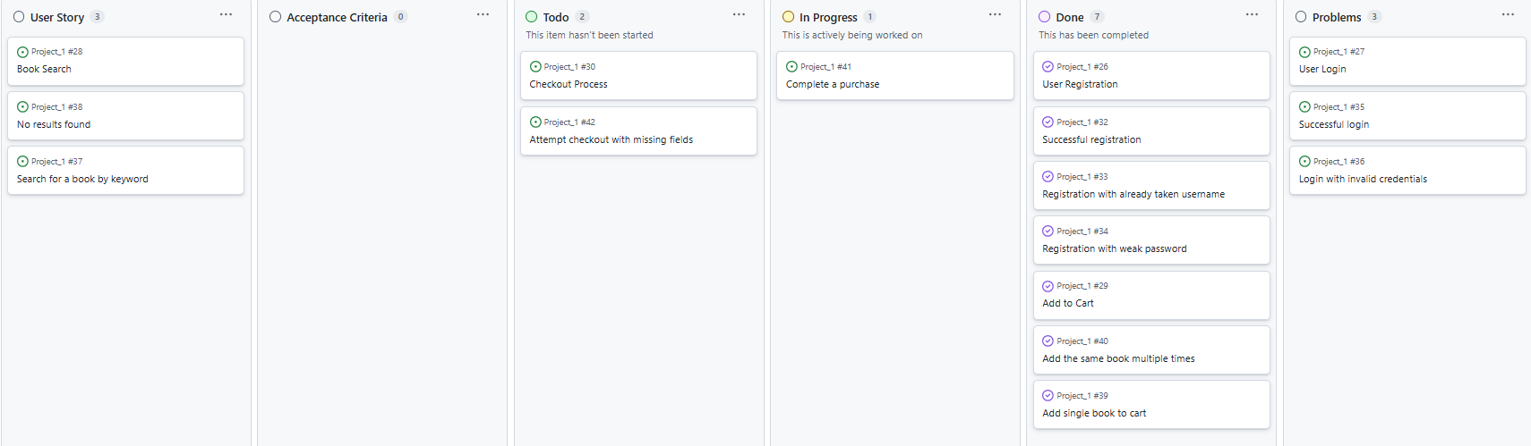
Project Board Progress

Slide 5
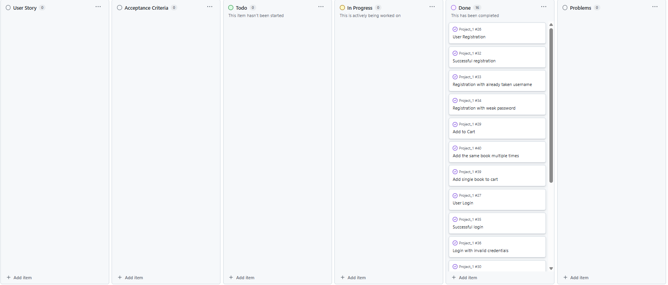
Project Board Complete

Slide 6
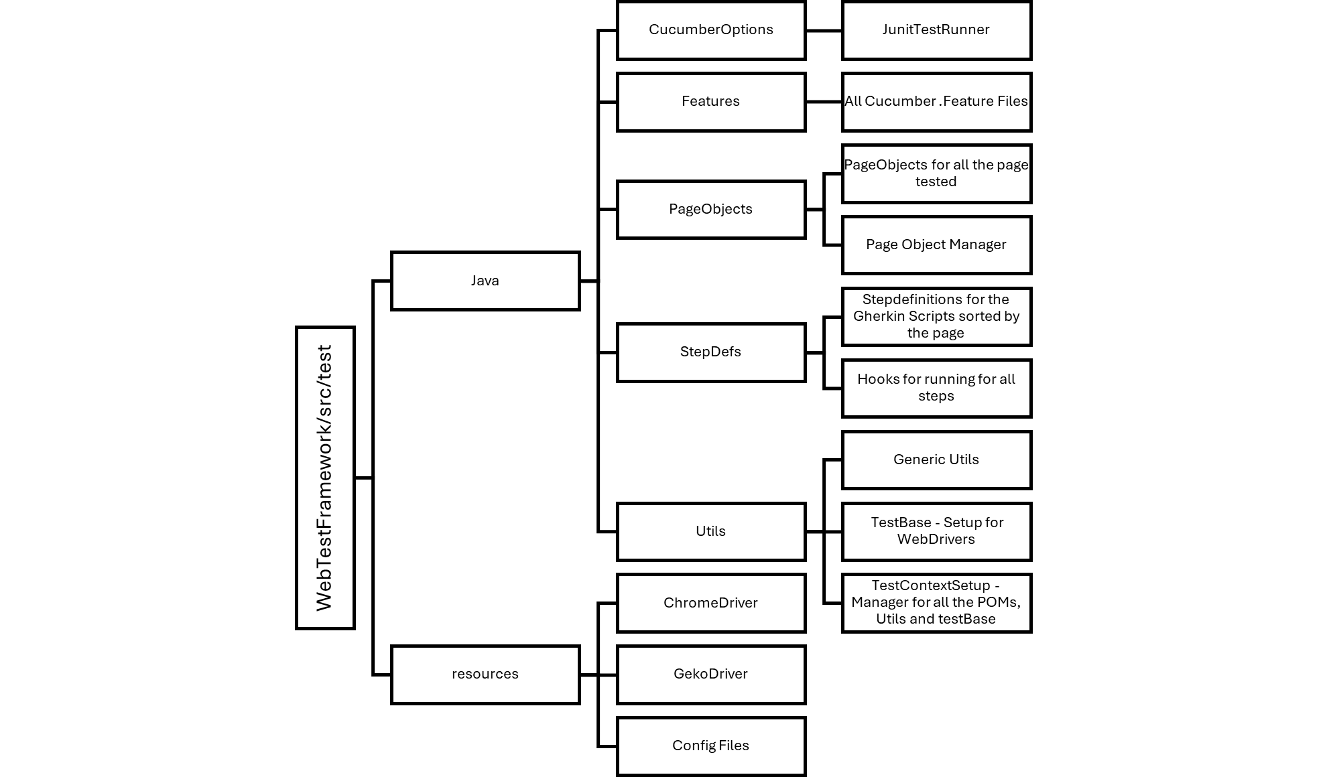
Project Structure (UML Diagram)

Slide 7
Examples of BDD Scenarios
@AddToCart Feature: AddToCart As a user, I want to add books to my cart so that I can purchase them later. @SingleBook Scenario: Add a single book to cart Given I am viewing a book's detail page When I click on Add to Cart button Then the item should appear in my cart with quantity "1" @MultipleBooks Scenario: Add the same book multiple times Given I have already added a book to the cart When I click on Add to Cart button Then the quantity of that book in the cart should increase to "2"
@BookSearch Feature: Book Search As a user, I want to search for books so that I can find titles of interest. @ValidSearch Scenario: Valid Search Given I am on the homepage When I enter "Harry Potter" into the search bar Then I should see a list of books with "Harry Potter" in the title or author @InvalidSearch Scenario: No Book Found Given I am on the homepage When I enter "xyznotabook" into the search bar Then I should see a "No books found." message

Slide 8
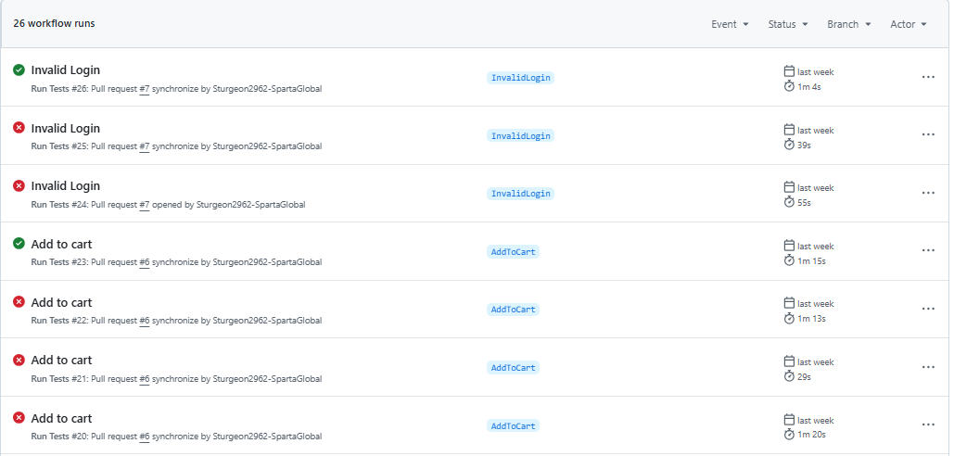
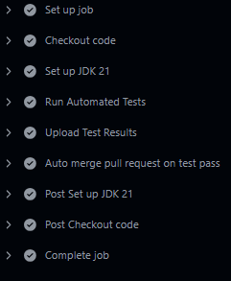
GitHub Actions

Slide 9
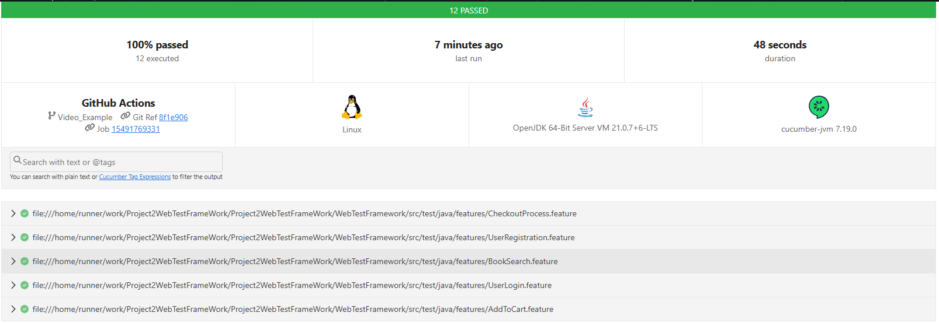
Test Suit Results

