Slide 1
A photographic negative imaging inspired method for low illumination night-time image enhancement
Student : Rogoz Bogdan
Group : 30433

Slide 2
Introduction
  Low illumination night-time image enhancement is critical for a wide range of image-related outdoor applications, such as surveillance systems, intelligent vehicles, satellite imaging, and outdoor object recognition systems. Images captured in night-time under low illumination conditions are usually seriously degraded due to insufficient light, such as low contrast, distorted colors and unclear details etc., and seriously affect the performance of image-related outdoor systems. It is obvious that low illumination night-time image enhancement is highly desirable to ensure the reliable of outdoor vision systems.
  The novel contributions of the method are summarized as follows:
  (1) Negative night time images can be conserved as hazed images
  (2) Low illumination image enhancement can be realized by rectification its corresponding negative images using a image dehazing method.

Slide 3
Algorithm steps
Compute the negative of the night-time image
Rectify the negative image using dark-channel prior
  Compute the dark channel of the negative image
  Compute the gray histogram of the dark channel
  Estimate the value of A (atmospheric light)
  Compute the transmission factor
  Compute the rectified image
Negate the rectified image

Slide 4
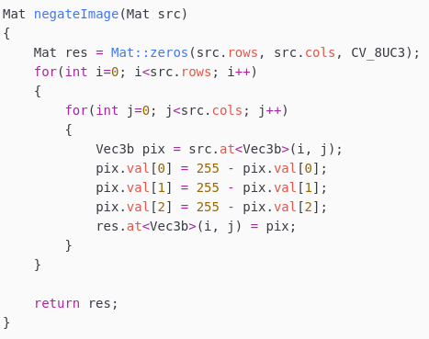
Code snippet – Negate image

Slide 5
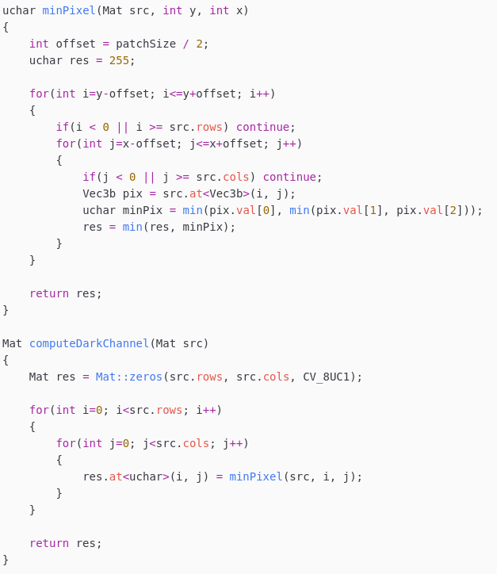
Code snippet – Dark channel
In order to compute the dark channel of an RGB
Image, we take each pixel and store the channel
With the lowest intensity value.
For example, for a pixel with RGB = (100, 90, 110),
The dark channel image will store the value 90 on
That position.

Slide 6
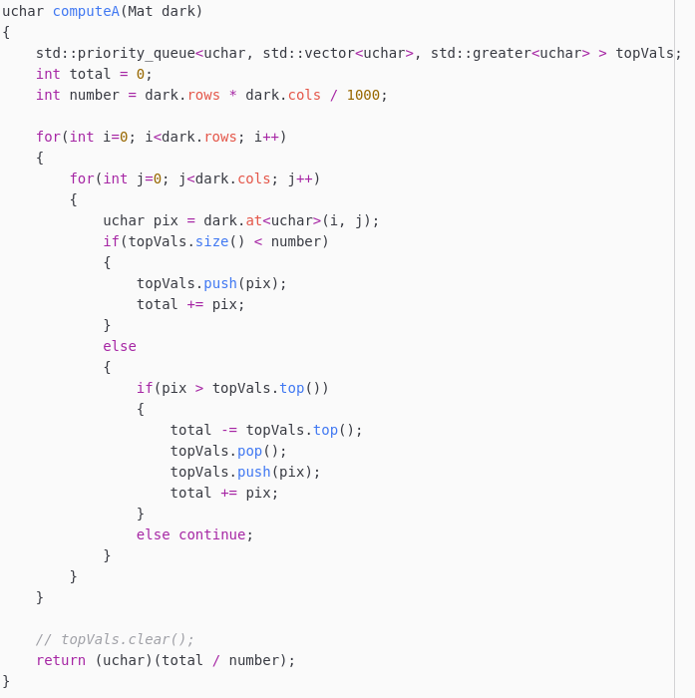
Code snippet – Atmospheric light
In order to compute the atmospheric light,
We take the top 0.1% brightest pixels in the
Dark channel image and compute their sum.
After computing the sum of the brightest pixels
In the image, we return their average value.

Slide 7
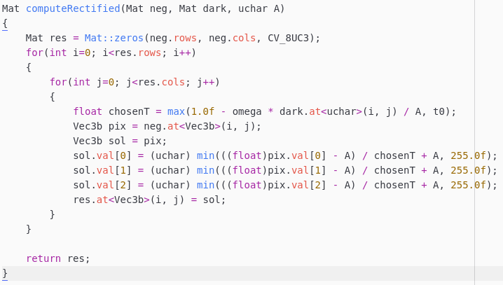


Code snippet – Rectified image
In order to compute the rectified
Image, we need to compute each
pixel’s transmission coefficient.
The transmission coefficient
Is computed with the formula:
If the transmission coefficient is
Too low, a default value t0 is
Assigned. The final rectified image
Is computed using the formula:

Slide 8
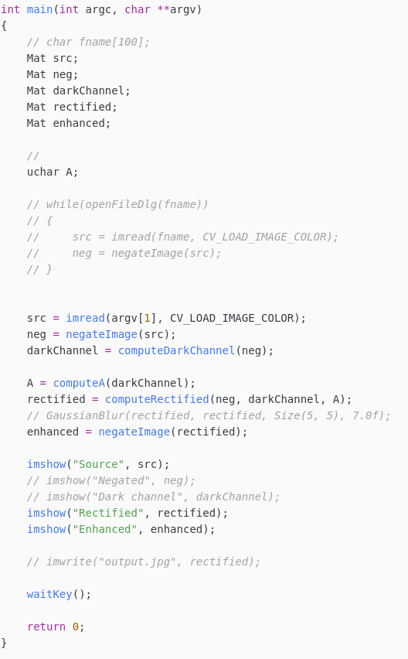

Code snippet – Constants and main function

Slide 9

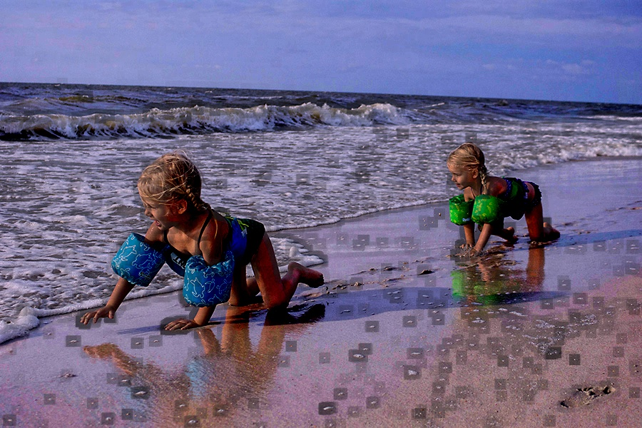
Examples
            Original Enhanced

Slide 10
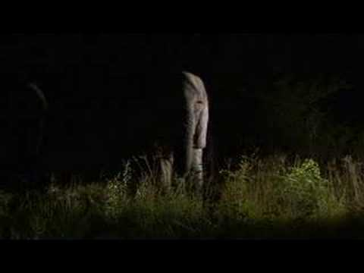
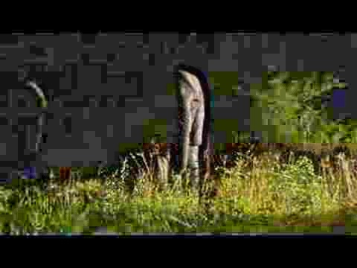
Examples
            Original Enhanced

Slide 11
Examples
            Original Enhanced

Slide 12
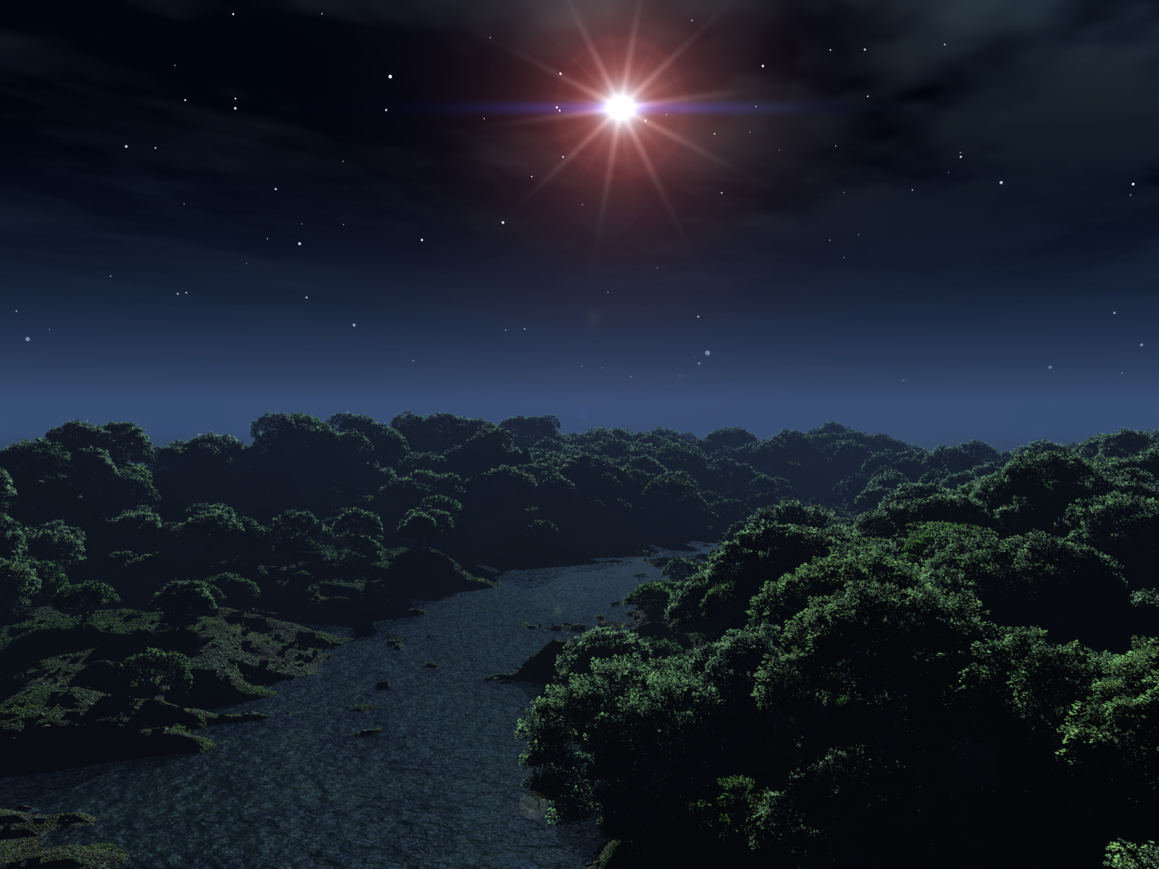
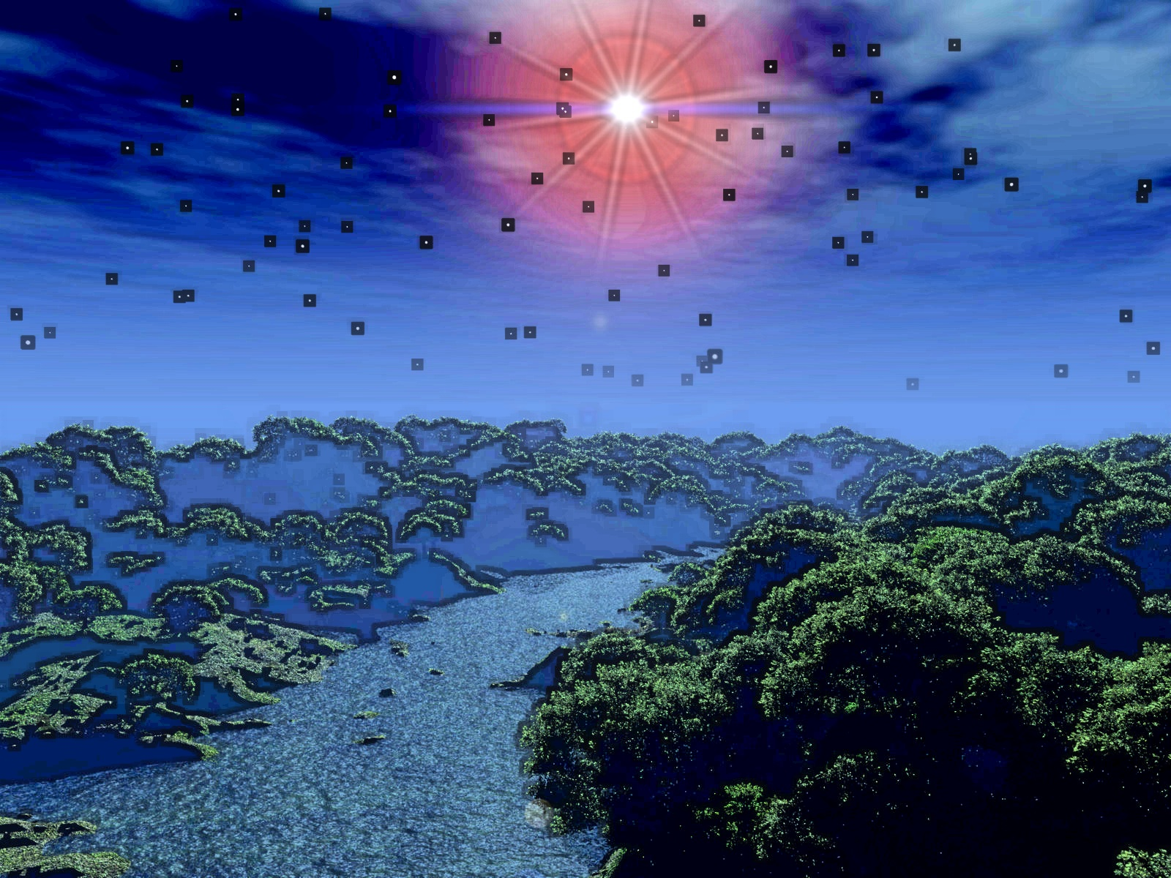
Examples
            Original Enhanced

Slide 13
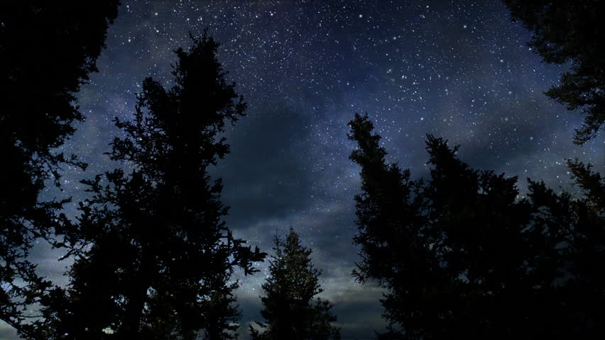
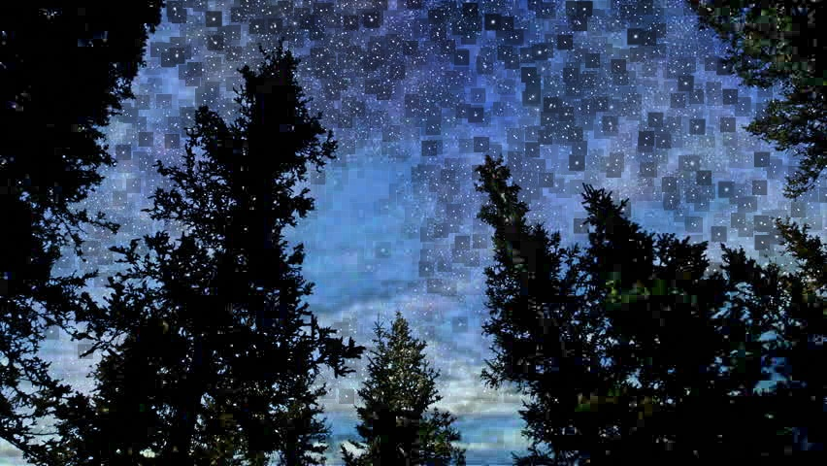
Examples
            Original Enhanced

Slide 14
Future improvements
Future improvements include:
Soft matting for improved output image quality
Mobile port
Video (real-time image) rendering

Slide 15
References
https://link.springer.com/article/10.1007/s11042-017-4453-z
https://www.robots.ox.ac.uk/~vgg/rg/papers/hazeremoval.pdf
https://jivp-eurasipjournals.springeropen.com/articles/10.1186/s13640-016-0104-y

