Slide 1
SQL TASK
Danduprolu Stuthi
4273 - LVADSUSR80
28-02-2024

Slide 2
Q1-Difference b/w Database and schema
A database is any collection of data. The data in a database is usually organized in such a way that the information is easily accessible. A schema is basically a formal description of how a database is formed and where everything is located

Slide 3
Q2-Real world examples of Constraints
Not Null – name, employee_id,student_id,username,password
Unique – phone number , Gmail, username , employee_id, student_id , username, password
Primary Key – employee_id , student_id ,username
Foreign Key- order_id , product_id , customer_id
Check – Category , class , veg/non-veg,food_coupon opt-in/opt-out
Default-Country,state,college,location

Slide 4
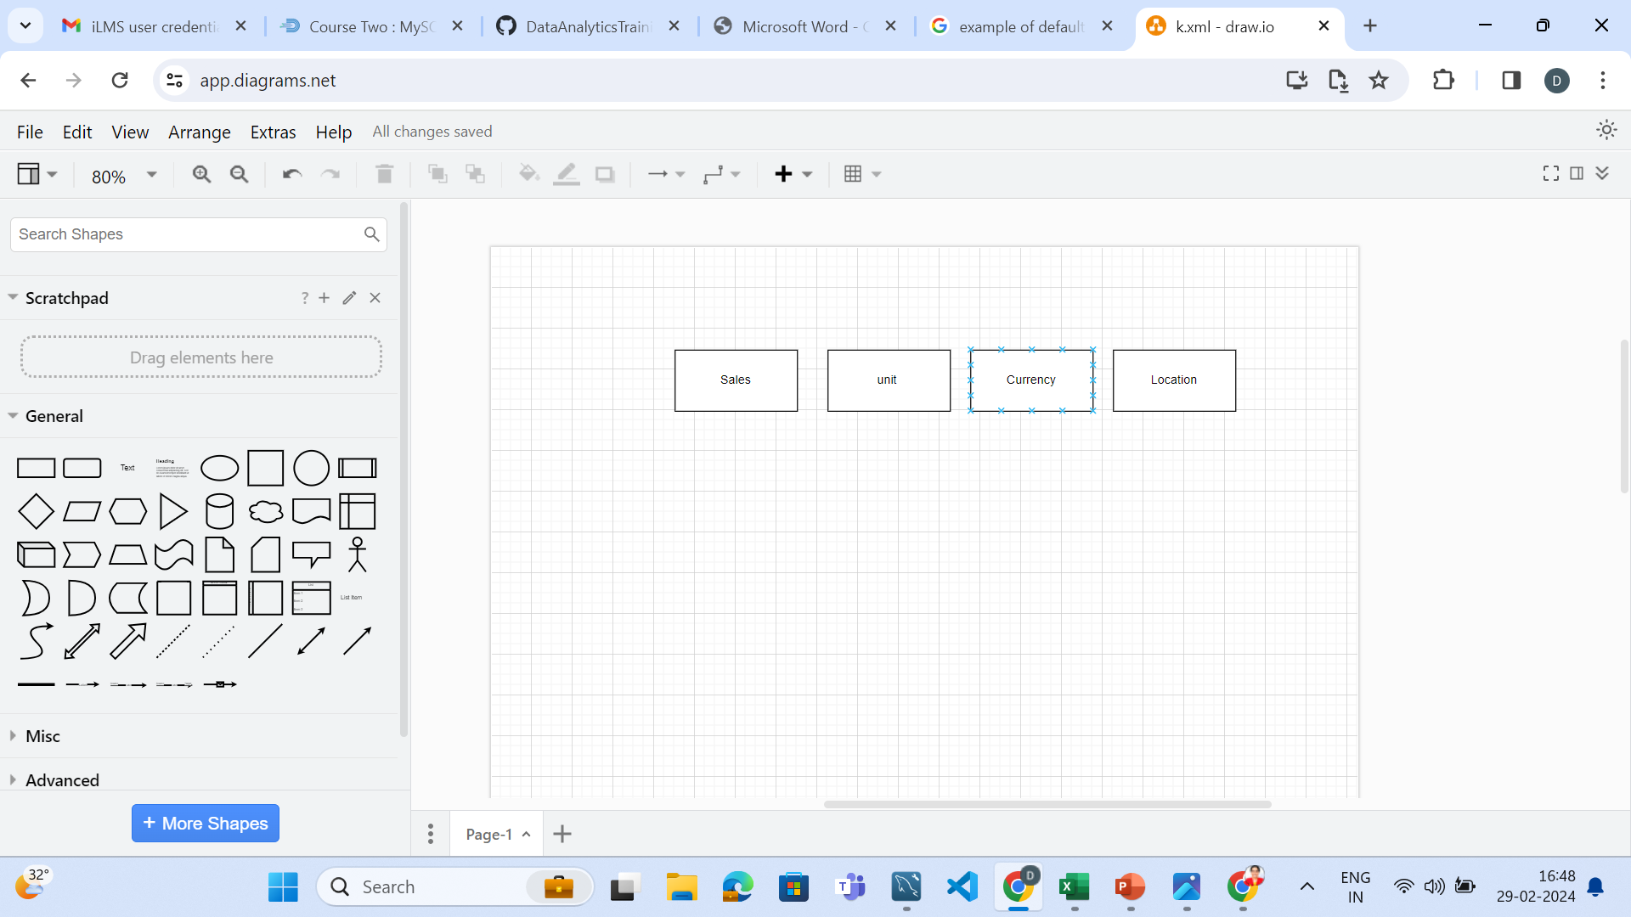
Q3-SALES DATA MODEL (Conceptual Data Model)

Slide 5
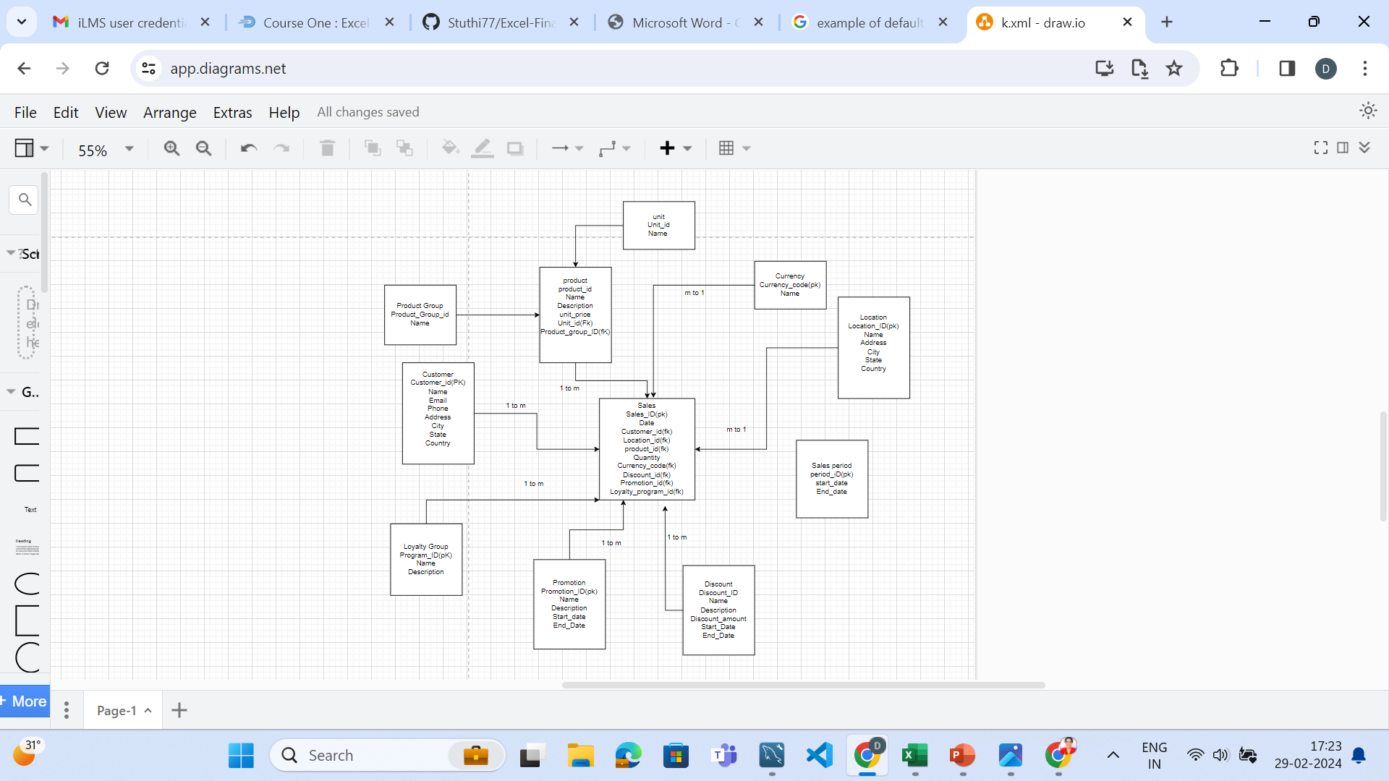
Logical Data Model

Slide 6
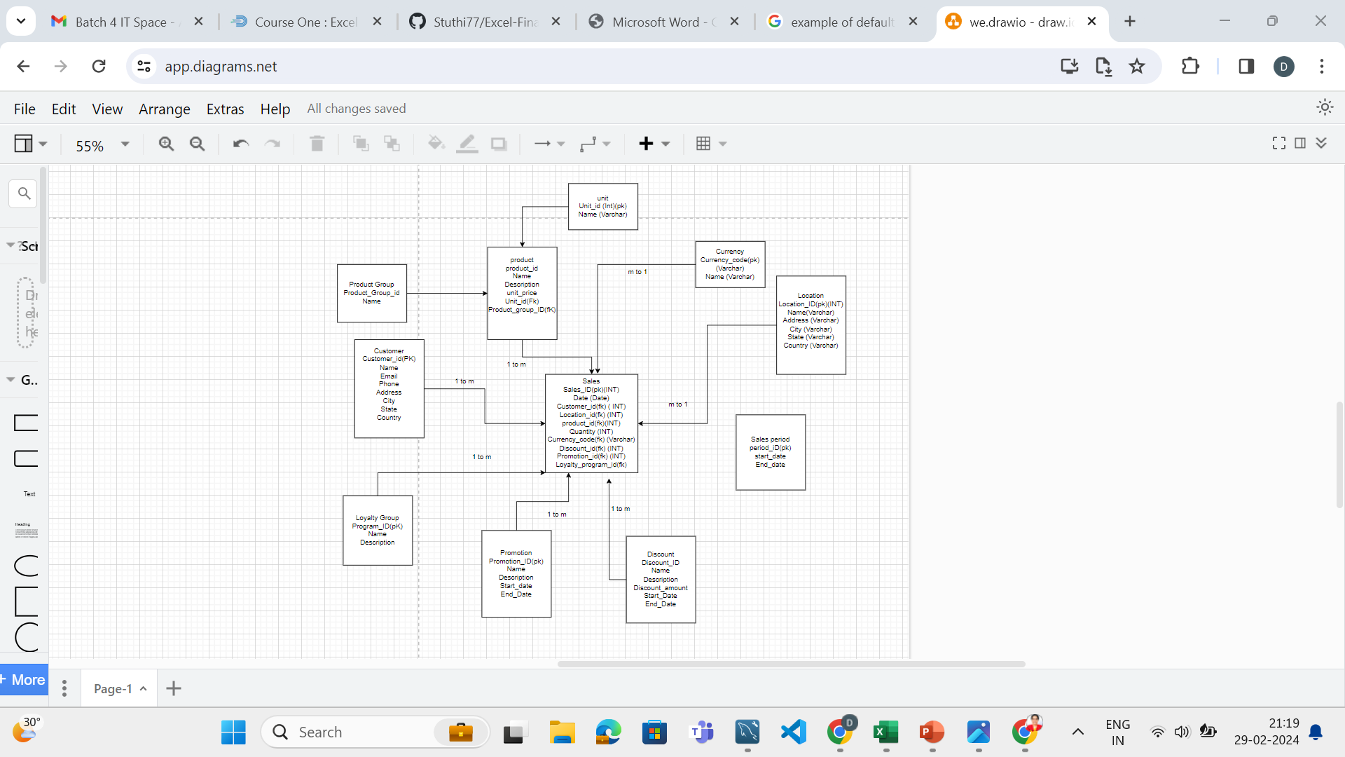
Physical data model

Slide 7
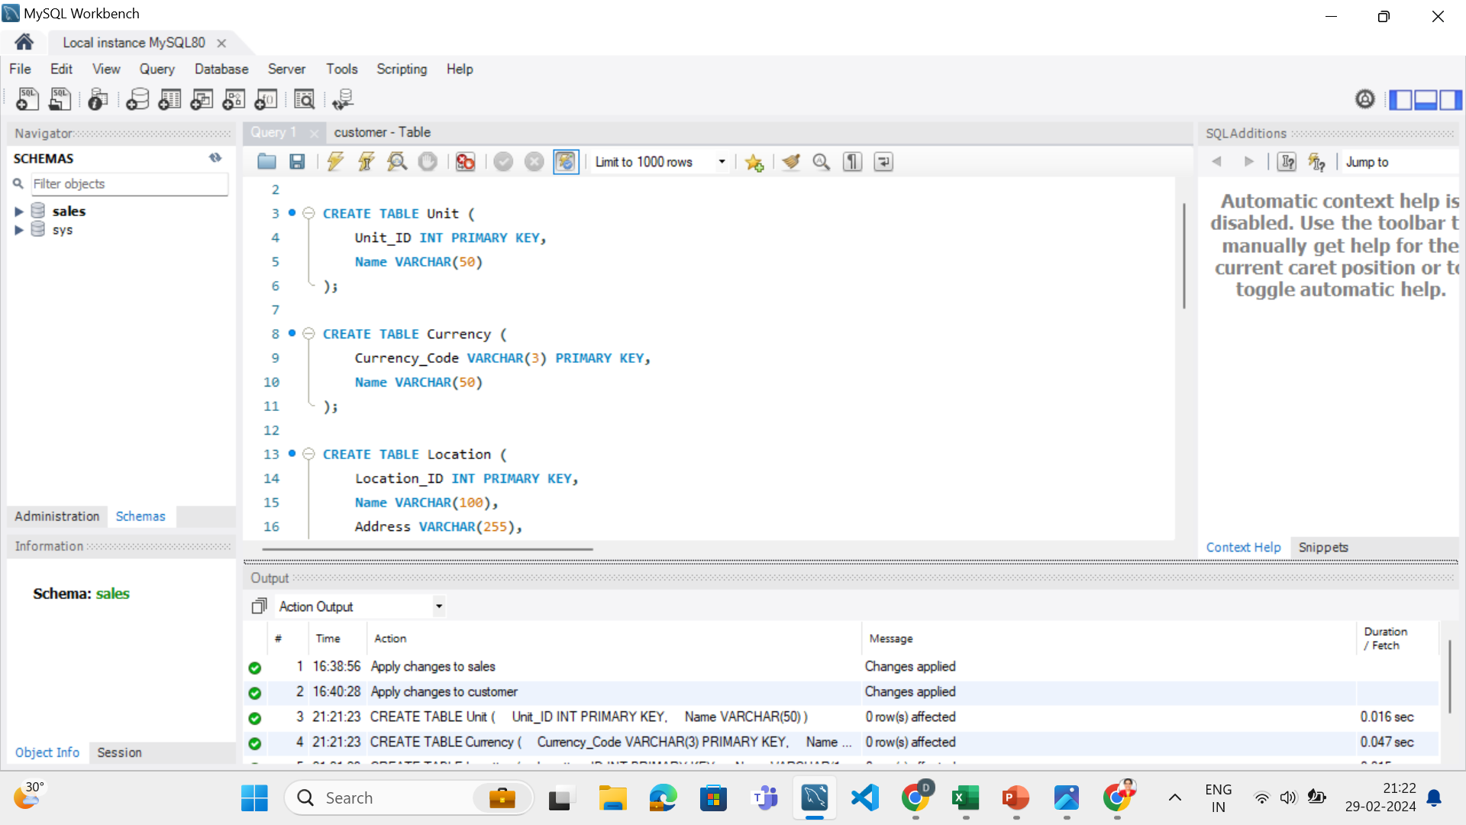
SQL Code

Slide 8
Sql Code
CREATE TABLE Unit (
Unit_ID INT PRIMARY KEY,
Name VARCHAR(50)
);
CREATE TABLE Currency (
Currency_Code VARCHAR(3) PRIMARY KEY,
Name VARCHAR(50)
);
CREATE TABLE Location (
Location_ID INT PRIMARY KEY,
Name VARCHAR(100),
Address VARCHAR(255),
City VARCHAR(100),
State VARCHAR(100),
Country VARCHAR(100)
-- Add more columns as needed
);
-- Similarly create tables for Customer, Product, Product_Group,
-- Loyalty_Program, Discount, Promotion, Sales_Period
-- Similarly create tables for Customer, Product, Product_Group,
-- Loyalty_Program, Discount, Promotion, Sales_Period
CREATE TABLE Sales (
Sales_ID INT PRIMARY KEY,
Date DATE,
Customer_ID INT,
Location_ID INT,
Product_ID INT,
Quantity INT,
Currency_Code VARCHAR(3),
Discount_ID INT,
Promotion_ID INT,
Loyalty_Program_ID INT,
FOREIGN KEY (Customer_ID) REFERENCES Customer(Customer_ID),
FOREIGN KEY (Location_ID) REFERENCES Location(Location_ID),
FOREIGN KEY (Product_ID) REFERENCES Product(Product_ID),
FOREIGN KEY (Currency_Code) REFERENCES Currency(Currency_Code),
FOREIGN KEY (Discount_ID) REFERENCES Discount(Discount_ID),
FOREIGN KEY (Promotion_ID) REFERENCES Promotion(Promotion_ID),
FOREIGN KEY (Loyalty_Program_ID) REFERENCES Loyalty_Program(Program_ID)
);

Slide 9
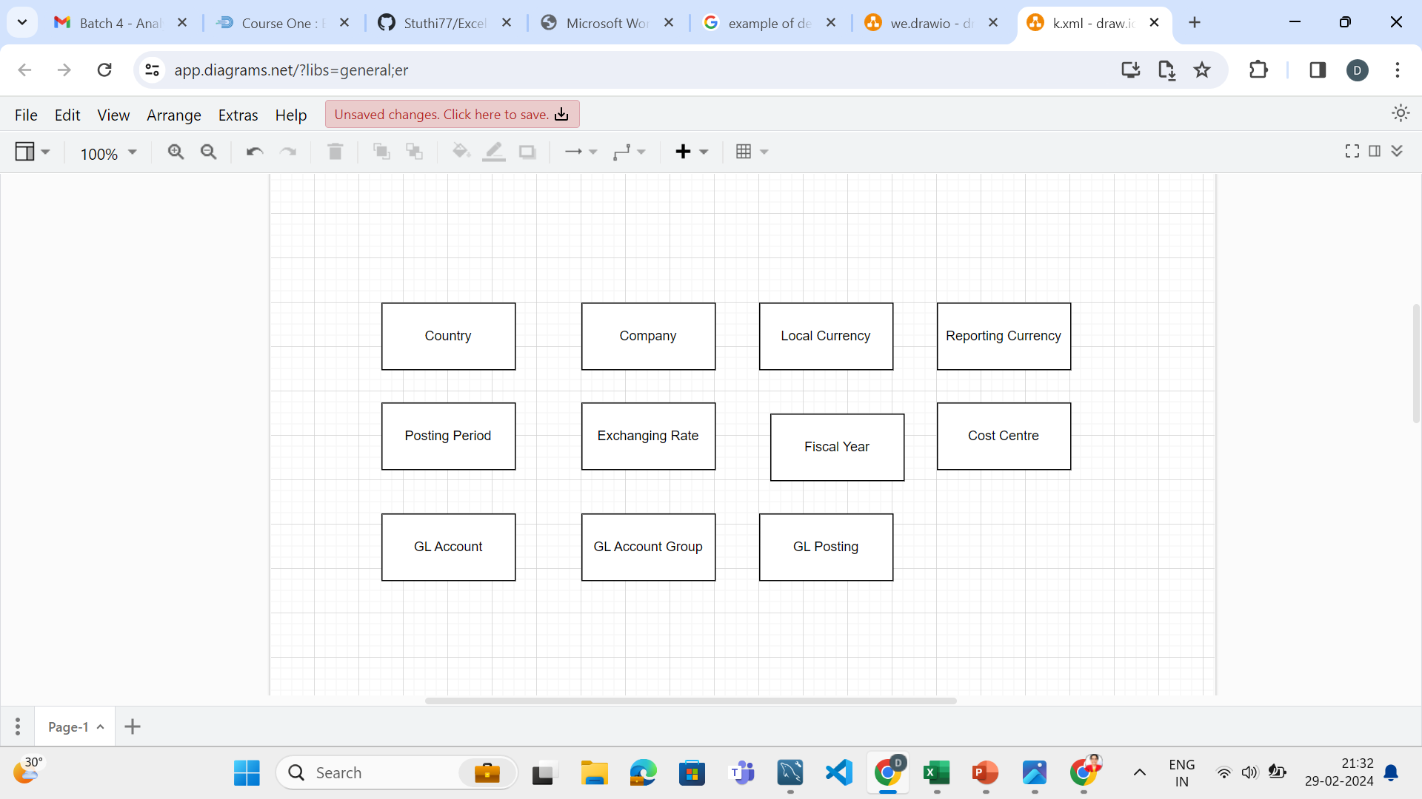
Finance data model ( Conceptual data model)

Slide 10
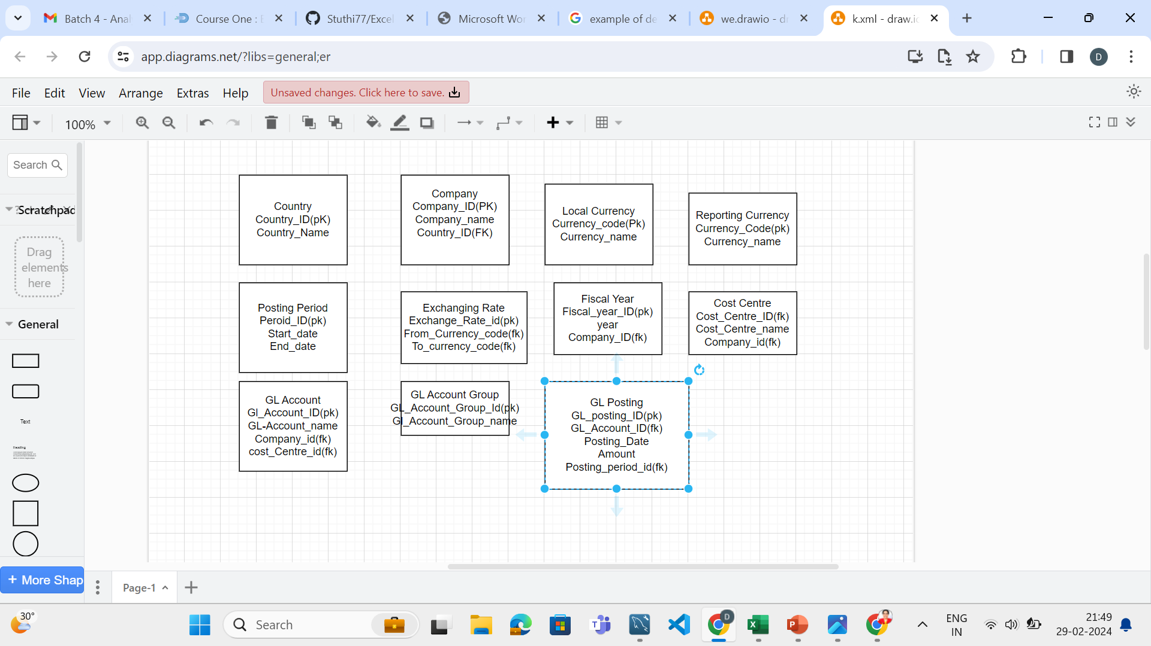
Logical Data model

Slide 11
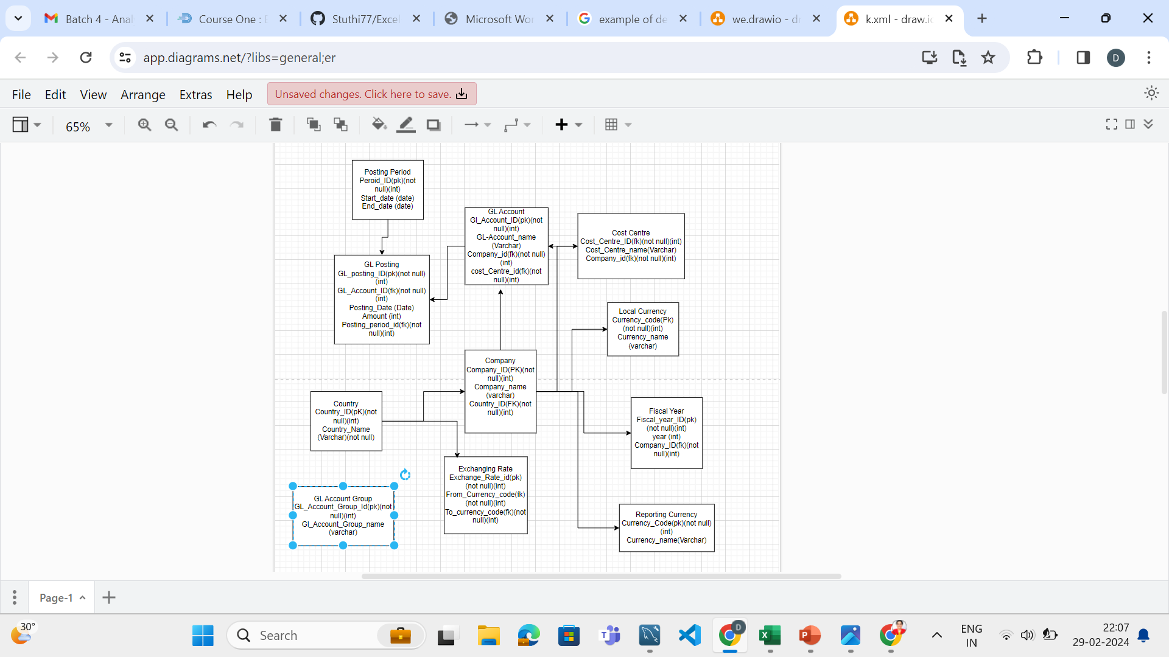
Physical Data Model

Slide 12
SQL Code
CREATE TABLE Country (
Country_ID INT PRIMARY KEY,
Country_Name VARCHAR(100)
);
CREATE TABLE Company (
Company_ID INT PRIMARY KEY,
Company_Name VARCHAR(100),
Country_ID INT,
FOREIGN KEY (Country_ID) REFERENCES Country(Country_ID)
);
CREATE TABLE Currency (
Currency_Code VARCHAR(3) PRIMARY KEY,
Currency_Name VARCHAR(100)
);
-- Create tables for Posting_Period, Exchange_Rate, Fiscal_Year, Cost_Centre,
-- GL_Account, GL_Account_Group, and GL_Posting similarly

Slide 13
CREATE TABLE Exchange_Rate (
Exchange_Rate_ID INT PRIMARY KEY,
From_Currency_Code VARCHAR(3),
To_Currency_Code VARCHAR(3),
Rate DECIMAL(18,6),
Exchange_Date DATE,
FOREIGN KEY (From_Currency_Code) REFERENCES Currency(Currency_Code),
FOREIGN KEY (To_Currency_Code) REFERENCES Currency(Currency_Code)
);
-- Similarly, create tables for other entities mentioned in the logical data model

Slide 14
5-Adding Another column
ALTER TABLE Customer
ADD COLUMN Feedback TEXT,
ADD COLUMN Sentiment VARCHAR(20);

