Slide 1
Plant Disease Classification Using Contrastive Learning
Submitted for CMPE-297 Submitted by-
Prof Vijay Eranti Bharath Gunasekaran
Tamanna Mehta
Stuti Agarwal
Riddhi Jain

Slide 2
Introduction
The occurrence of plant diseases has a negative impact on agricultural production. If plant diseases are not discovered in time, food insecurity will increase. Early detection is the basis for effective prevention and control of plant diseases, and they play a vital role in the management and decision-making of agricultural production. In recent years, plant disease identification has been a crucial issue.
In this project, we present the current trends and challenges for the detection of plant leaf disease using deep learning and advanced imaging techniques. A key ingredient of our approach is the use of big networks during pretraining and fine-tuning. We find that, the fewer the labels, the more this approach benefits from a bigger network.
The proposed semi-supervised learning algorithm can be summarized in three steps: unsupervised pre-training of a big ResNet model using SimCLRv2, supervised fine-tuning on a few labeled examples, and distillation with unlabeled examples for refining and transferring the task-specific knowledge.

Slide 3
Related Work
In recent years, a lot of research has been done on using deep learning and computer vision techniques in the study of Plant disease detection. In our project, we have used a deep learning method called simclrv2 for plant disease recognition, which is built on top of contrastive learning based Simclr.
The approach uses heavy data augmentation techniques followed by learning of the non linear transformation between representation and the contrastive loss which substantially improves the quality of learned representations.
Contrastive learning benefits from larger batch sizes compared to supervised learning. By amalgamating these methodologies, we are able to achieve high performance with small amounts of labeled data.

Slide 4
Dataset
Dataset for Pre-Training: Plant Village dataset
The Plant Village dataset consists of 54303 healthy and unhealthy leaf images divided into 38 categories by species and disease.
The dataset includes images and its corresponding labels as features.
Dataset for Fine-tuning and Distillation: Plant Pathology dataset.
Plant pathology dataset consist of apple leaves images which are classified as healthy, rust, scab and multi disease.
The dataset includes 1821 samples.

Slide 5
Model
Contrastive Learning using Simclrv2
The Simclrv2 is an advanced version of simclr that includes fine-tuning and distillation
Resnet50 model
Heavy data augmentation such as (1) random crop and resize, (2) random color distortions, and (3) random Gaussian blur on each input image.
Notes:
The contrastive learning technique applies heavy data augmentation Heavy data augmentation on each input image followed by learning of the non-linear transformation between representation and the contrastive loss, which substantially improves the quality of learned representations.
ut image

Slide 6
ML-Ops
To move the model from development to production, we have used TFX Pipeline.
A TFX pipeline is a sequence of components that implement an ML pipeline which is specifically designed for scalable, high-performance machine learning tasks.
For the TFX pipeline, first, the augmentation is applied to preprocessed images of the plant pathology dataset. On the top of that, TF records are created which includes images in byte format and labels in integer format as the features
Notes:
For automating and productizing machine learning algorithms.
TFX-everything from feature engineering to model training and predicting

Slide 7
Implementation :
Simclrv2 Resnet50 model is first pretrained with Plant village dataset that contain images belonging to one of the 38 categories
Once the model is pretrained, the weight are used for further fine-tuning and distillation using plant disease dataset
For fine-tuning where we removed the first projection head, attached a fine-tuning layer to the pretrained model and back propagated the loss for this dataset.
We used LARS as an optimizer that implements the Layer-wise Adaptive Moments.

Slide 8
Hyperparameter Settings:
Hyperparameter | Value
Momentum | 0.9
Learning Rate | 0.1
Weight_Decay | 0.1
Total_Iterations | 15
EETA_DEFAULT | .001
Batch_size | 64

Slide 9
Code Walk Through

Slide 10
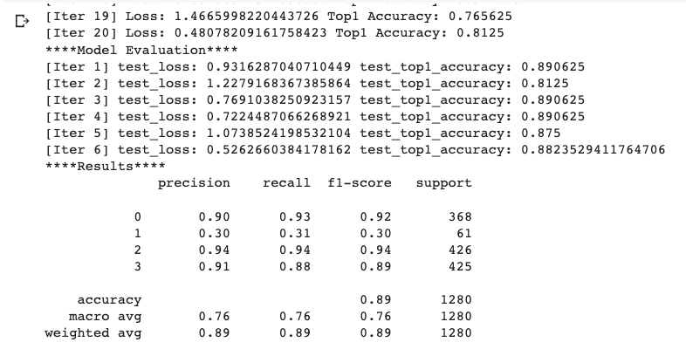
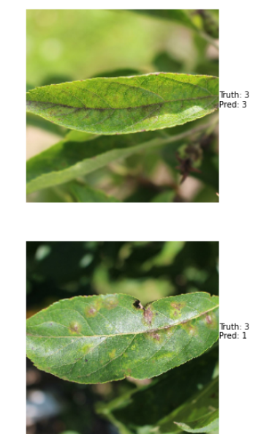
Results:
With this contrastive learning approach, our model provide a good accuracy of 89 percent.
Figure: Screenshot of Accuracy achieved using Pretrained Model
Figure: Prediction done by fine-tuned and distilled model

Slide 11
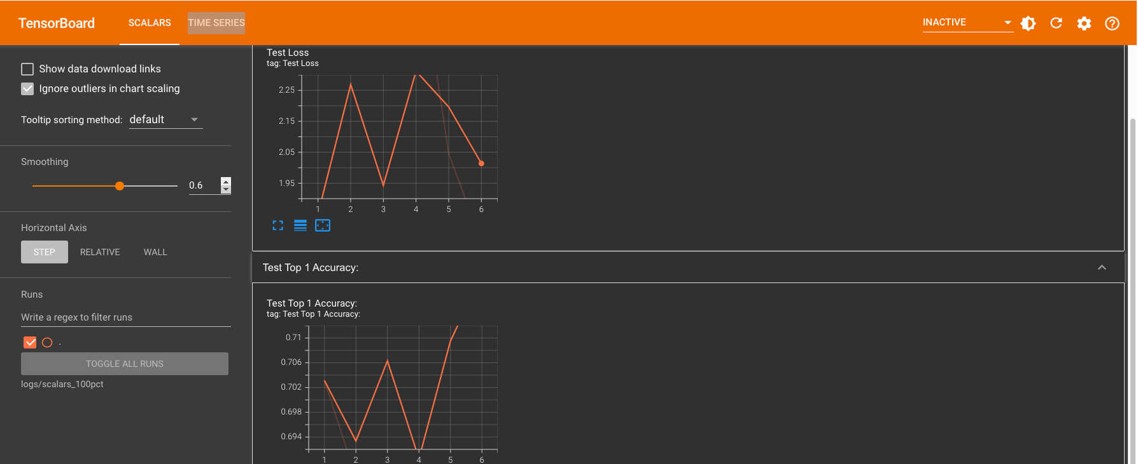
Results:

Slide 12
Deployment

Slide 13
Web Application

Slide 14
Conclusion & Future Scope
We used contrastive learning to accurately detect plant disease from plant leaf images.
Simclrv2 model learn the general features of a plant village dataset without labels by teaching the model which data points are similar or different. With the usage of pretrained model weights, the fine-tuned model provided accuracy of around 89 percent.
For future work, we can apply the pretrained weights to detect and classify disease for other agricultural crops.

Slide 15
References:
[1]. https://github.com/google-research/simclr
[2]. https://arxiv.org/abs/2006.10029
[3]. https://www.tensorflow.org/datasets/catalog/plant_village
[4]. https://arxiv.org/abs/2002.05709
[5]. Saleem, Muhammad Hammad, Johan Potgieter, and Khalid Mahmood Arif. "Plant disease detection and classification by deep learning." Plants 8.11 (2019): 468.

