Slide 1

Bank Marketing Analytics Project - Group 5
Presented By:
Paul Fomenko
Stuti Sanghavi
Yueying Qu

Slide 2
Introduction to the Dataset
https://www.kaggle.com/henriqueyamahata/bank-marketing
The bank marketing data has information about the direct marketing campaigns used by a Portuguese banking institution. The marketing campaigns were based on phone calls. And to gauge whether the client would make a termed deposit, they often had to contact the customer multiple times. The data consists of numerical, categorical variables and binary dependent variable. The dataset has 20 predictor variables (features) and around 41K rows.

Slide 3
Different types of variables in the dataset
Categorical Variables: Job, Marital, Education, Default, Housing, Loan, Contact, Month, Day_of_week, Poutcome
Numerical Variables: Age, Duration, Campaign, Pdays, Previous, Emp.var.rate, Cons.price.idx, Con.conf.idx, Euribor3m, Nr.employed
Binary Dependent Variable:
y: has the client subscribed a term deposit? (will be converted to 0 and 1)
Notes:
Numerical variables included in the data:
Age: age of contacted person
Duration: last contact duration, in seconds
Campaign: number of contacts performed during this campaign and for this client
Pdays: number of days that passes by after the client was last contacted from a previous campaign
Previous: number of contacts performed before this campaign and for this client
Emp.var.rate: employment variation rate (quarterly indicator)
Cons.price.idx: consumer price index (monthly indicator)
Con.conf.idx: consumer confidence index (monthly indicator)
Euribor3m: euribor 3 month rate (daily indicator)
Nr.employed: number of employees (quarterly indicator)
Categorical variables included in the data:
Job: type of job
Marital: marital status
Education: education level
Default: has credit in default?
Housing: has housing loan?
Loan: has personal loan?
Contact: contact communication type
Month: last contact month of year
Day_of_week: last contact day of the week
Poutcome: outcome of the previous marketing campaign
Binary Dependent Variable:
y: has the client subscribed a term deposit? (will be converted to 0 and 1)

Slide 4
Questions we asked:
One of the most important questions we are trying to answer is given all the variables, whether the client will make a termed deposit(‘yes’) or not (‘no’).
In order to more accurately determine if a potential customer will make a termed deposit, we asked the following questions, and more:
Are there certain job types making more termed deposits?
Do clients who are contacted multiple times more likely or less likely to make a deposit
How did the aspects of the customers reaction on the previous campaign, and whether it was successful or not, affect the current marketing campaign’s chances of success?
Is there a particular pattern observed for variables such as marital status and education? Does having a particular marital status and education affect how term deposits are made?

Slide 5
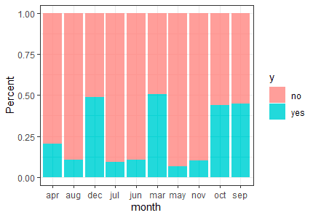
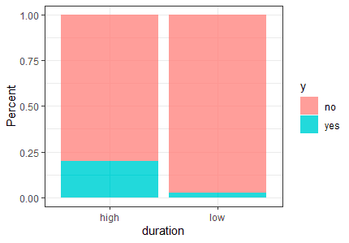
Variable Exploration and Analysis - Month and Duration
Low: 0 to 180
High: above 180

Slide 6
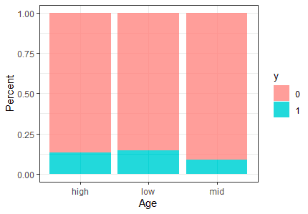
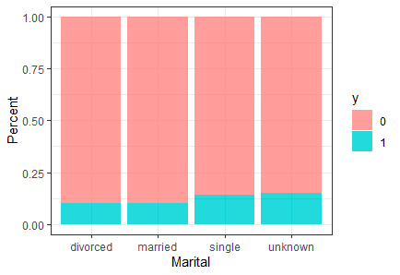
Age and Marital status
Low: 0 to 31
Mid: 32 to 47
High: above 48
Notes:
Exclude age and marital

Slide 7
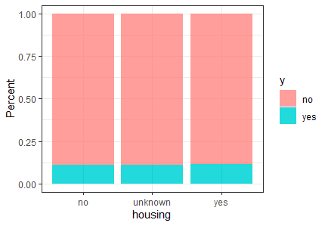
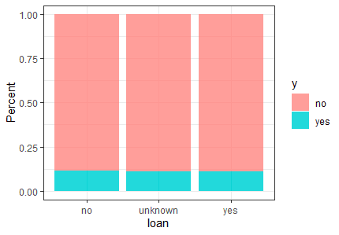
Housing and Loan
Notes:
Exclude loan

Slide 8
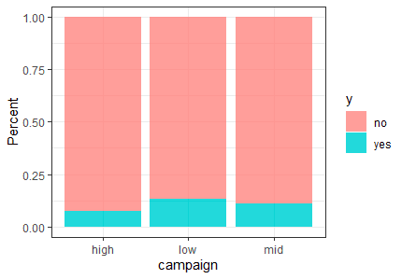
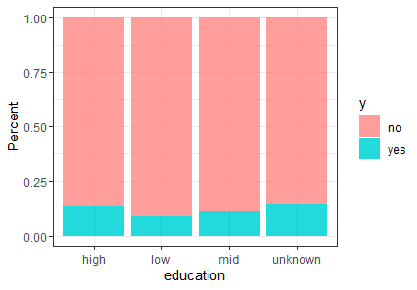
Campaign and Education

Slide 9
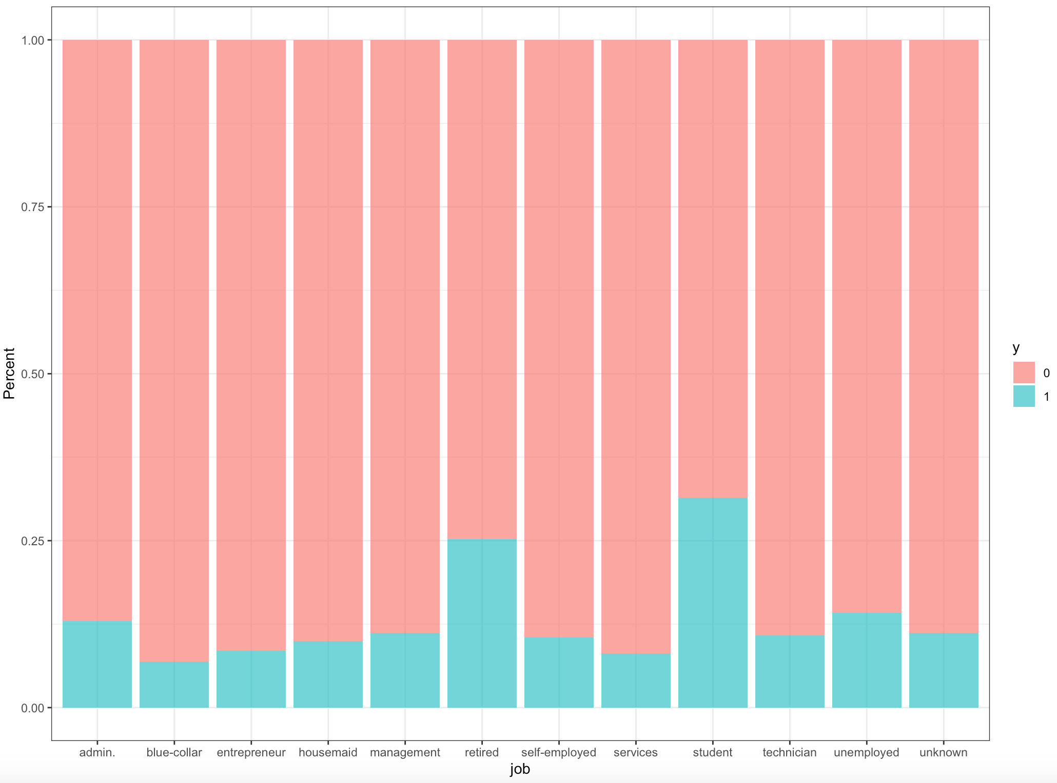
Job

Slide 10
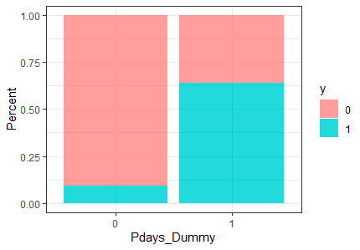
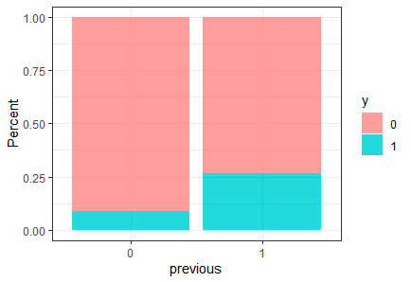
Pdays and Previous
0: if Pdays == 999 (999 means client was not
previously contacted)
1: if Pdays != 999

Slide 11
Logistic Regression

Slide 12
Logistic Regression Model
Variables used in logistic regression
glm (formula = y ~ education + default + duration + poutcome +
campaign * duration + pdays_dummy + campaign + month + emp.var.rate +
cons.price.idx + cons.conf.idx + euribor3m, family = "binomial",
data = train_lm)

Slide 13
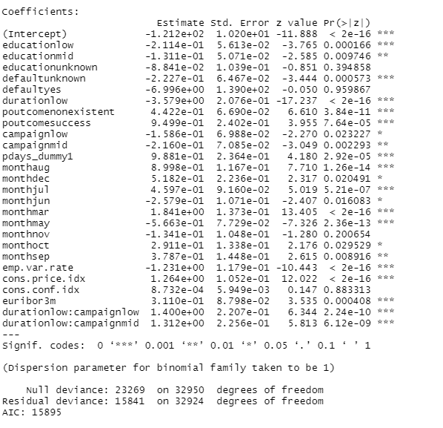
Notes:
Some Interesting Variable Results + Key Variables for Future Marketing Campaign to focus on:
Duration is very important. The longer the phone call the better.
Month = some months are very positive, some are very negative, regular seasonality does not seem to be the explanation.
Poutcomesuccess = if the previous marketing campaign was a success with this client than it is more likely this one will be successful as well.
Education = Low Mid and Unknown Education are all less likely to make a deposit than high education.

Slide 14
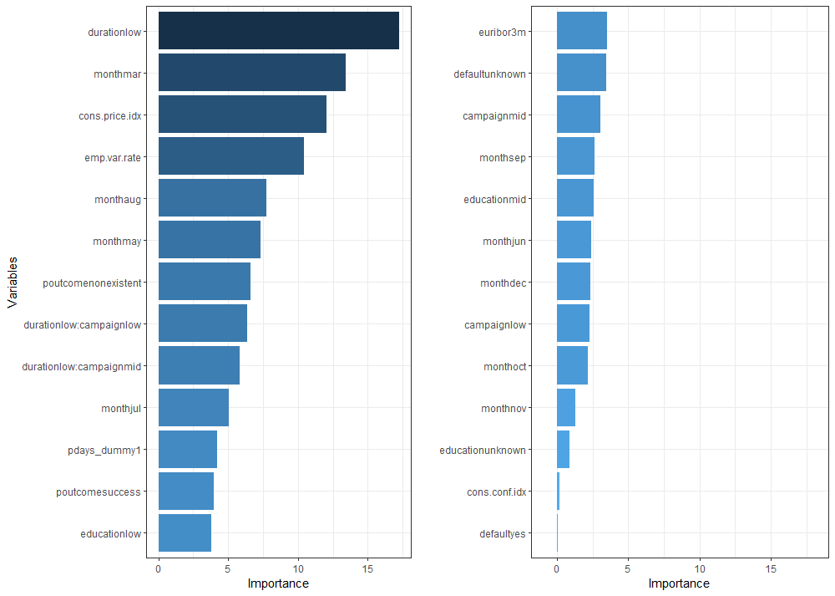
Variables important in Logistic model
Notes:
Some Interesting Variable Results + Key Variables for Future Marketing Campaign to focus on:
Duration is very important. The longer the phone call the better.
Month = some months are very positive, some are very negative, regular seasonality does not seem to be the explanation.
Poutcomesuccess = if the previous marketing campaign was a success with this client than it is more likely this one will be successful as well.
Education = Low Mid and Unknown Education are all less likely to make a deposit than high education.

Slide 15
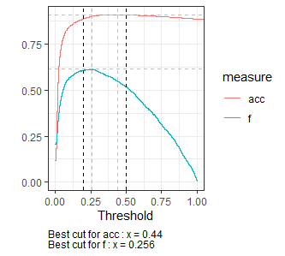




Cutoff on Train Data for Logistic Regression
Notes:
The accuracy for the Logistic Regression is strong at 89.35%, and the precision and recall is so and so.

Slide 16
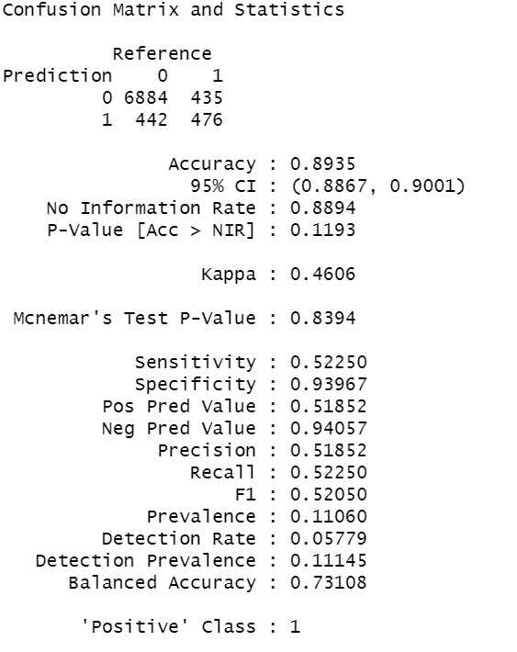
Confusion Matrix of test data - Logistic Regression

Slide 17
Decision Tree

Slide 18
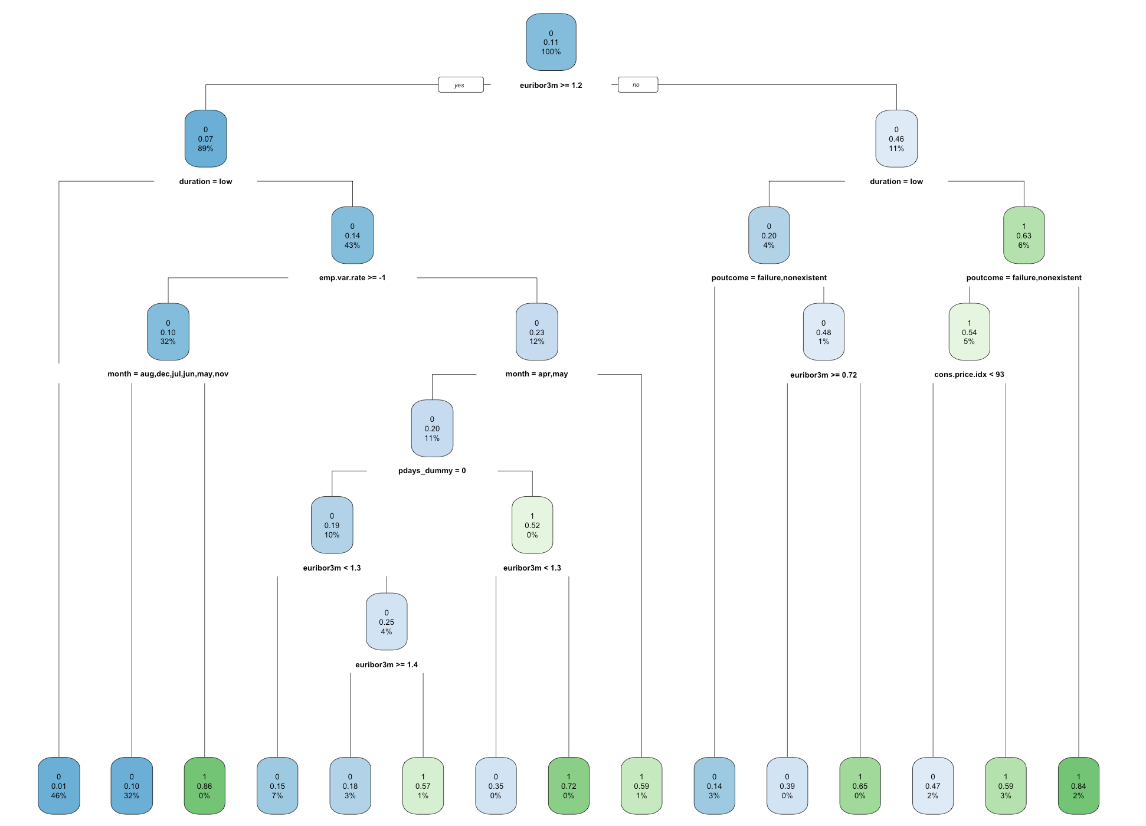
Notes:
These green ones are the ones we’d focus on in a future campaign: these 3 groups are: if the euribor is lesser than 1.2, the duration of the call is long, and the previous outcome was a success or CPI (aka inflation) is low, then focus your time on that client.

Slide 19
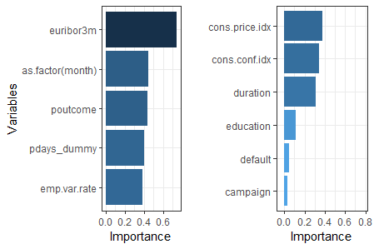
Variable Important in Decision Tree

Slide 20
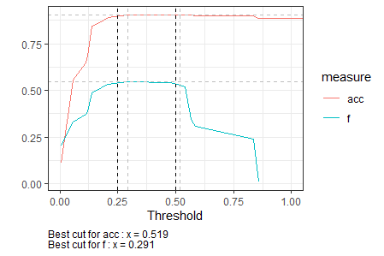
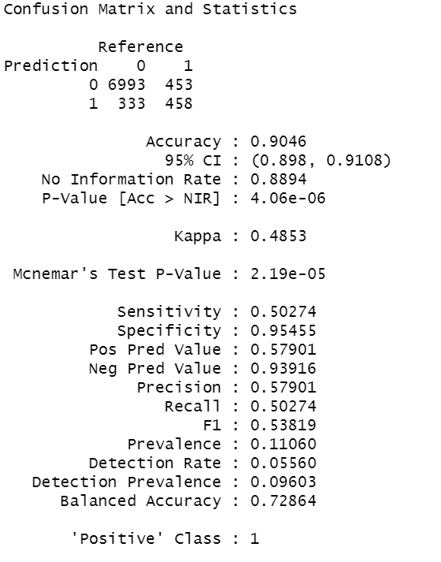
Cutoff and Confusion Matrix for Decision Tree
Notes:
The accuracy of the decision tree is slightly stronger than the Logistic Regression, and the F1 score is better in this model

Slide 21
Random Forest

Slide 22
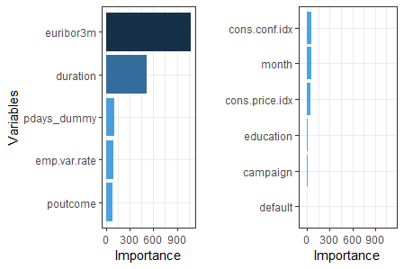
Variables Important in the Random Forest

Slide 23
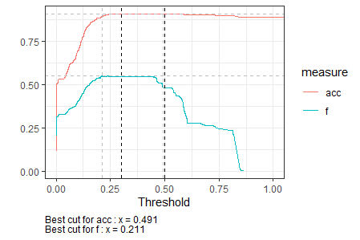

Confusion Matrix for Random Forest Test data

Slide 24
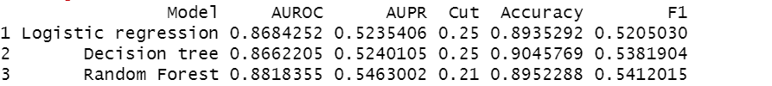
Model Comparison / Final Model (Test Data)
Notes:
Random Forest is more accurate but has less explainability of the variable importance, therefore we choose the logistic model to help improve our next marketing campaign’s targeting.

Slide 25
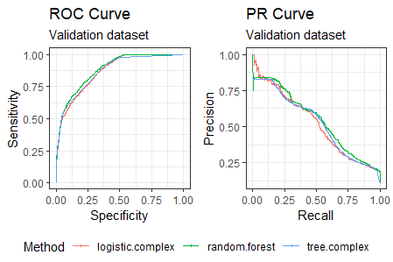

Slide 26
Conclusion
We observe that duration, month, previous campaign outcome and economic factors like consumer price index and employment variation rate have a greater impact on getting a customer to make a termed deposit.
We cannot control the economic factors, but we can definitely use other important factors for targeting the customer better. The logistic model provides the most insight into possible targeting variables, and so we choose it as our final model to assist the bank with its next marketing campaign.
We can also use the probability from the logistic model to rank order the potential leads

Slide 27
Appendix
Used under-sampling technique
Made representation of 1’s 25%
Tried logistic regression model with under sampled data
The precision, recall and F-1 score that we got on the under sampled test data are 0.2715, 0.7849 and 0.4034 respectively.
These results that we found are much lower than the original results we got from logistic regression model.
For next steps, we can try techniques like ‘SMOTE’ to oversample and see the performance
References : https://www.kaggle.com/henriqueyamahata/bank-marketing/kernels

Slide 28
THANK YOU!

