Slide 1
PLANT DISEASE CLASSIFICATION
TEAM NAME : PHOENIXSP
TEAM MEMBERS: POONAM
STUTI
KANAN

Slide 2
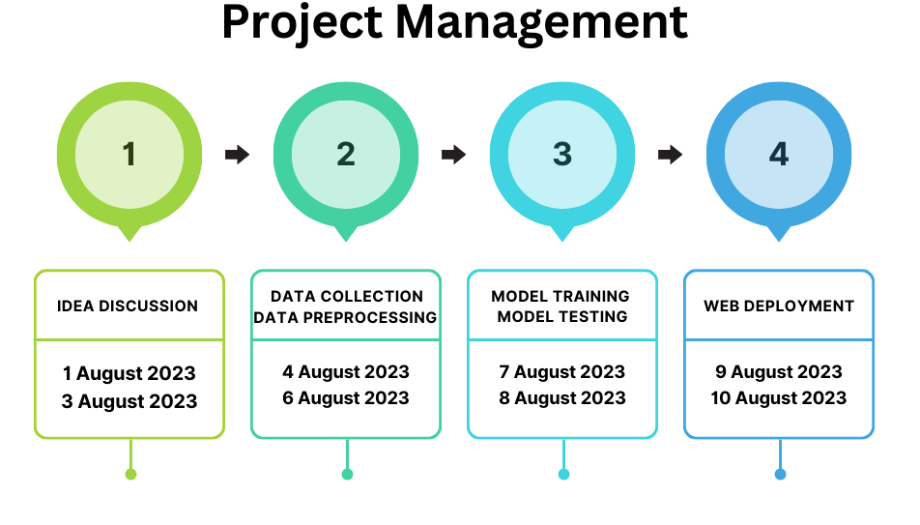

Slide 3
PHASE 1: IDEA DISCUSSION
To identify different types of plant diseases.
To collect and prepare a dataset of healthy and diseased plants.
To select and train an appropriate machine learning model.
To deploy the model in a production environment so that it can be used to classify new plant images as healthy or unhealthy.

Slide 4
MOTIVATION: SUSTAINABLE AGRICULTURE
Early detection and prevention
Biodiversity conservation.
Information sharing and collaboration of researchers with agriculturists (farmers)

Slide 5
PHASE 2: DATA COLLECTION & DATA PRE-PROCESSING
About Dataset
The dataset used for the Project is the Plant Village dataset which contains 50,000 expertly curated images of healthy and infected leaves of crop plants through the existing online platform Plant Village.
Total Images used 2000 which comprises 1000 healthy Images and 1000 bacterial images.

Slide 6
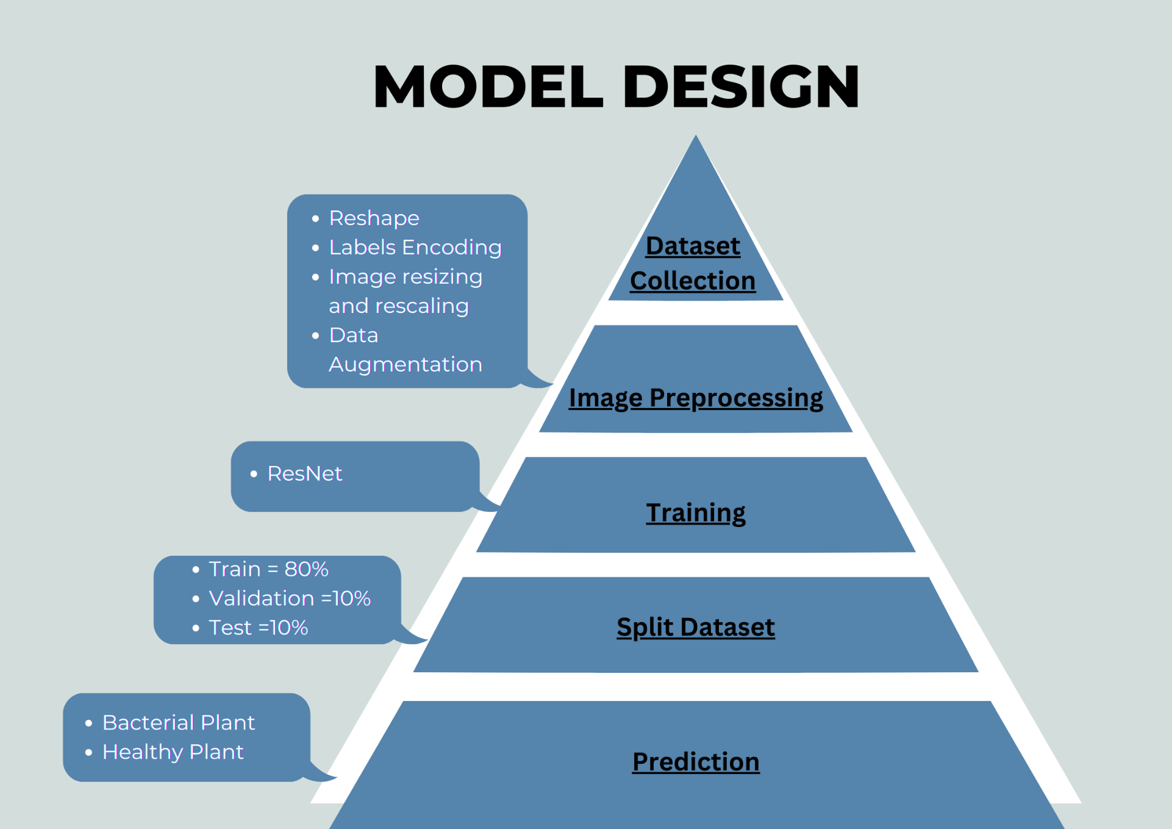

Slide 7
PHASE 3 :MODEL TRAINING & MODEL TESTING
CODE SNIPPETS

Slide 8
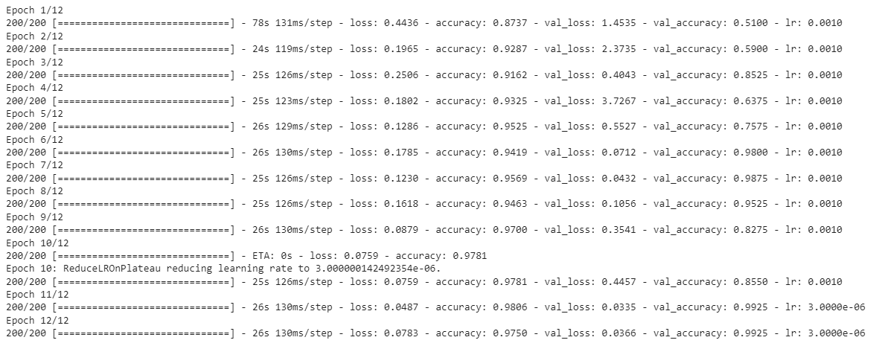

Slide 9
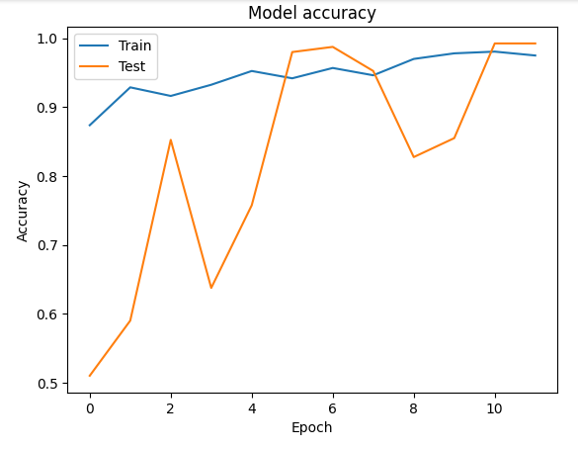
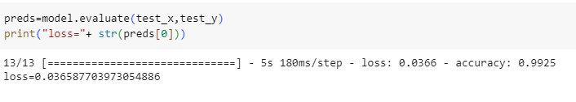
MODEL ACCURACY GRAPH

Slide 10
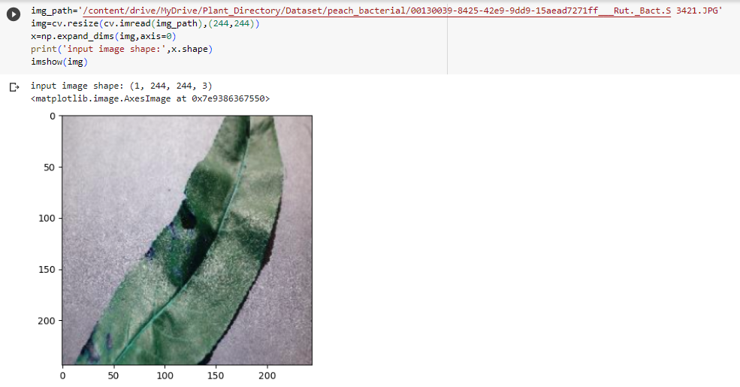
OUTPUT

Slide 11
PHASE 4: WEB DEPLOYMENT

Slide 12
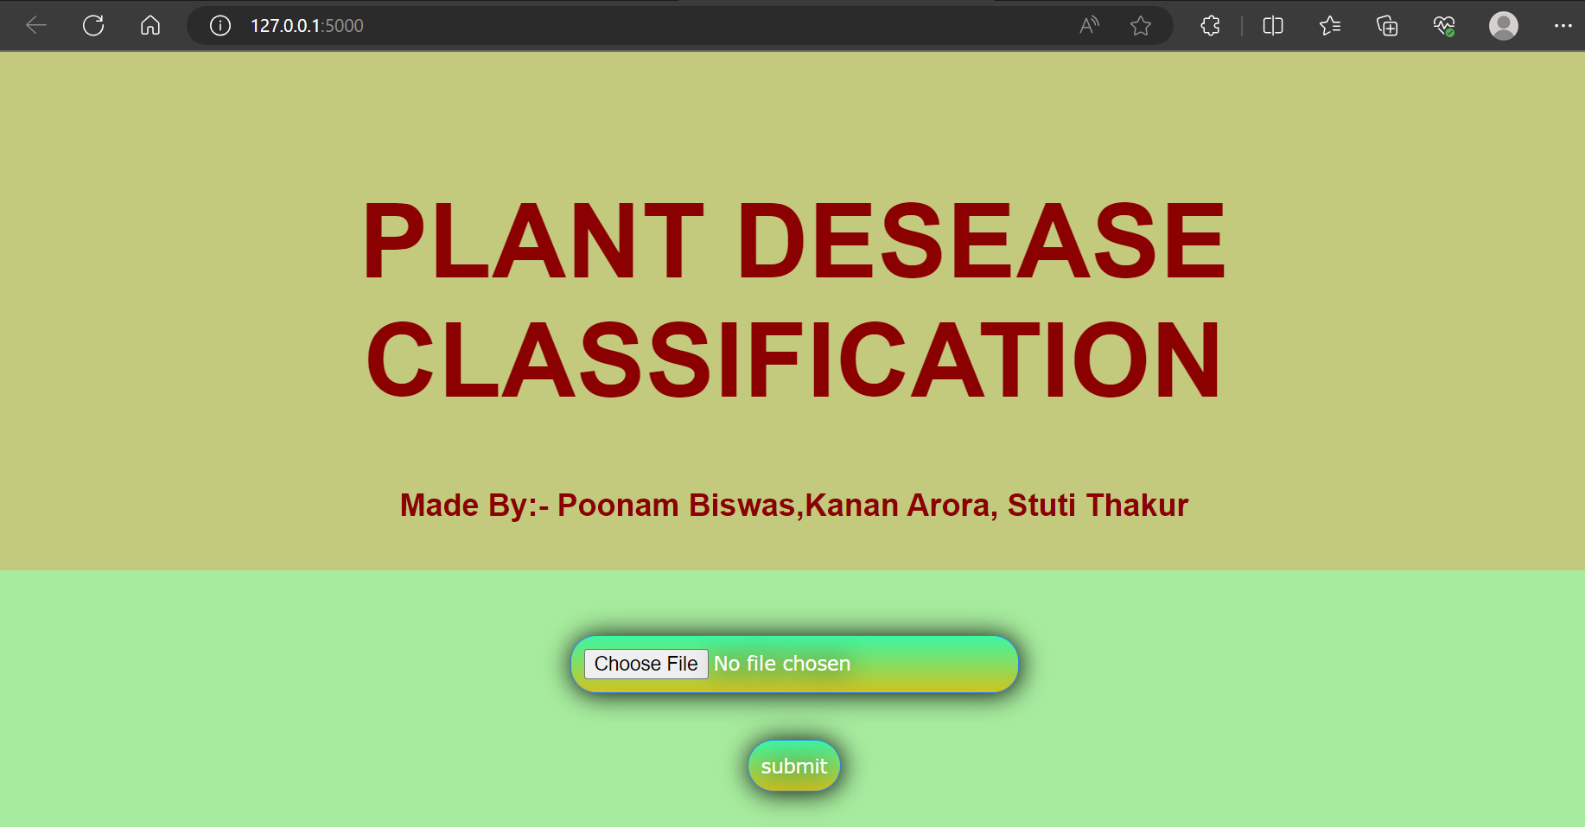
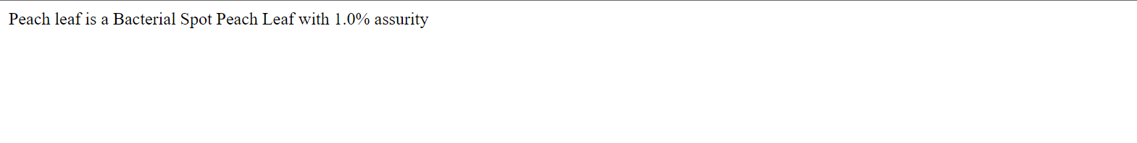

Slide 13
THANK YOU

