Slide 1
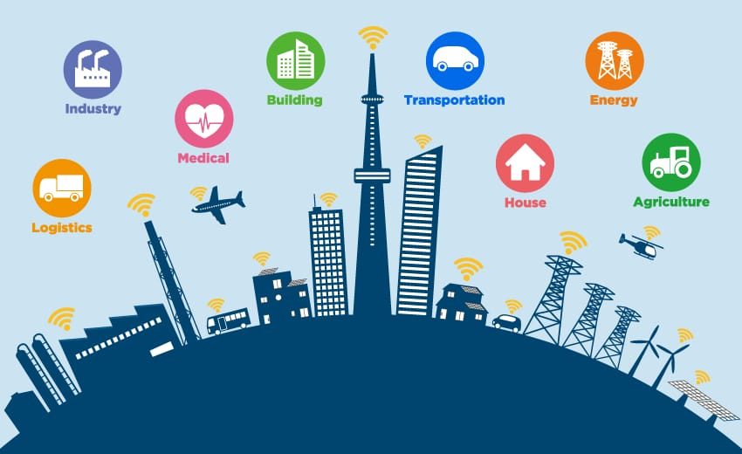
IOT For Smart Cities
Presentation By : Prajapati Stuti
Roll No : 34

Slide 2
Outline
1. Introduction……………………………………………………………………… 1
2. What is an Internet Of Things (IOT)?................................................................. 2
3. What is Smart Cities? …………………………………………………………... 3
4. Why Do We Need Them? …………………………………………………….... 4
5. Components Of Smart Cities. ……………………………………………….... 5
6. Smart City Development Framework. ……………………………………….. 6
7. How Smart Cities Work? ……………………………………………………... 7
8. Why Smart Cities are Important? ……………………………………………. 8
9. Smart City Features. …………………………………………………………... 9
10. Table of Contents. ………………………………………………………….… 10
  10.1 Smart Parking Management System. ……………………………...…….. 11
  10.2 Smart Traffic Management System. ……………………………………. 17
  10.3 Smart Street Lights Management System. …………………………....… 23
11. Advantages & Disadvantages of Smart city. ………………………………. 30
12. Smart City Challenges. ………………………………………….................... 31
13. Conclusion. …………………………………………………………………. 32
14. Reference. ……………………………………………………………………. 33

Slide 3
1. Introduction
The Internet of things (IOT) is changing the way we do business, with a tremendous impact on the world around us. The growth of IOT technologies and business models is transforming cities in various ways, from improving public safety to creating smarter cities.
Smart cities use a variety of software, user interfaces and communication networks alongside the Internet Of Smart cities use IOT devices such as connected sensors, lights, and meters to collect and analyze data. The cities then use this data to improve infrastructure, public utilities and services, and more.
Smart city devices work to make everyday tasks easier and more efficient, while relieving pain points related to public safety, traffic, and environmental issues.
1

Slide 4
2. What is an Internet of Things (IOT)?
The Internet of Things (IOT) describes the network of physical objects—“things”—that are embedded with sensors, software, and other technologies for the purpose of connecting and exchanging data with other devices and systems over the internet.
The Internet of Things is a network of physical objects that are connected to the Internet so that they can exchange data and information in order to improve productivity, efficiency, services, and more.
This technology allows for the collection and sharing of data from a vast network of devices, creating opportunities for more efficient and automated systems.
2

Slide 5
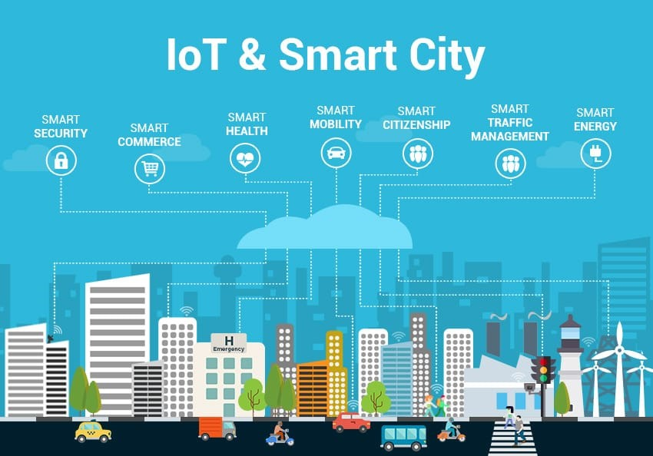
3. What is Smart Cities?
There is no only one definition of smart city broadly it is desire to provide good infrastructure services to the citizens of the city.
Smart city provides a good relation between citizens & government using available technologes.The relations between them is maintained by a good feedback system of to create mechanism to gather the information improve services delivery.
Figgure3.1 : IOT & Smart City
3

Slide 6
4. Why do we need them?
A smart city should provide an urban environment that delivers a high quality of life to residents while also generating economic growth. This means delivering a suite of joined-up services to citizens with reduced infrastructure costs.
This becomes increasingly important in the light of the future population growth in urban areas, where more efficient use of infrastructure and assets will be required.
Smart city improvements also provide new value from existing infrastructure while creating new revenue streams and operational efficiencies to help save money for governments and citizens alike.
4

Slide 7
5. Components of Smart Cities
Smart Parking.
Smart Traffic.
Smart Street Lights.
Smart Waste Management.
Smart Meters & Billing.
Public Transport.
Environment.
Public Safety.
Smart Agriculture.
Smart Homes.
Smart Industry.
Smart Infrastructure.
Smart Road.
5

Slide 8
6. Smart City Development Framework
Smart Government Road Map.
Identification Of City Priorities.
CO-Creating Solutions.
Urban Innovation lab.
Networked cities.
6

Slide 9
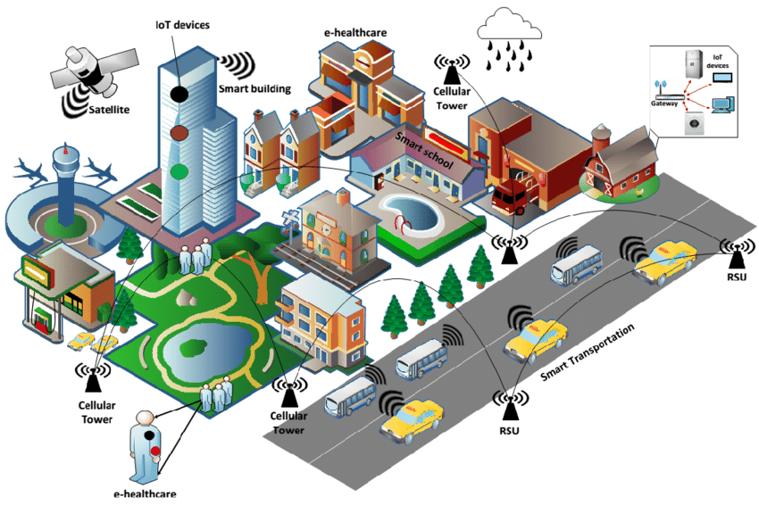
7. How Smart Cities Work?
Smart cities follow four steps to improve the quality of life and enable economic growth through a network of connected IOT devices and other technologies. These steps are as follows:
1. Collection
  2. Analysis
  3.Communication
  4. Action
  Figure 7.1: Smart Cities Work
  7

Slide 10
8. Why Smart Cities Are Important?
54% of the world’s populations live in cities and this is expected to rise to 66% by 2050, adding a further 2.5 billion people to the urban population over the next three decades. With this expected population growth there come needs to manage environmental, social and economic sustainability of resources.
Smart cities allow citizens and local government authorities to work together to launch initiatives and use smart technologies to manage assets and resources in the growing urban environment.
8

Slide 11
9. Smart City Features
Combining automation, machine learning and the IOT is allowing for the adoption of smart city technologies for a variety of applications. For example, smart parking can help drivers find a parking space and also allow for digital payment.
Another example would be smart traffic management to monitor traffic flows and optimize traffic lights to reduce congestion, while ride-sharing services can also be managed by a smart city infrastructure.
Smart city features can also include energy conservation and environmental efficiencies, such as streetlights that dim when the roads are empty. Such smart grid technologies can improve everything from operations to maintenance and planning to power supplies.
In addition, smart city technology can improve the efficiency of manufacturing, urban farming, energy use, and more.
9

Slide 12
10. Table of contents
  10.1 Smart Parking
  10.2 Smart Traffic
  10.3 Smart Street Lights
  10

Slide 13
10.1 Smart Parking Management System
What is Smart Parking management System?
Smart Parking is based on IOT (Internet of Things) and AI (Artificial Intelligence) technologies. It gives access to real-time parking occupancy and parking availability, predicts peak and non-peak times, makes dynamic pricing according to congestion and provides parking operators with big real-time data and reporting.
The system’s hardware features sensors that detect available parking slots and communicate this information to all drivers in the area. This data is updated in real-time, which means drivers never have to worry about not finding an available space.
11

Slide 14
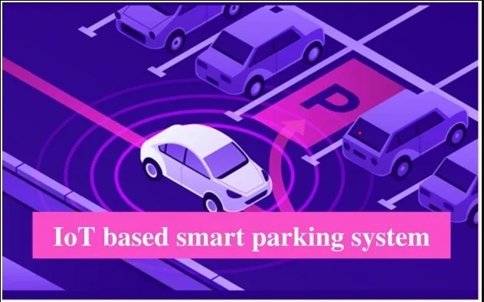
Why IOT Based Smart Parking System Is Needed?
Smart parking systems solve the problem of finding an available spot by providing
drivers with information about available spots near them. Drivers can also use the
system remotely via their smart phone to find a space before arriving at the parking
lot.
These systems help drivers to find an available spot faster and more easily than
traditional methods like circling around or waiting for someone to leave. By
leveraging this technology, drivers can avoid wasting time looking for a space.
Figure10.1.1 : IOT based Smart Parking System
12

Slide 15
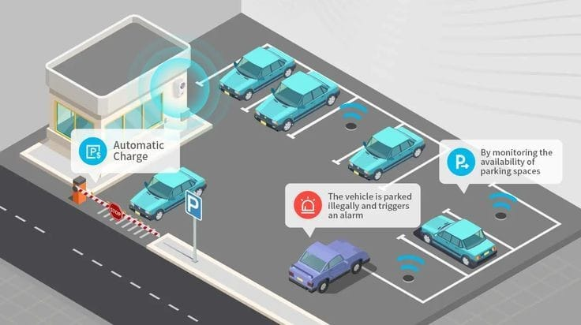
Architecture of Smart Parking System
Parking Sensors.
Processing Unit.
Mobile Application.
The cloud.
Figure 10.1.2: Architecture of Smart Parking
13

Slide 16
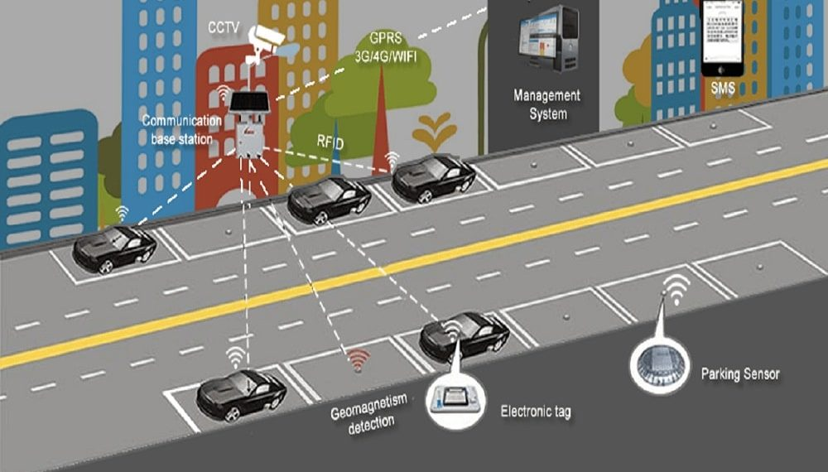
Smart Parking Technology
Smart parking maps.
Smart signage.
Smart detectors for vehicles.
Sensors to detect parking spot occupancy.
Figure 10.1.3: Smart Parking Technology
14

Slide 17
Advantages of Smart Parking System
Saves fuel.
Saves time.
Less traffic on road.
Easy payment option.
Disadvantages of Smart Parking System
Limited privacy.
Social control.
Excess network trust.
15

Slide 18
Future of smart parking System
The parking industry is in the midst of a transformation. Rapid technological advances
are enabling a new breed of parking solutions that are more efficient, convenient, and
sustainable. Cities and parking managers from across the globe are well aware of how
vital smart parking is. Much other technological advancement will be crucial for this
upcoming generation of parking facilities.
16

Slide 19
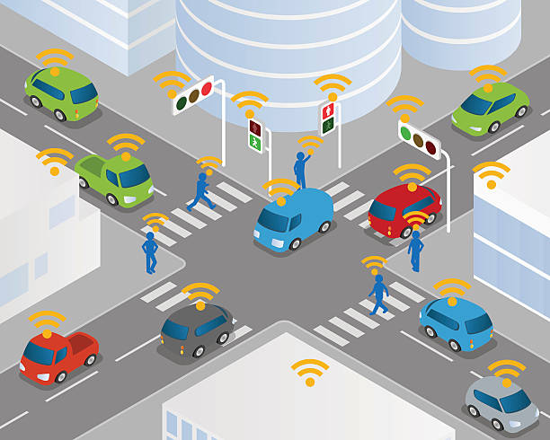
10.2 Smart Traffic Management System
What is Smart Traffic management system?
A smart traffic management system utilizing sensor data, communication and automated algorithms is to be developed to keep traffic flowing more smoothly. The aim is to optimally control the duration of green or red light for a specific traffic light at an intersection.
Figure 10.2.1: Smart Traffic Management System
17

Slide 20
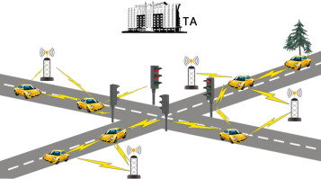
Components of Smart Traffic
  LEDS.
  IR Sensor.
  Jumper Wires.
Intelligent traffic management with the help of IOT technology
IOT traffic management systems are automated systems that incorporate the latest advances in IOT technology. Each IOT platform has its own set of unique features and mechanisms. Specifically, for Smart traffic management system, it offers:
  Data warehouse and data access.
  Communication, coordination, and device control capabilities.
  Deploy cloud and software for connected devices.
  And all the necessary infrastructure for all of the above.
Figure 10.2.2: Smart Traffic Signals
18

Slide 21
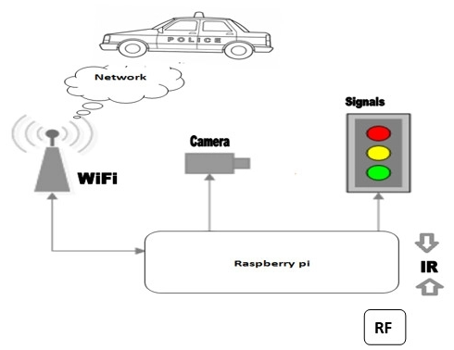
How Smart Traffic System work?
It relies on a priori information provided by the IOT sensors and adjusts the traffic signals so that the time interval depends on the number of vehicles on that particular part of the road. The main advantage of this system is that it can reduce downtime and traffic density in various areas. Some of the key functionalities that cities acquire through these systems include the following:
  Traffic jam detection.
  Adaptive control.
  Interaction with connected cars.
  Emergency routing.
  Figure 10.2.3 Work Process of Smart Traffic Signals
  19

Slide 22
Advantages of Smart Traffic System
Safe travel.
Efficient processes.
Improving the environment.
Disadvantages of Smart Traffic System
Expensive.
Not practical for all roads.
Perceived by some as a way of raising funds.
Less or no effect beyond the camera.
Need regular maintenance.
20

Slide 23
Challenges of integrating IOT in the traffic management system
Additional security requirements.
The need for high-tech network infrastructure.
Time spent on adaptation.
Additional investment.
21

Slide 24
Future of smart Traffic
Integrating the entire traffic management system with multiple layer security for various data generated from various sources can be another subject of future scope. Along with that an emergency signal for an emergency vehicle (such as an Ambulance) can also be included in order to serve them better.
22

Slide 25
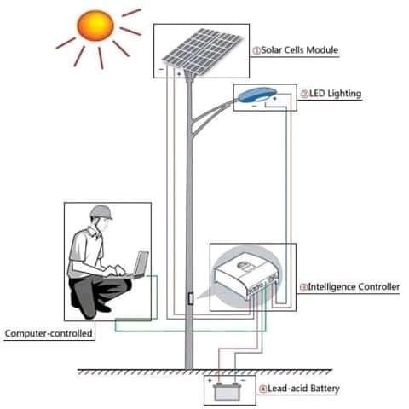
10.3 Smart Street Lights
What is Smart Street Light?
A smart streetlight is a public lighting fixture that incorporates technology, such as cameras, light-sensing photocells and other sensors, to introduce real-time monitoring functionalities.
Figure 10.3.1 Smart Street Lighting
23

Slide 26
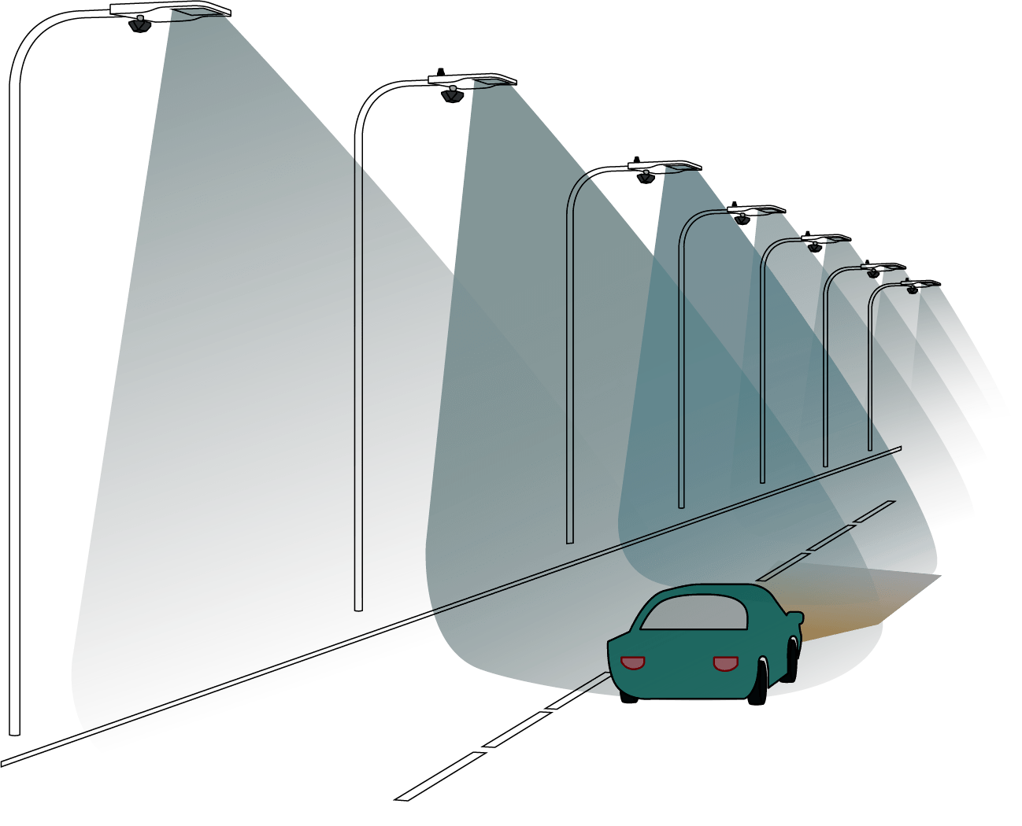
How Smart Street lights work?
When implemented on standard streetlights, these devices can detect movement that enables dynamic lighting and dimming.
Figure 10.3.2 Work Process of Smart Street Lighting
24

Slide 27
Challenges of Smart Street Light
Faulty lights.
Electricity theft.
Unnecessary usage.
Solution of Smart Street Lights
An IOT-based solution like Smart Street Lights involves a combination of connectivity and sensors. When installed on standard streetlights, these devices can detect movement that facilitates dynamic lighting and dimming.
25

Slide 28
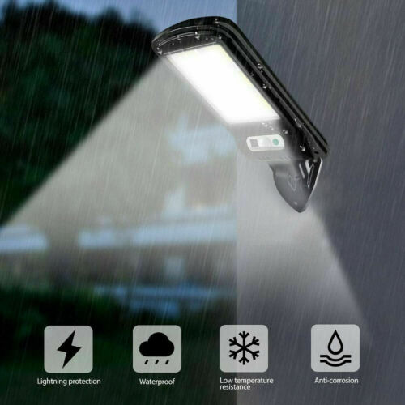
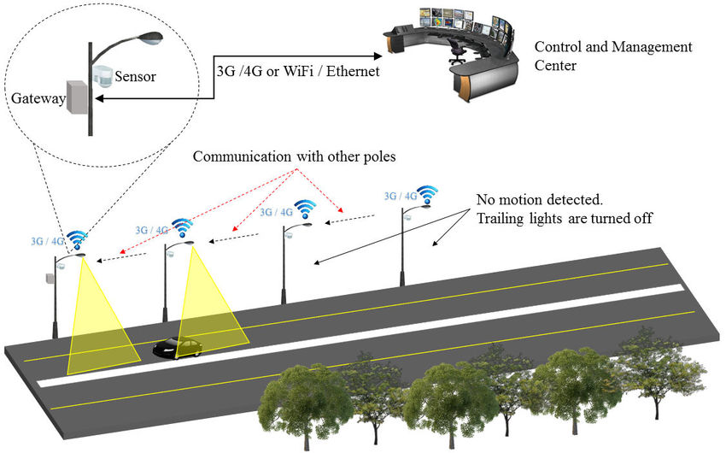
Figure 10.3.3 Solution of Smart Street Lights
Figure 10.3.4 Solution of Smart Street Lights
26

Slide 29
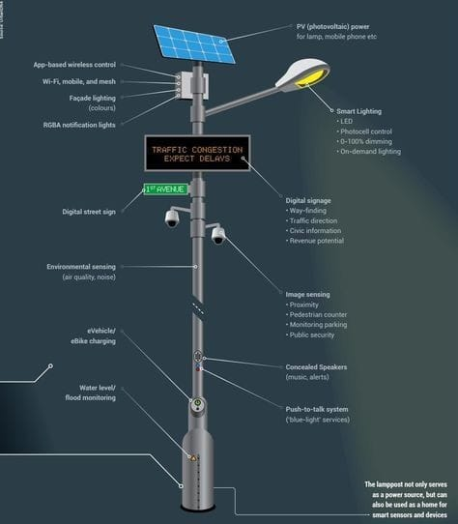
Features of smart streetlights
While the features of smart streetlights depend on the specific technology used by city planners, examples of common functionality include the following:
Dynamic lighting controls based on movement detection.
Environmental and weather monitoring.
Figure 10.3.2 Work Process of Smart Street Lighting
27

Slide 30
Advantages of smart streetlights
Reduced energy cost and usage with flexible dimming controls.
Reduced carbon emissions and light pollution.
Lowered repair and maintenance costs with the monitoring software.
Disadvantages of smart streetlights
Despite the long-term value in upgrading lighting networks, there are a few challenges. Although smart streetlights save money over time, the initial investment is a large one.
28

Slide 31
Future of Smart Street Light
These smart lights will help cities reduce electricity costs, lower CO2 emissions, and improve maintenance.
29

Slide 32
11. Advantages & Disadvantages of Smart City
Advantages of Smart City
Better transportation services.
Safer Communication.
Efficient public services.
Job opportunities.
Disadvantages of Smart City
Limited privacy.
Social control.
Excess network trust.
30

Slide 33
12. Smart City Challenges
For all of the benefits offered by smart cities, there are also challenges to overcome.
The largest challenge is quite probably that of connectivity, with thousands or even millions of IOT devices needing to connect and work in unison. This will allow services to be joined up and ongoing improvements to be made as demand increases.
Technology aside, smart cities also need to account for social factors that provide a cultural fabric that is attractive to residents and offer a sense of place. This is particularly important for those cities that are being created from the ground up and need to attract residents.
31

Slide 34
13. Conclusion
The smart city is a concept and a variety of definitions exist among academia and practitioners. A smart city can have one or more smart components, including smart transportation, smart grid, smart health care, and smart governance.
The need for smart cities is increasing day by day with the increase of population as earthly resources are limited.
32

Slide 35
14. Reference
1. https://simplycoding.in/internet-of-things/
2.https://www.twi-global.com/technical-knowledge/faqs/what-is-a-smart- city#SmartCityDefinition
3. https://www.finextra.com/blogposting/17931/what-is-the-role-of-iot-in-smart-cities
4. https://www.scnsoft.com/blog/iot-for-smart-city-use-cases-approaches-outcomes
5.https://www.insiderintelligence.com/insights/iot-smart-city-technology/#:~:text=Smart%20cities%20use%20IoT%20devices,utilities%20and%20services%2C%20and%20more
6. https://www.airtel.in/blog/business/iot-based-smart-parking-system-a-step-towards-building-smart-city/
7. https://chintglobal.com/blog/iot-based-smart-parking-system/
8. https://nobelsystemsblog.com/smart-city-with-iot/
33

Slide 36
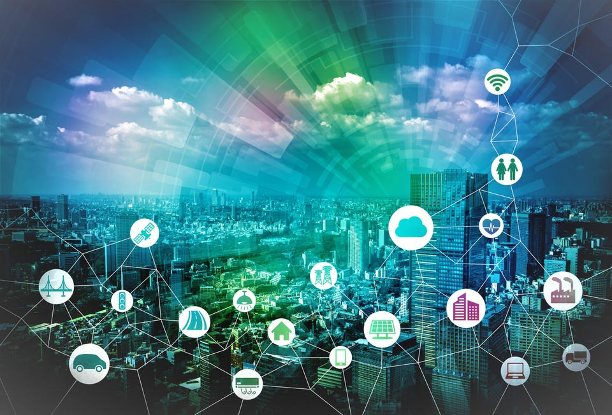
Thank You

