Slide 1
Aim of the project
K-Pizza
By:- Stuti P Pathy

Slide 2
About us
K Pizza is one of the branches where all the types of pizza are available. We sell both veg and Non-veg variety of Pizzas. We are providing a 30 % discount for every first user. The payments are accepted as UPI, Credit Card, Debit card, Cash, and meal cards.

Slide 3
Stage 1
Data Transformation
and
loading into the database
For data transformation and loading, we use Microsoft SQL server management studio.
First, the data is extracted from an excel sheet and then loaded into the database.

Slide 4
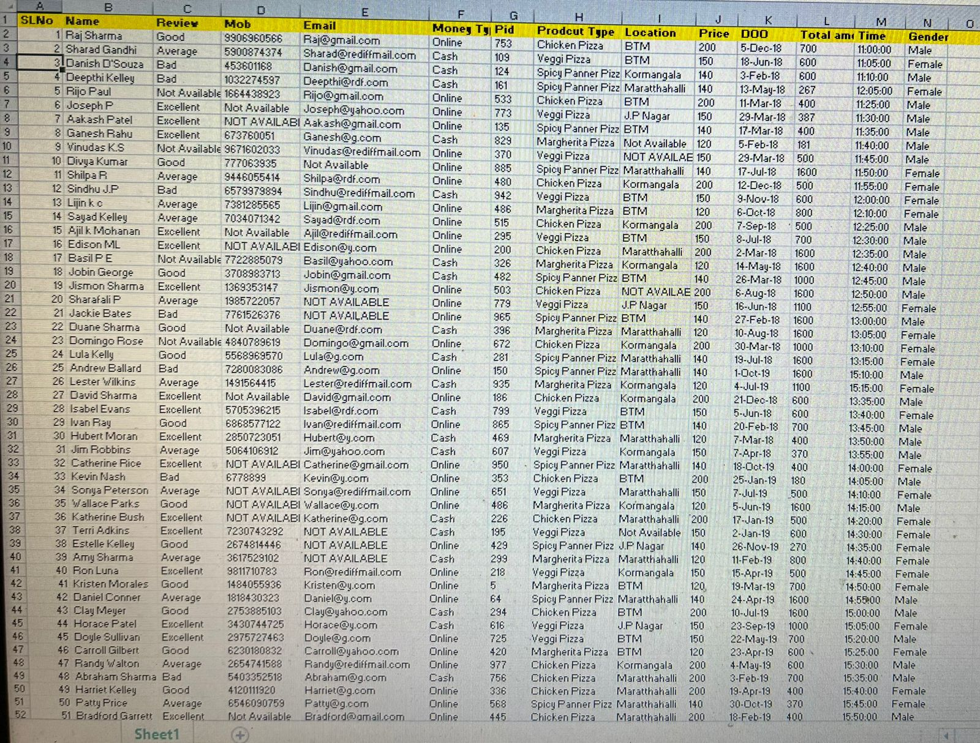

Slide 5
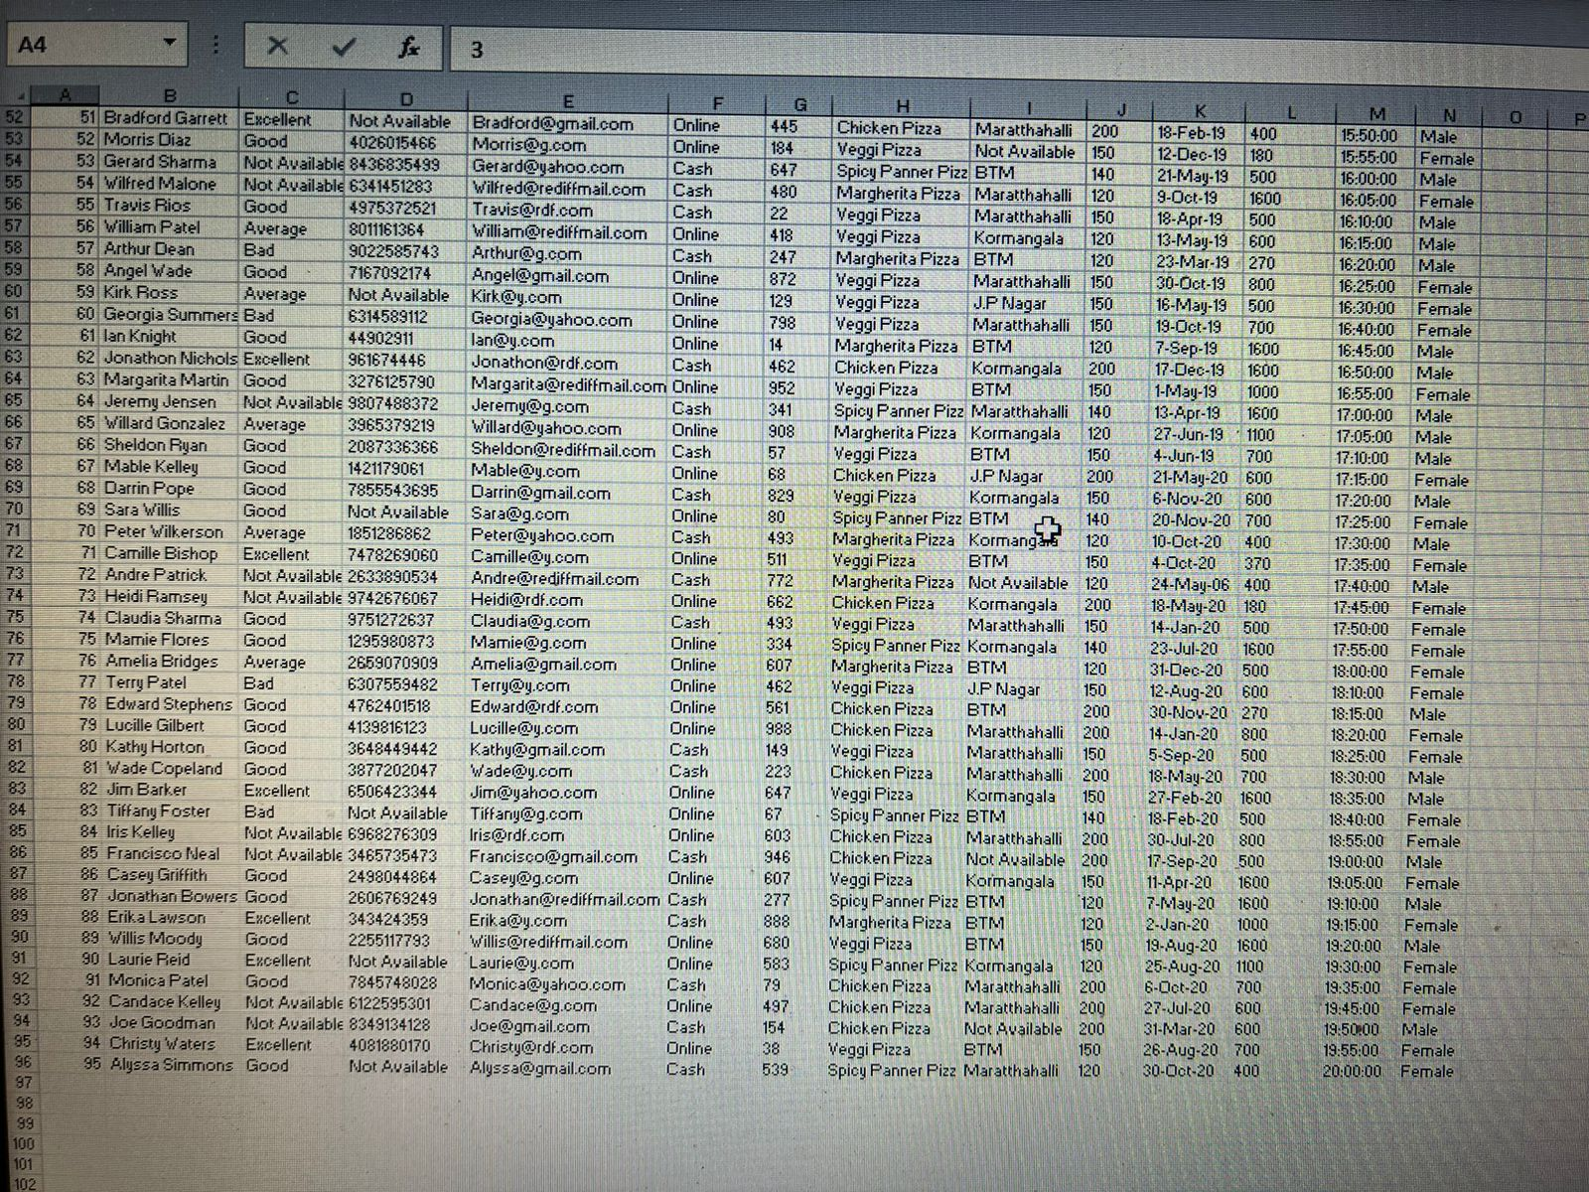

Slide 6
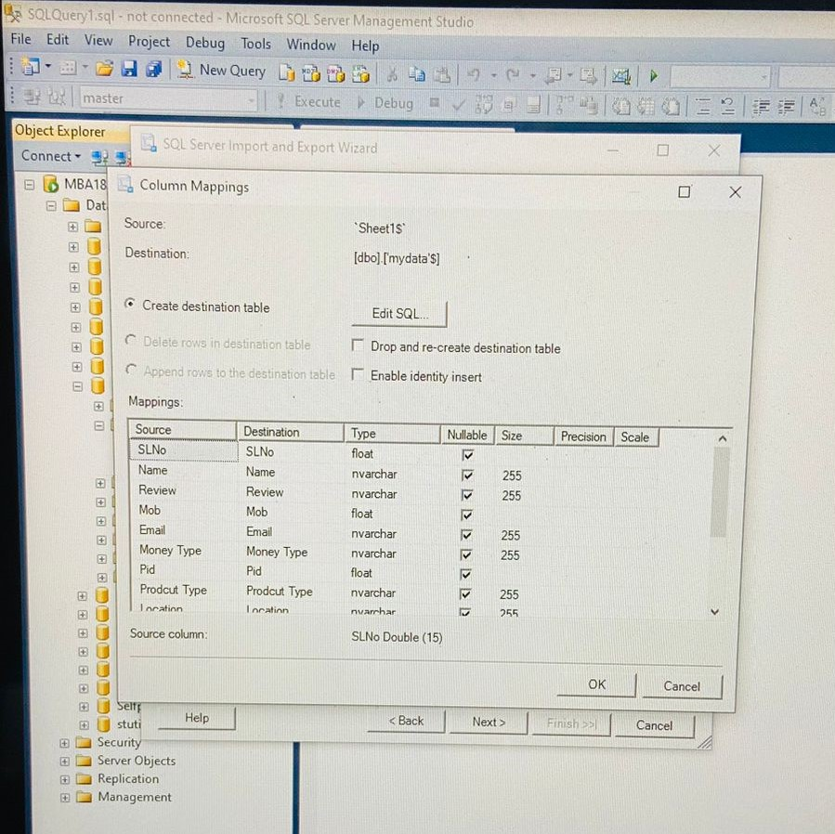
Stage 2

Slide 7
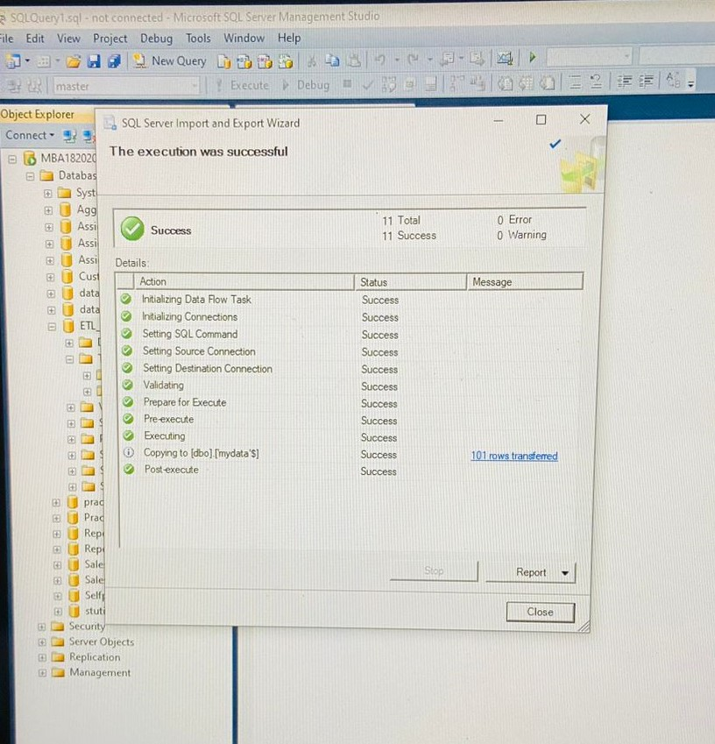

Slide 8
Stage 3
Performing SQL queries
on
the extracted data.

Slide 9
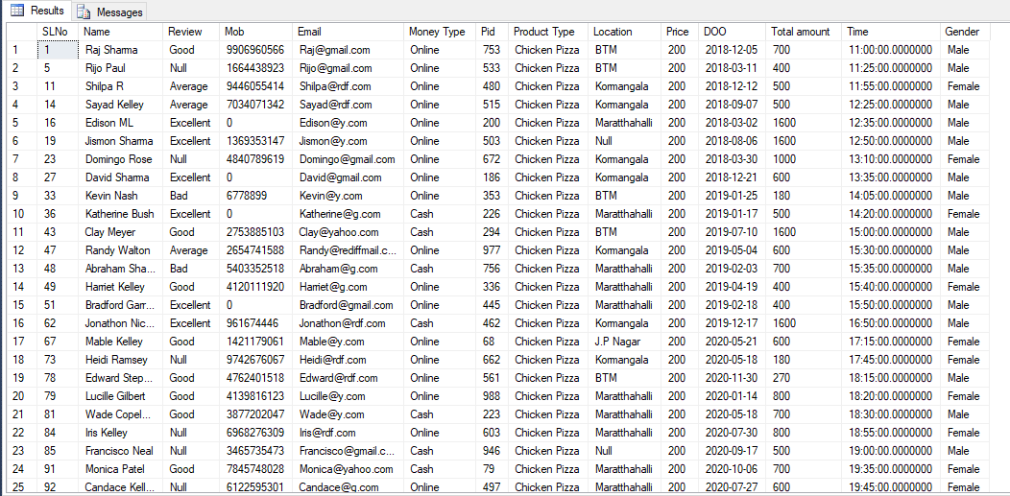
1. Query to fetch where price greater than Rs. 150

Slide 10
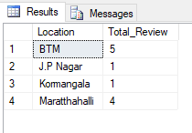
2.Query to fetch the count of reviews (bad) according to location.

Slide 11
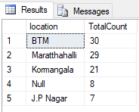
3.Query to fetch the count of orders from all locations.

Slide 12
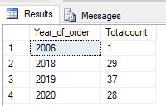
4.Query to fetch the count orders of pizzas yearly.

Slide 13
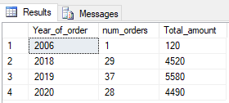
5.Query to fetch the count of orders of pizza yearly with total amount.

Slide 14

6. Query to fetch count of payment mode type.

Slide 15

7.Query to fetch the count of gender (Male, Female).

Slide 16
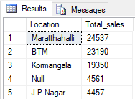
8. Query to fetch location wise sales.

Slide 17
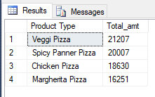
9. Query to fetch the total Amount of product type.

Slide 18

10. Query to fetch sales of payment mode type.

Slide 19
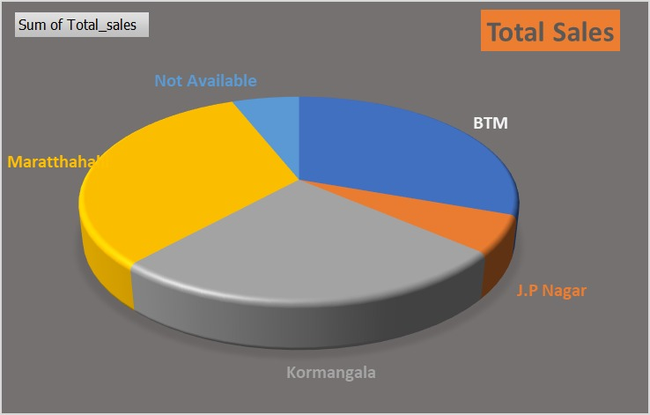
Visualization

Slide 20
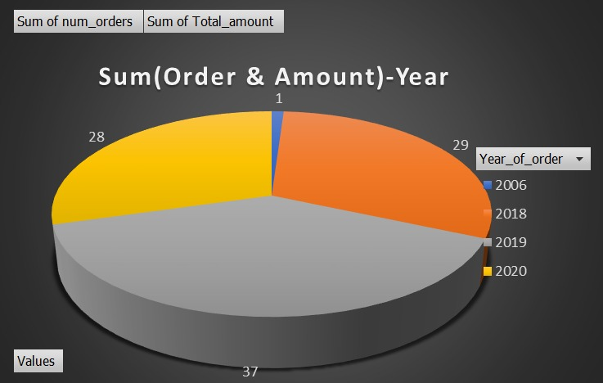
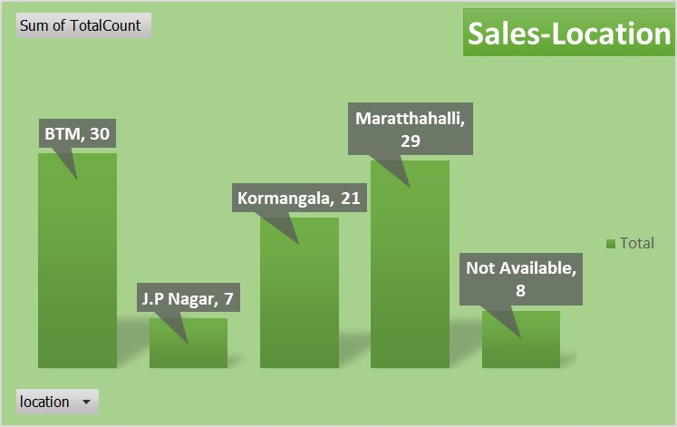

Slide 21
Conclusion
Kpizza can start online delivery option as we can visualize the payment mode are online and location wise we can start the online delivery option as the revenue is high.

Slide 22
Advantages
Home Delivery can expand the customer base.
Home delivery gives customers to pay in multiple payment modes.
Home delivery is cost-effective.
Home Delivery consumes less time.

Slide 23
Thank You

