Slide 1
FINGERPRINT CLASSIFICATION
TEAM: CV PROPHETS
FINAL EVALUATION
Utkarsh MK | 2020201027
Aditi Aggarwal​ | 2020201034​
Stuti Saxena​ | 2020201091​
Aditya Mahajan | 2020202017

Slide 2
PROBLEM STATEMENT
To reduce the search time and computational complexity, it is desirable to classify fingerprints in an accurate and consistent manner such that the input fingerprint needs to be matched only with a subset of the fingerprints in the database.
Fingerprint classification is a technique used to assign a fingerprint into one of the several prespecified types already established in the literature which can provide an indexing mechanism.
An input fingerprint is first matched at a coarse level to one of the prespecified types and then, at a finer level, it is compared to a subset of the database corresponding to that fingerprint type.
We classify fingerprints into five classes namely, whorl (W), right loop (R), left loop (L), arch (A), and tented arch (T).

Slide 3
SOLUTION PROPOSED
The paper we implemented is: "A Multichannel Approach to Fingerprint Classification"[1] by Anil K. Jain, Fellow, IEEE, Salil Prabhakar, Student Member, IEEE, and Lin Hong.
The paper proposes a fingerprint classification algorithm based on a novel representation scheme which is directly derived from local ridge structures.
The representation is capable of tolerating poor image quality, which is a major difficulty in fingerprint classification.

Slide 4
SOLUTION PROPOSED (contd.)
The main steps of our classification algorithm are as follows:​
Locate a registration point in the input image and define a spatial tessellation of the region around the registration point (sectors).​
Decompose the input image into a set of component images, each of which preserves certain ridge structures; compute the standard deviation of the component images in each sector to generate the feature vector (called FingerCode).​
Feed the feature vector into a classifier; in our algorithm, a two-stage classifier is used.​
This two-stage classifier uses a K-nearest neighbor classifier in its first stage and a set of neural network classifiers in its second stage to classify a feature vector into one of the five fingerprint classes.​

Slide 5
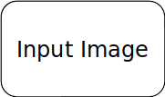
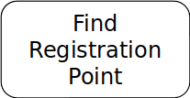
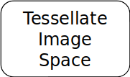
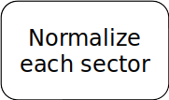

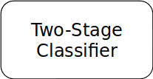
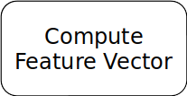
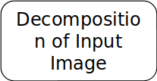
FLOW DIAGRAM

Slide 6
CORE POINT DETECTION
Following steps were involved in finding the core point for a fingerprint:
Image segmentation and normalization
Orientation field estimation
Computing Poincare value corresponding to each point in the orientation map
The points with value of 1 correspond to core point
To make the detection more accurate, following was done:
Computed the number of white blobs and area of each blob
If certain conditions are met, core point is marked as center of one of the blobs.
Else smooth the orientation field and repeat steps from finding Poincare values
The point of interest is 40 pixels below the core point.

Slide 7
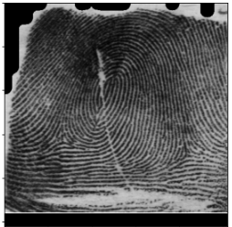
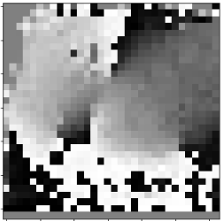
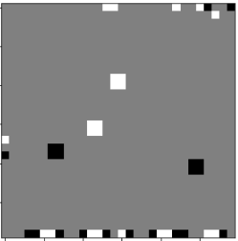
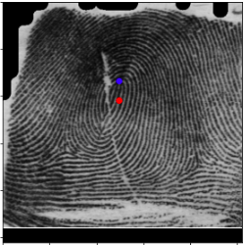
CORE POINT DETECTION
Normalized Image | Orientation Map | Poincare Values | Core Point and Centre Point

Slide 8
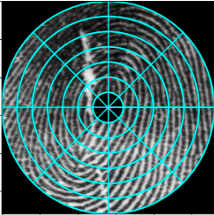
TESSELLATE IMAGE SPACE
The spatial tessellation of the image space consists of the region of interest which is defined by a collection of sectors.
We use six concentric bands around the center point. Each band is 20-pixels wide (b = 20) and segmented into eight sectors (k = 8).
Thus, a total of 8*6 = 48 sectors (S₀ through S₄₇ ) are defined.
Fig.: ROI tessellated into 48 sectors

Slide 9
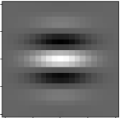
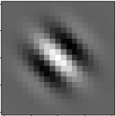
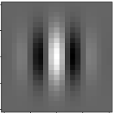
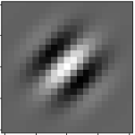
DECOMPOSITION
Fingerprints have well-defined spatial frequency in each local neighbourhood that does not contain singular points.
By applying properly tuned Gabor filters to a fingerprint image, the true ridge and furrow patterns can be greatly accentuated.
Figure shows Gabor filters oriented in 0,45,90 and 135 degrees respectively.

Slide 10
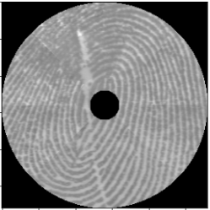
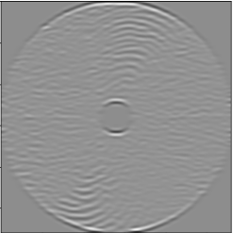
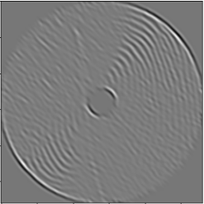
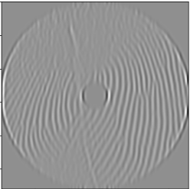
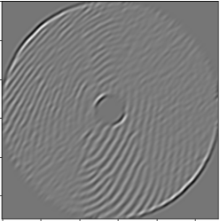
DECOMPOSITION (contd.)
Shown is the image formed by normalizing each sector seperately:
On applying 4 gabor filters to the above normalized image, we obtain following component images:

Slide 11
FEATURE VECTOR
In each component image, ridges and furrows parallel to the corresponding filter direction exhibit higher variation; whereas others are diminished.
These variations can be captured by the standard deviation of grayscale values.
The standard deviation within the sectors define the feature vector.

Slide 12
FEATURE VECTOR (contd.)
Let C_{iα}(x,y) be the component image corresponding to α for sector S_{i}
For all i in [0,1, …,47] and α in [0, 45, 90, 135], a feature is the standard deviation F_{iα} defined as:
F_{iα} = (Σ(C_{iα}(x,y) - M_{iα})²)^{0.5}
The summation is done over all the pixels in S_{i}.
M_{iα} is the mean of the pixel values in C_{iα}(x,y).
This gives us a 192- dimensional feature vector.

Slide 13
TWO STAGE
CLASSIFIER
The five-class problem is decomposed into 10 two-class problems.
We use a two-stage classifier for fingerprint classification.
The first stage uses a KNN classifier to find the two most probable classes for a given input pattern.
In the second stage classifier, a set of 10 (⁵C₂) neural networks are trained to solve the 10 different 2 class problems.

Slide 14
DATASET DESCRIPTION
The dataset used was NIST 8-Bit Gray Scale Images of Fingerprint Image Groups (FIGS).
The dataset consists of 800 images of each class (arch, left loop, right loop, whorl, tented arch).
Each image is a 512 x 512 PNG image.

Slide 15
RESULTS
After the first stage of the classifier (KNN), accuracy is 39.59%
After the second stage of classification (10 neural networks), the final accuracy is 23.68%.
 | Whorl | Left Loop | Right Loop | Arch | Tented Arch
Whorl
Left Loop
Right Loop
Arch
Tented Arch

Slide 16
THANK YOU

