Slide 1
Mid Evaluation: A Multichannel Approach to Fingerprint Classification
UTKARSH MK (2020201027)
ADITI AGGARWAL (2020201034)
STUTI SAXENA (2020201091)
ADITYA MAHAJAN (2020202017)

Slide 2
Problem Statement
In Fingerprint Matching problem, to reduce the search time and computational complexity, it is desirable to classify fingerprints in an accurate and consistent manner such that the input fingerprint needs to be matched only with a subset of the fingerprints in the database.
Fingerprint classification is a technique used to assign a fingerprint into one of the several prespecified types already established in the literature which can provide an indexing mechanism.
An input fingerprint is first matched at a coarse level to one of the prespecified types and then, at a finer level, it is compared to a subset of the database corresponding to that fingerprint type.
We classify fingerprints into five classes namely, whorl (W), right loop (R), left loop (L), arch (A), and tented arch (T).

Slide 3
Solution Proposed
We are implementing a fingerprint classification algorithm which is based on a novel representation scheme which is directly derived from local ridge structures.
The representation is capable of tolerating poor image quality, which is a major difficulty in fingerprint classification.

Slide 4
Algorithm Pipeline
Ridge Orientation Estimation And Smoothing
Input Image
Image Segmentation
Image Normalization
Centre Point Detection
Two-stage Classifier
Feature Vector
Decomposition
Tessellate Image Space
Fingerprint Category

Slide 5
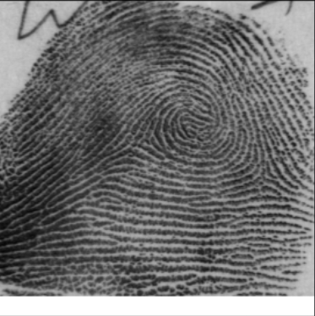
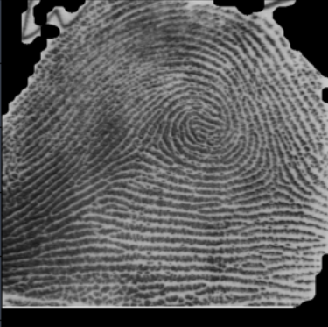
Image Segmentation
In this process, the background (non-fingerprint area) is removed and only the foreground or the fingerprint area of the image is kept.
The foreground region corresponds to the ridges and valleys and the areas of our interest.
A variance threshold method is used to separate background from foreground.
Input Image
Segmented Image

Slide 6
Image Normalization
Image normalization is a typical process in image processing that changes the range of pixel intensity values.
The main purpose of normalization is to reduce the variations in gray-level values along the ridges and valleys.
The normalization implemented is per-pixel basis.
Let img(i,j) represent the pixel intensity value at pixel (i,j) and N(i,j) represent the normalized pixel intensity value at pixel (i,j).
Let M₀ and V₀ are the desired mean and variance values respectively.

Slide 7
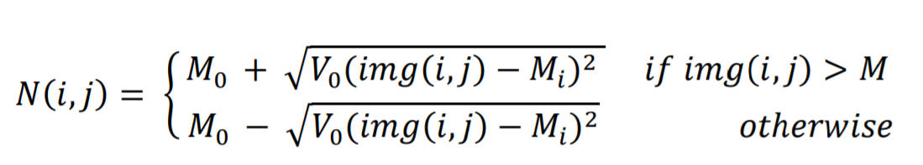
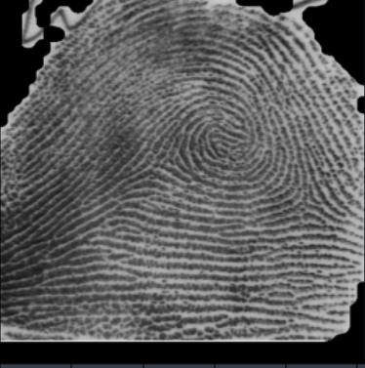
Image Normalization
Normalized Image

Slide 8
Orientation Estimation and Smoothing
Ridges and valleys follow a flow-like pattern. They exhibit orientation ranging from 0 to 180 degrees.
Let θ be the orientation field of the image. Θ(i,j) represents least square estimate of the local orientation of the block centered at pixel (i,j).
There could be discontinuity in the orientation field due to effects of noise. This effect can be reduced or softened using a low-pass filter. However, in order to apply a low-pass filter, the orientation field is first converted to a continuous vector field.
The smoothened orientation field can be obtained after low pass filter is then applied to the resulting vector field.

Slide 9
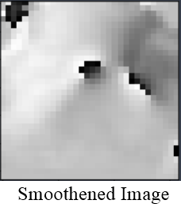
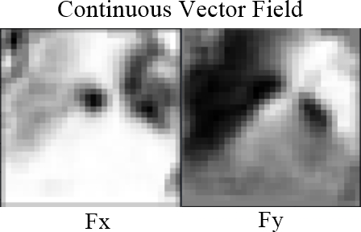
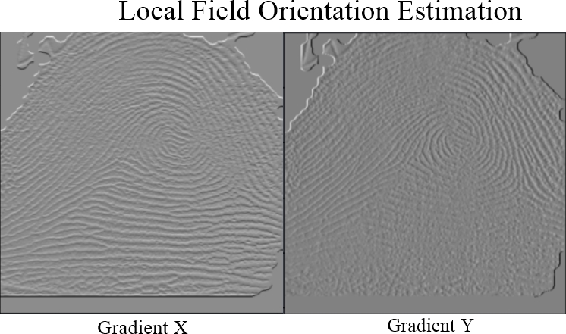
Orientation Estimation and Smoothing

Slide 10
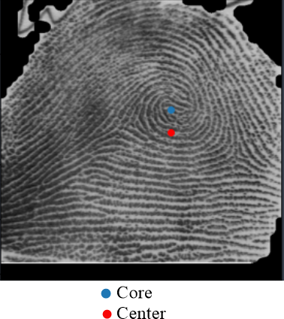
Core Point Detection
For detection of core point, Poincaré index is used.
Poincaré index at a pixel (i,j) is computed by algebraically summing the orientation differences between the adjacent elements of (i,j).
On closed curves, the Poincaré index assumes only one of the discrete values: 0°, ± 180°, and ± 360°
0°, if [i,j] does not belong to any singular region.
360°, if [i,j] belongs to a whorl type singular region.
180° , if [i, j] belongs to a loop type singular region.
-180° , if [i,j] belongs to a delta type singular region.

Slide 11
Thank You

