Slide 1
IML-CSL2010
Project Title : Stable Grasping
Stuti Yadav - B23CH1044

Slide 2
Problem Statement
The aim of the project is to build a Machine Learning model to predict the stability of a grasping robotic arm using sensor data from its joints.

Slide 3
Project Overview
This project focuses on building a Machine Learning model to predict the robustness value of a robotic arm and classifying the grasp as stable/unstable using sensor data from its joints. It explores the use of machine learning to predict the robustness of a shadow robot arm. Robustness refers to the robot's ability to maintain performance and stability under varying conditions.

Slide 4
Objective
Develop ML Models: Build classification, regression and deep learning models to predict robot arm robustness.
Outlier Handling Comparison: Compare different outlier handling techniques (e.g., filtering vs. imputation) and their effect on model performance.
Feature Selection & Reduction: Apply PCA and correlation analysis to select important features and reduce dimensionality.
Model Comparison: Compare the performance of multiple algorithms, including linear regression, decision trees, SVMs, Naive Bayes Classifier, ANNs and more.
Evaluate Model Performance: Use metrics like MSE and R² to assess the accuracy of the models.
Grasp Stability Prediction: Predict grasp stability based on sensor data from robot arm joints.

Slide 5
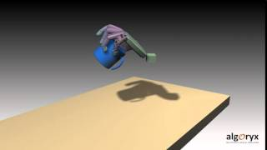
Robot Grasping Simulation

Slide 6
Dataset Overview
The grasping dataset availed from Kaggle has 30 columns.
A quick note about the names used in the columns:
H1 stands for Hand one (there's only one hand but…)
F1 for finger one (three fingers per hand)
J1 for joint one (three joints per finger)
pos / vel / effort are the position, velocity and effort measurements of the joints.
X’ (input features) is defined as all the columns in the dataset except Robustness and ‘y’ (target variables) is the Robustness column.
The higher the value of robustness, the less stable the grasp and vice-versa.

Slide 7
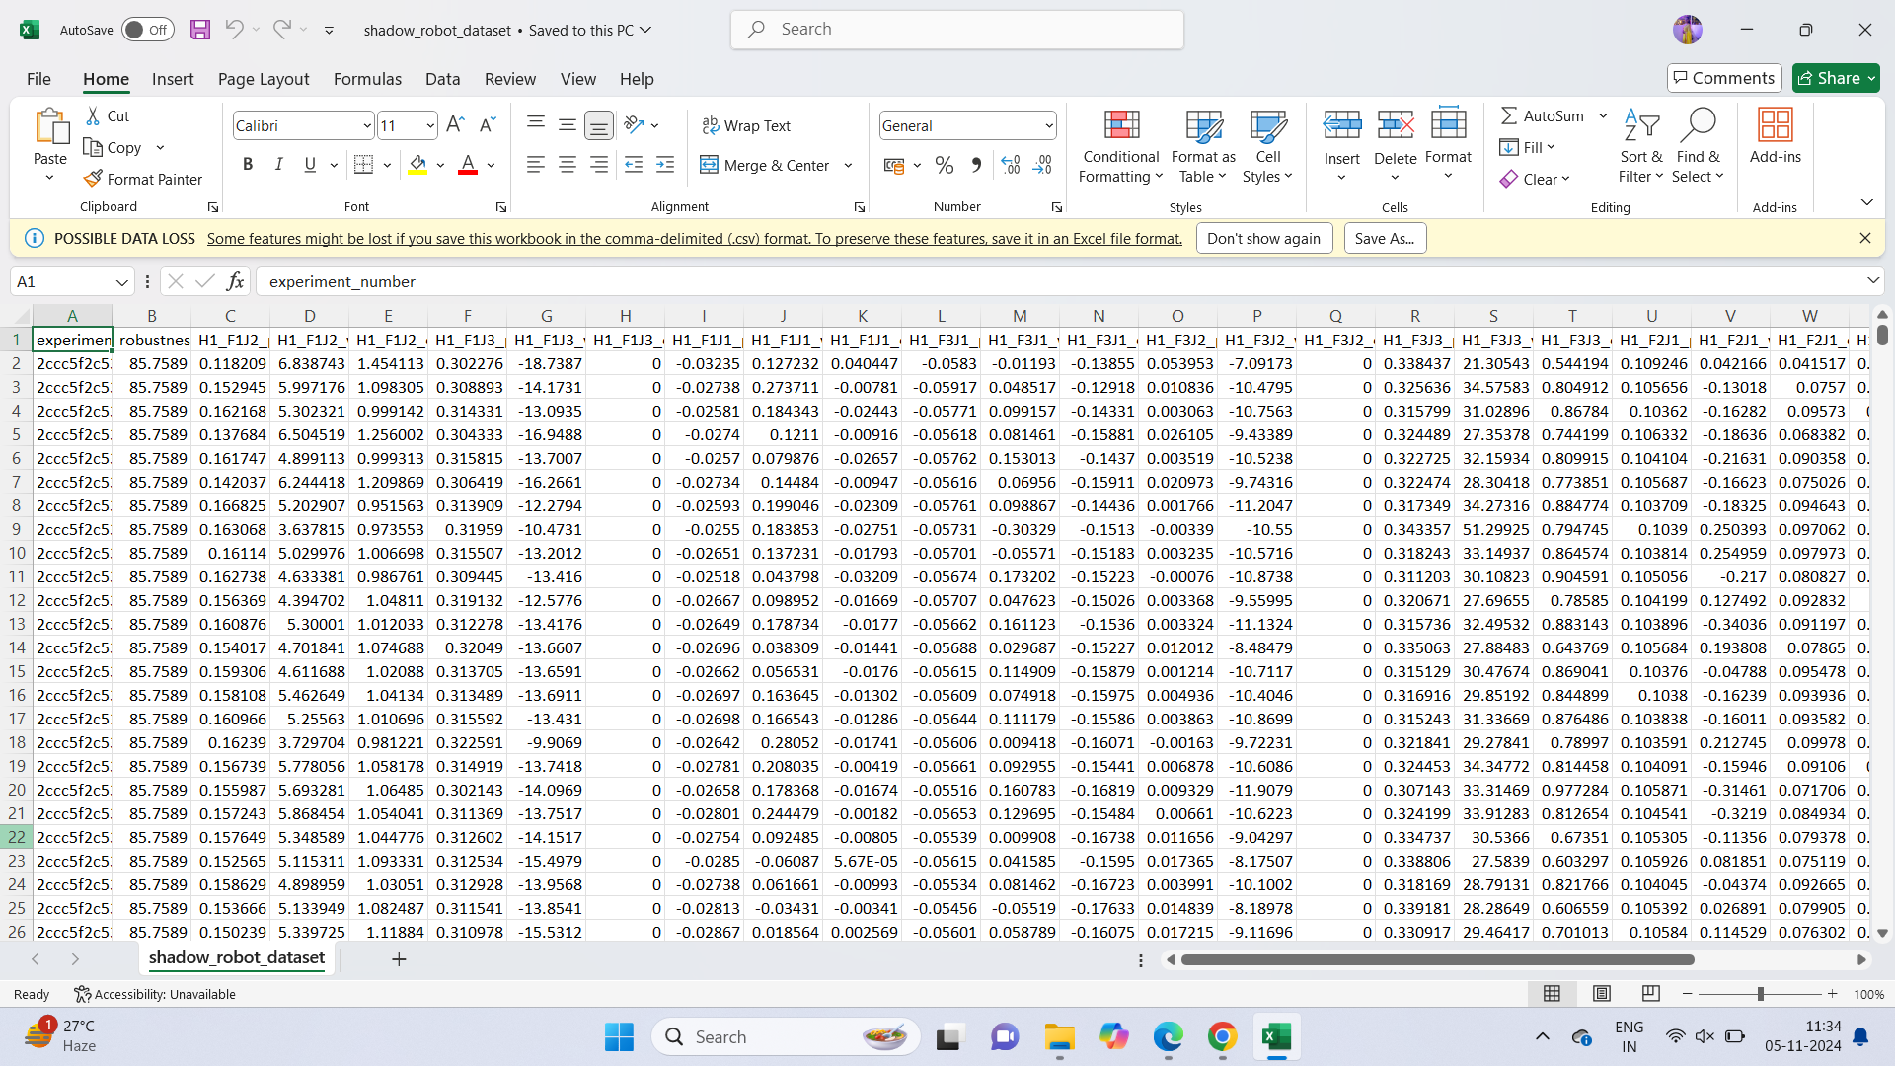
Fig : Shadow Robot Dataset

Slide 8
System Architecture
Shadow Robot Dataset
Step 1 : Data Pre-Processing
Checking for missing values, data standardization and dropping object type columns
Step 2 : EDA

Slide 9
Step 3 : Train- test split
Step 4 : Outlier Detection & Removal
By filtering/removing outliers
By replacing the outliers with mean
MODEL OPTIMIZATION
Step 5 : Dimension Reduction / Feature Selection
By Correlation Matrix
By Principal Component Analysis
Step 6 : Model Selection and Evaluation
Model evaluation performed on the Mean Squared Error (mse) and R² metrics

Slide 10
Model Selection
Machine Learning
Deep Learning
Regression
Classification
Artificial Neural Network
Linear Regression
Decision Tree Regressor
Random Forest Classifier
Logistic Regression
Support Vector Machines
Naive - Bayes Classifier

Slide 11
Observations and Results
Feature Selection: Performance of both i.e, feature selection from correlation matrix and Dimension Reduction from Principal Component Analysis were evaluated by decision tree model and Feature selection from correlation matrix showed better accuracy .
Accuracy
From correlation matrix : 0.8708
From PCA : 0.8148
Hence the final model used data after feature selection from correlation matrix .

Slide 12
Observations and Results
Outliers Handling : Removing outliers provided less accuracy while evaluation rather than replacing them with mean.
Accuracy by Removing outliers : 0.8260
Accuracy by Replacing them with the mean : 0.8372

Slide 13
Observations and Results
Regression models:
Decision Tree Regressor: Achieved a R² score of 0.87 which indicates best performance .
Linear Regression: R² score was 0.67, indicating performance with less accuracy.
Deep Learning:
ANN Regressor: The ANN emerged as the moderate-performing model, achieving the lowest MSE of 0.18 and highest R² value of 0.84.

Slide 14
Observations and Results
Classification models:
A threshold of 17.29 which is the lowest 30% of values that the robustness column holds was applied to the predicted robustness scores to classify the robot arm as "stable" or "unstable."
Classification models like Logistic Regression, Random Forest, SVM were evaluated for their accuracy in predicting stability.
Logistic Regression: Achieved an accuracy of 0.9751, demonstrating strong generalization on unseen data.
Naive Bayes Classifier: Achieved an accuracy of 0.7256.Which was least among all other models .
Random Forest Classifier: Provided the best accuracy at 0.9885, with excellent classification performance.
SVM: Achieved an accuracy of 0.9757, effectively separating classes.

Slide 15
Key Observations
Regression: Decision Tree Regressor performed best with R² = 0.87.
ANN: Achieved the lowest MSE (0.18) and highest R² (0.84), showing good performance but not the best for regression.
Feature Selection: Correlation Matrix outperformed PCA for feature selection.
Outlier Handling: Replacing outliers with mean resulted in better accuracy than removal.
Classification: Random Forest achieved the highest accuracy (0.9885), outperforming other classifiers like Logistic Regression and SVM.

Slide 16
Conclusion
Through the project, we successfully developed machine learning models to predict robot arm robustness as well as classify them as a stable/unstable grasp .
Outlier handling and feature selection techniques were found to influence model performance.
Models like Logistic Regression, Random Forest Classifier, Support Vector Machine showed promising results with an accuracy of 0.97.

Slide 17
THANK YOU!

