Slide 1
Car Dataset Exploration & Preparation Micro-Project #4 https://github.com/StutteringEmo/ANA500
Ethaniel Agas
6/1/25

Slide 2
Problem Statement
This project explores the Car Evaluation dataset to understand the structure and distribution of vehicle attributes that determine car acceptability. The goal is to prepare the data for future classification modeling by identifying structural patterns, potential class imbalance, and preprocessing needs.

Slide 3
Hypothesis Formulation
If a class imbalance exists in the dataset, then combining categories or applying balancing techniques will improve the effectiveness of classification models in accurately predicting car acceptability.

Slide 4
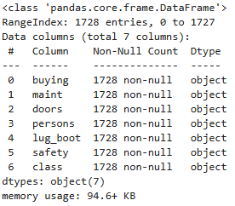
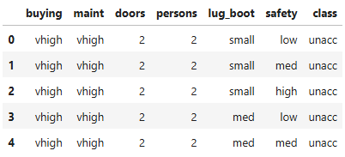
Acquire
The Car Evaluation dataset was selected from the list of curated classification datasets. It contains 7 categorical features across 1,728 entries, including variables like buying price, maintenance cost, and safety. The target variable is Class, which categorizes each vehicle based on acceptability.
The dataset was loaded using Pandas and inspected using df.head() and df.info to confirm its structure and completeness.

Slide 5
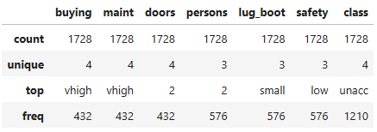
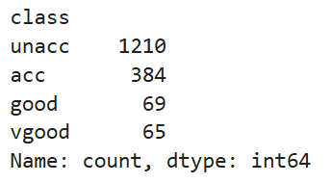
Prepare
The Car Evaluation dataset was explored and pre-processed using Pandas and NumPy.
No missing values were found across all 7 features.
All features are categorical and were set as the category data type for memory efficiency. Some features, such as safety, lug_boot, and buying/maint, have an inherent order and may be mapped to numeric values later.
The dataset shows a class imbalance, with most cars labeled as “unacc.” A potential strategy for future modeling is to consolidate class labels into broader groups like “acceptable” and “unacceptable.”
A duplicate check confirmed that no repeated rows exist in the dataset.
Value counts were reviewed for each feature to understand dominant and rare categories (e.g., 2 doors and low safety were most common).
Summary statistics confirmed that each categorical feature had exactly 3 to 4 unique values, indicating a consistent encoding format.
These steps ensure the dataset is clean, well-understood, and ready for classification modeling that can accurately assess car acceptability based on structured and meaningful input features.

Slide 6
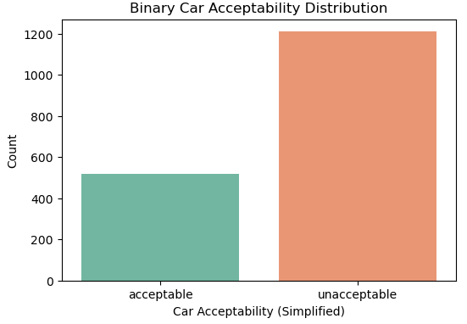
Analyze Data - Class Distribution
Visual exploration of the simplified class variable reveals a significant class imbalance.
Most vehicles are labeled as unacceptable, highlighting the need for potential resampling or grouping strategies in future modeling.
This simplification helps make the classification task more manageable and interpretable.

Slide 7
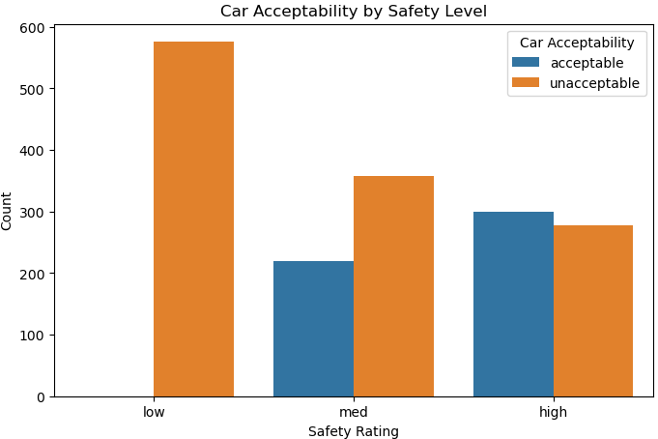
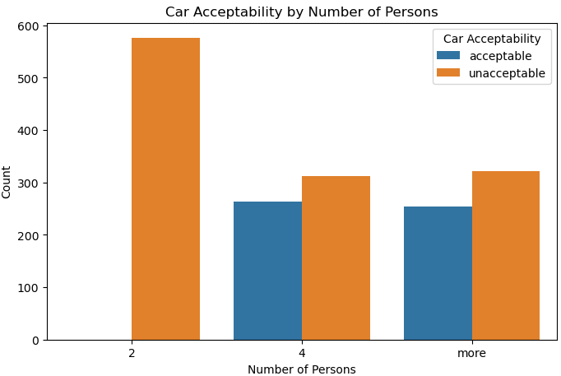
Analyze Data - Feature Relationships
Safety shows a strong relationship with car acceptability: most vehicles rated “low” for safety are classified as unacceptable, while “high” safety cars tend to be acceptable.
Seating capacity also plays a role — vehicles that seat 4 or more passengers are more often classified as acceptable.
These insights help identify which features may be most predictive in future modeling.

Slide 8
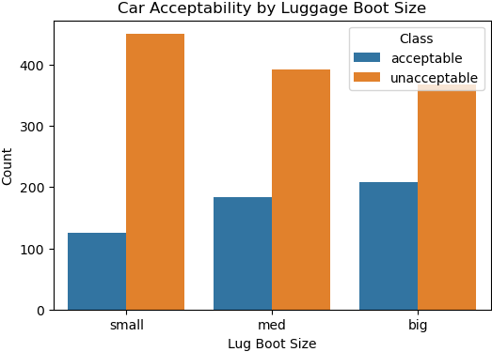
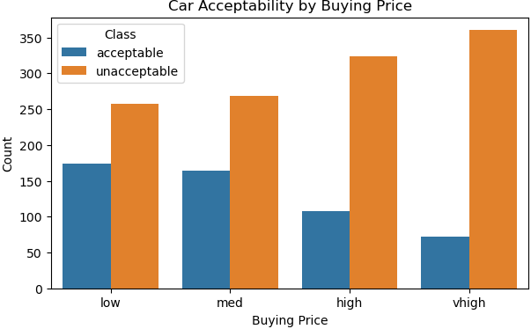
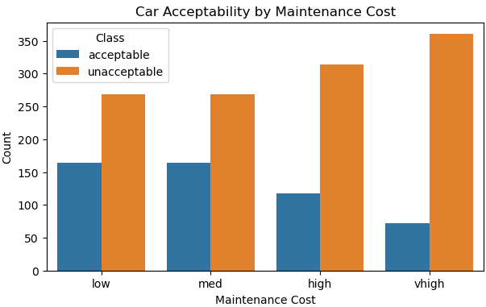
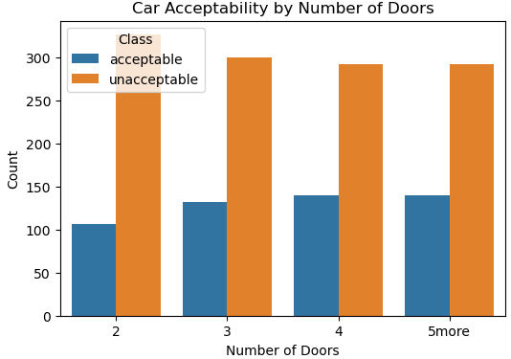
Analyze Data - Feature Encoding & Preparation
Visual analysis was expanded to include buying, maint, lug_boot, and doors.
Identified these as ordinal features with inherent order (e.g., low < med < high < vhigh).
Applied ordinal encoding to convert categorical features into numeric format suitable for machine learning.
Created a binary target variable to distinguish between acceptable and unacceptable cars.
Prepared dataset for regression-based modeling by splitting into training and test sets (80/20).

Slide 9
Report - Insights from Data Analysis
Key patterns in the dataset were identified through visualizations.
Class imbalance is significant and may require class grouping or rebalancing in future modeling steps.
Safety and seating capacity show strong associations with car acceptability, indicating their potential as predictive features.
Simplifying the class variable into two categories helped highlight clearer trends and relationships.
These insights will inform feature selection and modeling strategy in the next phase of analysis.

Slide 10
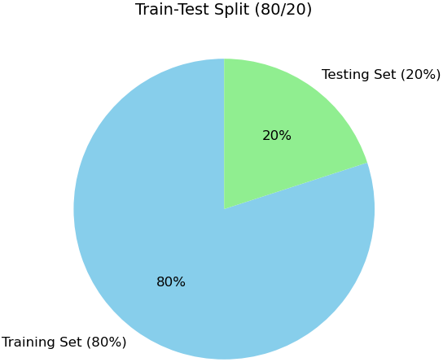


Report - Model Overview & Data Preparation
The dataset was split using an 80/20 ratio:
80% training data, 20% testing data
Ensures balanced evaluation of model performance
Three machine learning models were used:
Logistic Regression:
Simple and fast for linearly separable data
Struggles with complex, non-linear patterns
Support Vector Machine (SVM):
Effective in high-dimensional spaces
Less interpretable, longer training on large datasets
Neural Network:
Captures complex relationships; flexible architecture
Requires more data and tuning; risk of overfitting

Slide 11
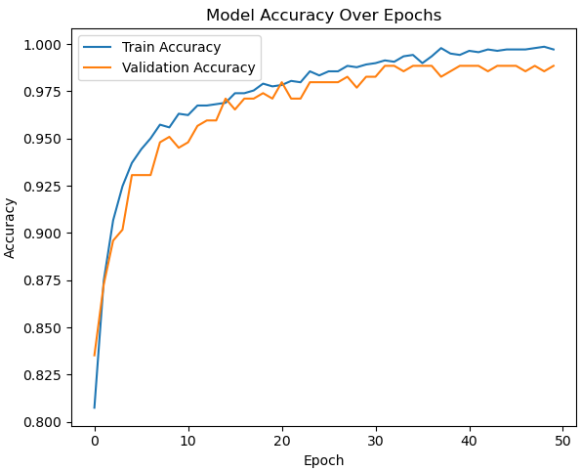
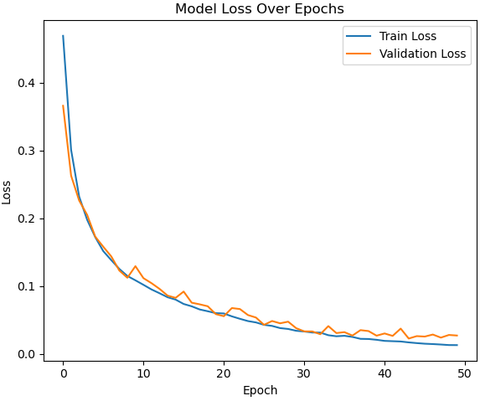
Report – Neural Network Training Progress
Model was trained over 50 epochs using early stopping to prevent overfitting.
Training and validation accuracy both reached ~99%, indicating strong learning.
Loss curves confirm training stability and convergence throughout.
Consistent gap between curves suggests good generalization without high variance.
Model architecture included two hidden layers (64 and 32 neurons) using ReLU activation and a sigmoid output for binary classification.
Validation loss closely followed training loss, showing no signs of significant overfitting.

Slide 12
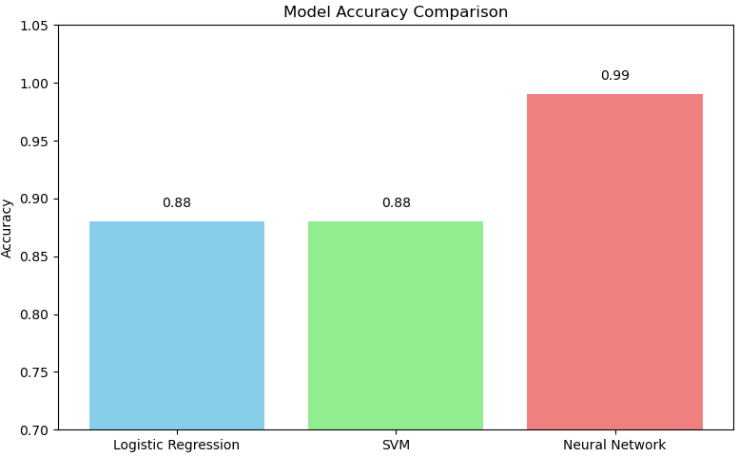
Report - Model Comparisons & Findings
All models achieved high accuracy on the test set:
Logistic Regression and SVM scored ~88%
Neural Network significantly outperformed others with ~99% accuracy.
Performance insights:
Logistic Regression showed slightly higher precision for identifying acceptable cars.
SVM had slightly fewer false positives.
Neural Network captured complex patterns with strong results across all metrics.
All models were evaluated using classification metrics on ordinal-encoded features to assess predictive performance.

Slide 13
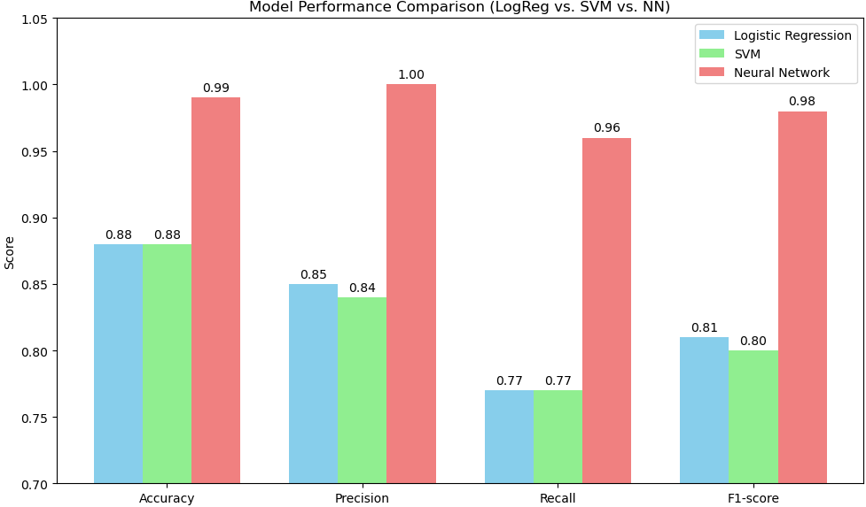
Report - Detailed Model Performance Comparison
A side-by-side comparison of all three models was conducted using four performance metrics: Accuracy, Precision, Recall, and F1-score.
Logistic Regression and SVM showed comparable performance (~88% accuracy), with Logistic Regression slightly outperforming in Precision and F1-score.
The Neural Network significantly outperformed both traditional models across all metrics, reaching ~99% in Accuracy and high scores in Precision, Recall, and F1-score.
This visual highlights the performance trade-offs between simpler models and more complex architectures, helping guide model selection based on evaluation goals and resource availability.

Slide 14
Act – Insights & Recommendations
Safety, maintenance cost, and passenger capacity were the most influential predictors of car acceptability.
Car sellers or manufacturers could prioritize vehicles rated high in safety and moderate in cost to improve acceptance rates.
Ordinal encoding proved effective for this dataset; future improvements could include feature interactions or advanced models like Random Forests or Neural Networks (noting their higher performance but greater resource demands).
Consider collecting more balanced data to improve model recall for minority class (acceptable vehicles).
This model could support automated assessments of car profiles for dealership platforms or inventory tools.

