Slide 1
UTS 31061 Database
Assignment 5 Presentation
Ho Man Cheng ( SID: 2458-1896)

Slide 2
Real World Reference
Spotify.
it has large amount of data and be popular in user.
one of interesting part for the web application, is no much for data structure in database table, (Track, Album, Artist, Playlist, User)

Slide 3
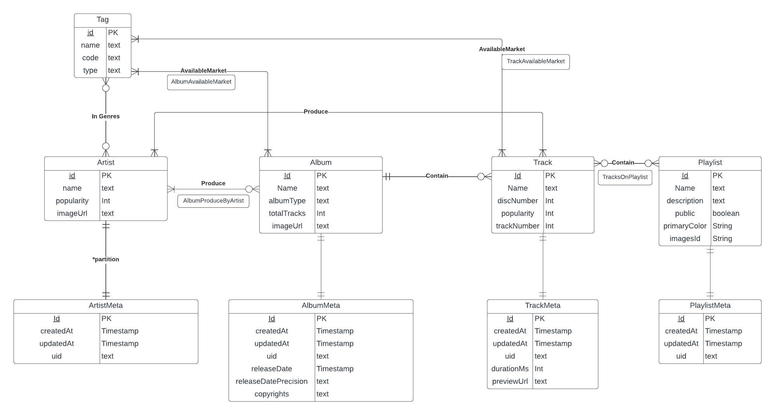
ERD

Slide 4
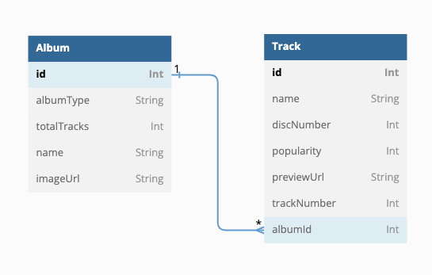
one to many relationship , Album to Track
# | trackName | discNumber | durationMs | previewUrl | trackNumber | albumId | albumName | albumType | totalTracks | imageUrl
1 | Paint It Black | 1 | 226306 | https://p.scdn.co/mp3-preview/ad055005d9a1546c6b244e2b74d91b8725f0d736?cid=ad404a1109eb4d86abc42b58bf23b924 | 1 | 15 | Hard Rock Superstars | compilation | 100 | https://i.scdn.co/image/ab67616d0000b273b519646443f8e8833dbabe14
2 | Round and Round | 1 | 275426 | https://p.scdn.co/mp3-preview/4c8bed2d9f7b57758ab1533b432967c1b4df5e01?cid=ad404a1109eb4d86abc42b58bf23b924 | 2 | 15 | Hard Rock Superstars | compilation | 100 | https://i.scdn.co/image/ab67616d0000b273b519646443f8e8833dbabe14
3 | Dream On | 1 | 268440 | https://p.scdn.co/mp3-preview/35e0741db18761a0a82dec4bbc62d6ac47862670?cid=ad404a1109eb4d86abc42b58bf23b924 | 3 | 15 | Hard Rock Superstars | compilation | 100 | https://i.scdn.co/image/ab67616d0000b273b519646443f8e8833dbabe14
4 | Battery | 1 | 320133 | https://p.scdn.co/mp3-preview/6750558dd1bb1deade918a1b270f714b03b9c928?cid=ad404a1109eb4d86abc42b58bf23b924 | 4 | 15 | Hard Rock Superstars | compilation | 100 | https://i.scdn.co/image/ab67616d0000b273b519646443f8e8833dbabe14
5 | Lonely Boy | 1 | 189399 | https://p.scdn.co/mp3-preview/a271f24ed8df49ecd0b278aa7b2d4dd6183a36ab?cid=ad404a1109eb4d86abc42b58bf23b924 | 5 | 15 | Hard Rock Superstars | compilation | 100 | https://i.scdn.co/image/ab67616d0000b273b519646443f8e8833dbabe14
6 | The Unforgiven | 1 | 391306 | https://p.scdn.co/mp3-preview/ce443a0ec0632e536a405c601c4d3bd6ebccec53?cid=ad404a1109eb4d86abc42b58bf23b924 | 6 | 15 | Hard Rock Superstars | compilation | 100 | https://i.scdn.co/image/ab67616d0000b273b519646443f8e8833dbabe14
SELECT
b.name AS "trackName",
b."discNumber",
b."durationMs",
b."previewUrl",
b."trackNumber",
b."albumId",
a.name AS "albumName",
a."albumType" ,
a."totalTracks" ,
a."imageUrl"
FROM "public"."Album" a
INNER JOIN "public"."Track" b ON b."albumId" = a.id
WHERE b."albumId" = 15
ORDER BY "albumId" ,"discNumber", "trackNumber"
LIMIT 100
;
Album-to-Track:
since the Track should under only one album or single,
while the Album may have multiple tracks for an album.

Slide 5
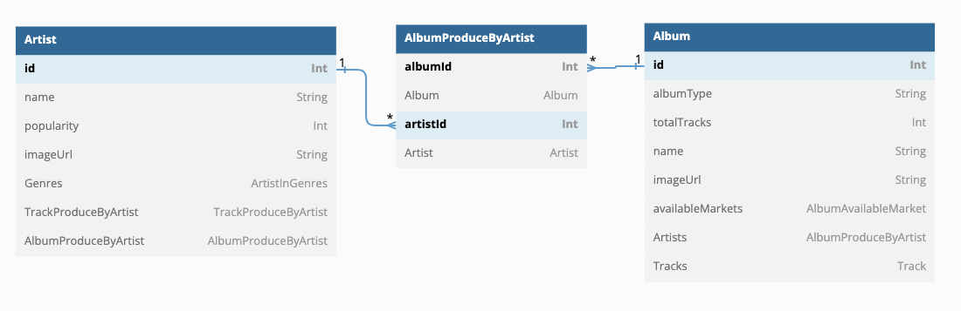
Many to many relationship , Artist to Album
SELECT
b.name AS "artistName",
b."imageUrl" AS "artistImageUrl",
a.name AS "albumName",
a."albumType" ,
a."totalTracks" ,
a."releaseDate" ,
a."imageUrl"
FROM "public"."Album" a
INNER JOIN "public"."AlbumProduceByArtist" c ON a.id = c."albumId"
INNER JOIN "public"."Artist" b ON b.id = c."artistId"
WHERE b.id = 1
ORDER BY "releaseDate" DESC
LIMIT 100
# | artistName | artistImageUrl | albumName | totalTracks | releaseDate | albumType | imageUrl
1 | Metallica | https://i.scdn.co/image/ab6761610000e5eb69ca98dd3083f1082d740e44 | Live Sh*t: Binge & Purge (Live In Mexico City) | 24 | 2031-02-28 13:00:00 | album | https://i.scdn.co/image/ab67616d0000b273f003fc67301640e0e99a77eb
2 | Metallica | https://i.scdn.co/image/ab6761610000e5eb69ca98dd3083f1082d740e44 | Metallica | 12 | 2031-02-28 13:00:00 | album | https://i.scdn.co/image/ab67616d0000b273cf84c5b276431b473e924802
3 | Metallica | https://i.scdn.co/image/ab6761610000e5eb69ca98dd3083f1082d740e44 | S&M | 21 | 2031-02-28 13:00:00 | album | https://i.scdn.co/image/ab67616d0000b2732a2e23c85aef280bffd824e7
4 | Metallica | https://i.scdn.co/image/ab6761610000e5eb69ca98dd3083f1082d740e44 | Reload | 13 | 2031-02-28 13:00:00 | album | https://i.scdn.co/image/ab67616d0000b273a49eff6d64cafc2551553380
Artist-to-Album:
since the Album can be made by multiple artist,
while the Album may have multiple album.

Slide 6
a. other query , single query
find the latest release of album.
SELECT "name" ,"albumType", "totalTracks", "releaseDate", "albumGroup", "imageUrl"
FROM "public"."Album" ORDER BY "releaseDate" DESC LIMIT 100;
# | name | albumType | totalTracks | releaseDate | albumGroup | imageUrl
1 | The More Things Change... | album | 10 | 2031-02-28 13:00:00 | album | https://i.scdn.co/image/ab67616d0000b27346efc239ea6eba381256026a
2 | Youthanasia | album | 12 | 2031-02-28 13:00:00 | album | https://i.scdn.co/image/ab67616d0000b2731d9c7b91334880fb1700dc00
3 | Persistence of Time (30th Anniversary Edition: Bonus Tracks) | album | 12 | 2031-02-28 13:00:00 | album | https://i.scdn.co/image/ab67616d0000b273586a3fd741ebec685172429a
4 | Van Halen Live: Right Here, Right Now | album | 24 | 2031-02-28 13:00:00 | album | https://i.scdn.co/image/ab67616d0000b27306506461443591e4011f2125
5 | A Fistful Of Alice (Live) | album | 14 | 2031-02-28 13:00:00 | album | https://i.scdn.co/image/ab67616d0000b273f718bfa5e2bf02f4539b32a5

Slide 7
b. other query , query with neutral join
find the latest release of album.
SELECT *
FROM “public”.”Album" NATURAL JOIN “public”.”AlbumMeta” ORDER BY "releaseDate" DESC LIMIT 100;
Table 1-1
id | name | popularity | imageUrl | createdAt | updatedAt | uid
1 | Metallica | 84 | https://i.scdn.co/image/ab6761610000e5eb69ca98dd3083f1082d740e44 | 2023-04-30 17:25:01.706 | 2023-04-30 17:25:01.706 | 2ye2Wgw4gimLv2eAKyk1NB
2 | Guns N' Roses | 80 | https://i.scdn.co/image/ab6761610000e5eb50defaf9fc059a1efc541f4c | 2023-04-30 17:25:01.706 | 2023-04-30 17:25:01.706 | 3qm84nBOXUEQ2vnTfUTTFC
3 | DECO*27 | 59 | https://i.scdn.co/image/ab6761610000e5ebe18756b9265f7b53964157f2 | 2023-04-30 17:25:01.706 | 2023-04-30 17:25:01.706 | 7kZTWx6cRLc0TSRPq1XBMP
4 | T.M.Revolution | 52 | https://i.scdn.co/image/ab67616d0000b273f628f8daba2dde063d6b2d2e | 2023-04-30 17:25:01.706 | 2023-04-30 17:25:01.706 | 3jdzcmtw5XOmOkSb2mRDtr
5 | Takanori Nishikawa | 39 | https://i.scdn.co/image/ab6761610000e5eb6b11b253ccf95465a7b7e0ed | 2023-04-30 17:25:01.706 | 2023-04-30 17:25:01.706 | 2ayMogRmamCnzMAk4YiFAz
6 | Kanaria | 62 | https://i.scdn.co/image/ab6761610000e5eb1acb134c45378a93e7d4c35d | 2023-04-30 17:25:01.706 | 2023-04-30 17:25:01.706 | 1k5LyiTCRzPjORzcgHqJxF
7 | ZAQ | 48 | https://i.scdn.co/image/ab6761610000e5eb307bde0ff134b194e2bfceda | 2023-04-30 17:25:01.706 | 2023-04-30 17:25:01.706 | 56TyClNQ0oVZLhK2V9KhA6
8 | ASIAN KUNG-FU GENERATION | 61 | https://i.scdn.co/image/ab6761610000e5eb4ccea7adc552148d508e157b | 2023-04-30 17:25:01.706 | 2023-04-30 17:25:01.706 | 0MK8l3nURwwQIjafvXoJJt

Slide 8
c. other query , query with inner join
find the album with its tracks
SELECT
b.name AS "trackName",
b."discNumber",
b."durationMs",
b."previewUrl",
b."trackNumber",
b."albumId",
a.name AS "albumName",
a."albumType" ,
a."totalTracks" ,
a."imageUrl"
FROM "public"."Album" a
INNER JOIN "public"."Track" b
ON b."albumId" = a.id
WHERE b."albumId" = 15
ORDER BY
“albumId" ,"discNumber", "trackNumber"
LIMIT 100
;
# | trackName | discNumber | durationMs | previewUrl | trackNumber | albumId | albumName | albumType | totalTracks | imageUrl
1 | Paint It Black | 1 | 226306 | https://p.scdn.co/mp3-preview/ad055005d9a1546c6b244e2b74d91b8725f0d736?cid=ad404a1109eb4d86abc42b58bf23b924 | 1 | 15 | Hard Rock Superstars | compilation | 100 | https://i.scdn.co/image/ab67616d0000b273b519646443f8e8833dbabe14
2 | Round and Round | 1 | 275426 | https://p.scdn.co/mp3-preview/4c8bed2d9f7b57758ab1533b432967c1b4df5e01?cid=ad404a1109eb4d86abc42b58bf23b924 | 2 | 15 | Hard Rock Superstars | compilation | 100 | https://i.scdn.co/image/ab67616d0000b273b519646443f8e8833dbabe14
3 | Dream On | 1 | 268440 | https://p.scdn.co/mp3-preview/35e0741db18761a0a82dec4bbc62d6ac47862670?cid=ad404a1109eb4d86abc42b58bf23b924 | 3 | 15 | Hard Rock Superstars | compilation | 100 | https://i.scdn.co/image/ab67616d0000b273b519646443f8e8833dbabe14
4 | Battery | 1 | 320133 | https://p.scdn.co/mp3-preview/6750558dd1bb1deade918a1b270f714b03b9c928?cid=ad404a1109eb4d86abc42b58bf23b924 | 4 | 15 | Hard Rock Superstars | compilation | 100 | https://i.scdn.co/image/ab67616d0000b273b519646443f8e8833dbabe14
5 | Lonely Boy | 1 | 189399 | https://p.scdn.co/mp3-preview/a271f24ed8df49ecd0b278aa7b2d4dd6183a36ab?cid=ad404a1109eb4d86abc42b58bf23b924 | 5 | 15 | Hard Rock Superstars | compilation | 100 | https://i.scdn.co/image/ab67616d0000b273b519646443f8e8833dbabe14
6 | The Unforgiven | 1 | 391306 | https://p.scdn.co/mp3-preview/ce443a0ec0632e536a405c601c4d3bd6ebccec53?cid=ad404a1109eb4d86abc42b58bf23b924 | 6 | 15 | Hard Rock Superstars | compilation | 100 | https://i.scdn.co/image/ab67616d0000b273b519646443f8e8833dbabe14

Slide 9
d. other query, query with GROUP BY
Find popular genre of artist
# | tagId | totalArtist | name
1 | 185 | 41 | hard rock
2 | 423 | 35 | anime
3 | 418 | 34 | vocaloid
4 | 187 | 31 | rock
5 | 189 | 25 | metal
SELECT a1."tagId" , a1."totalArtist", b."name"
FROM (
SELECT
a."tagId" ,
COUNT(*) AS "totalArtist"
FROM "public"."ArtistInGenres" a
GROUP BY "tagId"
) a1
INNER JOIN "public"."Tag" b ON a1."tagId" = b."id"
ORDER BY "totalArtist" DESC

Slide 10
e. other query, query with Subquery
Get artists info, with their genres tags
name | popularity | imageUrl | artistGenres
Metallica | 84 | https://i.scdn.co/image/ab6761610000e5eb69ca98dd3083f1082d740e44 | ["hard rock", "metal", "old school thrash", "rock", "thrash metal"]
Guns N' Roses | 80 | https://i.scdn.co/image/ab6761610000e5eb50defaf9fc059a1efc541f4c | ["glam metal", "hard rock", "rock"]
DECO*27 | 59 | https://i.scdn.co/image/ab6761610000e5ebe18756b9265f7b53964157f2 | ["anime rock", "j-pixie", "vocaloid"]
T.M.Revolution | 52 | https://i.scdn.co/image/ab67616d0000b273f628f8daba2dde063d6b2d2e | ["anime", "classic j-pop", "j-pop"]
Takanori Nishikawa | 39 | https://i.scdn.co/image/ab6761610000e5eb6b11b253ccf95465a7b7e0ed | ["anime"]
Kanaria | 62 | https://i.scdn.co/image/ab6761610000e5eb1acb134c45378a93e7d4c35d | ["vocaloid"]
ZAQ | 48 | https://i.scdn.co/image/ab6761610000e5eb307bde0ff134b194e2bfceda | ["anime", "j-pixie"]
ASIAN KUNG-FU GENERATION | 61 | https://i.scdn.co/image/ab6761610000e5eb4ccea7adc552148d508e157b | ["anime", "j-pop", "j-poprock", "j-rock", "japanese emo", "japanese pop punk"]
SELECT a."name"
,a."popularity"
,a."imageUrl"
,b."artistGenres"
FROM "public"."Artist" a
INNER JOIN (
SELECT
b1."artistId" , JSON_AGG(b2."name") AS "artistGenres"
FROM "public"."ArtistInGenres" b1
INNER JOIN "public"."Tag" b2 ON b1."tagId" = b2."id"
GROUP BY "artistId"
) b
ON a."id" = b."artistId"

Slide 11
f. other query, complex query
Get artists info, with their genres tags
# | name | discNumber | durationMs | popularity | previewUrl | trackNumber | albumId | albumName | albumType | totalTracks | ArtistsInfo | ArtistsCount
1 | ダンスロボットダンス - アレンジメドレー(キメラver) はるまきごはん×煮ル果実×和田たけあき×栗山夕璃(蜂屋ななし)×じん×かいりきベア×てにをは×Chinozo×ピノキオピー×稲葉曇×一二三×Aqu3ra×Neru×ナユタン星人 | 1 | 182013 | 0 | https://p.scdn.co/mp3-preview/1b40c5e497ccc3719134325b80bed1537d1a0c63?cid=ad404a1109eb4d86abc42b58bf23b924 | 8 | 708 | キメラ | compilation | 8 | [{"id" : 54, "name" : "Neru", "imageUrl" : "https://i.scdn.co/image/ab67616d0000b27320cb63ece80e6e61e1b45117"}, {"id" : 58, "name" : "Nayutalien", "imageUrl" : "https://i.scdn.co/image/ab6761610000e5ebe42104b4ea1b44a28108b9f1"}, {"id" : 107, "name" : "Kairikibear", "imageUrl" : "https://i.scdn.co/image/ab67616d0000b273745ff8443f0db1cda32e5c97"}, {"id" : 111, "name" : "Chinozo", "imageUrl" : "https://i.scdn.co/image/ab6761610000e5eb4b8f3852cbeaa5335ad8b7e0"}, {"id" : 112, "name" : "PinocchioP", "imageUrl" : "https://i.scdn.co/image/ab6761610000e5eb9e41c9b34f4772baa492e86d"}] | 5
2 | Elected - Live At Cabo Wabo Cantina, Cabo San Lucas, Mexico/1996 | 1 | 313386 | 0 |  | 12 | 407 | A Fistful Of Alice | album | 13 | [{"id" : 27, "name" : "Slash", "imageUrl" : "https://i.scdn.co/image/ab6761610000e5eb16bbce3d5fb8a51e7cc3dce0"}, {"id" : 33, "name" : "Alice Cooper", "imageUrl" : "https://i.scdn.co/image/ab6761610000e5ebb5687d33f85251658264d9f4"}] | 2
3 | デビルじゃないもん | 1 | 163682 | 0 | https://p.scdn.co/mp3-preview/a09300faf2e7cbcb8f7a81220aaf608f7ad11e8b?cid=ad404a1109eb4d86abc42b58bf23b924 | 1 | 374 | デビルじゃないもん | single | 3 | [{"id" : 45, "name" : "DECO*27", "imageUrl" : "https://i.scdn.co/image/ab6761610000e5ebe18756b9265f7b53964157f2"}, {"id" : 112, "name" : "PinocchioP", "imageUrl" : "https://i.scdn.co/image/ab6761610000e5eb9e41c9b34f4772baa492e86d"}] | 2
4 | BraveSail Instrumental | 1 | 306706 | 0 |  | 4 | 87 | Senpai - EP | single | 4 | [{"id" : 53, "name" : "HoneyWorks", "imageUrl" : "https://i.scdn.co/image/ab6761610000e5ebcc7b1d24a5cec3a30c4db7aa"}, {"id" : 131, "name" : "TrySail", "imageUrl" : "https://i.scdn.co/image/ab6761610000e5eb449e3a3e0d2bba8485388234"}] | 2
SELECT
a."name", a."discNumber", a1."durationMs", a."popularity", a1."previewUrl", a."trackNumber", a."albumId",
b."name" AS "albumName" , b."albumType" , b."totalTracks" ,
d."ArtistsInfo" , d."ArtistsCount"
FROM "public"."Track" a
NATURAL JOIN "public"."TrackMeta" a1
INNER JOIN "public"."Album" b ON a."albumId" = b."id"
INNER JOIN (
SELECT d1."trackId" ,
JSON_AGG( JSON_BUILD_OBJECT( 'id',d2."id", 'name', d2."name", 'imageUrl',d2."imageUrl" )) AS "ArtistsInfo",
COUNT(*) AS "ArtistsCount"
FROM "public"."TrackProduceByArtist" d1
INNER JOIN "public"."Artist" d2 ON d1."artistId" = d2."id"
GROUP BY "trackId"
) d ON d."trackId" = a."id"
ORDER BY "ArtistsCount" DESC
LIMIT 100;

Slide 12
CHECK statement
ALTER TABLE "AlbumAvailableMarket"
ADD CONSTRAINT market_id_check CHECK(
“tagId" BWTWEEN 1 TO 184 )
to check the Many-to-Many Table (AlbumAvailableMarket) inputing ;

Slide 13
On DELETE CASCADE statement
ALTER TABLE "TracksAvailableMarket"
CONSTRAINT "TracksAvailableMarket_tagId_fkey" FOREIGN KEY ("tagId") REFERENCES "Tag"("id") ON DELETE CASCADE ON UPDATE CASCADE,
when the tag row data delete, the Many-to-many data for track to tag should be removed

Slide 14
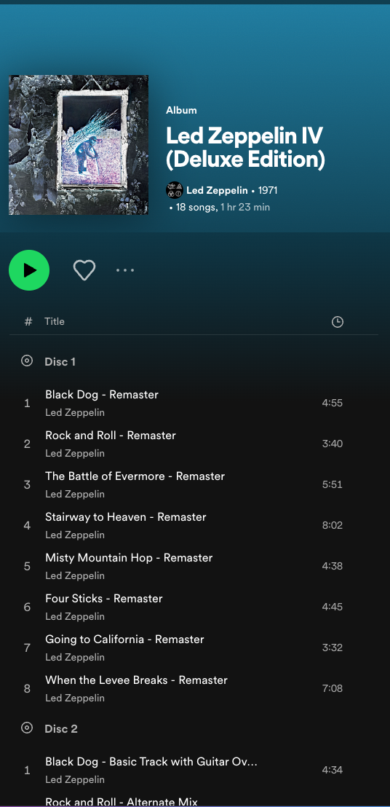
illustrate the use of view
CREATE VIEW v_track_row AS
SELECT
a."name", a."discNumber", a1."durationMs", a."popularity", a."trackNumber", a."albumId",
d."ArtistsInfo"
FROM "Track" a
NATURAL JOIN "public"."TrackMeta" a1
INNER JOIN (
SELECT d1."trackId" ,
JSON_AGG( JSON_BUILD_OBJECT(
'id',d2."id",
'name', d2."name",
'imageUrl',d2."imageUrl"
)) AS "ArtistsInfo",
COUNT(*) AS "ArtistsCount"
FROM "public"."TrackProduceByArtist" d1
INNER JOIN "public"."Artist" d2 ON d1."artistId" = d2."id"
GROUP BY "trackId"
) d ON d."trackId" = a."id"
ORDER BY "albumId" ,"discNumber", "trackNumber" ASC;
;
SELECT * FROM v_track_row WHERE “albumId” = 12
name | discNumber | durationMs | popularity | trackNumber | albumId | ArtistsInfo
Some Kind Of Monster | 1 | 505705 |  | 1 | 25 | [{"id" : 1, "name" : "Metallica", "imageUrl" : "https://i.scdn.co/image/ab6761610000e5eb69ca98dd3083f1082d740e44"}]
The Four Horsemen - Live | 1 | 320585 |  | 2 | 25 | [{"id" : 1, "name" : "Metallica", "imageUrl" : "https://i.scdn.co/image/ab6761610000e5eb69ca98dd3083f1082d740e44"}]
Damage, Inc. - Live | 1 | 299238 |  | 3 | 25 | [{"id" : 1, "name" : "Metallica", "imageUrl" : "https://i.scdn.co/image/ab6761610000e5eb69ca98dd3083f1082d740e44"}]
Leper Messiah - Live | 1 | 355678 |  | 4 | 25 | [{"id" : 1, "name" : "Metallica", "imageUrl" : "https://i.scdn.co/image/ab6761610000e5eb69ca98dd3083f1082d740e44"}]
Motorbreath - Live | 1 | 199932 |  | 5 | 25 | [{"id" : 1, "name" : "Metallica", "imageUrl" : "https://i.scdn.co/image/ab6761610000e5eb69ca98dd3083f1082d740e44"}]
Ride The Lightning - Live | 1 | 400918 |  | 6 | 25 | [{"id" : 1, "name" : "Metallica", "imageUrl" : "https://i.scdn.co/image/ab6761610000e5eb69ca98dd3083f1082d740e44"}]
Hit The Lights - Live | 1 | 252358 |  | 7 | 25 | [{"id" : 1, "name" : "Metallica", "imageUrl" : "https://i.scdn.co/image/ab6761610000e5eb69ca98dd3083f1082d740e44"}]
Some Kind Of Monster - Edit | 1 | 256798 |  | 8 | 25 | [{"id" : 1, "name" : "Metallica", "imageUrl" : "https://i.scdn.co/image/ab6761610000e5eb69ca98dd3083f1082d740e44"}]

