Slide 1
Case Study: Airbnb listings Analysing the price for listings in Amsterdam
Stephan van der Putten & Joep Helmonds

Slide 2
Index
Introduction
Airbnb
InsideAirbnb
Background Dataset
Dataset
Distributions
Neighbourhoods
Results
Questions/Remarks

Slide 3

Airbnb1
Founded in 2008 in California
Online marketplace to offer and find lodging
Especially focused on tourism experience
1 en.wikipedia.org/wiki/Airbnb

Slide 4
InsideAirbnb2
Independent organisation
Webscraping of the data each month since 2015
Earlier research analysed gentrification in San Francisco
Datasets are pre-processed and cleaned
2 http://insideairbnb.com/about.html#disclaimers

Slide 5
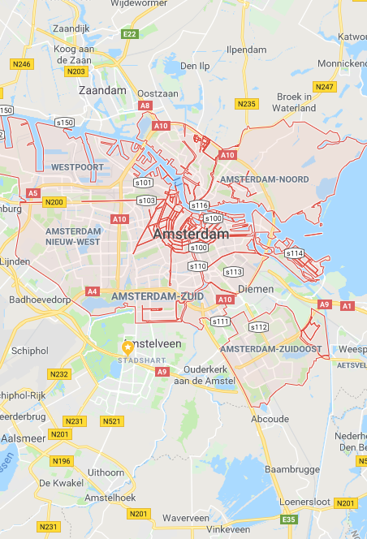
Background Dataset
Airbnb in Amsterdam 3
Amsterdam was heralded as the first city in the World to pass an "Airbnb-friendly law", however according to Het Parool, there is "No brakes on the growth of Airbnb in Amsterdam", including apparently following the law. Airbnb vowed to send an e-mail twice a year to hosts reminding them of the local laws.
The Law
In February 2014, Amsterdam created a new category of housing, a "Particuliere Vakantieverhuur", or "private vacation rental" which allows short term vacation rentals to tourists under the following conditions:
Only the registered, main occupant of a dwelling may rent out a property
The owner is the only person that can rent out the property, in most cases Amsterdam leases prohibit a tenant renting to others
The dwelling must not be rented for more than two months a year in total
No more than 4 people can rent a property at a time
3 http://insideairbnb.com/amsterdam/

Slide 6
Dataset - General
Listings of the month November 2018 Amsterdam (Publicly available)
Listings 20010
Columns 96
Anonymised (No personal data)

Slide 7
Dataset – Listings
Removed
NA’s
Useless columns (ids)
Prices above $ 500 per night
New
Number of Amenities
Description length
13006 listings remaining, 60 columns

Slide 8
Dataset - Summary
summary(listings)
description_length num_amenities square_feet price
Min. : 2.0 Min. : 1.00 Min. : 0.0 Min. : 8.0
1st Qu.: 763.2 1st Qu.:14.00 1st Qu.: 0.0 1st Qu.: 95.0
Median :1000.0 Median :19.00 Median : 382.5 Median :125.0
Mean : 841.1 Mean :20.89 Mean : 470.1 Mean :141.4
3rd Qu.:1000.0 3rd Qu.:26.00 3rd Qu.: 753.0 3rd Qu.:170.0
Max. :1000.0 Max. :73.00 Max. :2691.0 Max. :499.0

Slide 9
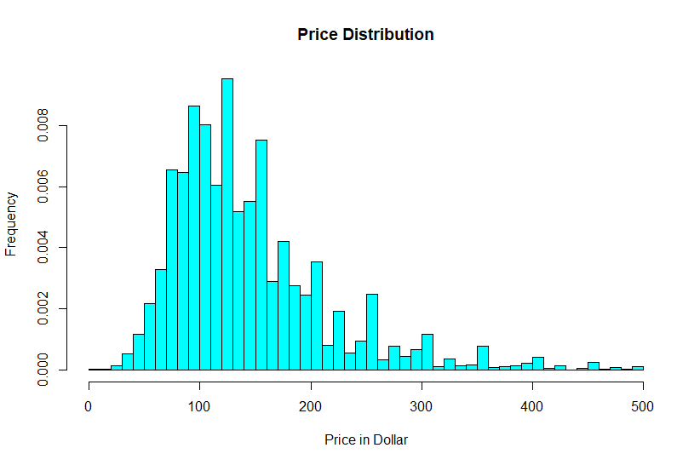
Distributions - Price
Mean: 141
Median: 125
Mode: 150

Slide 10
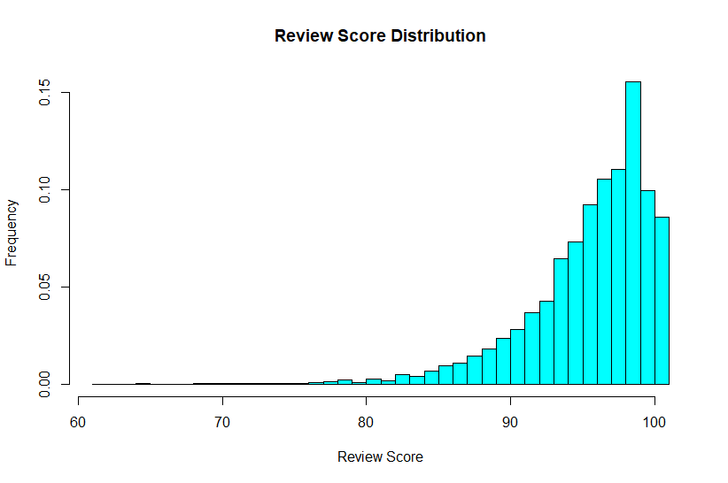
Distributions - Score
Mean: 95
Median: 96

Slide 11
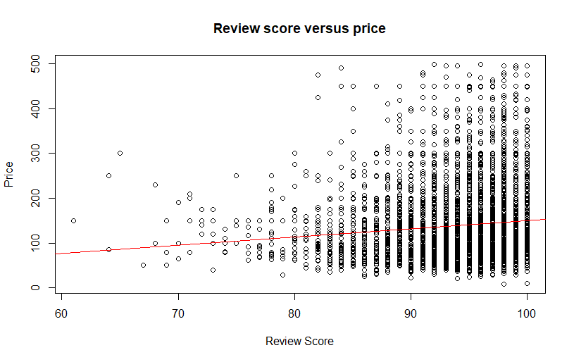
Review versus Price

Slide 12
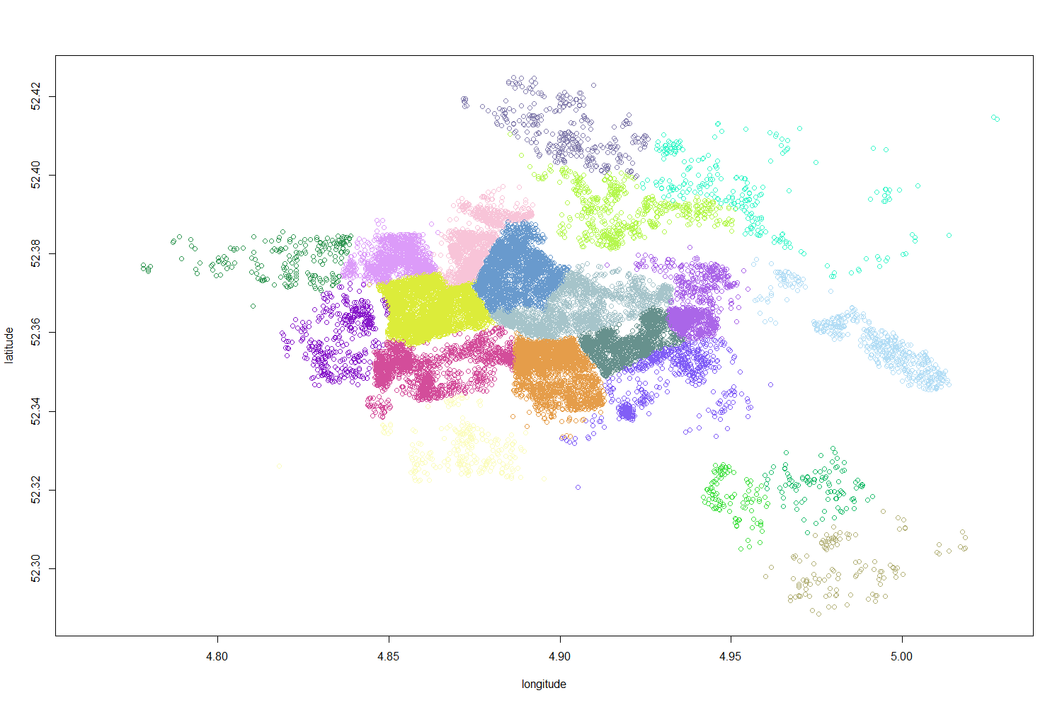
Neighbourhoods

Slide 13
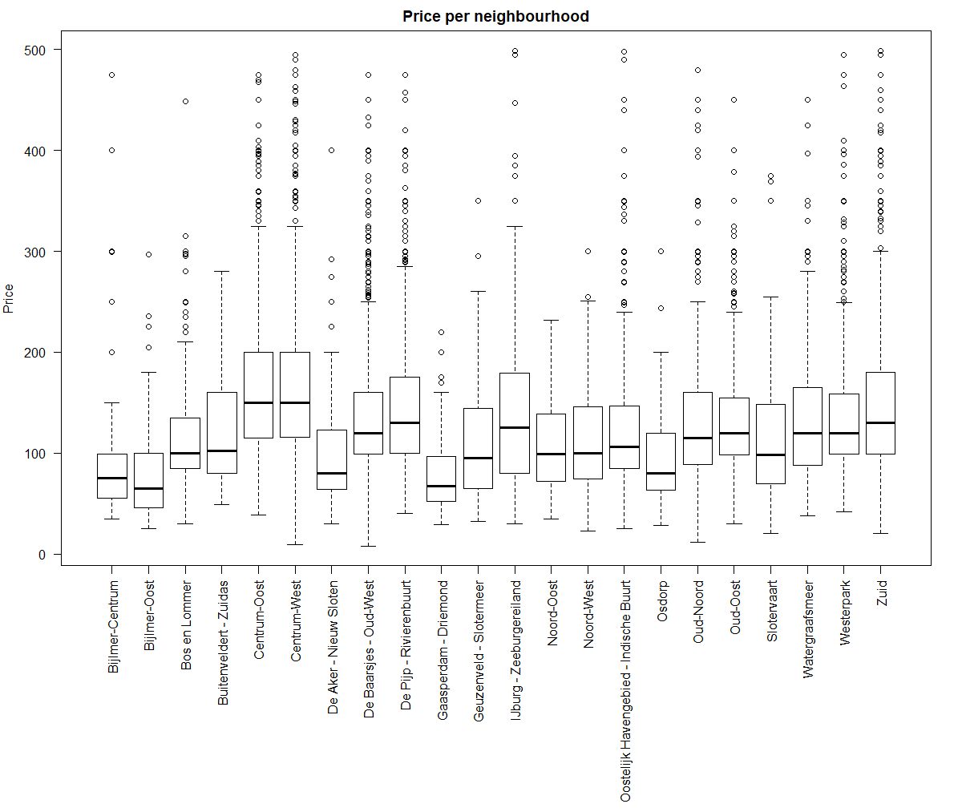
Neigbourhoods - Price
Neighbourhood | Avg Price
Gaasperdam-Driemond | $ 80
Bijlmer-Oost | $ 84
Osdorp | $ 95
... | ...
Zuid | $ 151
Centrum-Oost | $ 168
Centrum-West | $ 172

Slide 14
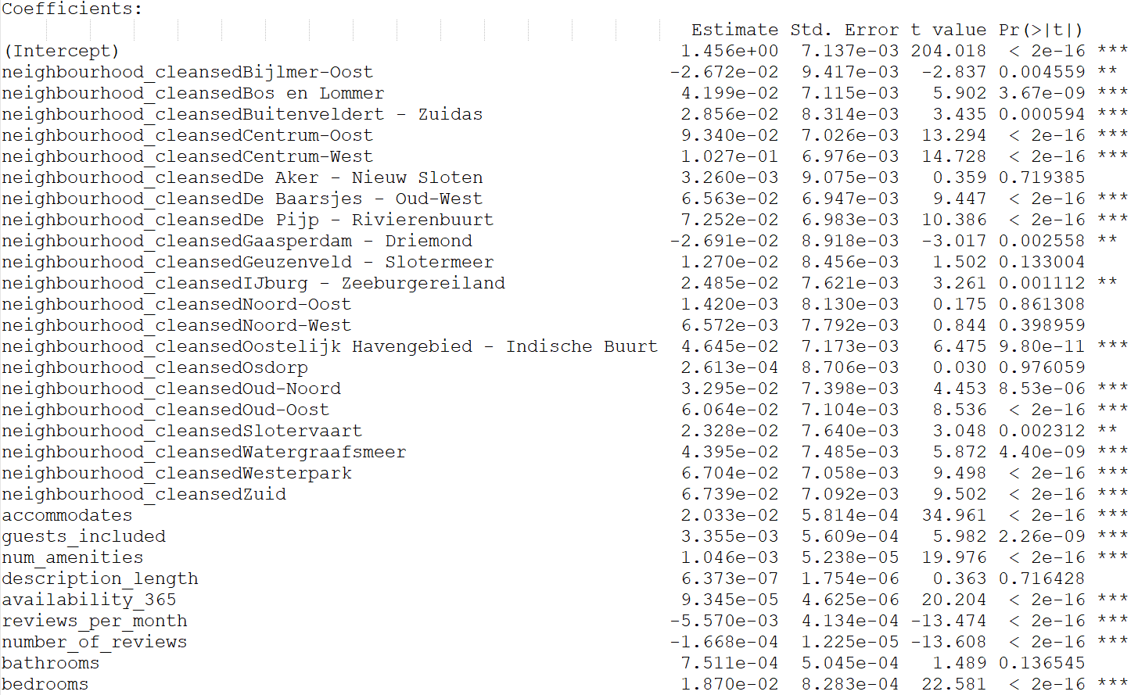
Results

Slide 15
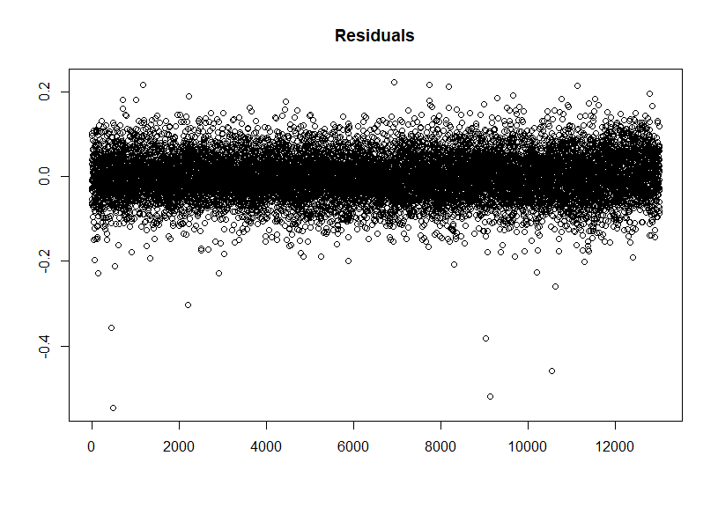
Residuals

Slide 16
Questions?

