Slide 1
FIRST CAR PROJECT
01 / 07
BUYING MY
FIRST CAR
$150.48 / month
ON A BUDGET
My transportation budget
Rehan Mangar

Slide 2
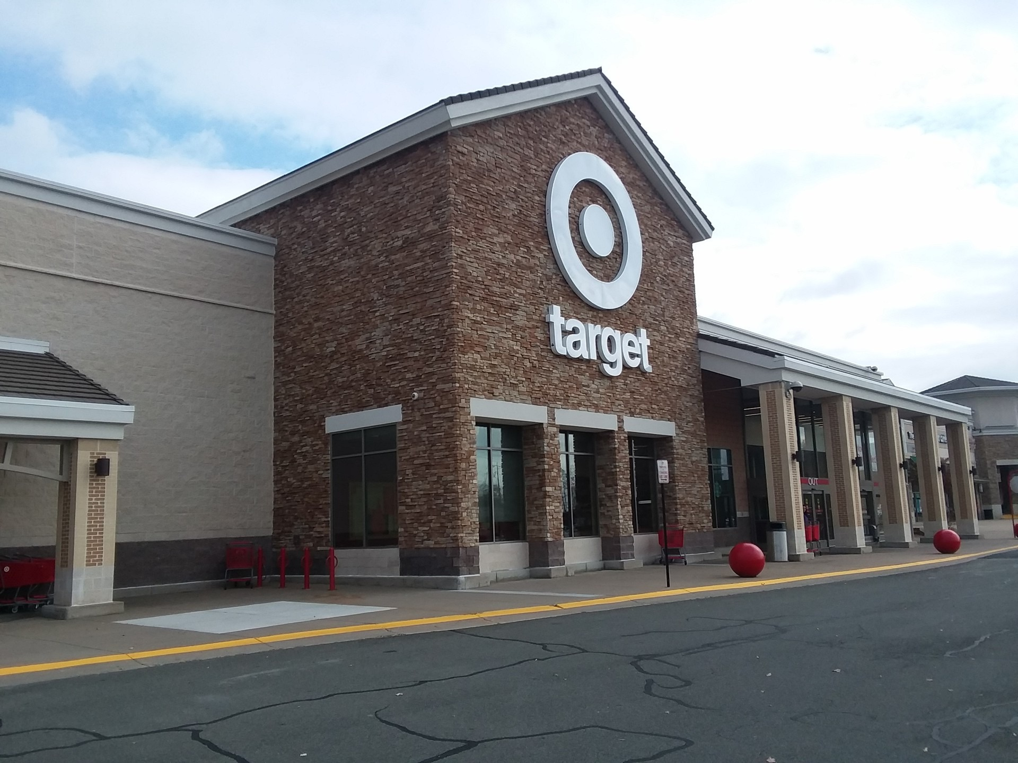
My job
02 / 07
TARGET TEAM MEMBER
HOURLY PAY
HOURS EACH WEEK
$14.25
24
GROSS WEEKLY PAY
GROSS MONTHLY PAY
$342
$1,368
$14.25 × 24 = $342 a week. $342 × 4 = $1,368 a month before taxes.

Slide 3
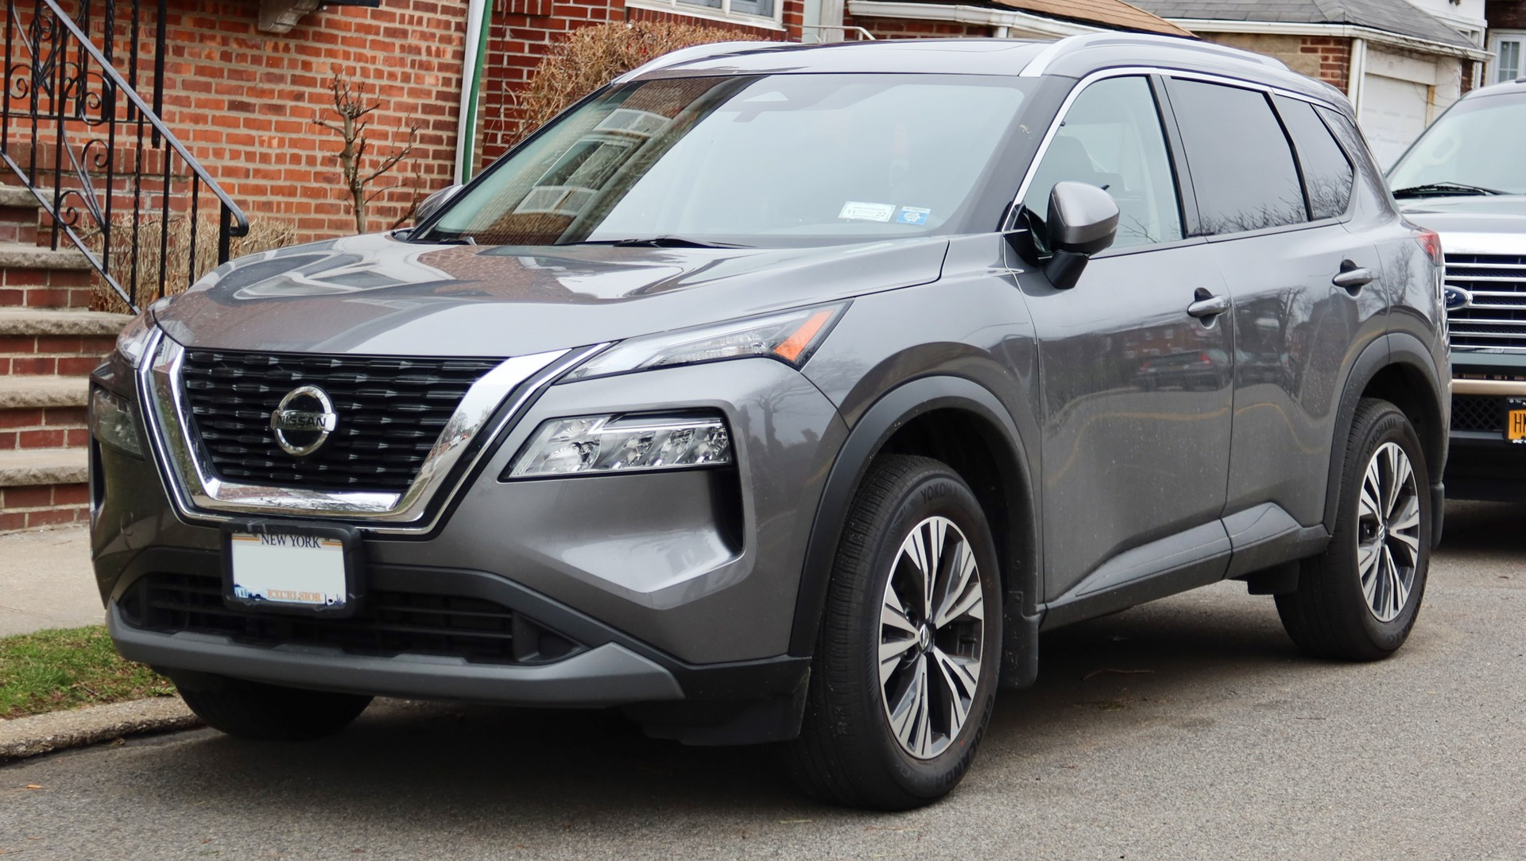
Car #1
03 / 07
2023 Nissan Rogue S AWD
PRICE
$11,376
FEATURES & SAFETY
Keyless start, Apple CarPlay,
and Android Auto.
AWD, lane warning, brake assist,
and cross-traffic alert.
WHY I LIKE IT
FULL TANK: $56.41
No accidents or damage. Nice car for the price.
14.5 gal × $3.89/gal

Slide 4
Car #1: loan options
04 / 07
PARENT LOAN A
BANK LOAN B
$229.42
$214.56
per month
per month
4.2% simple interest
5.1% compounded daily
5 years (60 payments)
6 years (72 payments)
Interest: $2,388.96
Interest: $4,072.08
Total: $13,764.96
Total: $15,448.08
I would choose Loan A. It saves $1,683.12 in interest.

Slide 5
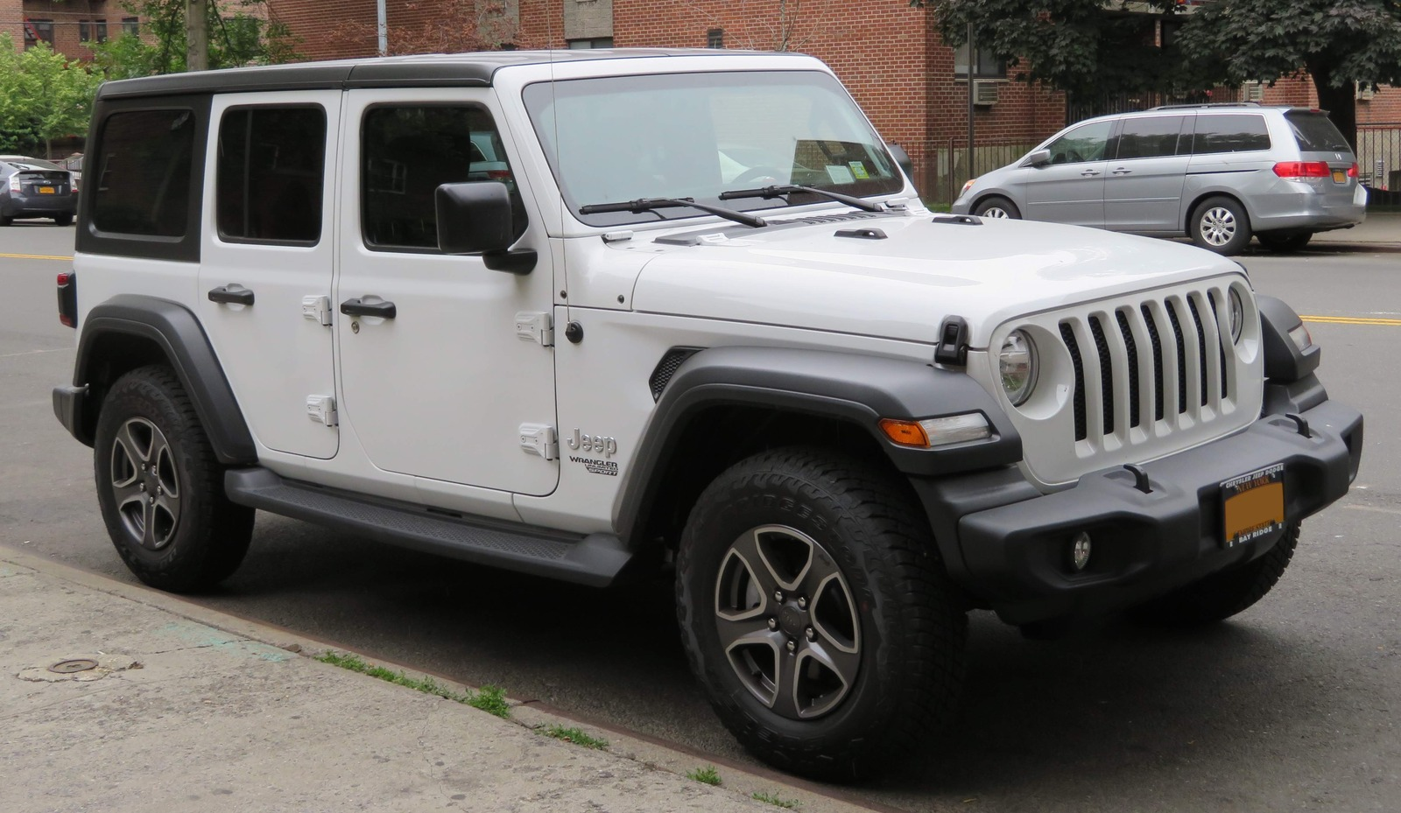
Car #2
05 / 07
2012 Jeep Wrangler Unlimited Sport 4WD
PRICE
$8,995
FEATURES & SAFETY
Durable interior and four-wheel drive.
ESC, ERM, advanced airbags, HSA,
and ABS.
WHY I LIKE IT
FULL TANK: $87.53
It seemed like a good deal for the price.
22.5 gal × $3.89/gal

Slide 6
Car #2: loan options
06 / 07
PARENT LOAN C
BANK LOAN D
$181.40
$169.65
per month
per month
4.2% simple interest
5.1% compounded daily
5 years (60 payments)
6 years (72 payments)
Interest: $1,888.95
Interest: $3,219.79
Total: $10,883.95
Total: $12,214.79
I would choose Loan C. It saves $1,330.84 in interest.

Slide 7
Follow-up: my choice & budget
07 / 07
MY CHOICE
2012 Jeep with Loan C, $181.40/month.
TOTAL EACH MONTH
$426.40
TRANSPORTATION BUDGET
11% of $1,368 = $150.48 a month.
$181.40 loan + $245 insurance
Gas would cost extra.
DOES THE PAYMENT FIT?
No. It's $30.92 over, before insurance.
CAR INSURANCE
I like the Jeep, but I can't
afford it yet.
About $245 a month.
I need more hours or a bigger
down payment before I buy it.

