Slide 1

MY CAR PRESENTATION
CAR PROJECT
BUYING MY FIRST CAR
ON A BUDGET
PREPARED BY:
Rehan Mangar

Slide 2
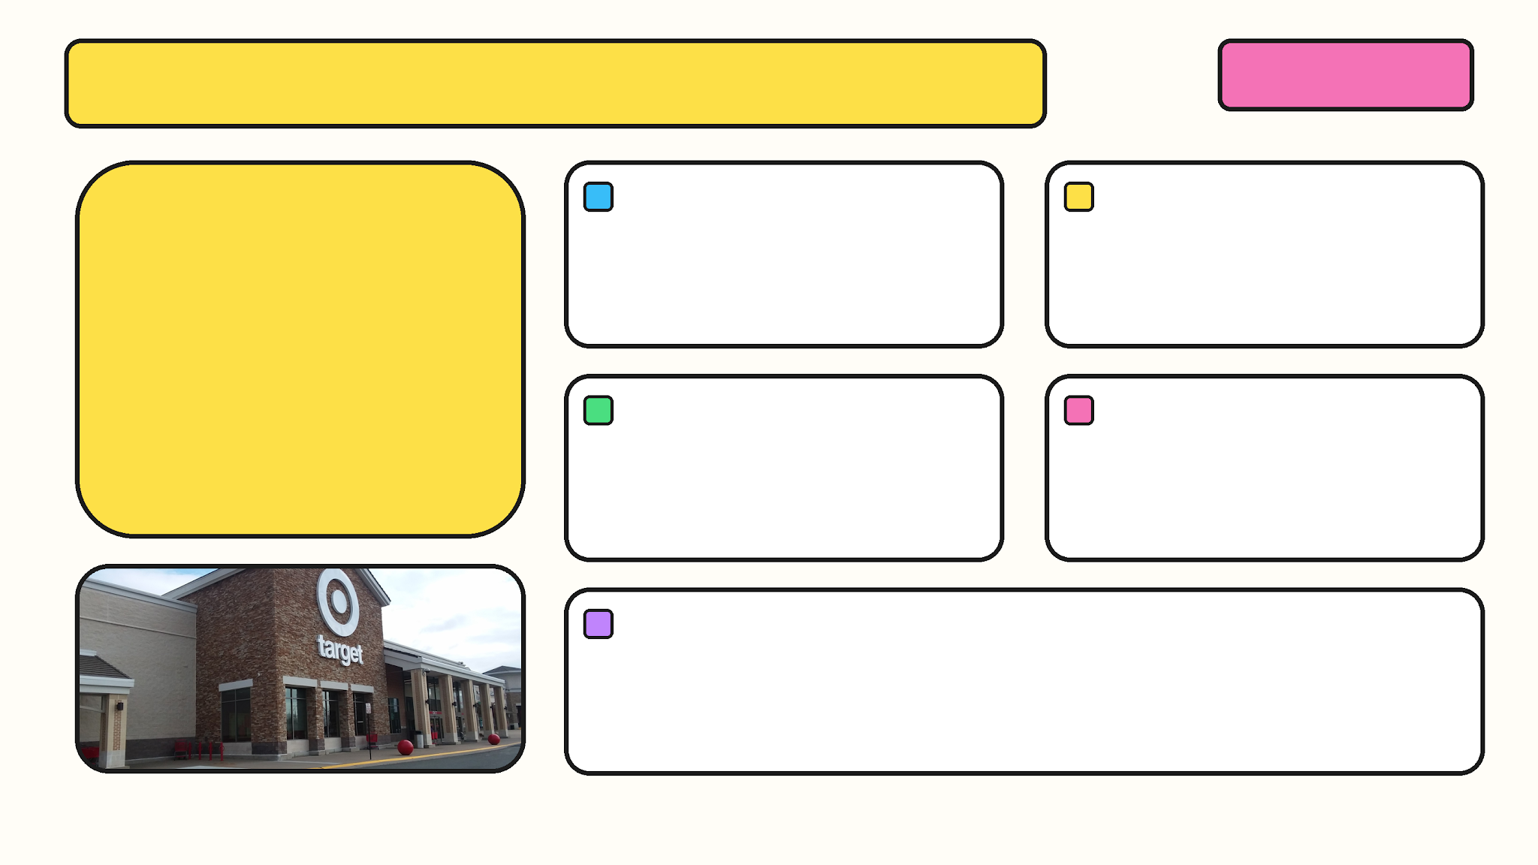
MY JOB & PAY
SLIDE 02 / 07
MY JOB
HOURLY PAY
GROSS MONTHLY PAY
Target team member
$14.25
$1,368
HOURS EACH WEEK
GROSS WEEKLY PAY
Before taxes
24 hours
$342
HOW I GOT MY PAY
$14.25 × 24 = $342 a week
$342 × 4 weeks = $1,368 a month

Slide 3
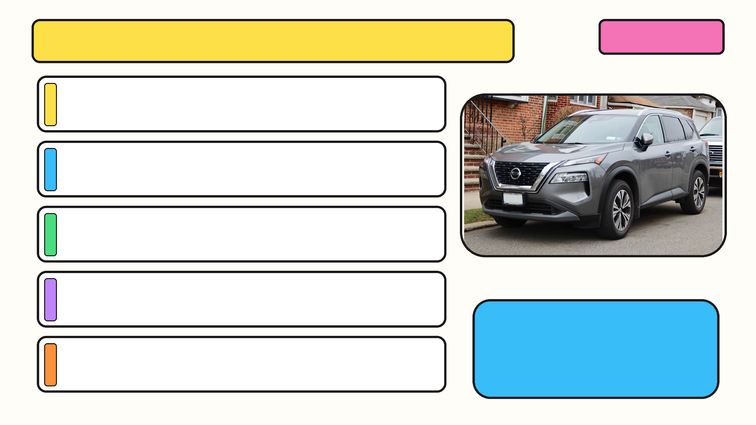
CAR #1: 2023 NISSAN ROGUE S AWD
SLIDE 03 / 07
YEAR / MAKE / MODEL
2023 Nissan Rogue S AWD
PRICE
$11,376
FEATURES
Keyless start, Apple CarPlay, Android Auto.
COST TO FILL THE TANK
$56.41 (14.5 gal at $3.89/gal)
SAFETY FEATURES
AWD
Lane departure warning
Brake assist
Cross-traffic alert
WHY I LIKE IT
No accidents or damage. Nice car for the price.

Slide 4
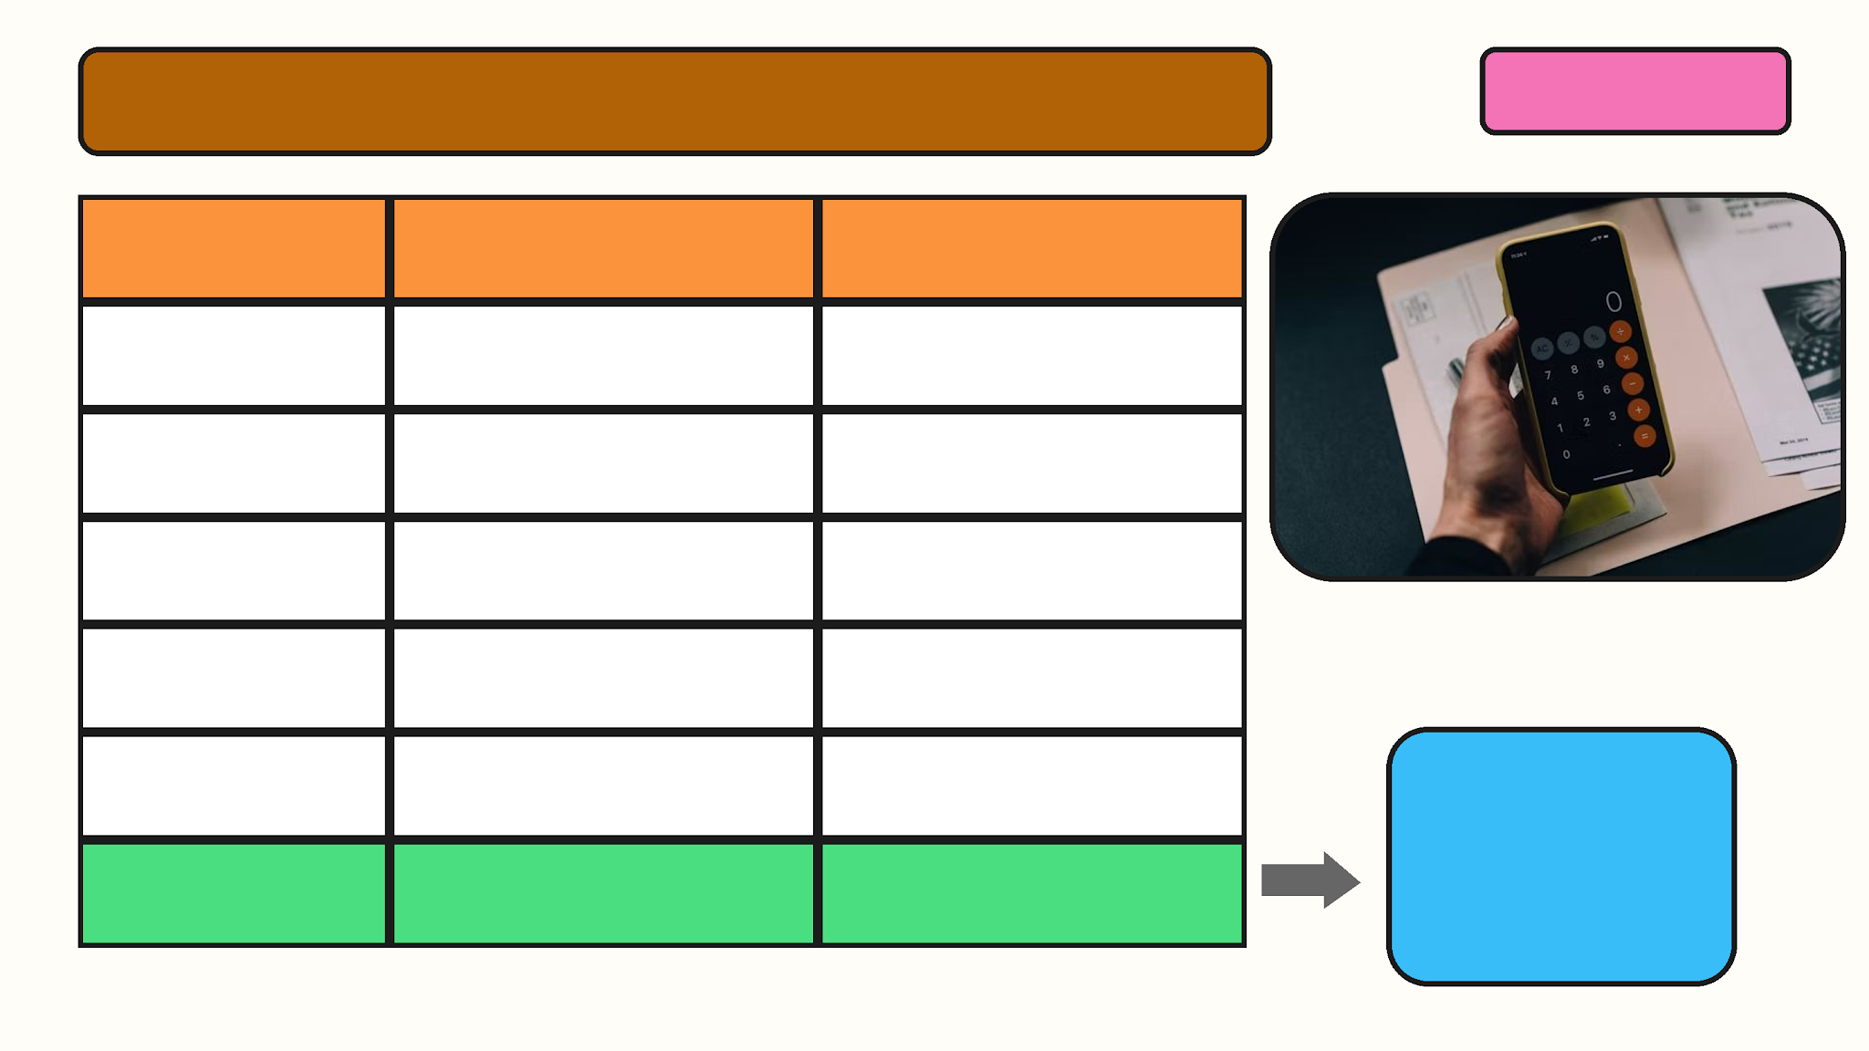
CAR #1: LOAN COMPARISON
SLIDE 04 / 07
Loan A (parents)
Loan B (bank)
Rate
4.2% simple
5.1% daily compound
Term
5 years
6 years
Payments
60
72
Interest
$2,388.96
$4,072.08
Total cost
$13,764.96
$15,448.08
MY PICK: LOAN A
$229.42
Monthly payment
$229.42
$214.56
Saves $1,683.12
in interest

Slide 5
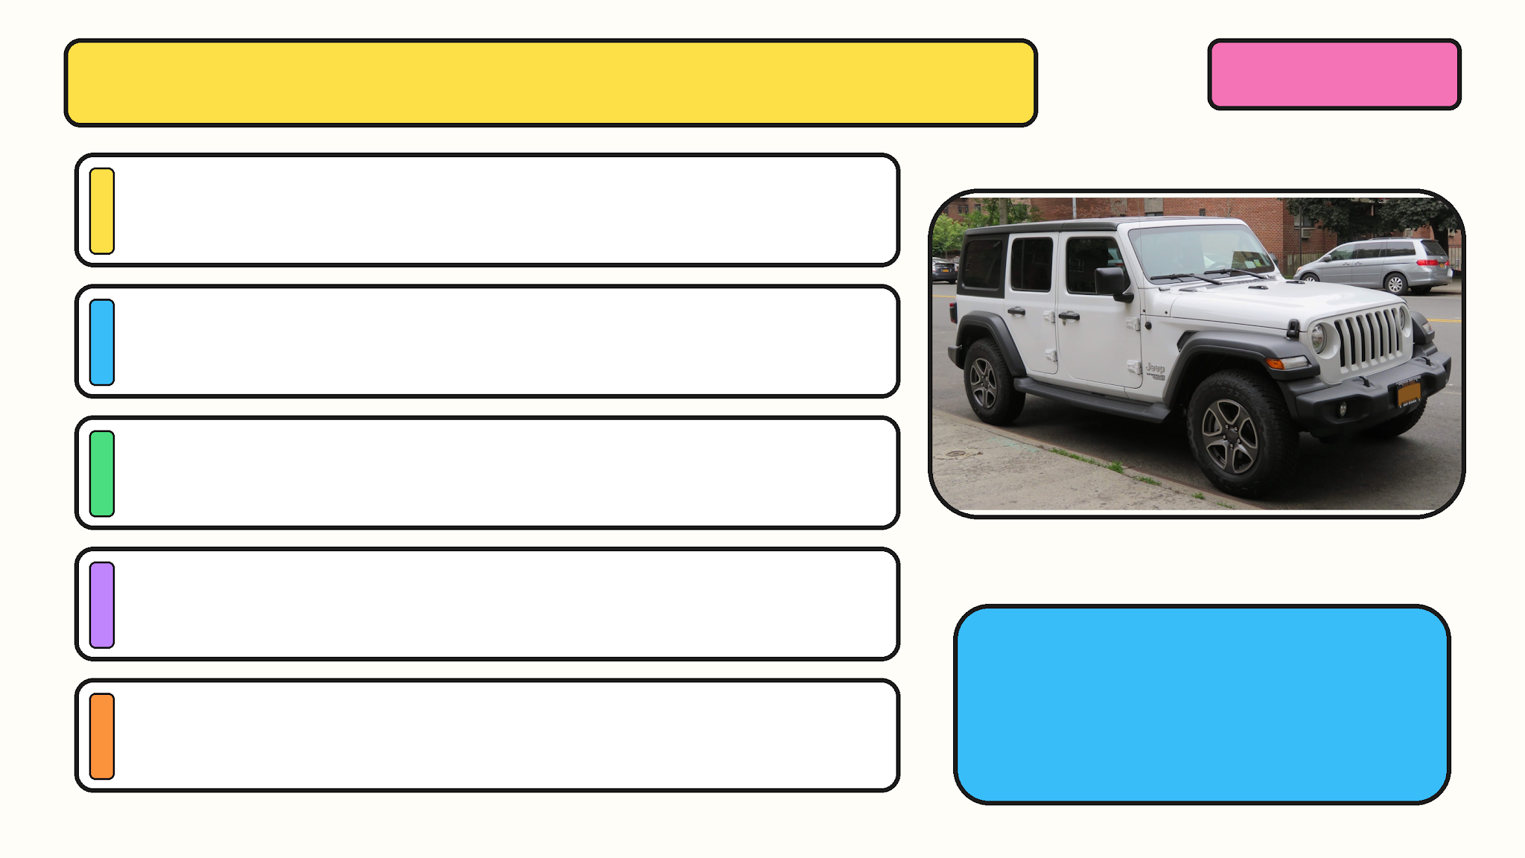
CAR #2: 2012 JEEP WRANGLER
SLIDE 05 / 07
YEAR / MAKE / MODEL
2012 Jeep Wrangler Unlimited Sport 4WD
PRICE
$8,995
FEATURES
Durable interior and four-wheel drive.
COST TO FILL THE TANK
$87.53 (22.5 gal at $3.89/gal)
SAFETY FEATURES
ESC and ERM
Advanced airbags
HSA and ABS
WHY I LIKE IT
It seemed like a good deal for the price.

Slide 6
CAR #2: LOAN COMPARISON
SLIDE 06 / 07
Loan C (parents)
Loan D (bank)
Rate
4.2% simple
5.1% daily compound
Term
5 years
6 years
Payments
60
72
Interest
$1,888.95
$3,219.79
Total cost
$10,883.95
$12,214.79
MY PICK: LOAN C
$181.40
Monthly payment
$181.40
$169.65
Saves $1,330.84
in interest

Slide 7

FOLLOW-UP QUESTIONS
SLIDE 07 / 07
1. WHICH CAR AND PAYMENT DID I PICK?
2012 Jeep Wrangler with Loan C, $181.40/month.
2. WHAT IS MY TRANSPORTATION BUDGET?
11% of $1,368 = $150.48/month.
3. DOES THE PAYMENT FIT?
No. It is $30.92 over, before insurance.
4. WHAT WOULD INSURANCE COST?
I LIKE THE JEEP, BUT I
CANNOT AFFORD IT YET.
About $245/month.
5. WHAT IS MY TOTAL MONTHLY COST?
I need more hours or a
bigger down payment.
$181.40 + $245 = $426.40, before gas.

