Slide 1
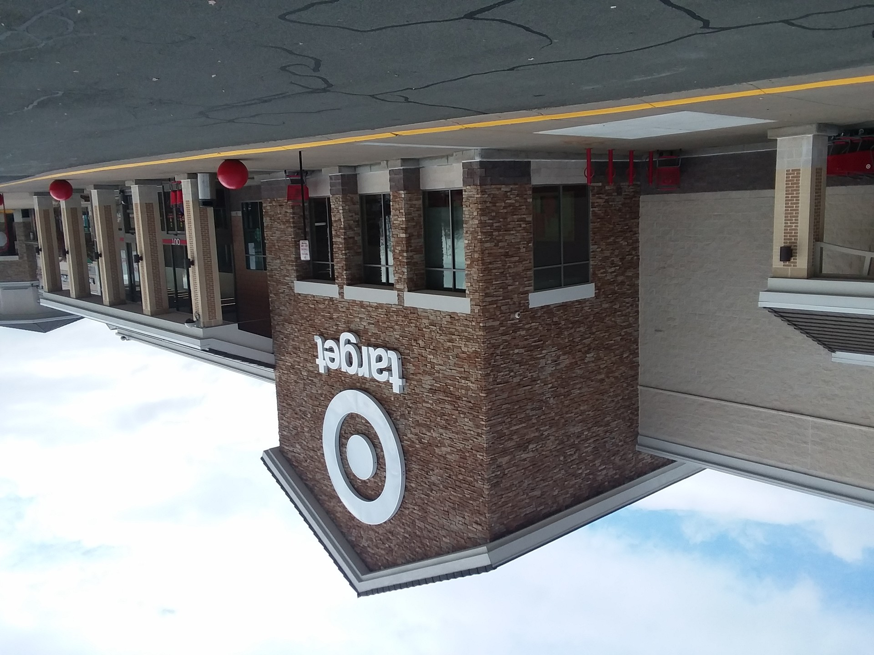
ASSIGNED JOB PROFILE
SLIDE 01 OF 06 • REHAN MANGAR
Employment Profile & Transportation Budget Baseline
PERSONAL FINANCE FOUNDATION
Target Team Member
Hourly Pay Rate: $14.25 / hr
↳ Assigned entry-level starting wage
Work Schedule: 24 hrs / week
↳ Part-time school-year schedule
Gross Weekly Income: $342.00 / week
↳ 24 hours × $14.25 / hr
Gross Monthly Income: $1,368.00 / mo
↳ $342.00 / week × 4 weeks
11% TRANSPORTATION BUDGET GUIDELINE
$150.48 / month
Calculation: $1,368.00 gross monthly income × 0.11 baseline budget allocation.
RELIABLE CASH FLOW FOUNDATION
Consistent hourly employment provides the income stream necessary to finance and operate a vehicle responsibly during high school while building personal savings.

Slide 2
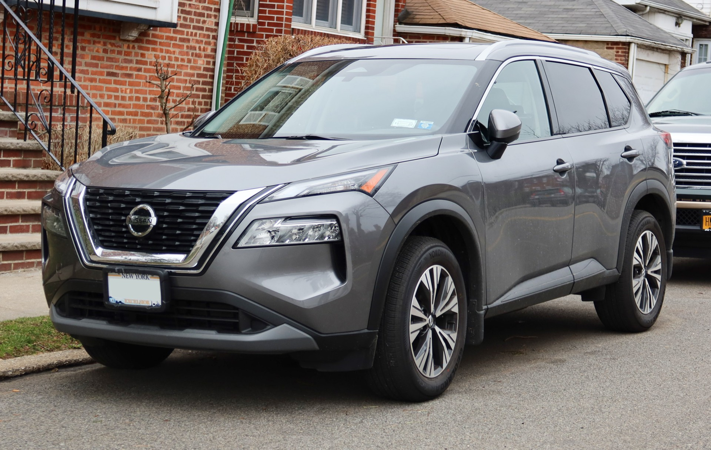
PRIMARY VEHICLE CHOICE
SLIDE 02 OF 06 • REHAN MANGAR
Car #1 Overview: 2023 Nissan Rogue S AWD
TECHNOLOGY & CONVENIENCE
• Apple CarPlay & Android Auto seamless smartphone connectivity
• Keyless start & remote entry with push-button ignition
• Rearview backup camera & automatic parking assistance
• 8-inch digital touchscreen display with Bluetooth audio
ACTIVE SAFETY & TRACTION
• Intelligent All-Wheel Drive (AWD / 4WD) for safe snow and rain control
• Automatic Emergency Braking with Pedestrian Detection
• Lane Departure Warning & Blind Spot Warning system
• Rear Cross-Traffic Alert and comprehensive airbag canopy
PURCHASE PRICE
$11,376
Under $20K project limit
TANK FILL-UP COST
$56.41
14.5 Gal × $3.89/gal
WHY THIS VEHICLE WAS CHOSEN
"Verified clean history with zero accident reports, no exterior or structural damage, all-weather AWD capability crucial for winter commuting, and exceptional overall value at $11,376."

Slide 3
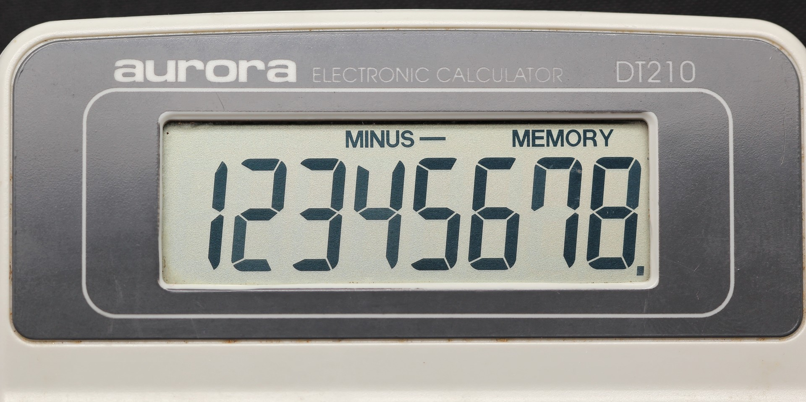
COMPARATIVE LOAN ANALYSIS
SLIDE 03 OF 06 • REHAN MANGAR
Car #1 Financing Breakdown: Nissan Rogue
$229.42 / month
• Terms: 4.2% Simple APR / 5 Years (60 Months)
• Interest Formula: I = $11,376 × 0.042 × 5 = $2,388.96
• Total Repayment: $11,376 + $2,388.96 = $13,764.96
• Monthly Payment: $13,764.96 ÷ 60 months = $229.42 / mo
• Interest Benefit: Saves $1,683.12 in total interest vs. Bank!
★ RECOMMENDED: LOAN A (PARENTS SIMPLE INTEREST)
$214.56 / month
• Terms: 5.1% Compounded Daily (365) / 6 Years (72 Mos)
• Compound Formula: $11,376 × (1 + 0.051/365)^2190
• Total Repayment: $15,448.08 principal + interest
• Total Interest Paid: $15,448.08 - $11,376 = $4,072.08
• Monthly Payment: $15,448.08 ÷ 72 months = $214.56 / mo
LOAN B: COMMERCIAL BANK (COMPOUND INTEREST)
COMPOUND TRAP:
A longer 6-year bank term lowers monthly payments by $14.86, but adds $1,683 in extra interest.
WHICH LOAN WOULD YOU CHOOSE? — FINAL DECISION: LOAN A (PARENTS)
• Lowest Monthly Payment: Loan B has the lower monthly payment ($214.56/mo vs. $229.42/mo — $14.86 cheaper per month).
• Lowest Total Interest Paid: Loan A saves $1,683.12 in total interest ($2,388.96 vs. $4,072.08).
• Recommendation: I choose Loan A. Paying $14.86 more per month eliminates over $1,683 in interest and clears debt a full 12 months earlier.

Slide 4
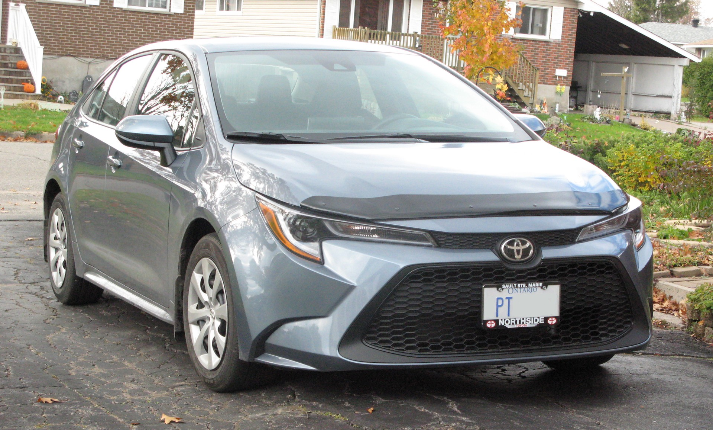
ALTERNATIVE VEHICLE CHOICE
SLIDE 04 OF 06 • REHAN MANGAR
Car #2 Overview: 2021 Toyota Corolla LE
TECHNOLOGY & INFOTAINMENT
• Apple CarPlay, Android Auto & Amazon Alexa compatibility
• 8-inch high-resolution touchscreen infotainment display
• Integrated backup camera with projected guidelines
• Remote keyless entry & Bluetooth hands-free phone system
ACTIVE SAFETY (TOYOTA SAFETY SENSE 2.0)
• Pre-Collision System with Daytime/Low-Light Pedestrian Detection
• Lane Departure Alert with Steering Assist & Lane Tracing
• Full-Speed Dynamic Radar Cruise Control & Road Sign Assist
• 10 advanced airbags & Star Safety System
PURCHASE PRICE
$14,500
Well under $20K budget
TANK FILL-UP COST
$51.35
13.2 Gal × $3.89/gal
WHY THIS VEHICLE WAS CHOSEN
"Industry-leading mechanical dependability, class-leading 38 MPG highway fuel efficiency reducing weekly gas costs, lower teenage insurance premiums, and outstanding resale value."

Slide 5

COMPARATIVE LOAN ANALYSIS
SLIDE 05 OF 06 • REHAN MANGAR
Car #2 Financing Breakdown: Toyota Corolla
$292.42 / month
• Terms: 4.2% Simple APR / 5 Years (60 Months)
• Interest Formula: I = $14,500 × 0.042 × 5 = $3,045.00
• Total Repayment: $14,500 + $3,045.00 = $17,545.00
• Monthly Payment: $17,545.00 ÷ 60 months = $292.42 / mo
• Interest Benefit: Saves $2,142.23 in total interest vs. Bank!
★ RECOMMENDED: LOAN C (PARENTS SIMPLE INTEREST)
$273.43 / month
• Terms: 5.1% Compounded Daily (365) / 6 Years (72 Mos)
• Compound Formula: $14,500 × (1 + 0.051/365)^2190
• Total Repayment: $19,687.23 principal + interest
• Total Interest Paid: $19,687.23 - $14,500 = $5,187.23
• Monthly Payment: $19,687.23 ÷ 72 months = $273.43 / mo
LOAN D: COMMERCIAL BANK (COMPOUND INTEREST)
COMPOUNDING LOSS:
Commercial daily compounding causes over $5,187 to be lost strictly to interest.
WHICH LOAN WOULD YOU CHOOSE? — FINAL DECISION: LOAN C (PARENTS)
• Lowest Monthly Payment: Loan D has the lower monthly payment ($273.43/mo vs. $292.42/mo — $18.99 cheaper per month).
• Lowest Total Interest Paid: Loan C saves $2,142.23 in total interest ($3,045.00 vs. $5,187.23).
• Recommendation: I choose Loan C. Paying $18.99 more per month saves over $2,142 in interest and finishes 12 months sooner.

Slide 6
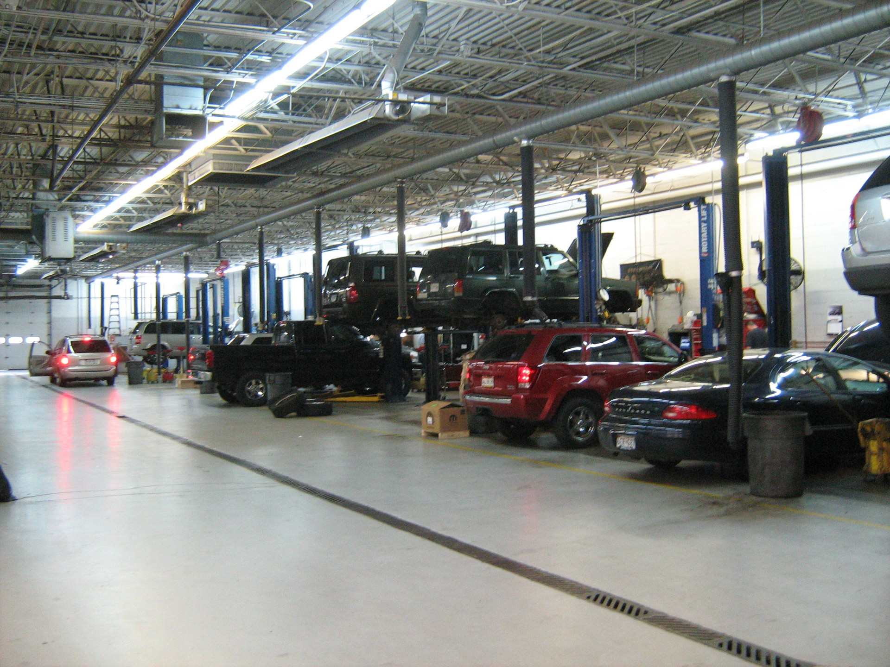
PARENT PITCH & ACTION PLAN
SLIDE 06 OF 06 • REHAN MANGAR
Career & Budget Reflection: Pitch to Parents
1. VEHICLE SELECTION & INITIAL BUDGET ALIGNMENT
• Chosen Vehicle & Loan: 2023 Nissan Rogue S AWD with Loan A ($229.42 / mo) or Loan B ($214.56 / mo).
• Baseline Transportation Budget (11%): $150.48 / month ($1,368.00 gross income × 0.11).
• Does it fit into your initial budget? No. The vehicle payment alone exceeds the initial $150.48 budget by $64.08 to $78.94 per month before factoring in insurance.
2. INSURANCE, TOTAL COMMITMENT & ACTION PLAN
• Researched Teen Car Insurance: $245.00 / month (average for teen added to family policy).
• Total Monthly Transportation Commitment: $474.42 / month ($229.42 loan + $245.00 insurance; or $459.56 with Loan B).
• Three Budget Modifications to Afford It:
1) Increase Target hours from 24 to 32 hrs/wk (+1 shift = +$456/mo gross = $1,824/mo total income);
2) Eliminate non-essential spending on dining out & entertainment ($150+/mo);
3) Save an upfront cash down payment of $1,500–$2,000 beforehand.
MY COMMITMENT TO MY PARENTS
By taking on one additional shift at Target each week, I will generate an extra $456.00/month gross. This surplus completely covers my total monthly car and insurance obligation of $474.42 while maintaining personal savings and building verifiable credit and financial responsibility.

