Slide 1
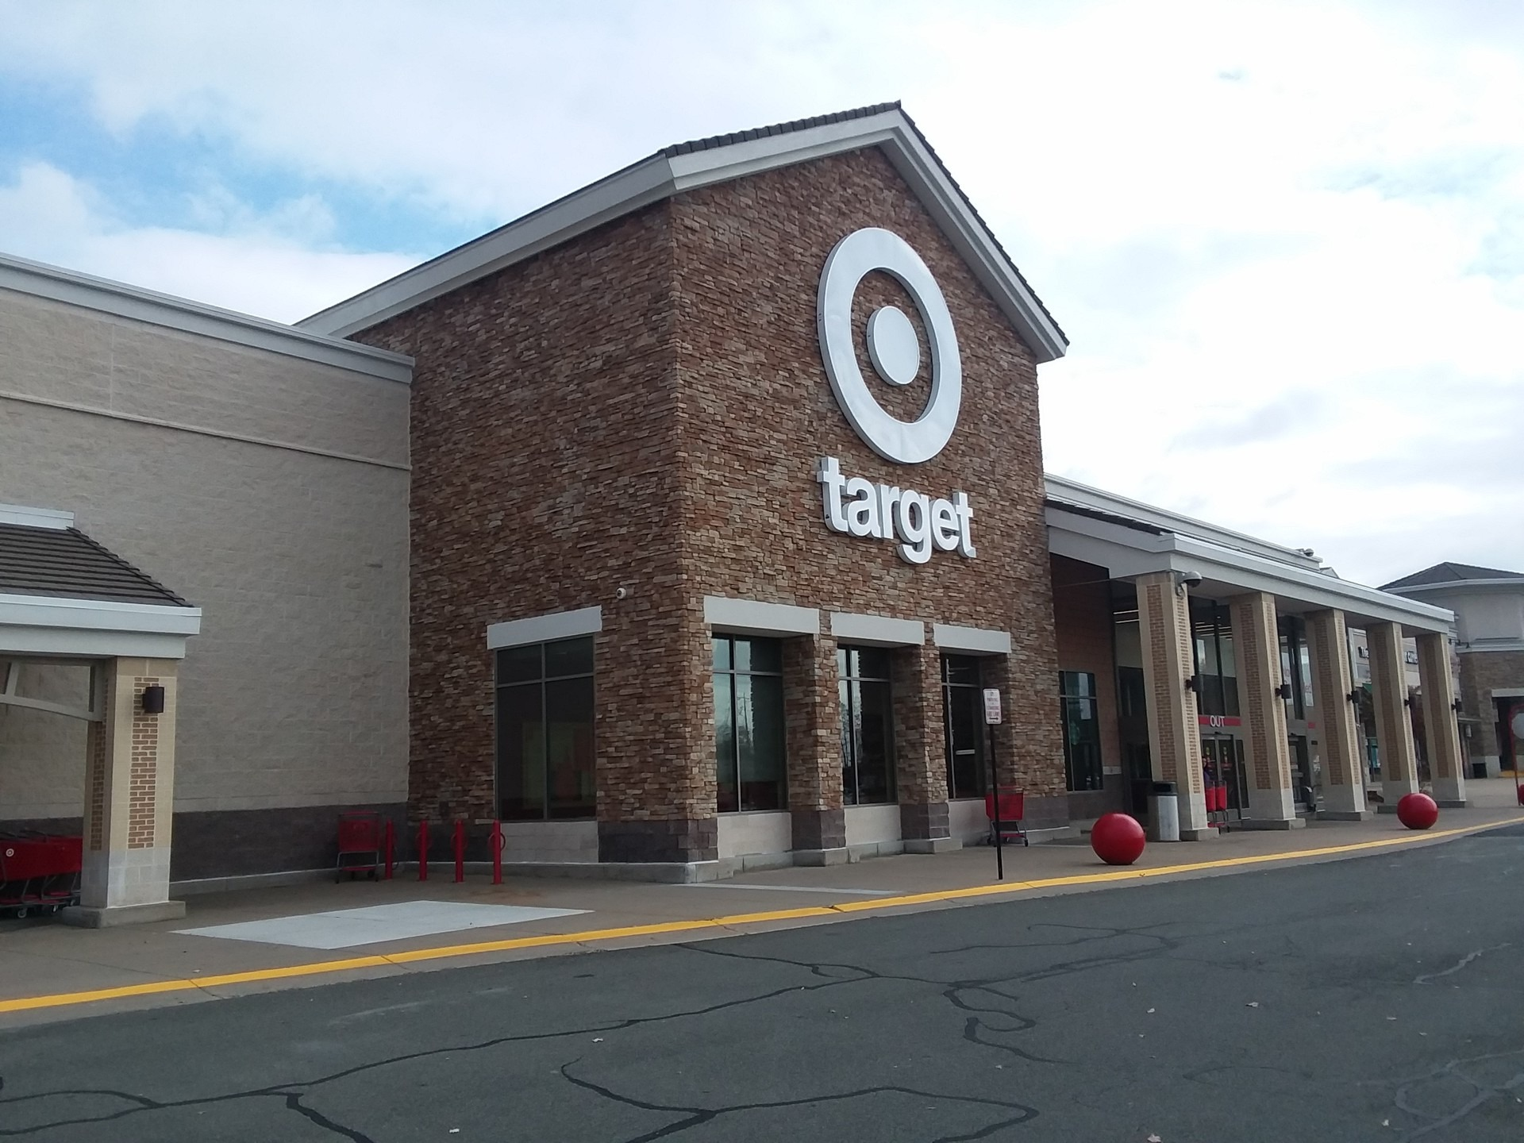
My First Car Plan
I work at Target.
24 hours a week at $14.25 an hour.
$14.25 × 24 = $342 gross each week.
$342 × 4 weeks = $1,368 gross each month.
$342
gross pay each week
$1,368
gross pay each month

Slide 2
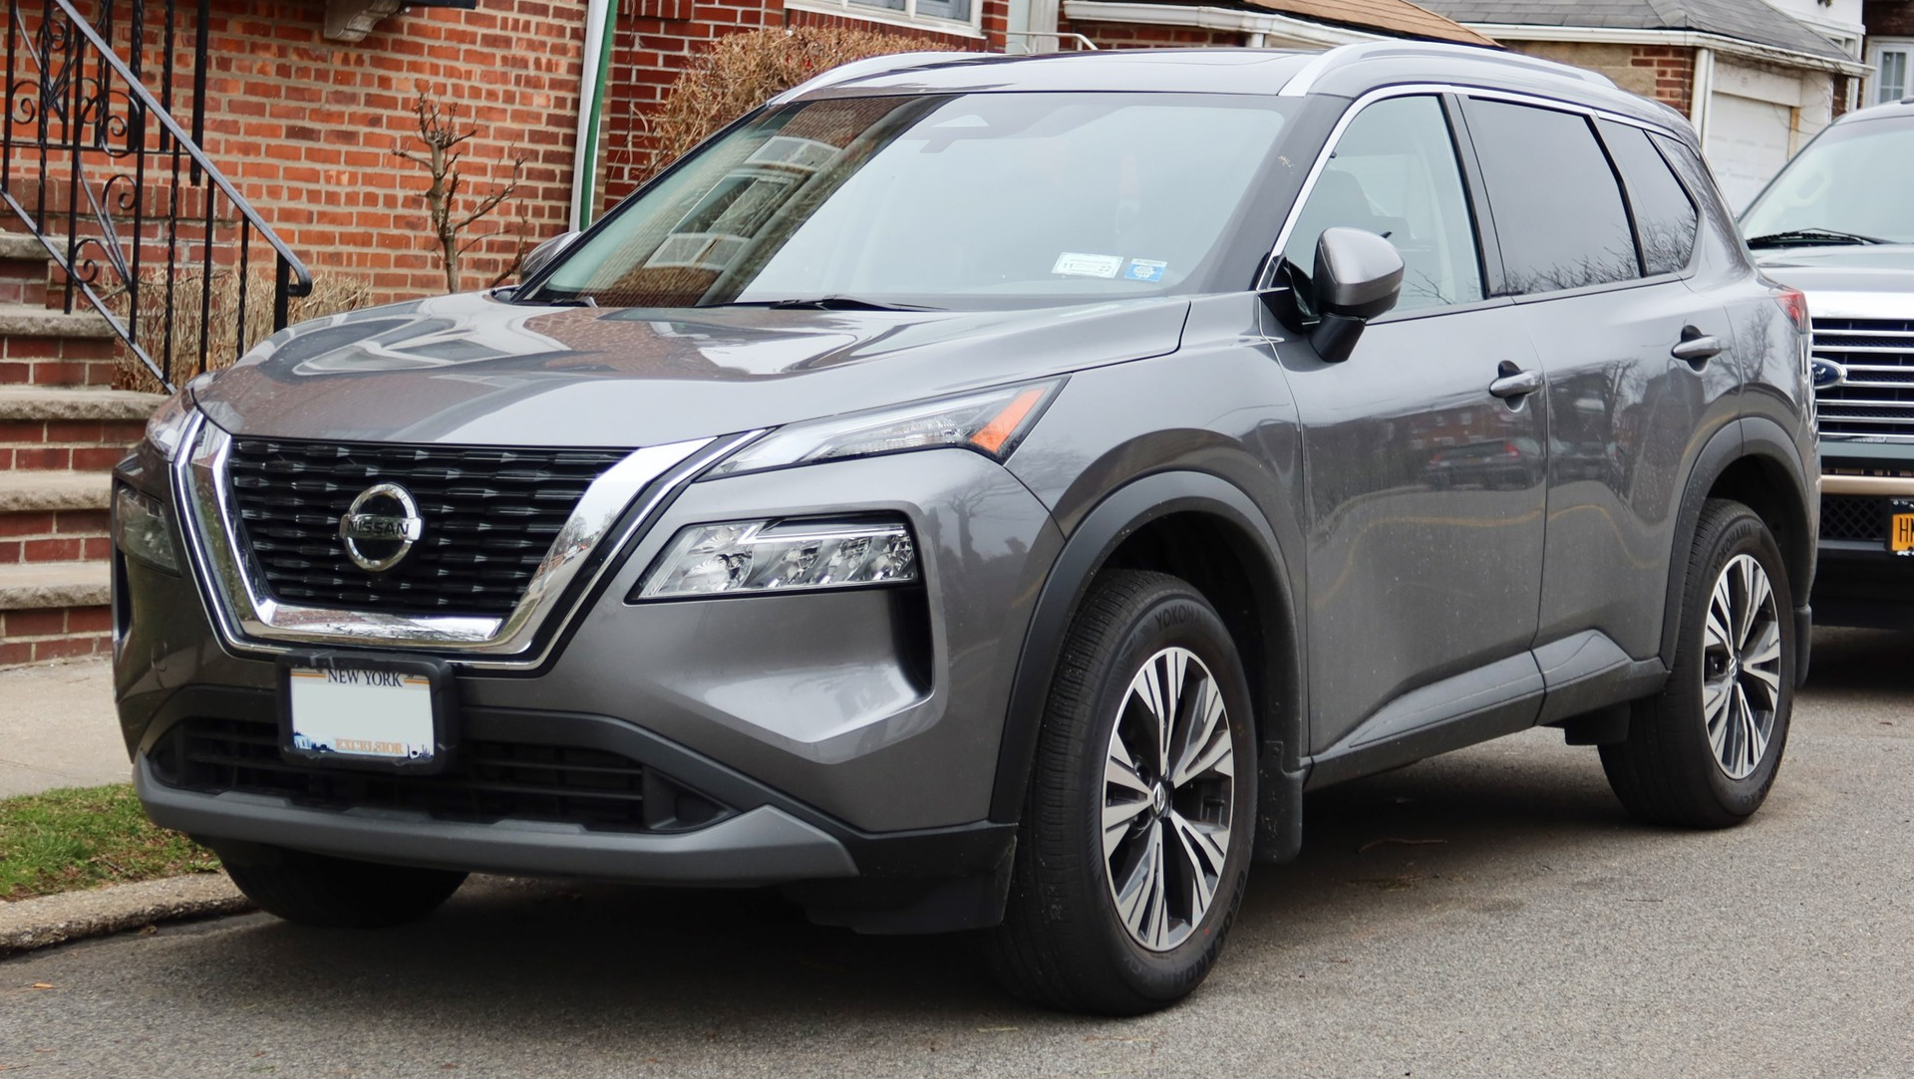
2023 Nissan Rogue S AWD
Price: $11,376
The tank holds 14.5 gallons. A full tank costs $56.41 at $3.89 per gallon.
Features
Keyless start, Apple CarPlay, and Android Auto.
Safety
AWD, lane departure warning, brake assist, and cross-traffic alert.
I liked the price. It had no accidents or damage, and it looked nice.

Slide 3
Nissan Rogue loan options
Parent Loan A
Bank Loan B
4.2% simple interest for 5 years
5.1% compounded daily for 6 years
$11,376 × 0.042 × 5 = $2,388.96 interest
Total with interest: $15,448.08
Total: $13,764.96
$15,448.08 − $11,376 = $4,072.08 interest
$13,764.96 ÷ 60 = $229.42/month
$15,448.08 ÷ 72 = $214.56/month
I would pick Loan A. It saves $1,683.12 in interest and is paid off a year sooner.

Slide 4
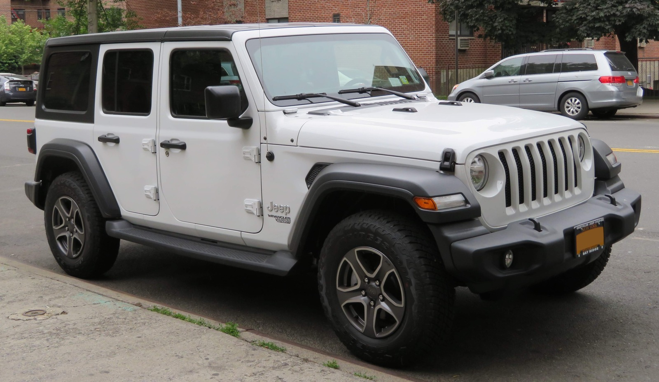
2012 Jeep Wrangler Unlimited Sport 4WD
Price: $8,995
The tank holds 22.5 gallons. A full tank costs $87.53 at $3.89 per gallon.
Features
It has a durable interior and 4WD.
Safety
ESC, ERM, advanced airbags, HSA, and ABS.
I chose it because it seemed like a great deal for the price.

Slide 5
Jeep Wrangler loan options
Parent Loan C
Bank Loan D
4.2% simple interest for 5 years
5.1% compounded daily for 6 years
$8,995 × 0.042 × 5 = $1,888.95 interest
Total with interest: $12,214.79
Total: $10,883.95
$12,214.79 − $8,995 = $3,219.79 interest
$10,883.95 ÷ 60 = $181.40/month
$12,214.79 ÷ 72 = $169.65/month
I would pick Loan C because it saves $1,330.84 in interest.
Loan D has the lowest monthly payment at $169.65, but that is still $19.17 over my budget.

Slide 6
My choice and the budget
I like the Jeep, but I can't afford it yet.
With my choice
I picked the 2012 Jeep with Loan C. The payment is $181.40 a month.
$426.40
My budget is $150.48 a month, so the payment is $30.92 over. It does not fit yet.
Loan C plus insurance is $426.40 a month, $275.92 over budget.
Insurance would cost about $245 a month.
Even Loan D is $19.17 over budget before insurance. With insurance, it would be $414.65 a month.
Monthly budget
I need more hours, less spending, and a bigger down payment before I buy it.
$150.48

