Slide 1
ECE 490-ST
Wireless Computing
Lesson 6 :: Impedance Transforming

Slide 2
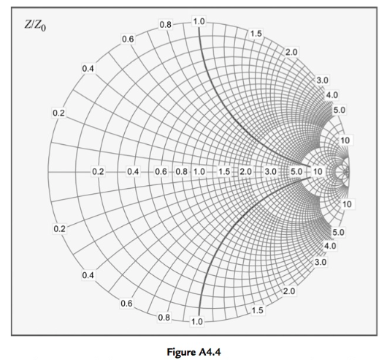
Eyeballing impedance shifts

Slide 3
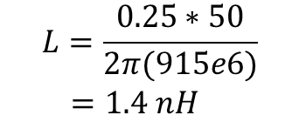
Eyeballing Impedance Shifts
If Gamma moves .25 around the Smith chart —
  X = j w L X = -j / (w C)
  X = w L X = -1 / (w C)
  L = (X * Z0) / w C = -1 / (Z0 * X * w)
EX: We move from 0 -> 1.1. At 915 MHz:
  L = (1.1 * 50) / (2*π*915e6)
  L = 9.566 nH

Slide 4
VNA DEMO
What is my hand acting like?
What is the value of my hand?

Slide 5
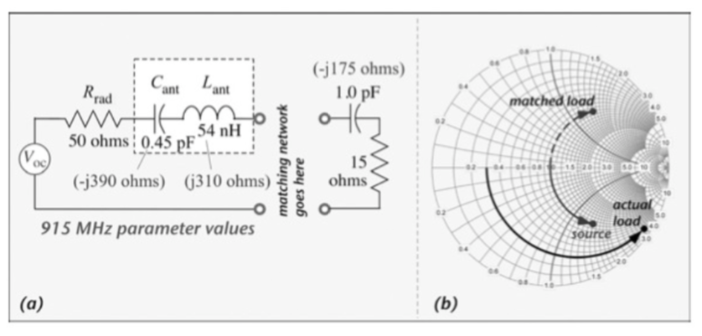
I want the load to appear as the conjugate of source

Slide 6
IMPEDANCE TRANSFORMING
What is Gamma when looking into the source?
What is the conjugate of the input Gamma?
What is Gamma when looking into the load?
Which way do we need to rotate?
Can we get there with 1 element?
What other element do we need?

Slide 7
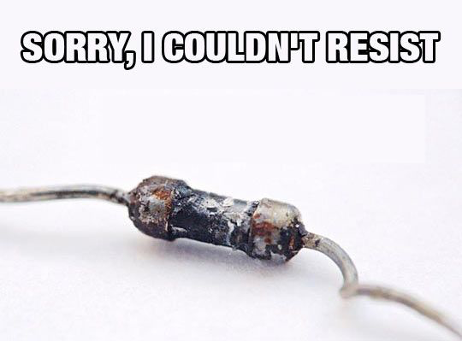
Transforming impedances
For impedance transformation networks, we will only use L and C
These elements do not absorb energy.
However, the job of a RESISTOR is to convert current into heat.
We do not want that
We don’t want to lose power.
So, NO RESISTORS in impedance transformation circuits

Slide 8
For homework¹
Be ready to find networks (circuits) that can transform impedances.
By inspection and small calculations
Verify with numerical tool (MATLAB) and plotting tools (Your handy dandy Smith chart)
¹ At least a part of it

Slide 9

Introducing Q
¿Qué?

Slide 10
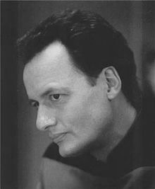
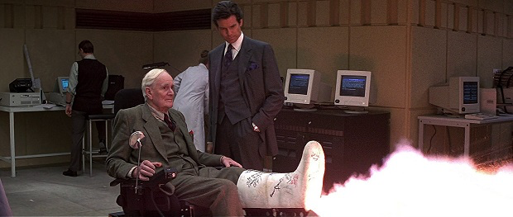
Introducing Q
Not him either

Slide 11
Introducing Q – the Quality Factor
Q let’s us quantify the bandwidth of a network

Slide 12
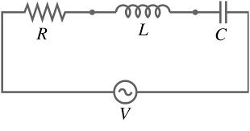
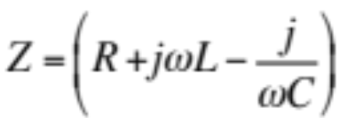
Introducing Q – the Quality Factor
Q let’s us quantify the bandwidth of a network
Take an RLC circuit
Notes:
For any L and C combination, there will be some frequency where the reactances will perfectly cancel and we are only left with a resistive circuit!
At that point, we will get much larger currents (assuming small R)

Slide 13
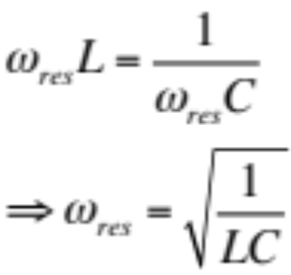
Introducing Q – the Quality Factor
Q let’s us quantify the bandwidth of a network
Notes:
For any L and C combination, there will be some frequency where the reactances will perfectly cancel and we are only left with a resistive circuit!
At that point, we will get much larger currents (assuming small R)

Slide 14
Introducing Q – the Quality Factor
Q let’s us quantify the bandwidth of a network
The ratio of reactance to resistance is Q.
The lower the resistance, the less energy loss
Q is inversely proportional to Bandwidth
High Q means a narrower bandwidth
For you, it just means you can calculate resistance
Notes:
For any L and C combination, there will be some frequency where the reactances will perfectly cancel and we are only left with a resistive circuit!
At that point, we will get much larger currents (assuming small R)

Slide 15
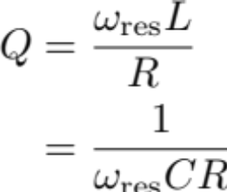
Introducing Q – the Quality Factor
For you, it just means you can calculate resistance
Notes:
For any L and C combination, there will be some frequency where the reactances will perfectly cancel and we are only left with a resistive circuit!
At that point, we will get much larger currents (assuming small R)

Slide 16
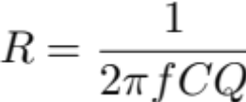
Introducing Q – the Quality Factor
For you, it just means you can calculate resistance
For a capacitor:
Find R, then add back into circuit in series with the capacitor
Notes:
For any L and C combination, there will be some frequency where the reactances will perfectly cancel and we are only left with a resistive circuit!
At that point, we will get much larger currents (assuming small R)

Slide 17
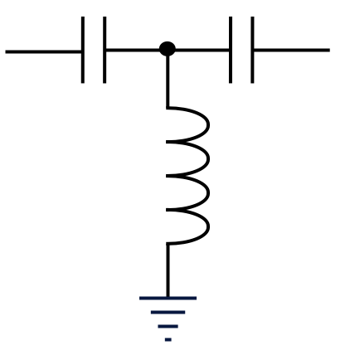
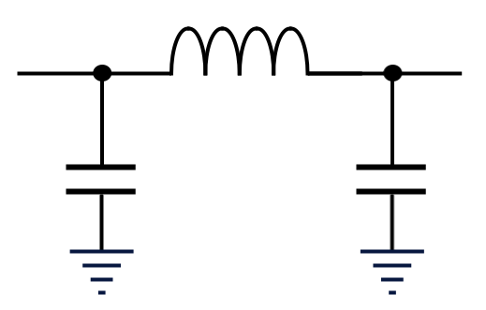
Designing Transformation Networks
Most inductors or capacitors will specify a Q value.
You do not have access to every possible L and C value
Need to get as close as possible.
Common Networks are
PI Network
L Network
TEE Network

Slide 18
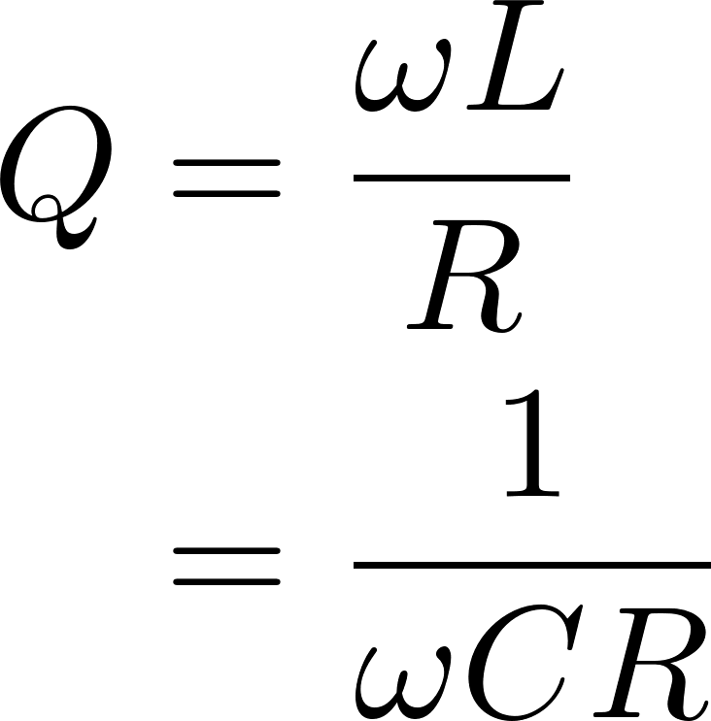
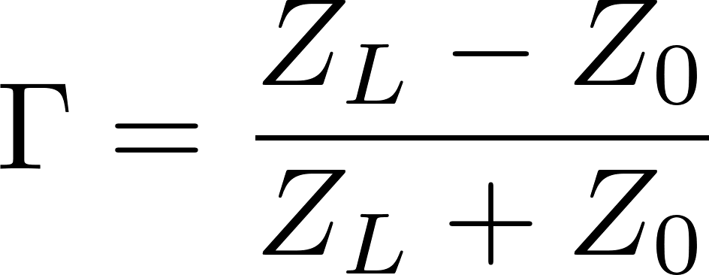
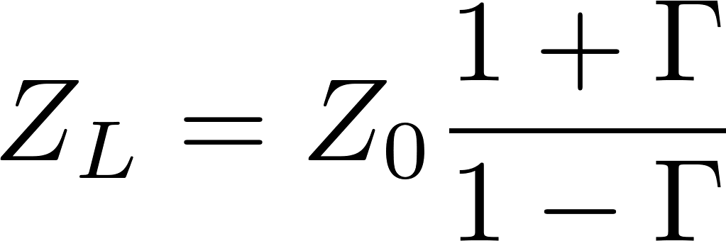
Useful equations to know
Given load impedance,
Find reflection coefficient
Given reflection coefficient,
Find load impedance
Given Q & frequency, solve to find series R

Slide 19
For Homework (the 2nd part)
Design a network to transform the load impedance to 50 Ohms (at 915 MHz)
  You are limited to L and C only, and only a small set of values
  Find the network that you think works best and justify this (i.e., compare to other networks)
  Once you’ve designed your network, implement the network and use MATLAB to apply it to the measured data to predict how it will perform.

