Slide 1
ECE 490-ST
Wireless Computing
Lesson 6 :: Impedance Transforming

Slide 2
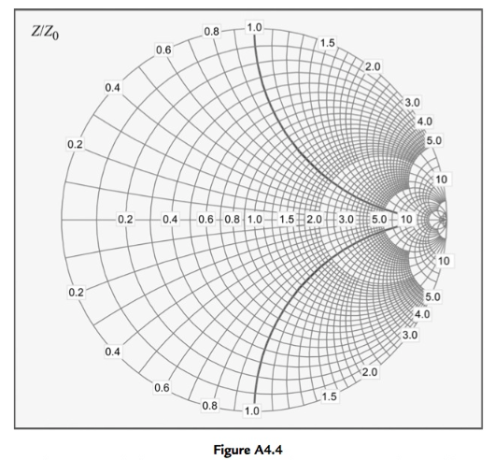
Eyeballing impedance shifts

Slide 3
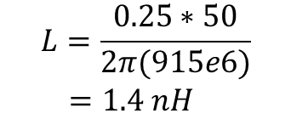
Eyeballing Impedance Shifts
If Gamma moves .25 around the Smith chart —
  X = j w L X = -j / (w C)
  X = w L X = -1 / (w C)
  L = (X * Z0) / w C = -1 / (Z0 * X * w)
EX: We move from 0 -> 1.1. At 915 MHz:
  L = (1.1 * 50) / (2*π*915e6)
  L = 9.566 nH

Slide 4
VNA DEMO
What is my hand acting like?
What is the value of my hand?

Slide 5
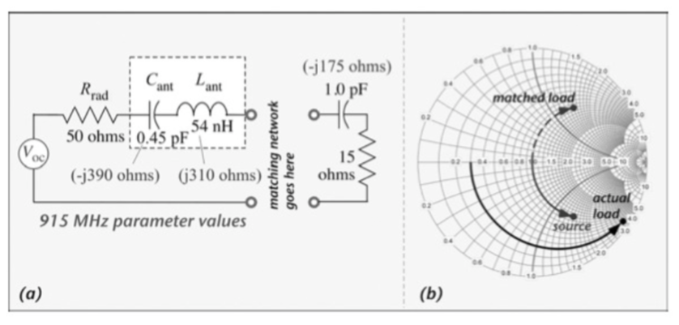
I want the load to appear as the conjugate of source

Slide 6
IMPEDANCE TRANSFORMING
What is Gamma when looking into the source?
What is the conjugate of the input Gamma?
What is Gamma when looking into the load?
Which way do we need to rotate?
Can we get there with 1 element?
What other element do we need?

Slide 7
Transforming impedances
For impedance transformation networks, we will only use L and C
These elements do not absorb energy.
However, the job of a RESISTOR is to convert current into heat.
We do not want that
We don’t want to lose power.
So, NO RESISTORS in impedance transformation circuits

Slide 8
For homework¹
Be ready to find networks (circuits) that can transform impedances.
By inspection and small calculations
Verify with numerical tool (MATLAB) and plotting tools (Your handy dandy Smith chart)
¹ At least a part of it

Slide 9
I want the load to appear as the conjugate of source

Slide 10
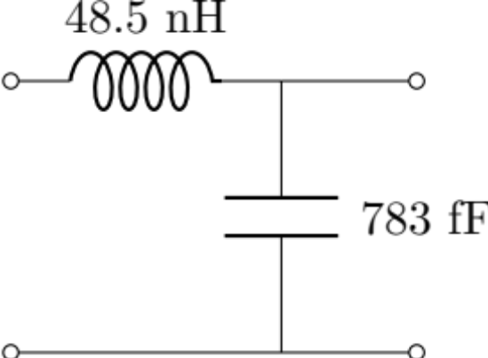
I want the load to appear as the conjugate of source
(to Source)
(to Load)

Slide 11
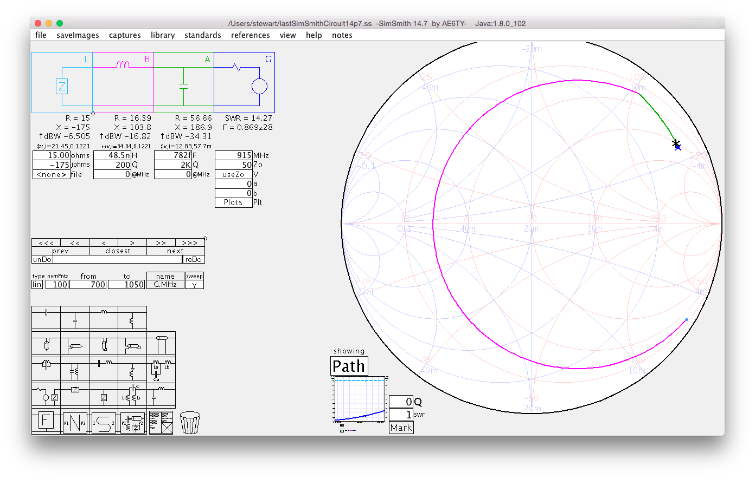
I want the load to appear as the conjugate of source
(to Source)
(to Load)

Slide 12
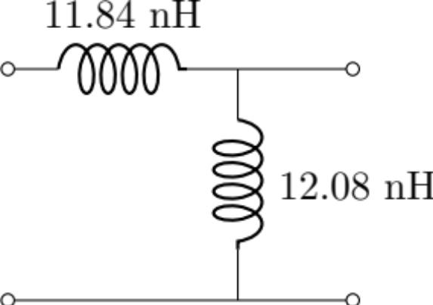
I want the load to appear as the conjugate of source
(to Source)
(to Load)

Slide 13
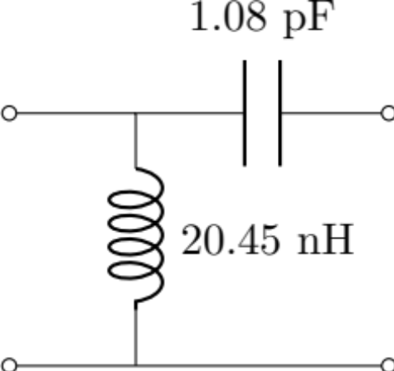
I want the load to appear as the conjugate of source
(to Source)
(to Load)

Slide 14
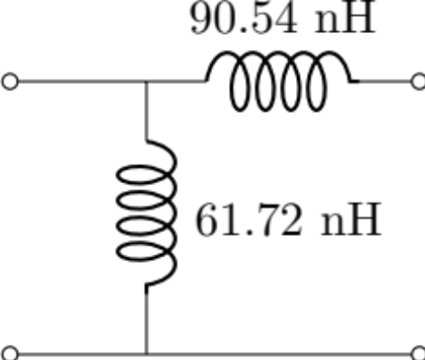
I want the load to appear as the conjugate of source
(to Source)
(to Load)

Slide 15
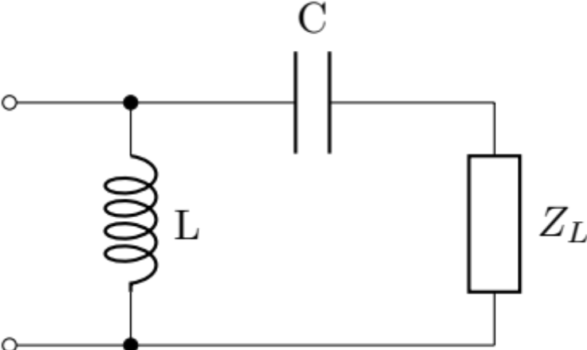
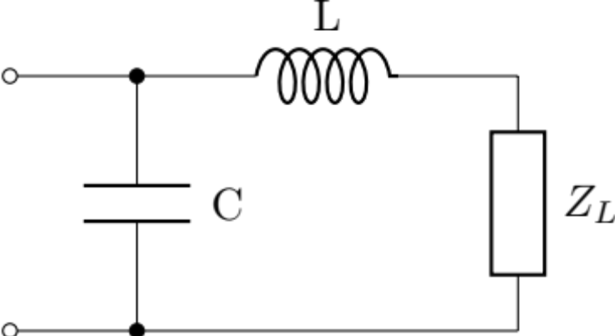
Two networks are shown below. 1) Select the one that can transform
Z_{L} = 38.5 + j57.7 to 50 Ohm. 2) Find the element values at f = 1 GHz
Example
A
B

Slide 16

Introducing Q
¿Qué?

Slide 17


Introducing Q
Not him either

Slide 18
Introducing Q – the Quality Factor
Q let’s us quantify the bandwidth of a network

Slide 19
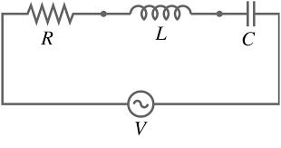
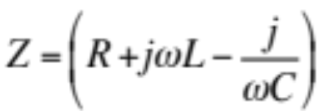
Introducing Q – the Quality Factor
To the RF engineer, Q can be used to quantify the bandwidth of a network
Take an RLC circuit
Notes:
For any L and C combination, there will be some frequency where the reactances will perfectly cancel and we are only left with a resistive circuit!
At that point, we will get much larger currents (assuming small R)

Slide 20
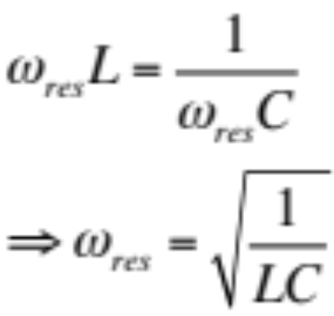
Introducing Q – the Quality Factor
To the RF engineer, Q can be used to quantify the bandwidth of a network
Notes:
For any L and C combination, there will be some frequency where the reactances will perfectly cancel and we are only left with a resistive circuit!
At that point, we will get much larger currents (assuming small R)

Slide 21
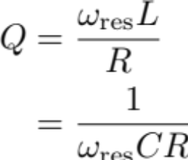
Introducing Q – the Quality Factor
Q is the ratio of reactance to resistance is Q.
The lower the resistance, the less energy loss
Q is inversely proportional to Bandwidth
  High Q means a narrow band
  Low Q means broader band
For you, it just means you can calculate resistance
Notes:
For any L and C combination, there will be some frequency where the reactances will perfectly cancel and we are only left with a resistive circuit!
At that point, we will get much larger currents (assuming small R)

Slide 22
Introducing Q – the Quality Factor
For you, it just means you can calculate resistance
Notes:
For any L and C combination, there will be some frequency where the reactances will perfectly cancel and we are only left with a resistive circuit!
At that point, we will get much larger currents (assuming small R)

Slide 23
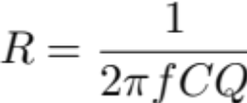
Introducing Q – the Quality Factor
For you, it just means you can calculate resistance
For a capacitor:
Find R, then add back into circuit in series with the capacitor
Notes:
For any L and C combination, there will be some frequency where the reactances will perfectly cancel and we are only left with a resistive circuit!
At that point, we will get much larger currents (assuming small R)

Slide 24
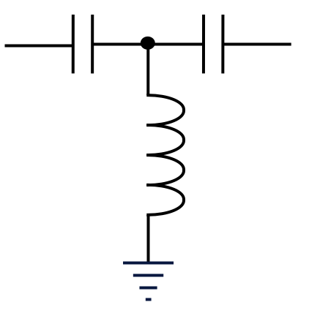
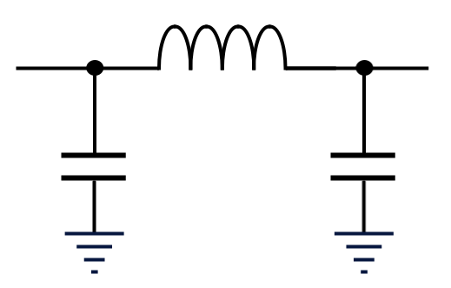
Designing Transformation Networks
Most inductors or capacitors will specify a Q value.
You do not have access to every possible L and C value
Need to get as close as possible.
Common Networks are
PI Network
L Network
TEE Network

Slide 25
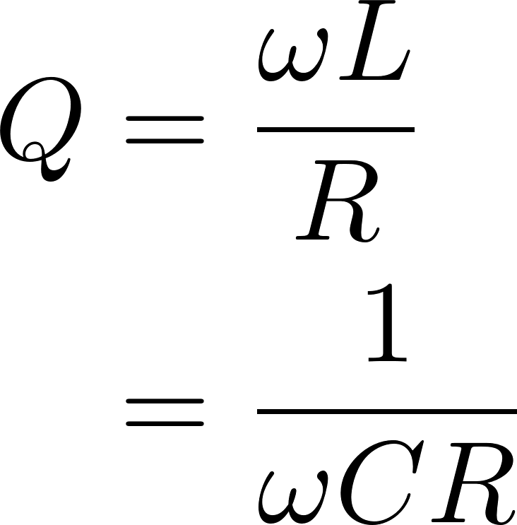
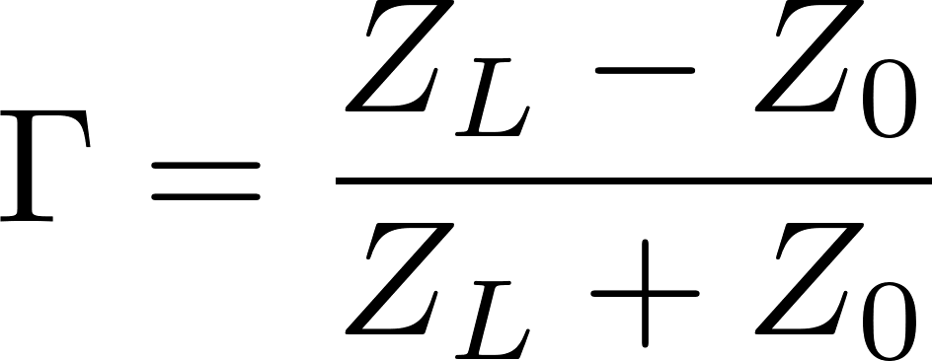
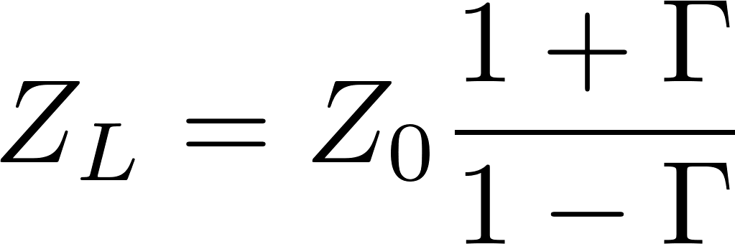
Useful equations to know
Given load impedance,
Find reflection coefficient
Given reflection coefficient,
Find load impedance
Given Q & frequency, solve to find series R

Slide 26
For Homework (the 2nd part)
Design a network to transform the load impedance to 50 Ohms (at 915 MHz)
  You are limited to L and C only, and only a small set of values
  Find the network that you think works best and justify this (i.e., compare to other networks)
  Once you’ve designed your network, implement the network and use MATLAB to apply it to the measured data to predict how it will perform.

Slide 27
Useful links
Online impedance matching designer
https://home.sandiego.edu/~ekim/e194rfs01/jwmatcher/matcher2.html
NOTE: This designer transforms to the *CONGUGATE* of the source. So to match to “Znew = 80 + j90” you would enter source resistance as “80” and source reactance as “-90”.
SimSmith downloadable tool
http://www.ae6ty.com/smith_charts.html
Direct link for Windows x64 [mac and linux versions also available]
http://www.ae6ty.com/Smith_Charts_files/SimSmith_windows-x64_14_7.exe

