Slide 1
ECE 490-ST
Wireless Computing
Lesson 10a :: Matching boards

Slide 2
Step 1
Measure the boards

Slide 3
Step 1
Measure the boards

Slide 4
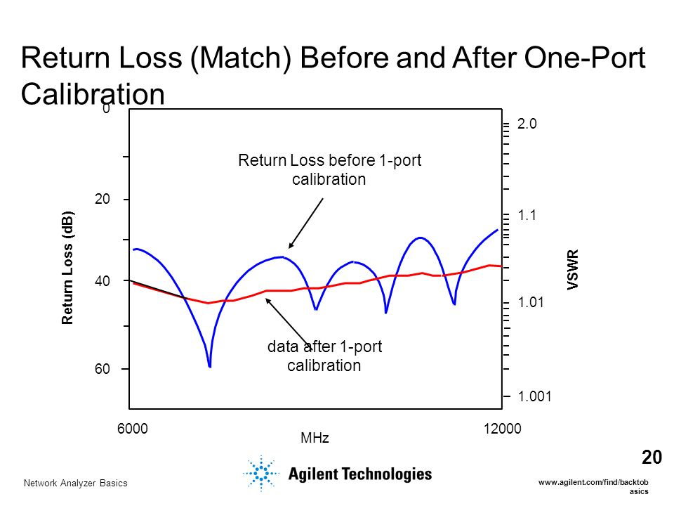
Step 0
Calibrate the VNA
Removes unintended errors
Gives “true” impedance measurement

Slide 5
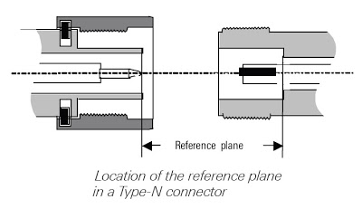
Step 0
Calibrate the VNA
Removes unintended errors
Gives “true” impedance measurement
Calibrate with 3 known impedances
Typically, Open, Short, Load

Slide 6
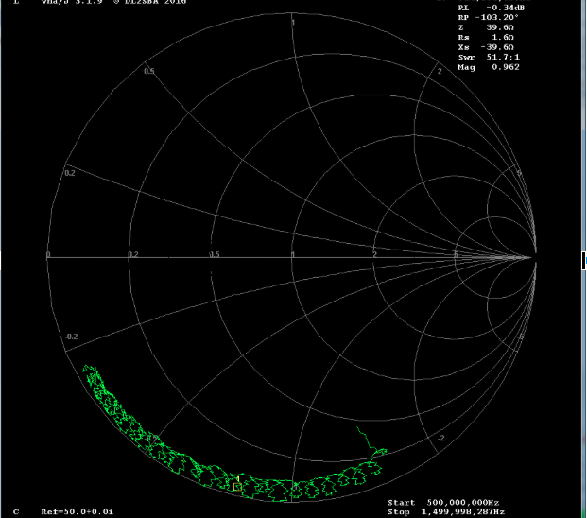
Step 1
Measure the boards
Z_{L} = 1.6 – j39.6

Slide 7
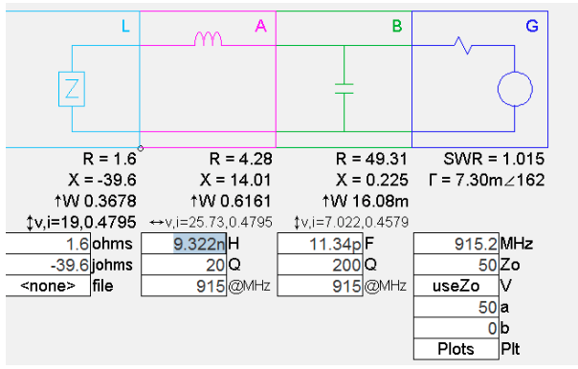
Step 3
Design a matching network
Goal of matching to 50Ω
Series L, Shunt C
Use 10 nH first

Slide 8
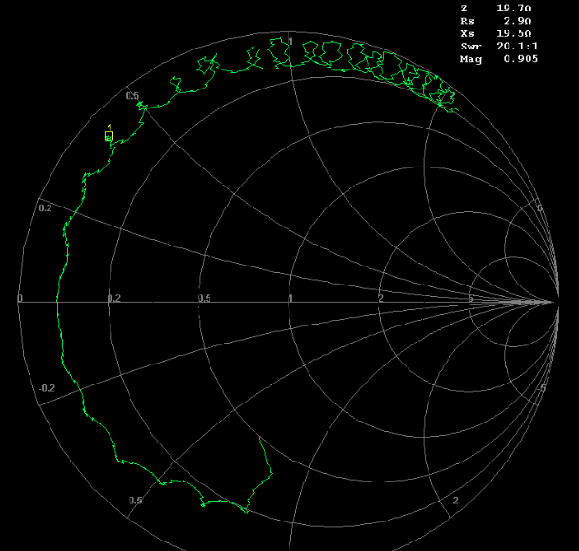
Step 4
Start implementing!
L moves to 2.9 + j19.5
Wanted: 4.2 + j14
L appears as 10.4 nH w/ Q=43
Try 8.2 nH!

Slide 9
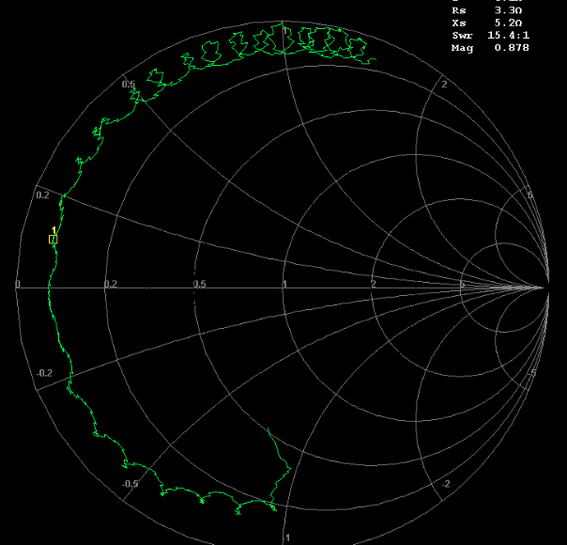
Step 4
Start Implementing!
End up at 3.3 + j5.2 – Too low!
Appears as L of 8.02 nH with Q of 24.4

Slide 10
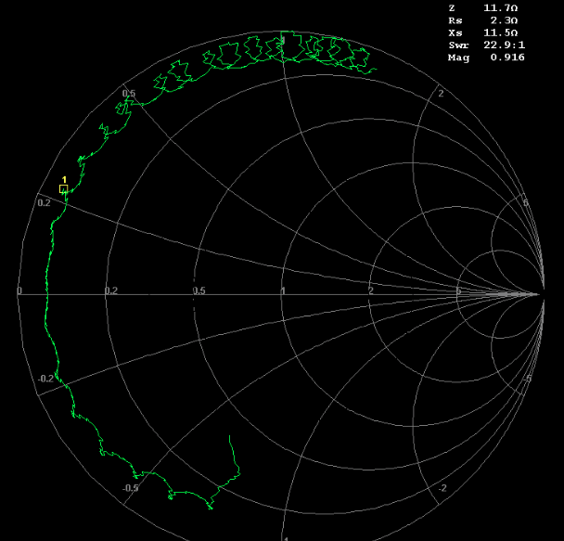
Step 3 (again)
Design a matching network.
Add in a shunt 0.8 pF C next to the load (to counteract parasitics)
Now at, 2.3 + j11.5
Looks good!

Slide 11
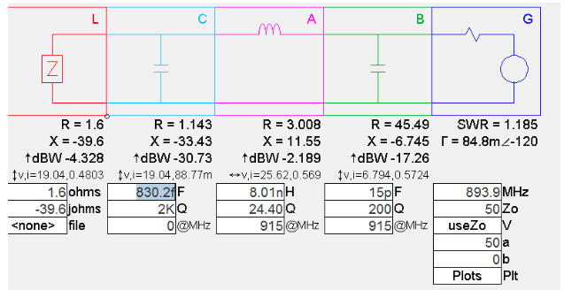
Step 3 (again)
Update your matching network
(includes any “fudge factors” that you’ve found aleady)

Slide 12
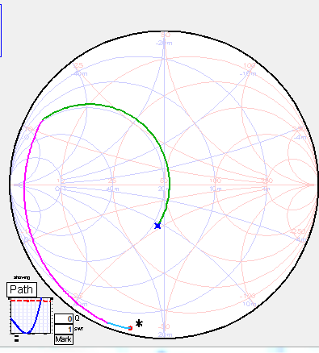
Step 4 Implement it!
Goal after final element
Keep implementing changes, reading values from VNA, and moving forward.
(Or rather, backward to the generator)
Add in the last change, and

Slide 13
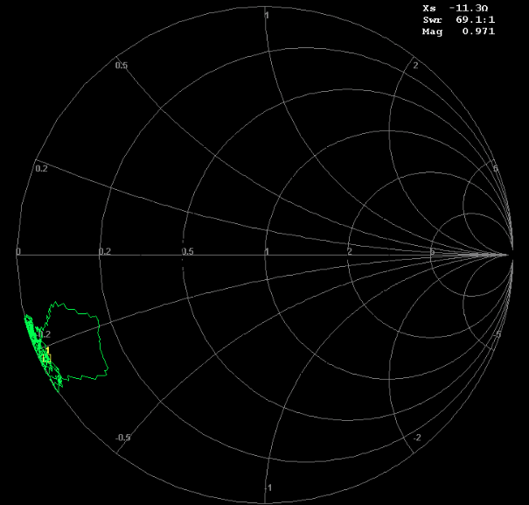
Step 4 Implement it!
Keep implementing changes, reading values from VNA, and moving forward.
(Or rather, backward to the generator)
Add in the last change, and
WAT?

Slide 14
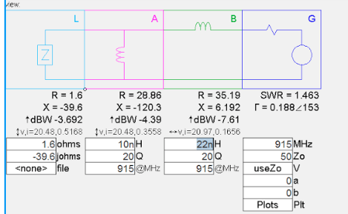
Go back to step 1
Start with a new network. Forget this old one.
Based on 2 inductors.
Actually a better design

Slide 15
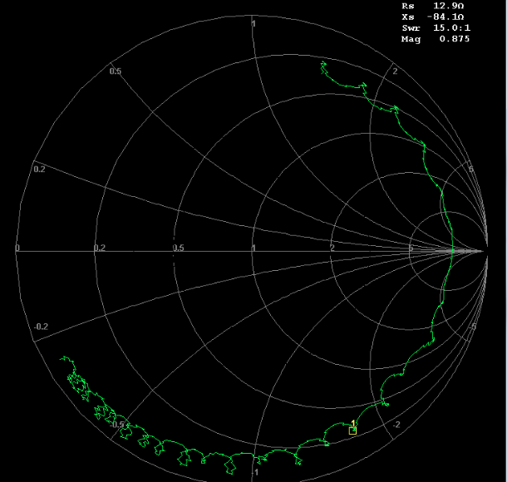
Step ???
Add in the shunt L, 10 nH
Seems a bit low. Let’s reduce the inductance a hair.

Slide 16
Step ???
Add in the shunt L, 10 nH
Seems a bit low. Let’s reduce the inductance a hair.

Slide 17
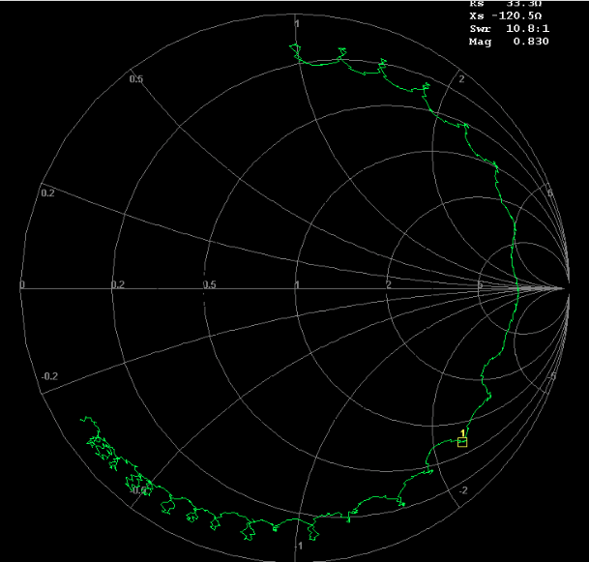
Step ???++
Trying 8.2 nH. Looks good, but seems to add just a bit of capicitance.

Slide 18
Step Alpeh
Add in the next value …

Slide 19
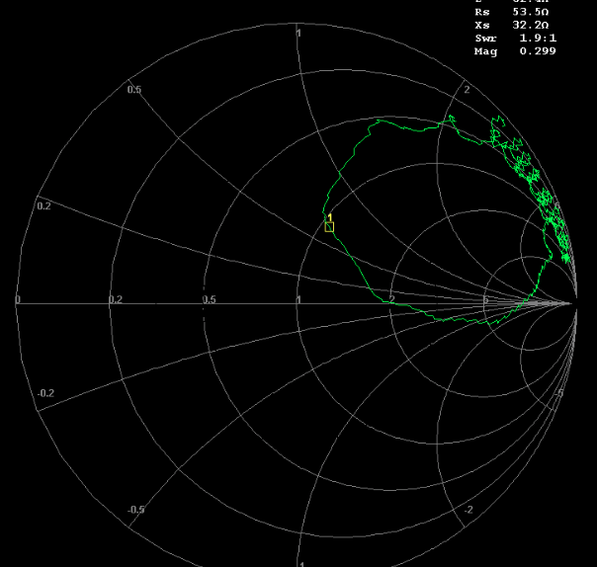
Step Alpeh
Add in the next value …
And claim success!!
The middle of the Smith chart is good.
How good of a match is it?

Slide 20
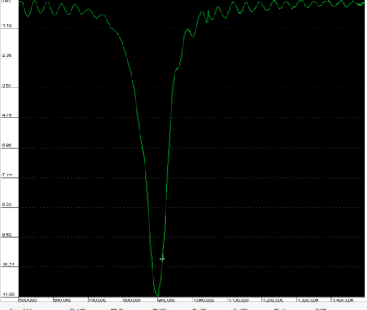
Return Loss
Magnitude of Gamma in deciBels
Low means lower magnitude of Gamma. Meaning less power is being reflected and consequently, more power is being absorbed by the load.

Slide 21
Step The End
A shunt 8.2 nH near the load. Then a series 22 nH. Brings the circuit fairly close to 50Ω, our goal.
Different from your values because … diodes. We will cover this in a future lecture.
Final component values are:

