Slide 1
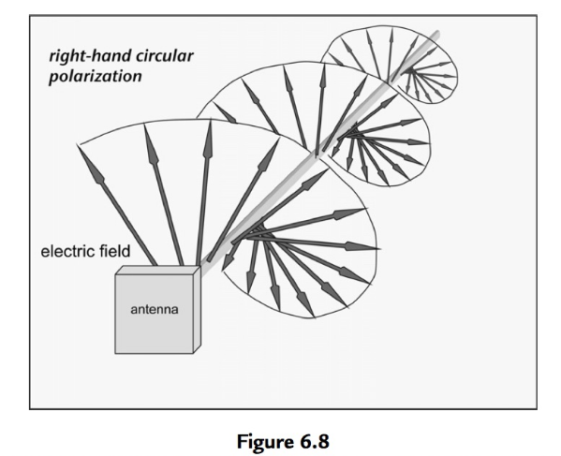
ECE 490-ST :: Wireless Computing
Circular polarization

Slide 2
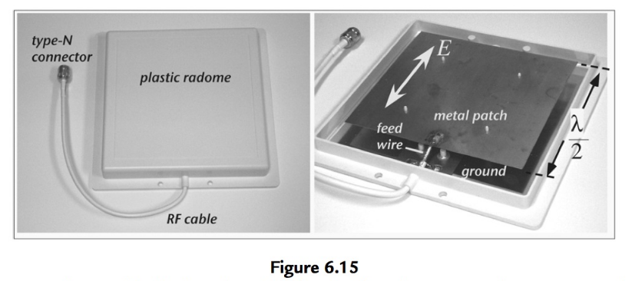
Patch antenna
Distance corresponds to wavelength over 2
For this antenna, distance between “ground” and the radiating element is important.

Slide 3
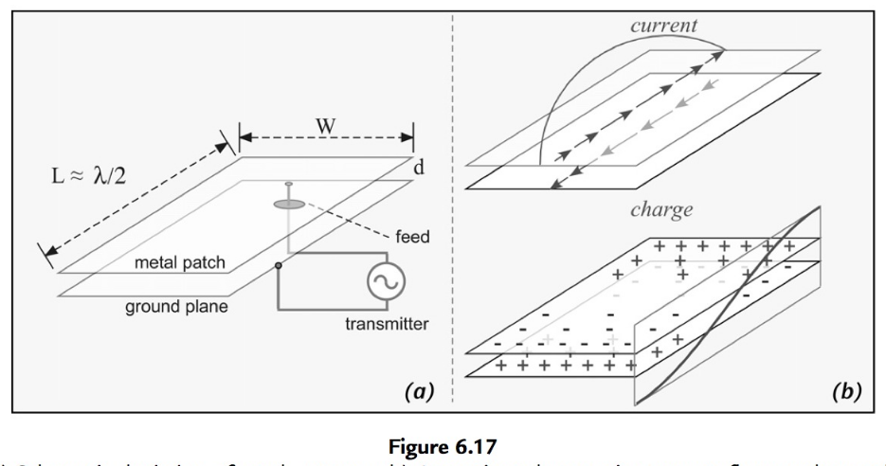
Flat Patch antenna

Slide 4
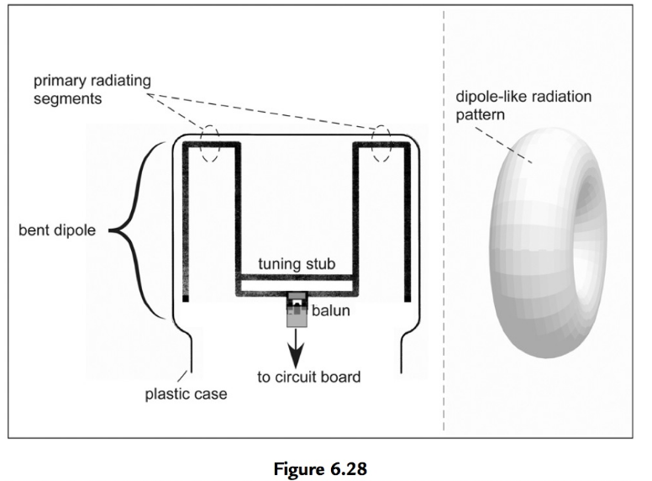

Slide 5
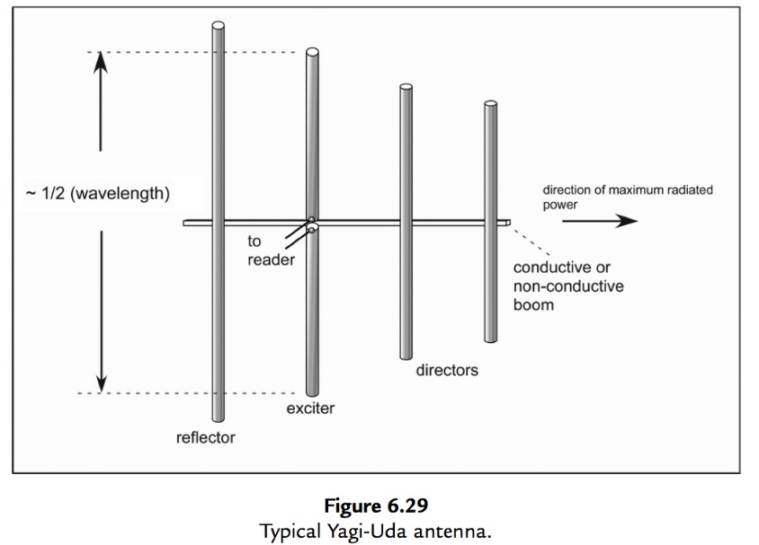

Slide 6
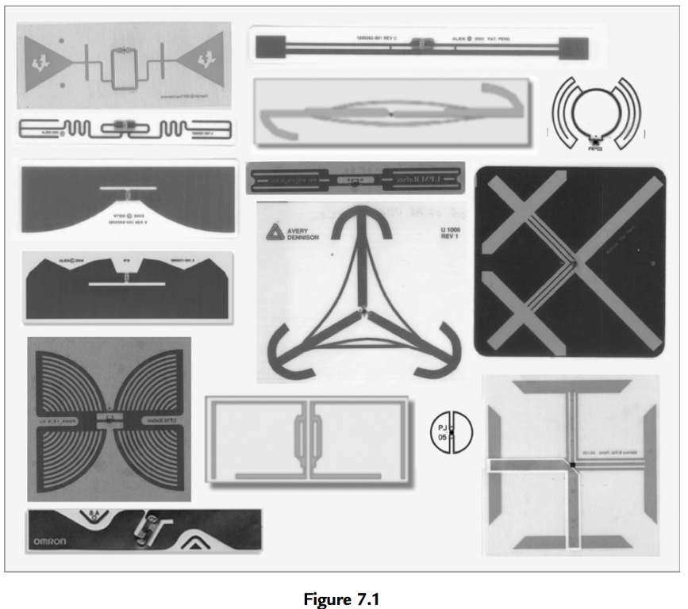
Tag antennas

Slide 7
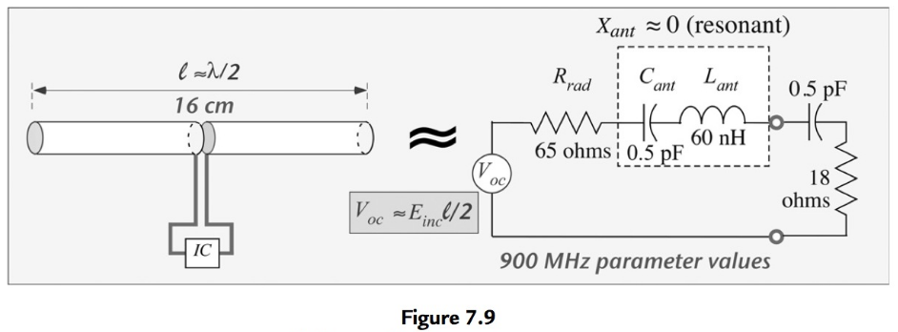
Typical Dipole

Slide 8
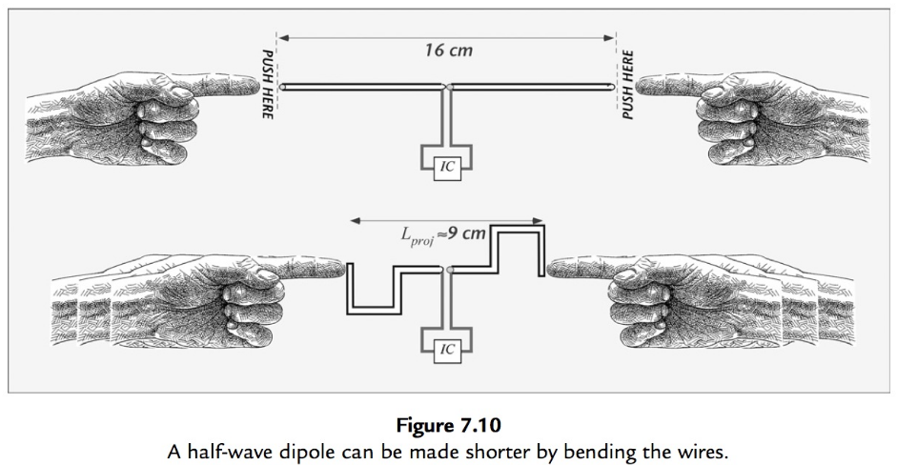
How do we make a dipole shorter?

Slide 9
How do we make a dipole shorter?
SQUISH IT!!

Slide 10
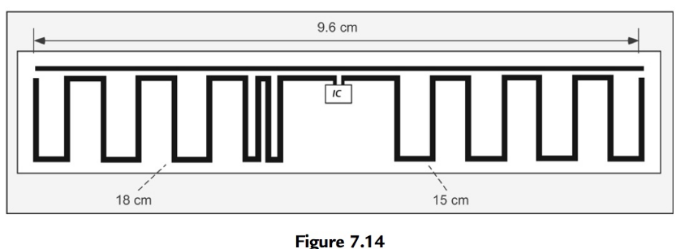
Meandered dipole
Actual RFID antenna in use

Slide 11
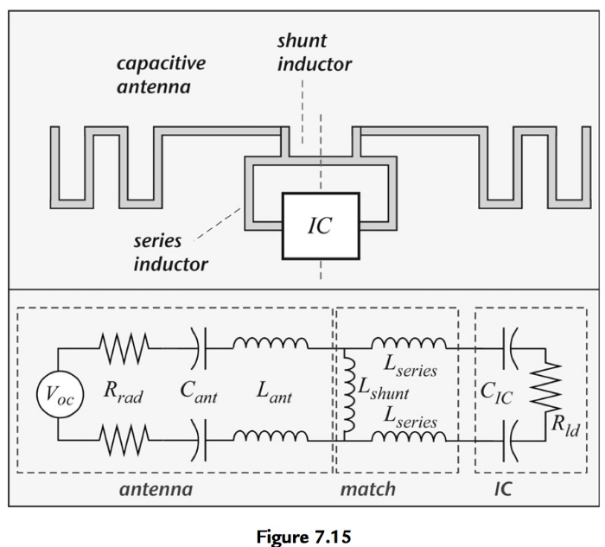
Why do these look so weird?
They are also matching networks!

Slide 12
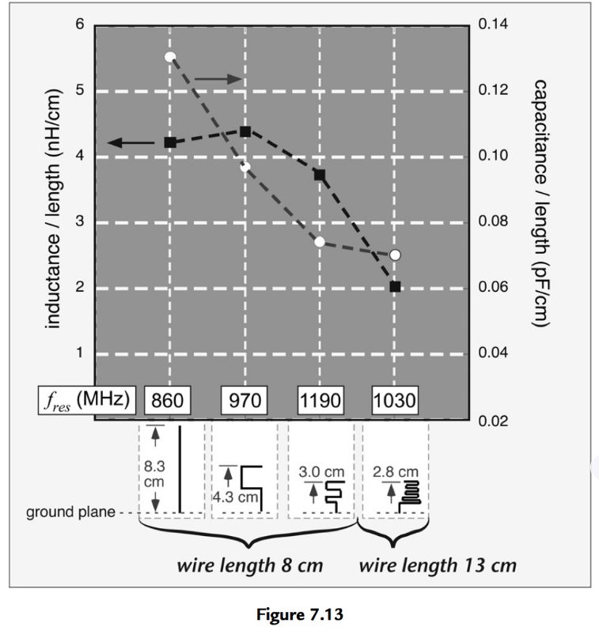
A piece of copper tape is…
An inductor?
A capacitor?
Say what???

Slide 13
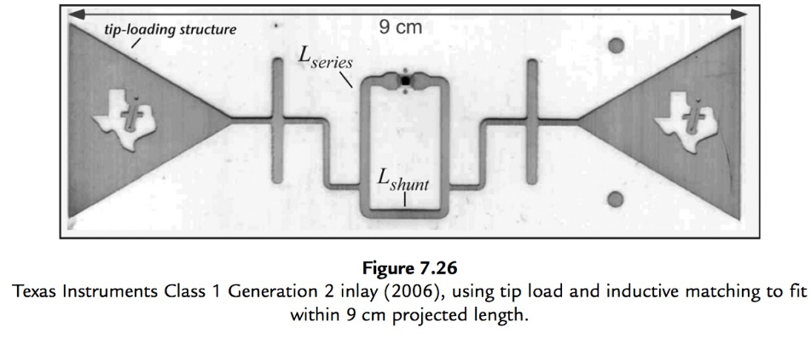
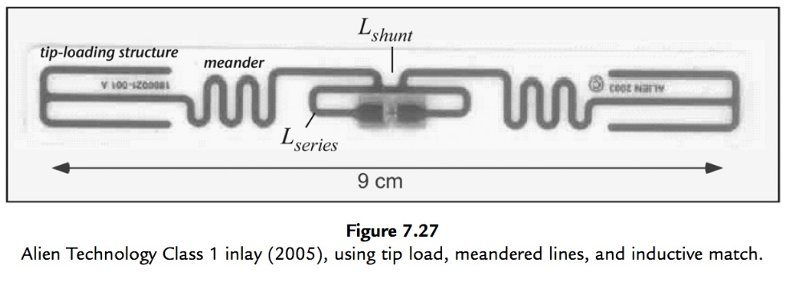
Example antennas
TI antenna above
Alien “Squiggle” below

Slide 14
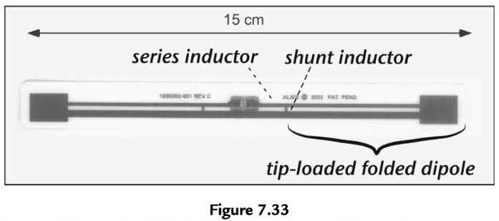
Folded dipoles
Can work ☺

