Slide 1
ECE 490-ST :: Wireless Computing
Path Loss and Propagation

Slide 2
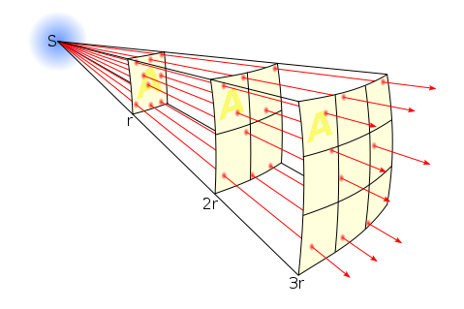

Slide 3
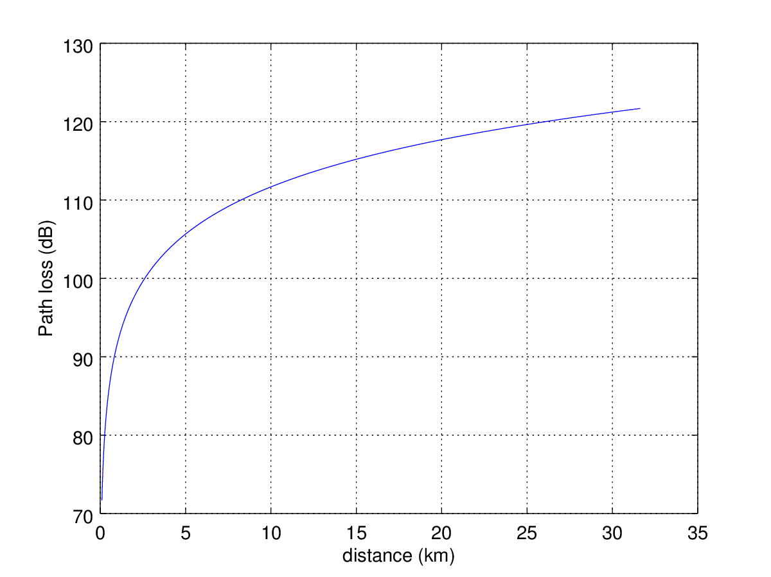
Path Loss
F = 915 MHz
105 dB loss at 5 km
Transmit 1 W, at 5 km receive
31.6 pW!

Slide 4
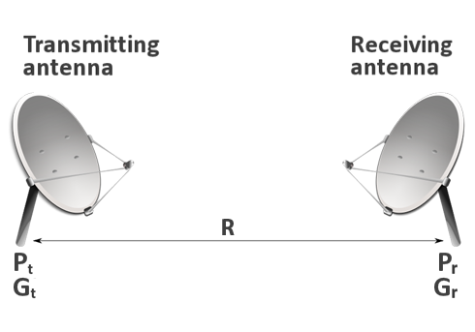
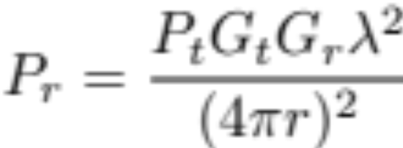
Friis transmission formula
Or in dB:
Pr = Pt + Gt + Gr +
20*log10(lambda/(4*pi*4))

Slide 5
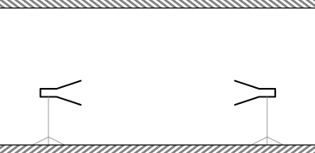
Friis Exercise
Two antennas in a hallway
One is transmitting 0 dBm (1 mW) at 915 MHz.
Plot received power from 1 to 15 meters.
Ant. Gains = 6 dBi
Plot Pr (dBm) versus distance for r = 3 to 25 meters

Slide 6
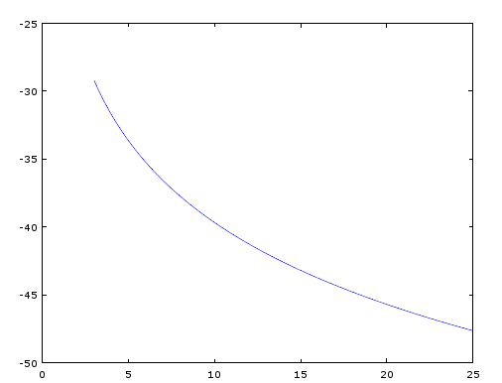
Friis Exercise
Two antennas in a hallway
One is transmitting 0 dBm (1 mW) at 915 MHz.
Plot received power from 1 to 15 meters.
Ant. Gains = 6 dBi
Plot Pr (dBm) versus distance for r = 3 to 25 meters

Slide 7
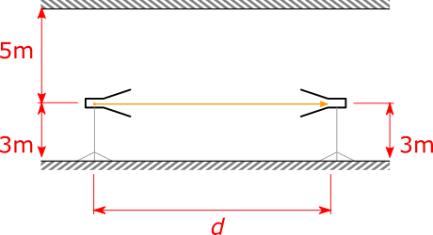
Friis Exercise
Two antennas in a hallway
One is transmitting 0 dBm (1 mW) at 915 MHz.
Plot received power from 1 to 15 meters.
Ant. Gains = 6 dBi
Plot Pr (dBm) versus distance for r = 3 to 25 meters

Slide 8
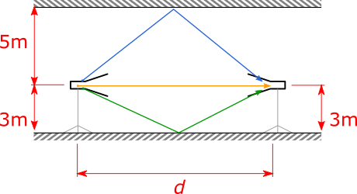
Friis Exercise
Two antennas in a hallway
One is transmitting 0 dBm (1 mW) at 915 MHz.
Plot received power from 1 to 15 meters.
Ant. Gains = 6 dBi
Plot Pr (dBm) versus distance for r = 3 to 25 meters

