Slide 1
ECE 490-ST :: Wireless Computing
Lesson 18
  Making Sense of the Harvester Characteristics

Slide 2
… at this point
Board (mostly) soldered
Can get measureable DC voltage out of chip
  Should be see about 1.2V when at -6 dBm input
Can confirm “goodness” of analog frontend from Smith chart
Harvester has a maximum efficiency curve
So what?

Slide 3
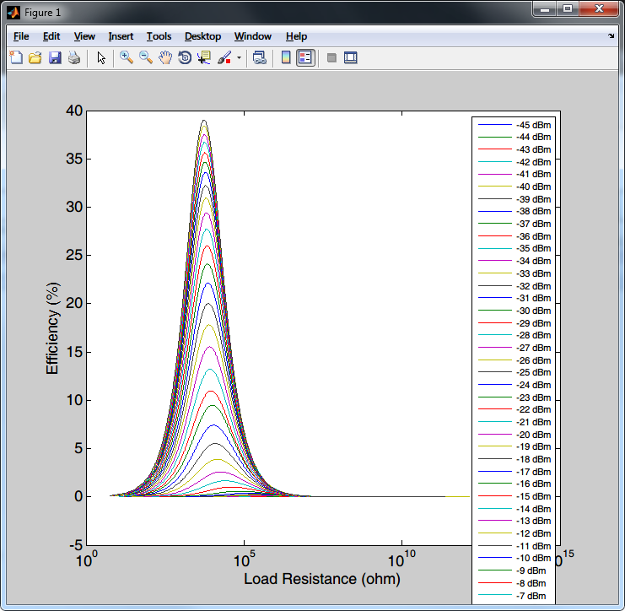
1:Harvester Eff.
X-axis is Load Resistance (log scale)
Y-Axis is efficiency (%) defined as P(load) / P(RF-in)
As RF power increases:
Maximum efficiency improves
Voltage goes up
Most efficient load goes down
What does this mean?

Slide 4
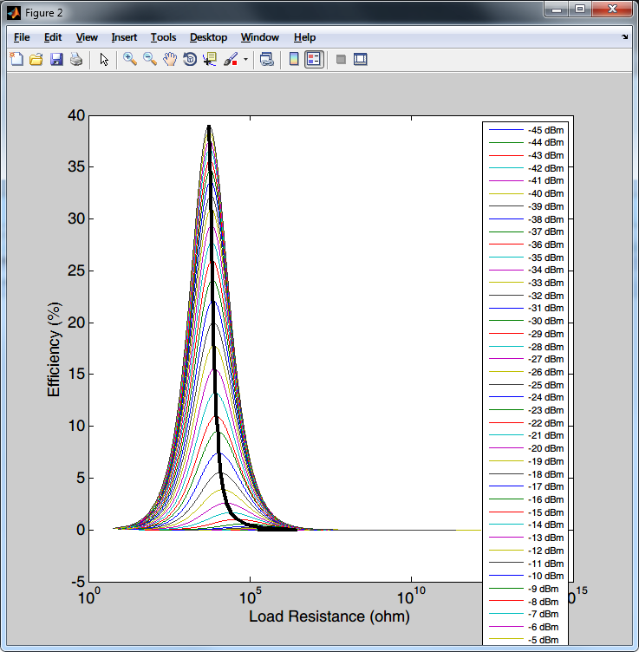
2:Harvester Eff.
If we know the input power, we can determine the best load to use
It’s gonna be in the 10’s to 100’s of kOhm range
But Prof. Thomas! How do we know our input power levels???

Slide 5
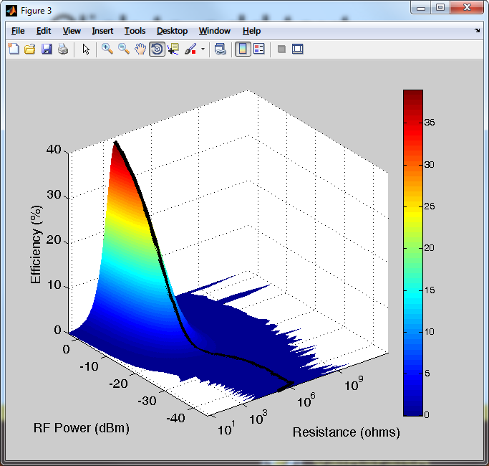
3: Oooh Pretty

Slide 6
So what?
So the harvester has a maximum efficiency curve corresponding to some load
We’re using a microcontroller! How do we change the load!???!?!??!!? !?!? !??!? !?! ?!??!!??! Eleven

Slide 7
So what?
So the harvester has a maximum efficiency curve corresponding to some load
We’re using a microcontroller! How do we change the load!???!?!??!!? !?!? !??!? !?! ?!??!!??! Eleven
What is a resistor?

Slide 8
So what?
So the harvester has a maximum efficiency curve corresponding to some load
We’re using a microcontroller! How do we change the load!???!?!??!!? !?!? !??!? !?! ?!??!!??! Eleven
What is a resistor?
What is resistance?

Slide 9
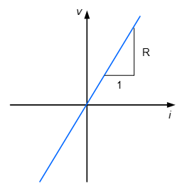

Slide 10
So if resistance is the current drawn for a given voltage, if we change how much current a device draws (on average) we can generate an effective resistor.
That’s cool!
I agree.

Slide 11
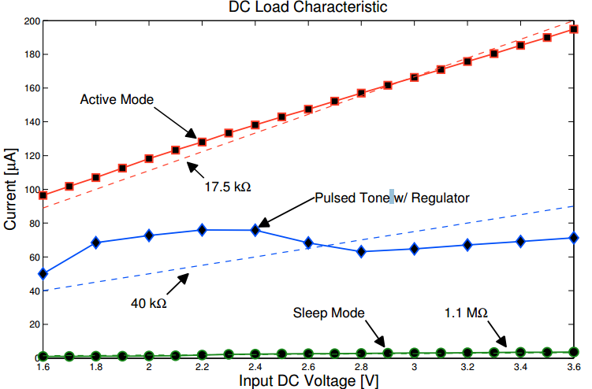
Example
RED trace: MSP430 generating a tone
GREEN trace: MSP430 in LOW-POWER mode (twiddle thumbs mode)
Blue Trace: Pulsed tone generation.
ACTS AS A 40 kOHM RESISTOR!

Slide 12
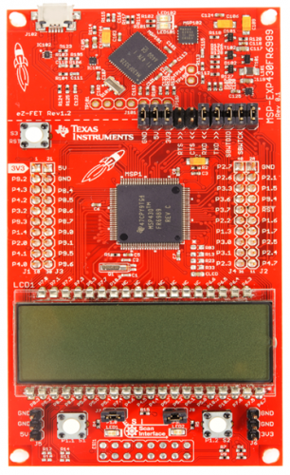
These wires will program our microcontroller
Remove jumpers and connect as follows:

Slide 13
These wires will program our microcontroller
Remove jumpers and connect as follows:
GND → GND on 490 board

Slide 14
These wires will program our microcontroller
Remove jumpers and connect as follows:
GND → GND on 490 board
3V3 -> VDD on 490 board

Slide 15
These wires will program our microcontroller
Remove jumpers and connect as follows:
GND → GND on 490 board
3V3 -> VDD on 490 board
SBWTCK -> TEST

Slide 16
These wires will program our microcontroller
Remove jumpers and connect as follows:
GND → GND on 490 board
3V3 -> VDD on 490 board
SBWTCK -> TEST
SBWTDIO -> RST

Slide 17
These wires will program our microcontroller
Remove jumpers and connect as follows:
ON 490 BOARD, make sure that the power jumper is between pins 2 and 3. This will let the Launchpad power our MCU.

Slide 18
Make a new CCS project
You’ll probably need a new workspace for ECE 490
We will be programming either the MSP430F2012 or the MSP430F2011 (which one did you put on your board?)
Use the provided program to make your MCU beep.

