Slide 1
ECE 490-ST :: Wireless Computing
Lesson 19
  The one where I begin by apologizing

Slide 2
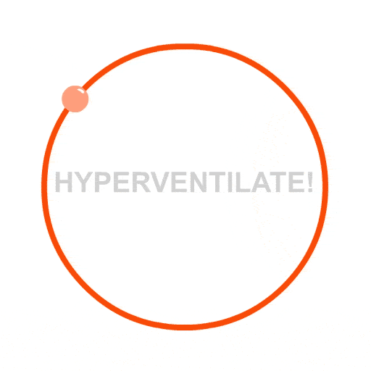
ECE 490-ST :: Wireless Computing
Lesson 19
  The one where I begin by apologizing

Slide 3
When Modeling
They will not always match reality.
  Intrinsic problems in the model
  Intrinsic problems in the simulation engine
You need to a) understand the problem b) understand your modeling system and c) understand your measurement system
Always test your equipment!

Slide 4
ECE 490-ST :: Wireless Computing
Lesson 19
  The one where I start by apologizing
  And then go on to discuss
  Low Power Programming

Slide 5
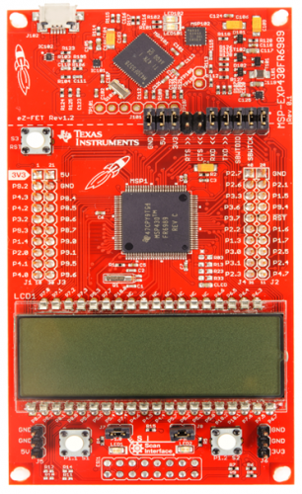
These wires will program our microcontroller
Remove jumpers and connect as follows:
REMINDER
ON 490 BOARD, make sure that the power jumper is between pins 2 and 3. This will let the Launchpad power our MCU.

Slide 6
Goals for today
Make a pulsed beeping program that consumes the lowest power possible

Slide 7
Lesson Plan
Measure power draw from last lesson’s program
Remove low-power clocking and measure power draw
Make it so the beep “pulses” Beep … Beep … Beep
  Measure power draw between two states, and control duty cycle to make effective resistor

Slide 8
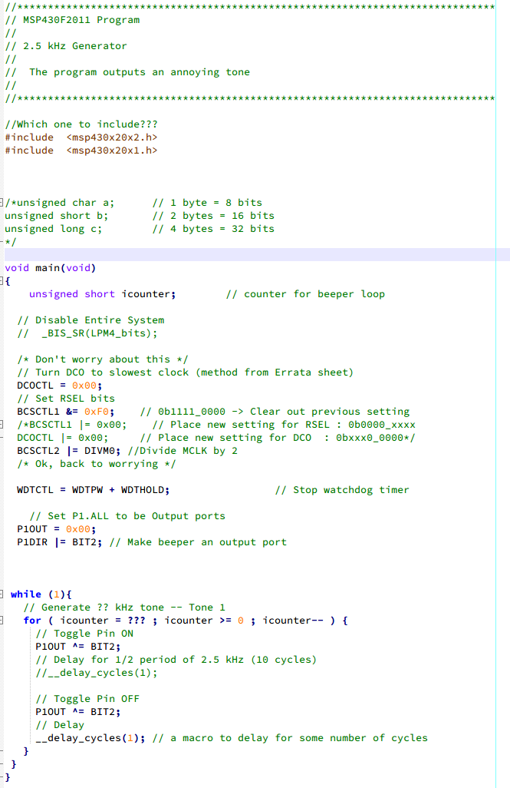
These lines control the frequency of the beep

Slide 9
These lines control the frequency of the beep
This for loop controls duration of beep (actually it does nothing right now)

Slide 10
These lines control the frequency of the beep
This for loop controls duration of beep (actually it does nothing right now)
You’ll need to insert code here, at the end of the for loop to delay between beeps

Slide 11
STEP 1
These lines control the frequency of the beep
This for loop controls duration of beep (actually it does nothing right now)
You’ll need to insert code here, at the end of the for loop to delay between beeps
Make it so, and measure power
Remove from Launchpad, send 3.3V to the VDD line, measure the current

Slide 12
Hmm, what if we delete this nice little section and leave the MSP430 in the default clock mode?

Slide 13

Hmm, what if we delete this nice little section and leave the MSP430 in the default clock mode?

Slide 14
Hmm, what if we delete this nice little section and leave the MSP430 in the default clock mode?
Now, adjust to keep roughly the same beeping output (beep tone, and beep duty cycle)
And …

Slide 15
STEP 2
Hmm, what if we delete this nice little section and leave the MSP430 in the default clock mode?
Now, adjust to keep roughly the same beeping output (beep tone, and beep duty cycle)
And …
Measure the power

Slide 16
Now we basically have 2 states:

Slide 17


Now we basically have 2 states:
1) Doot – Doot’ing a beep.
2) Waiting until we can Doot –Doot a beep.

Slide 18
Now we basically have 2 states:
1) Doot – Doot’ing a beep.
2) Waiting until we can Doot –Doot a beep.
If we made a program that ONLY beeped, how much power does it consume? What is its effective load?

Slide 19
Now we basically have 2 states:
1) Doot – Doot’ing a beep.
2) Waiting until we can Doot –Doot a beep.
If we made a program that ONLY waited, how much power does it consume? What is its effective load?

Slide 20
Now we basically have 2 states:
1) Doot – Doot’ing a beep.
2) Waiting until we can Doot –Doot a beep.
If we made a program that spent X time making a BEEP and Y time waiting, we can create it to be an effective load!

Slide 21
TO DO LIST
(It’s an assignment)
Count the cycles.
  Time on = for loop iterations * (total number of delay cycle)
  Time off = for loop iterations * (number of delay cycles)
Fill out the sheet that will:
  Alter beep code to pulse and measure power
  Remove default clock and measure power
  Control duty cycle to make an effective 7 ohm resistor

