Slide 1
ECE 490-ST
Wireless Computing
Course Overview

Slide 2

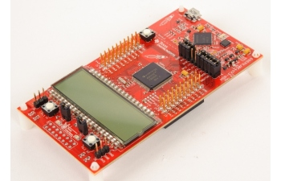
Syllabus
It’s on blackboard
Office Hours
  M 4:30-5:20
  T, Th 2:30-4:20
  F 12:30-1:20

Slide 3

But first …
A Quiz!

Slide 4
Syllabus
It’s on blackboard
Office Hours
  M 4:30-5:20
  T, Th 2:30-4:20
  F 12:30-1:20

Slide 5
Instructional Objectives
Upon successful completion of ECE 490-ST, you should be able to:
  Describe the key features of an RFID system and how they differ from traditional communication systems.
  Draw and use a Smith Chart to aid in engineering decisions.
  Describe the function and utility of a Vector Network Analyzer (VNA).
  Create a link budget using a propagation model.
  Characterize a wireless power system.
  Design low-power microcontroller programs.
  Build a battery-free device.

Slide 6
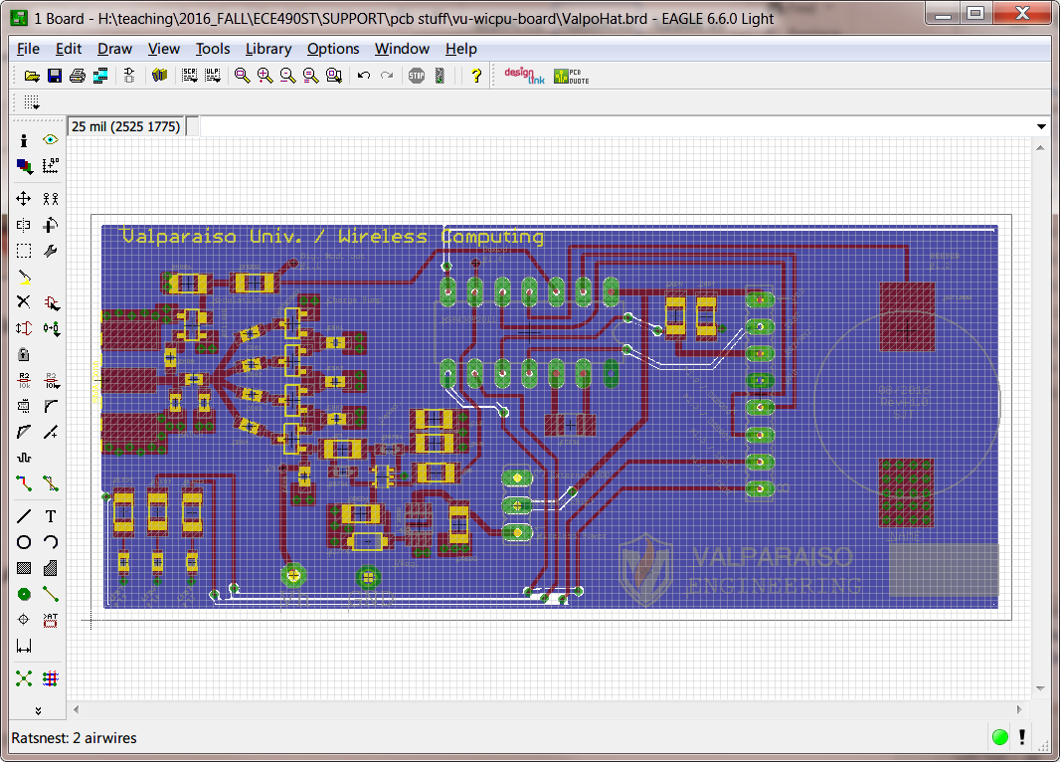
VU – WiCPU Board
You will:
Solder it up.
Test it out.
Characterize it.
Use it.
Do a final project.

Slide 7



Slide 8

DEMO OR DIE
German for Demo or The.

Slide 9
FINAL EXAM
Covers many topics from Exam 1
Adds in MSP430 stuff
Understand the code that was handed out

Slide 10

THANKS!

