Slide 1
DEV-1545 Beyond Domino Designer

Slide 2
Please note
IBM’s statements regarding its plans, directions, and intent are subject to change or withdrawal without notice at IBM’s sole discretion.
Information regarding potential future products is intended to outline our general product direction and it should not be relied on in making a purchasing decision.
The information mentioned regarding potential future products is not a commitment, promise, or legal obligation to deliver any material, code or functionality. Information about potential future products may not be incorporated into any contract.
The development, release, and timing of any future features or functionality described for our products remains at our sole discretion.
Performance is based on measurements and projections using standard IBM benchmarks in a controlled environment. The actual throughput or performance that any user will experience will vary depending upon many factors, including considerations such as the amount of multiprogramming in the user’s job stream, the I/O configuration, the storage configuration, and the workload processed. Therefore, no assurance can be given that an individual user will achieve results similar to those stated here.

Slide 3

Agenda
What, Why, How
The tools
Developer Workflow
Demo
Q & A

Slide 4
What, Why, How

Slide 5
What
Deliver modern looking web & mobile applications, that are:
Well tested
Familiar to use
Frequently updated
Maintainable by “typical web developers”

Slide 6

Why

Slide 7

If you are a Hobbit - maybe
Why
Source: http://kingofwallpapers.com/gandalf/gandalf-004.jpg

Slide 8
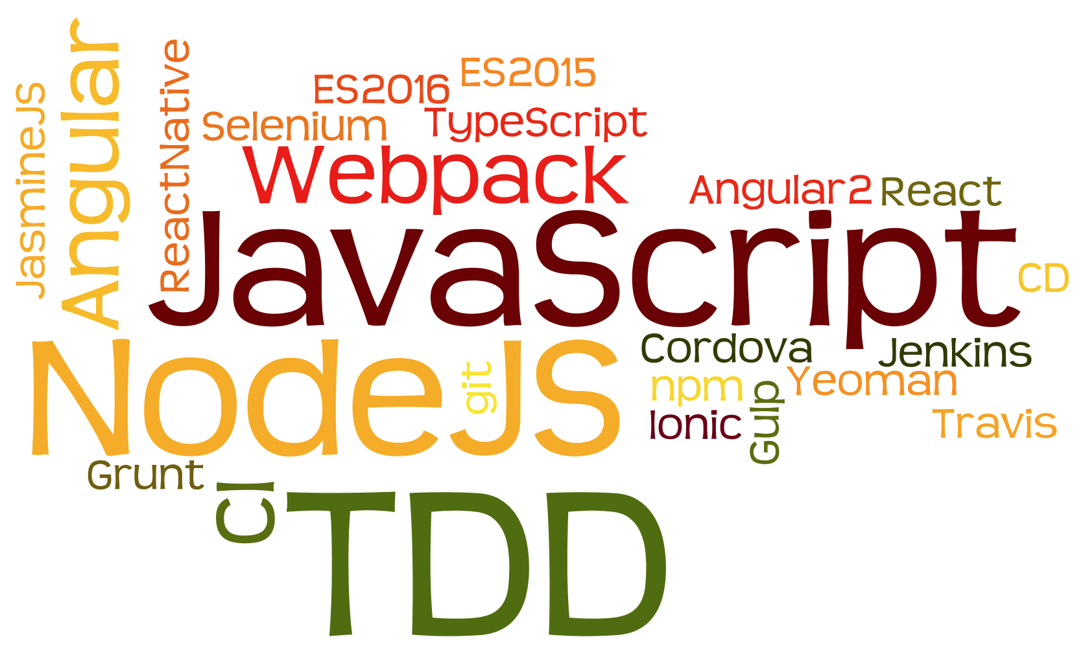
Why
http/2

Slide 9
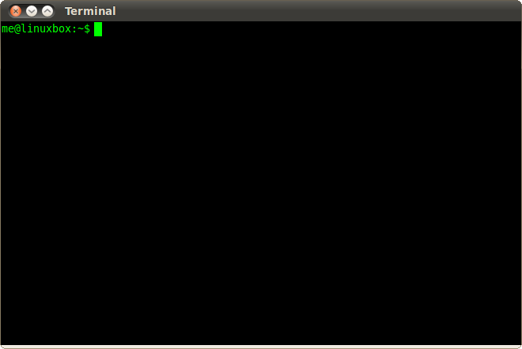
How
Command line irony

Slide 10
The tools

Slide 11

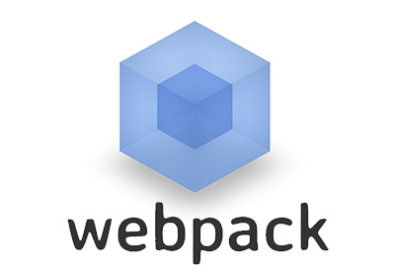



What – JavaScript tooling
NodeJS
Webpack
Gulp
Wallaby
Angular
Npm

Slide 12
Developer workflow

Slide 13




What – Development flow
Project Structure
Version Control
Testing
Lots of testing

Slide 14
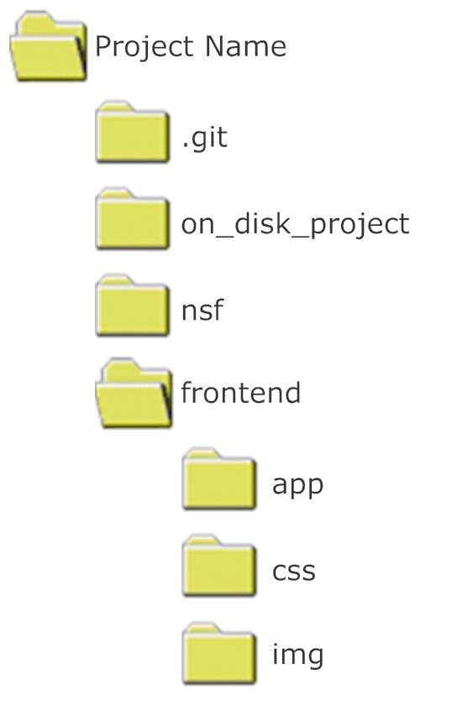
Project structure
.gitignore
.DS_Store
*.nsf
Desktop.ini
.Spotlight-V100
.Trashes
Thumbs.db

Slide 15
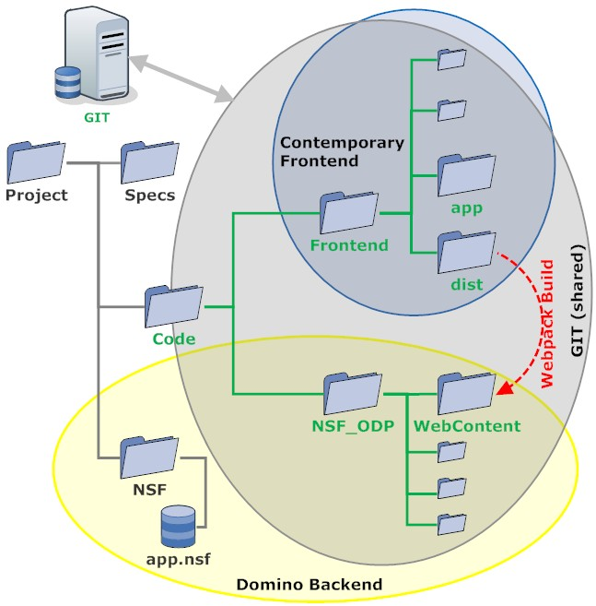
Deployment
Option 1

Slide 16
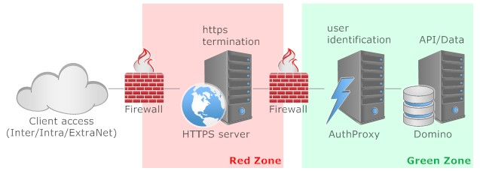
Deployment
Option 2

Slide 17
Comparing deployment options
Single NSF
Easy deployment
Domino HTTP stack
Domino authentication
Single tier
Front-end / Back-end split
Easy update of frontend
http2 capable
Any authentication
Multi tier

Slide 18
Demo

Slide 19
Notices and disclaimers
Copyright © 2017 by International Business Machines Corporation (IBM). No part of this document may be reproduced or transmitted in any form without written permission from IBM.
U.S. Government Users Restricted Rights — Use, duplication or disclosure restricted by GSA ADP Schedule Contract with IBM.
Information in these presentations (including information relating to products that have not yet been announced by IBM) has been reviewed for accuracy as of the date of initial publication and could include unintentional technical or typographical errors. IBM shall have no responsibility to update this information. THIS DOCUMENT IS DISTRIBUTED "AS IS" WITHOUT ANY WARRANTY, EITHER EXPRESS OR IMPLIED. IN NO EVENT SHALL IBM BE LIABLE FOR ANY DAMAGE ARISING FROM THE USE OF THIS INFORMATION, INCLUDING BUT NOT LIMITED TO, LOSS OF DATA, BUSINESS INTERRUPTION, LOSS OF PROFIT OR LOSS OF OPPORTUNITY. IBM products and services are warranted according to the terms and conditions of the agreements under which they are provided.
IBM products are manufactured from new parts or new and used parts. In some cases, a product may not be new and may have been previously installed. Regardless, our warranty terms apply.”
Any statements regarding IBM's future direction, intent or product plans are subject to change or withdrawal without notice.
Performance data contained herein was generally obtained in a controlled, isolated environments. Customer examples are presented as illustrations of how those customers have used IBM products and the results they may have achieved. Actual performance, cost, savings or other results in other operating environments may vary.
References in this document to IBM products, programs, or services does not imply that IBM intends to make such products, programs or services available in all countries in which IBM operates or does business.
Workshops, sessions and associated materials may have been prepared by independent session speakers, and do not necessarily reflect the views of IBM. All materials and discussions are provided for informational purposes only, and are neither intended to, nor shall constitute legal or other guidance or advice to any individual participant or their specific situation.
It is the customer’s responsibility to insure its own compliance with legal requirements and to obtain advice of competent legal counsel as to the identification and interpretation of any relevant laws and regulatory requirements that may affect the customer’s business and any actions the customer may need to take to comply with such laws. IBM does not provide legal advice or represent or warrant that its services or products will ensure that the customer is in compliance with any law

Slide 20
Notices and disclaimers continued
Information concerning non-IBM products was obtained from the suppliers of those products, their published announcements or other publicly available sources. IBM has not tested those products in connection with this publication and cannot confirm the accuracy of performance, compatibility or any other claims related to non-IBM products. Questions on the capabilities of non-IBM products should be addressed to the suppliers of those products. IBM does not warrant the quality of any third-party products, or the ability of any such third-party products to interoperate with IBM’s products. IBM EXPRESSLY DISCLAIMS ALL WARRANTIES, EXPRESSED OR IMPLIED, INCLUDING BUT NOT LIMITED TO, THE IMPLIED WARRANTIES OF MERCHANTABILITY AND FITNESS FOR A PARTICULAR PURPOSE.
The provision of the information contained herein is not intended to, and does not, grant any right or license under any IBM patents, copyrights, trademarks or other intellectual property right.
IBM, the IBM logo, ibm.com, Aspera®, Bluemix, Blueworks Live, CICS, Clearcase, Cognos®, DOORS®, Emptoris®, Enterprise Document Management System™, FASP®, FileNet®, Global Business Services ®, Global Technology Services ®, IBM ExperienceOne™, IBM SmartCloud®, IBM Social Business®, Information on Demand, ILOG, Maximo®, MQIntegrator®, MQSeries®, Netcool®, OMEGAMON, OpenPower, PureAnalytics™, PureApplication®, pureCluster™, PureCoverage®, PureData®, PureExperience®, PureFlex®, pureQuery®, pureScale®, PureSystems®, QRadar®, Rational®, Rhapsody®, Smarter Commerce®, SoDA, SPSS, Sterling Commerce®, StoredIQ, Tealeaf®, Tivoli®, Trusteer®, Unica®, urban{code}®, Watson, WebSphere®, Worklight®, X-Force® and System z® Z/OS, are trademarks of International Business Machines Corporation, registered in many jurisdictions worldwide. Other product and service names might be trademarks of IBM or other companies. A current list of IBM trademarks is available on the Web at "Copyright and trademark information" at: www.ibm.com/legal/copytrade.shtml.

Slide 21
Thank you

Slide 22
Further readings
Would you like to know more?*
* In case you didn’t get the reference: https://www.youtube.com/watch?v=kdrjzE1SE58

Slide 23
Tool locations (and install sequence)
Node.js: https://nodejs.org/
NPM: https://www.npmjs.com/
Jasmine:https://jasmine.github.io/
Protractor: http://www.protractortest.org/
AngularJS:https://angular.io/
Angular CLI: https://cli.angular.io/
TypeScript: https://www.typescriptlang.org/
Webpack: https://webpack.js.org/
Microsoft Code: https://code.visualstudio.com/
Wallaby: https://wallabyjs.com/
GIT: https://git-scm.com/
Tower: https://www.git-tower.com/
Sourcetree: https://www.sourcetreeapp.com/

Slide 24
Helper tools used
DXLDump
DXLLoad
FormExtractor
Mustache

