Slide 1

POWER BI DATA ANALYSIS PROJECT
Customer Analytics &
Shipping Performance Dashboard

Slide 2

Introduction
This project analyses customer and shipment data for an e-commerce company selling electronic products. The objective is to
identify patterns in customer demographics, satisfaction, product importance, shipping preferences, delivery performance and warehouse usage, while also uncovering additional insights that can support business decision-making.

Slide 3

TOTAL ORDERS
10,999
ON-TIME RATE
40.3%
10,999 orders analysed — but only 4 in 10 arrived on time.
AVG ORDER VALUE
204.94
TOTAL PAID
2M

Slide 4

SHIPMENT COMPLETION PERFORMANCE
ABOUT THE DATA
59.67% of orders (6.56K) were delayed, while 40.33% (4.44K) arrived on time — delivery reliability is the biggest operational gap.
On time 4440
Delayed 6560

Slide 5
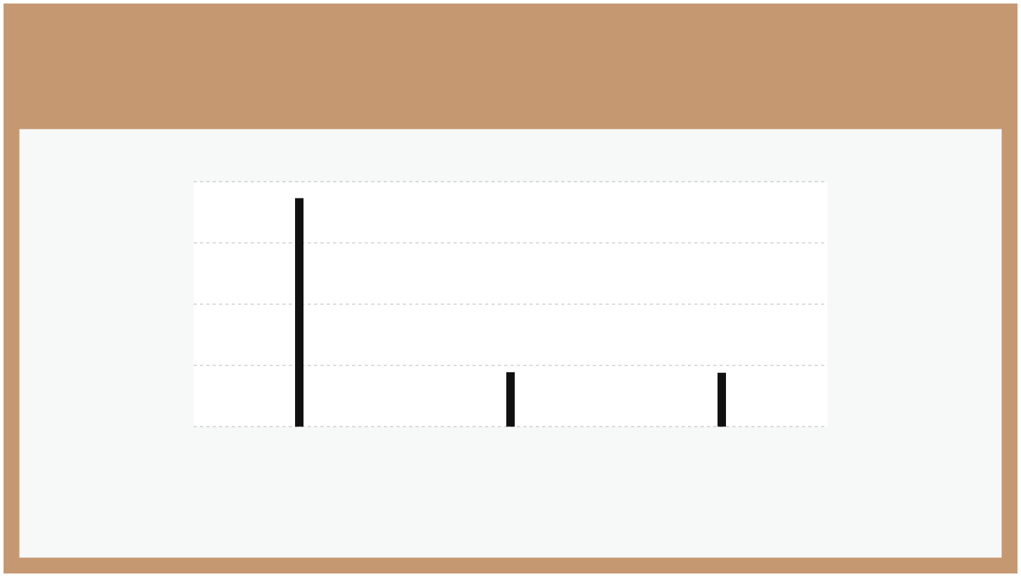
PREFERRED MODE OF SHIPMENT
8000
7462
6000
4000
2000
1777
1760
0
Ship
Flight
Road
Ship is by far the most used mode; Flight and Road are roughly equal (approx. values)

Slide 6
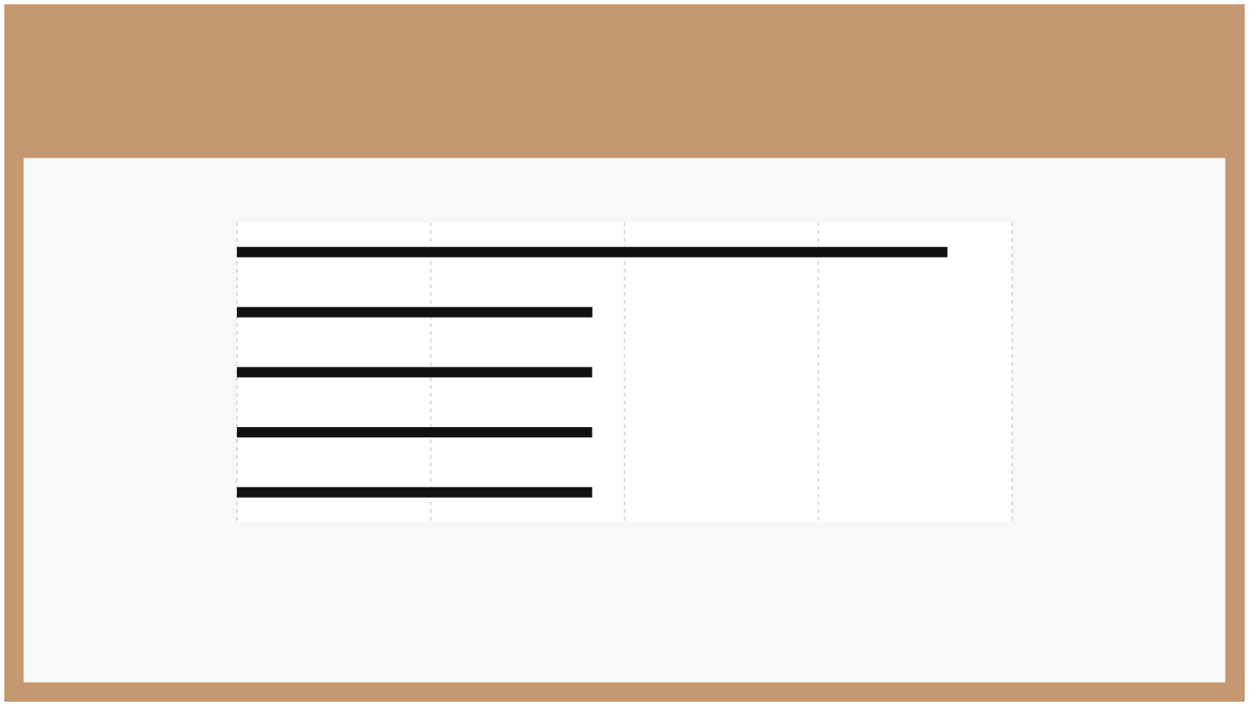
WAREHOUSE BLOCK USAGE
Block_E
3666
Block_D
1834
Block_A
1833
Block_B
1833
Block_C
1833
0
1000
2000
3000
4000
Block E handles about twice the volume of any other block (approx. values)

Slide 7

CUSTOMER GENDER DISTRIBUTION
ABOUT THE DATA
The customer base is almost evenly split: 50.41% female and 49.59% male. Average order value is also near-identical across genders (~200).
Male 5450
Female 5550

Slide 8

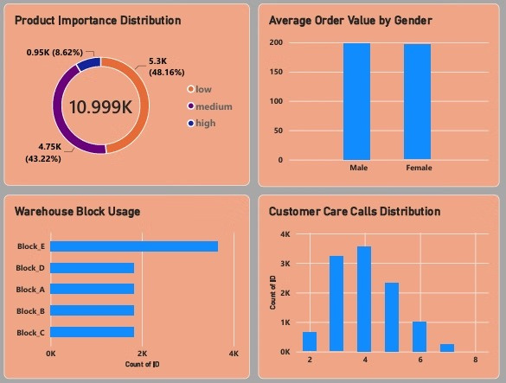
Dashboard visuals

Slide 9
Key Findings
What the dashboard reveals
Customer Satisfaction
Shipment Performance
Shipping Preference
Ratings are spread evenly from Poor to Excellent (~2.2K each), signalling room to lift satisfaction.
59.67% of orders (6.56K) were delayed; only 40.3% arrived on time.
Ship is the dominant mode (~7.5K orders), far ahead of Flight and Road (~1.8K each).
Warehouse Utilisation
Discount Impact
Delivery Cost
Block E handles roughly double the volume of Blocks A–D, indicating uneven workload.
High-importance products receive the highest average discount (~15), vs ~13 for low.
Most orders fall in the 10 delivery-fee band, followed by 5; the 15 band is negligible.

Slide 10
Conclusion
The analysis provides a clearer understanding of customer behaviour, satisfaction, shipping performance and warehouse
utilisation. The additional analysis of discounts, delivery fees, order value and customer care activity provides further insight into operational and commercial performance. These findings can support better decisions around customer service, shipping operations, warehouse allocation and promotional strategies.

