Slide 1
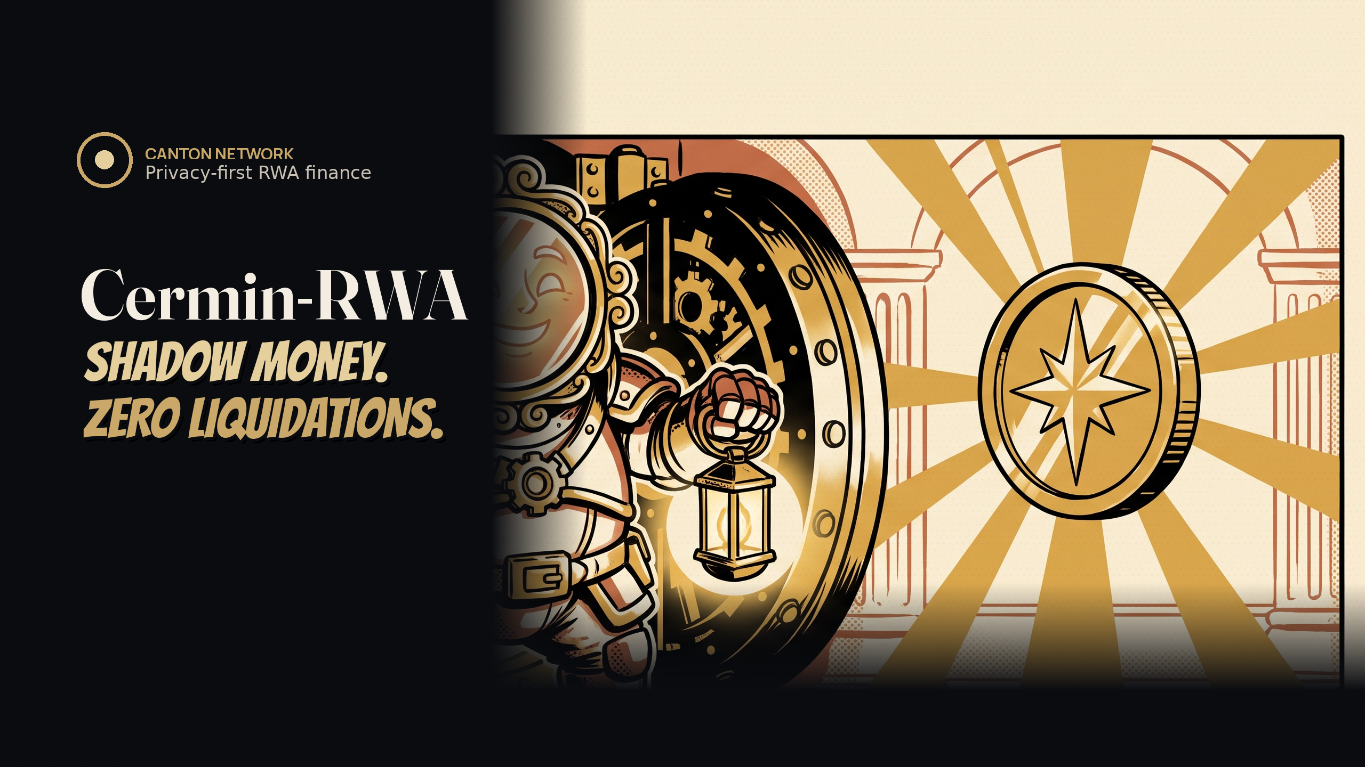
Autonomous liquidation protection for tokenized real world asset loans, live on Canton Network.
cermin-rwa.vercel.app
Autonomous · Private · Live on DevNet
Notes:
[SLIDE 1 — HOOK | ~20 dtk]
Hi, I'm Yeheskiel. Quick question: lots of projects let you TRADE privately. But when the market crashes... who PROTECTS you privately?
This is Cermin-RWA — shadow money, zero liquidations.
It's not a place to trade. It's an agent that acts FOR you: it rescues your loan by itself, before liquidation can happen.
And it's live on Canton DevNet right now.

Slide 2
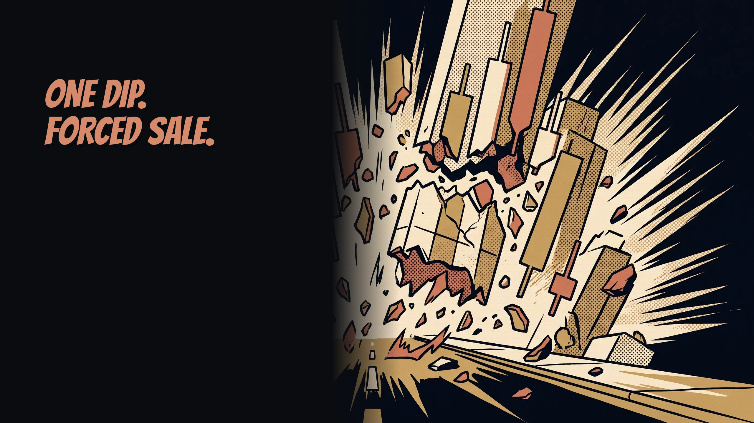
THE PROBLEM
RWA collateralized loans inherit DeFi's ugliest mechanic: forced liquidation. Rates move, bond and gold prices dip, and positions get sold at the worst possible moment.
57% of OTC transaction costs are operational, mostly manual margin work. (ISDA)
Notes:
[SLIDE 2 | ~18 dtk]
The problem: RWA loans on-chain still use forced liquidation.
Price dips — your assets get sold at the worst moment.
Real markets don't work like this. A shortfall starts a process, not a fire sale.

Slide 3
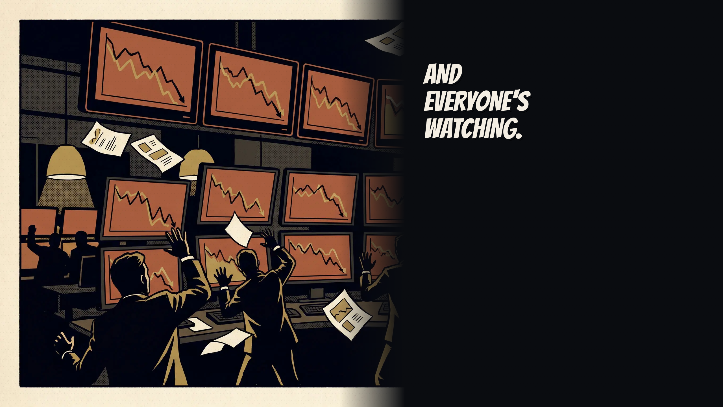
WHY IT'S WORSE ON-CHAIN
On public chains your position is visible to everyone. Liquidation bots hunt it and competitors front run it. Liquidation becomes public theater, a headline no institution can afford.
Notes:
[SLIDE 3 | ~13 dtk]
On public chains it's worse: everyone sees your position.
Bots hunt it. No institution wants a public liquidation.

Slide 4
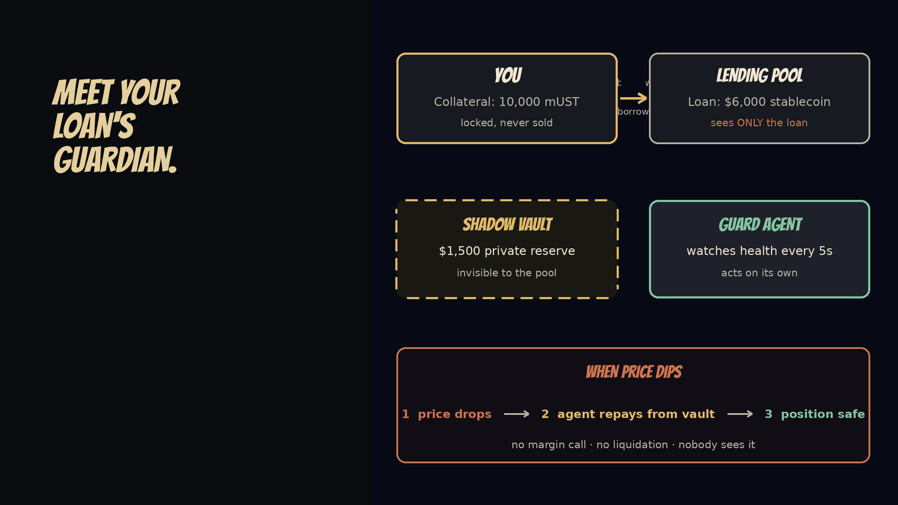
THE SOLUTION
Cermin-RWA is an autonomous guard agent with a private Shadow Vault. When your collateral dips, it quietly repays part of your loan before any margin call or liquidation. No fire sale. No one sees it happen.
Notes:
[SLIDE 4 | ~22 dtk]
Our answer: a guard agent plus a private Shadow Vault.
You borrow from the pool, and fund a private reserve the pool can't see.
When price dips, the agent repays part of your loan from that vault — automatically.
No margin call. No liquidation. Nobody sees it.

Slide 5
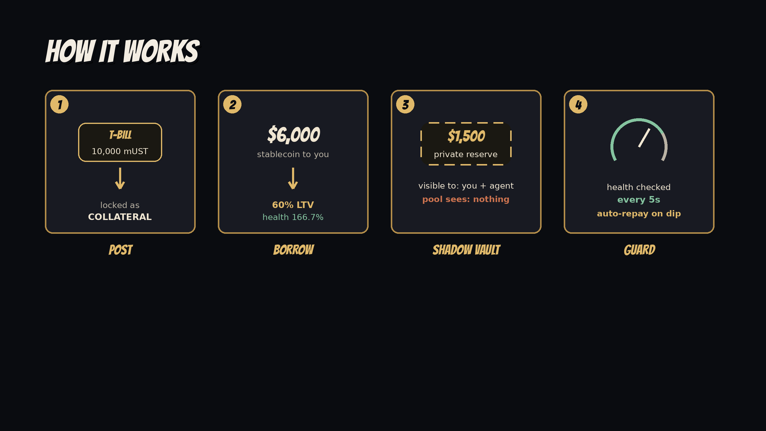
Four steps, then your loan protects itself.
Post tokenized Treasury or gold as collateral.
Draw stablecoin against it.
Fund a private reserve only you can see.
Cermin watches every 5s and auto-repays on a dip.
Notes:
[SLIDE 5 | ~16 dtk]
Four steps: post Treasuries or gold, borrow stablecoin, fund your vault — done.
The agent watches every 5 seconds. Your loan protects itself.

Slide 6
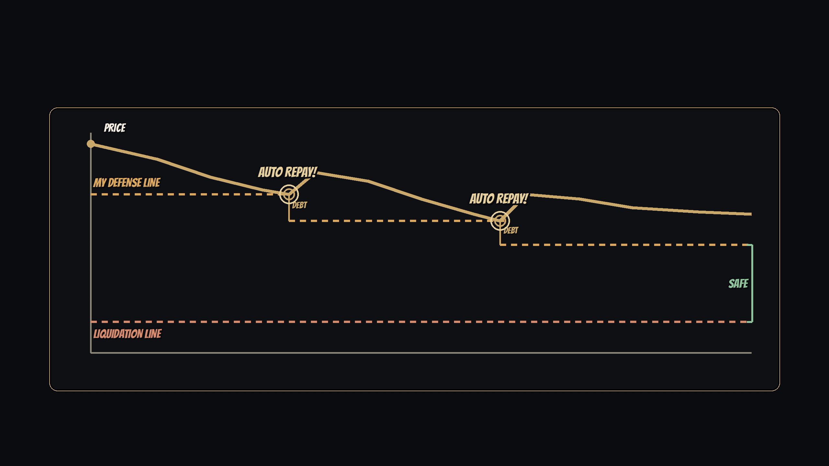
THE MECHANISM
Repay early. Never even close.
166.7% dips to 126.7% Cermin repays $758.62 back to 145.0%
Each repay shrinks the loan, so the breach price steps down and liquidation never gets a chance.
Notes:
[SLIDE 6 | ~28 dtk]
Here's how it works — think of automatic braking in a car.
The gold line is your collateral price. The dashed line below is the danger zone.
The moment price touches it, the agent takes a little money from the vault and pays down the loan. Early, and only a little.
And here's the trick: a smaller loan means the danger zone drops lower. So every rescue pushes danger further away.
We tested this live: price crashed 24% — the agent fixed it in five seconds. Liquidation never even got close.

Slide 7
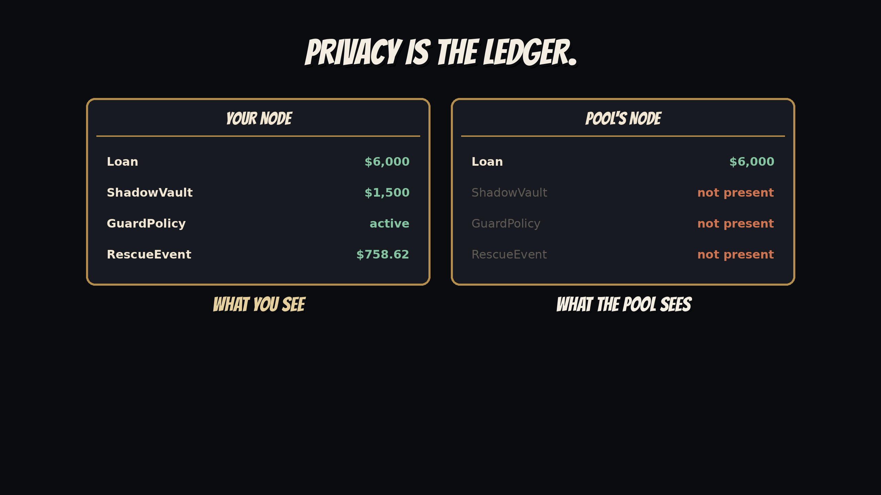
Your vault
Your policy
Every rescue
0 vaults
0 rescues
0 policies
Impossible on EVM. Structural on Canton. Daml ships each contract only to its named parties.
Notes:
[SLIDE 7 | ~24 dtk]
Now the best part: nobody can see any of this happen.
Left: your view — your vault, your policy, every rescue.
Right: what the pool sees — no vault, no policy, no rescue. Just a loan that's always paid on time.
This isn't an app setting. The ledger simply never sends your private contracts to them.
On a public chain, everyone would see everything. Here, protection is invisible.

Slide 8
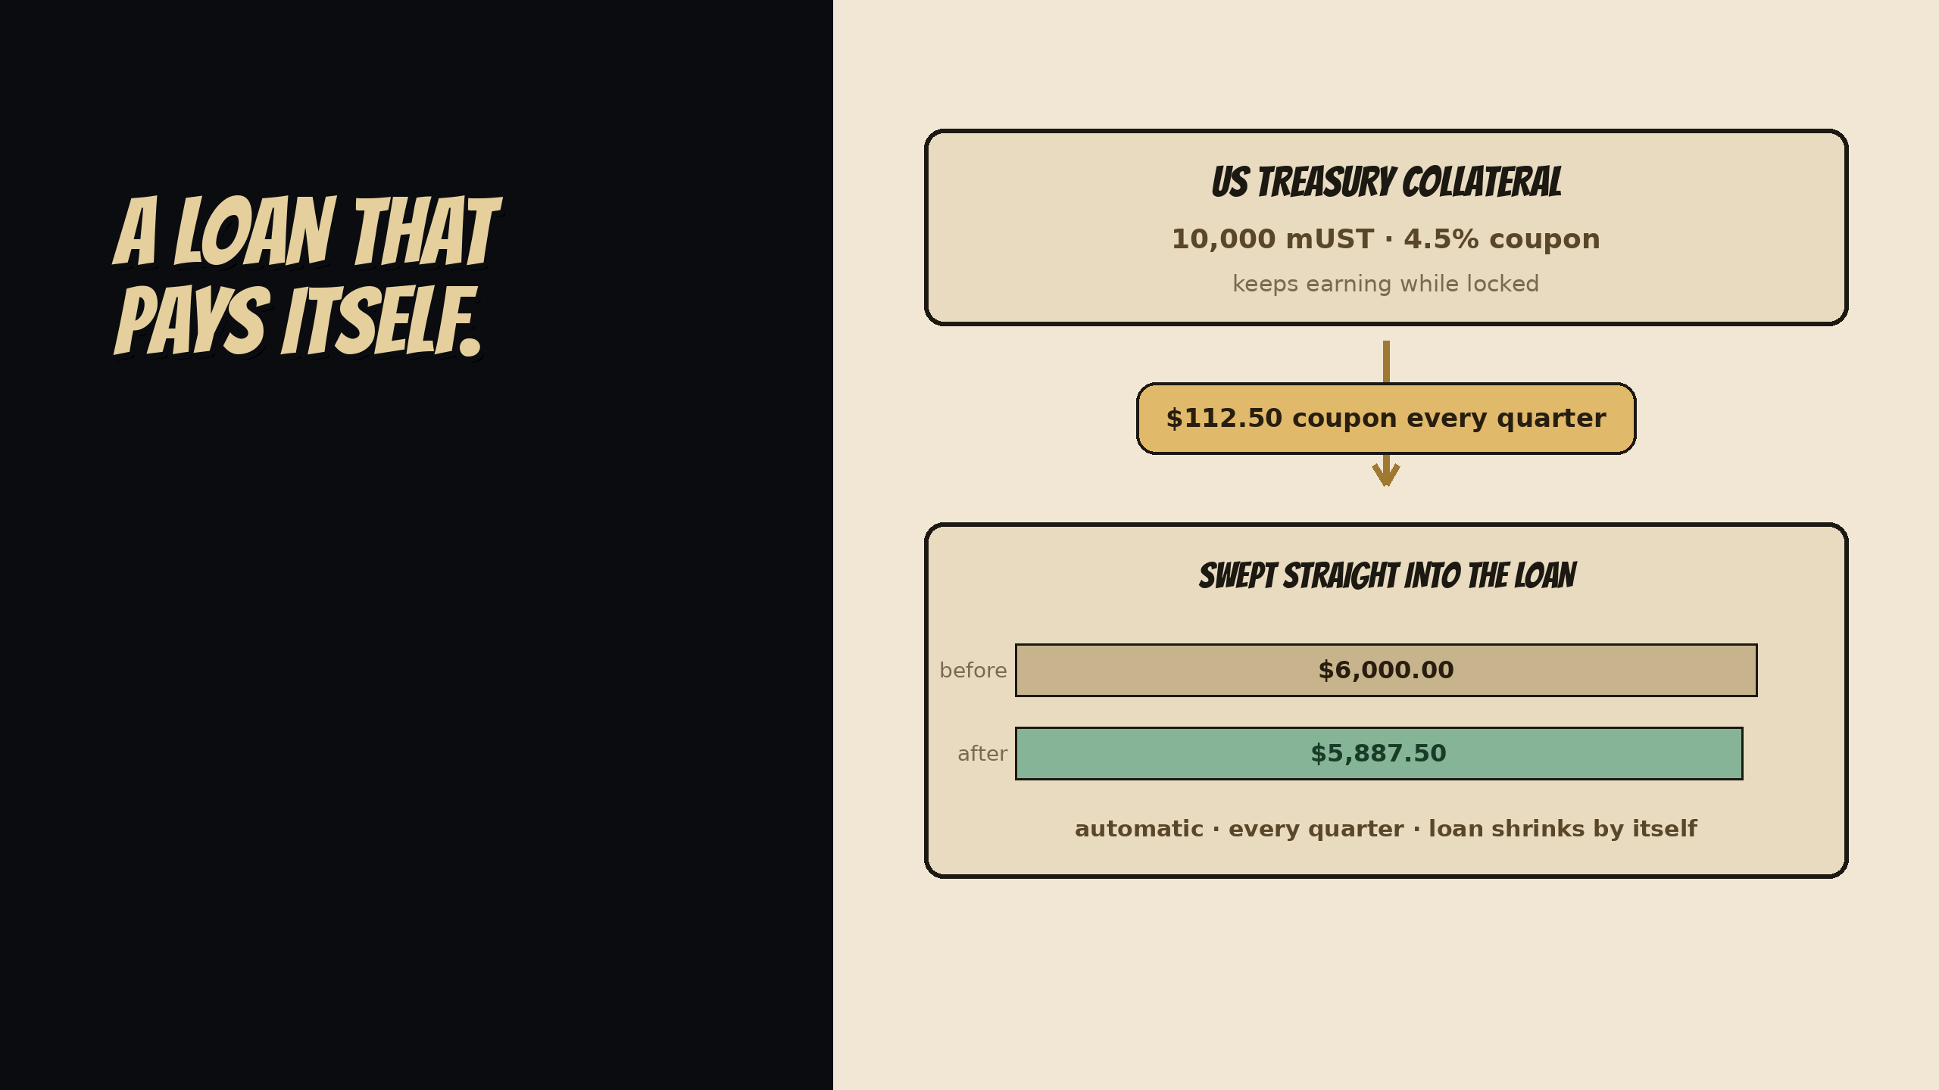
THE RWA SUPERPOWER
Treasuries pay coupons. Cermin routes that yield straight into loan repayment, so the loan shrinks while it stays protected.
$112.50 swept every quarter, automatically.
BTC could never do this. RWA can.
Notes:
[SLIDE 8 | ~18 dtk]
One more thing only RWA can do: Treasuries pay coupons.
Cermin sweeps that yield into the loan — 112 dollars every quarter, automatic.
The loan pays itself off. BTC can't do that.

Slide 9

Cermin-RWA · Built on Canton Network
Try it live → cermin-rwa.vercel.app
Notes:
[SLIDE 9 — CLOSE | ~13 dtk]
So: others built private places to transact.
We built the agent that protects you while you do — and it already rescued a real loan on DevNet, and nobody saw it happen.
Cermin-RWA. Shadow money, zero liquidations. Try it: cermin-rwa.vercel.app. Thank you!
[TOTAL ~2 mnt 50 dtk]

