Slide 1


CERMIN
Self-driving Bitcoin banking on Mezo
Your BTC stays whole. The Shadow is what you live on.
Supernormal Foundation × Mezo Hackathon
Notes:
[~10s]
This is Cermin — Bitcoin banking that runs itself. Put in your BTC, live off the cash it makes, and never get liquidated. Here's how.

Slide 2

THE DILEMMA
Bitcoin makes you rich.
Spending it makes you sell.
Sell BTC
Get cash now — but lose all future upside.
Hold BTC
Keep the upside — but no cash to live on.
Mezo lets you borrow dollars against BTC at 1%. But then you manage the risk, the yield, and the liquidation yourself — 24/7.
Notes:
[~20s]
Bitcoin holders are stuck. Sell, you lose the upside. Hold, you have no cash. Mezo lets you borrow dollars against your BTC at 1% — but then you manage everything yourself, all day. Most people get it wrong, or get liquidated.

Slide 3





THE SOLUTION
Cermin is the autopilot.
Deposit your BTC once. Cermin borrows at 1%, earns ~5%, and pays you the difference — about $167 a month per BTC.
Borrows dollars against your BTC
Earns about 5% on those dollars
Grows your cash when BTC goes up
Repays debt when BTC drops — no liquidation
Notes:
[~25s]
Cermin does it for you. Put in your BTC once and pick a setting. It borrows at 1%, earns about 5%, and pays you the difference — around $167 a month per Bitcoin. Your BTC is never sold; you just spend the dollars.

Slide 4
THE ENGINE
Two automatic actions — that's it.
SKIM — when BTC goes up
DEFEND — when BTC goes down
When BTC rises, more borrowing room opens up.
Cermin turns it into spendable cash plus yield. Your balance grows — your BTC is never sold.
Before you get near liquidation, Cermin repays some debt to keep you safe.
It runs automatically, on-chain — anyone can trigger it, so you're safe even if we're offline.
Two contracts · one keeper · no LLM, no indexer, no custody
Notes:
[~30s]
It only does two things. When BTC goes up, it turns the new room into cash plus yield, without selling any BTC. When BTC goes down, it repays debt early so you stay safe. It runs on-chain by itself, and anyone can trigger the defense — so you're safe even if we're offline. Two contracts, one keeper. That's it.

Slide 5


WHY CERMIN WINS
DeFi makes you do the work. Cermin does it for you.
Typical DeFi
Cermin
Setup
Read docs, do the math
Pick a preset. Done.
Risk
You watch it, 24/7
Cermin watches it for you
Yield
Hunt for yield yourself
Earns yield automatically
Strategy
Set once, never changes
Adapts as BTC moves
Feel
Feels like a spreadsheet
Feels like a bank app
Notes:
[~18s]
Normal DeFi makes you do all the work — the math, the watching, the worry. Cermin does it for you. The big one: it defends itself, so you don't get liquidated. A spreadsheet becomes a bank app.

Slide 6
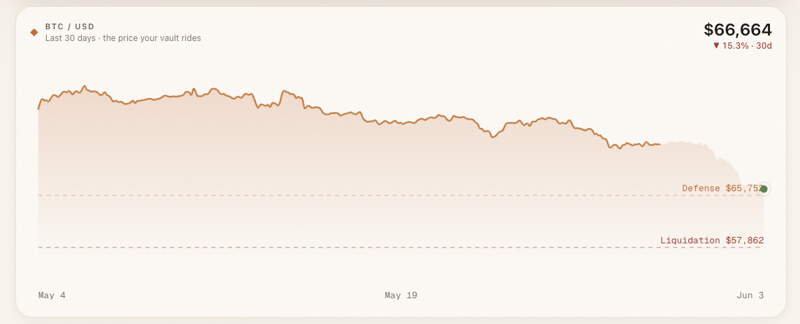
ON-CHAIN PROOF
It defends itself.
BTC dropped 15% in a month. Cermin defended 5 times — never close to liquidation.
Defense $65,757 held · liquidation $57,862 never touched · verified on Mezo testnet
Notes:
[~18s]
And it's real. Last month BTC dropped 15%. Every time it got close to the danger line, Cermin repaid debt and pulled it back. It never came near liquidation. This is live on Mezo's test network.

Slide 7
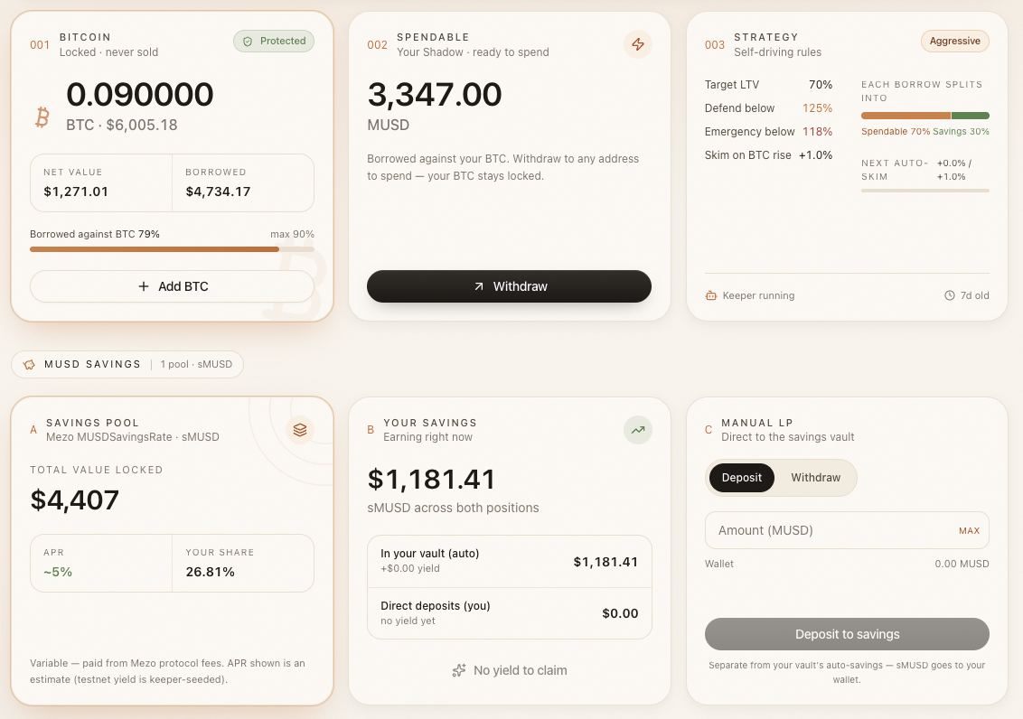
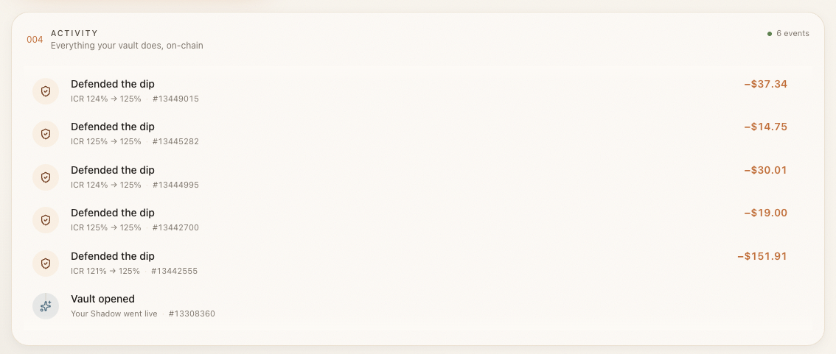
LIVE ON MEZO TESTNET
Five auto-defends. Zero liquidations.
The real app — and its real on-chain history.
Defended transactions — verify on-chain:
explorer.test.mezo.org/tx/0x558e48ee…f5df1586
explorer.test.mezo.org/tx/0x622302fb…4916b6a3
Notes:
[~18s]
Here's the proof. A real dashboard: BTC locked, dollars to spend. And the real history: five automatic defenses, zero liquidations. Every one is on-chain — you can check the links.

Slide 8

Your BTC stays whole.
The Shadow is what you live on.
Anti-liquidation proven · 5 auto-defends · verified on Mezo testnet
cermin-gamma.vercel.app · Supernormal × Mezo Hackathon
Notes:
[~12s]
Your BTC stays whole. The dollars are what you live on. And it can't be liquidated out from under you. Try it at cermin-gamma.vercel.app. Thank you.

